Slide 1
Harvesting death: Do tobacco growers need financial inclusion?
An analysis into the monetary problems and prospects enshrouding farmers harvesting tobacco in Basti District,
Uttar Pradesh - India.
Dr. Syed Aiman Raza
Assistant Professor
Department of Anthropology
Shia PG College
Lucknow
India

Slide 2
Introduction
In the 21st century, agriculture continues to be a fundamental instrument for sustainable development and poverty reduction.
Transforming countries like India by far make up the largest portion of the agricultural world, with a rural population of 2.2 billion people and massive rural poverty (about 600 million rural people below the
$1-a-day poverty line, half the world total) (World Bank, 2007).
They also present a unique situation in which agriculture is often done by landless farmers. These farmers often work for the landowners in exchange of a produce or money.
They sometimes remain as tenant farmers,taking up land on rent for a season and tilling patches of arable land,generating enough produce that could suffice for their family.

Slide 3
Research Addresses Three Main Research Questions
This study tries to uncover how tobacco which generates huge incomes for multinational companies, is a cause of monetary misery for the farmers - that if a grower wants to have a future in tobacco, he should spend money for it.
What are the financial problems and prospects for landless tenant farmers harvesting tobacco?
In absence of any collateral is the financial inclusion of small farmers possible, if they are willing to take cash intensive crops?
Whether the prospects for improving the welfare of small farmers becoming worse and will the small farmers be able to take advantage of higher world prices through the expansion of their production?

Slide 4
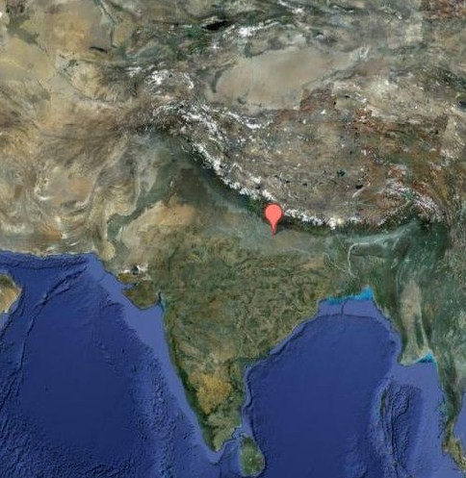
Methodology
Fieldwork was conducted at Sikandarpur village in Basti district of Uttar Pradesh, India, amongst 56 households.
Purposive sampling was done to select landless farmers cultivating tobacco.
Structured interview schedule was used which included both closed and open ended questions.
Case studies and group discussions were also taken from the respondents.
Participant observation was the key technique in this whole study.

Slide 5
Tobacco- a cash intensive crop
Preparation of Nursery
Tilling in Nursery
Sowing of seeds in Nursery
Watering of Seeds in Nursery
Plucking of Saplings
Preparation of Farm
Tilling of Farm
Sowing of Saplings
Watering of Farm
Fertilization
Weeding
Harvesting
Processing of Tobacco
Reverse feeding
Shredding of leaves from the Stalk
Stacking of Shredded leaves according to quality
Farmers harvesting tobacco are in need of cash credit from time to time.
The following are the stages in which labor and cash input is required.

Slide 6
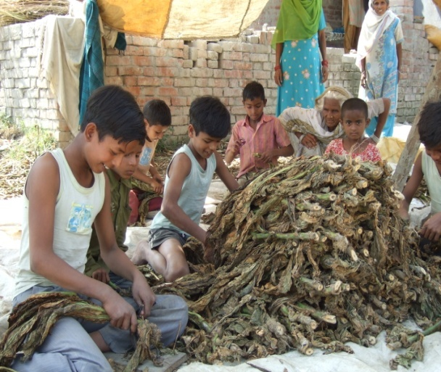
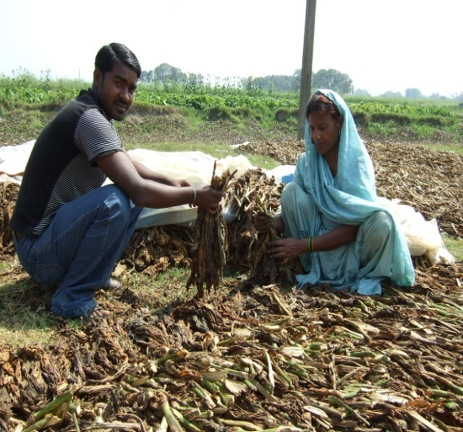
Labour Input
Labor is needed at regular intervals starting from sowing of seeds to harvesting of tobacco leaves.
Once the leaves are harvested, labor input is again required during the processing of tobacco leaves. It is during this time when the leaves attain their color and quality, and this determines its rate in the market.

Slide 7
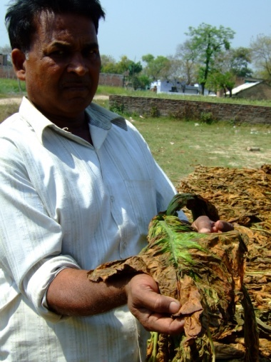
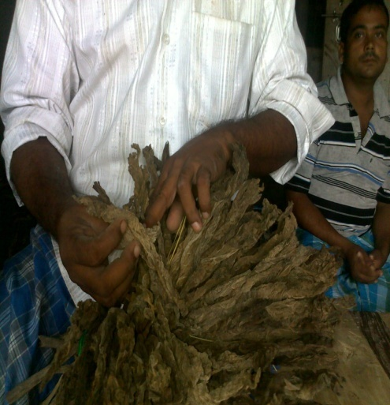
Production
Land rentals vary according to the soil texture on which productivity depends.
Super leaf generates the highest selling price which is followed by medium and impaired leaf varieties.
The rates are determined by the color and growth the leaves have attained once the curing process is completed, hence environmental conditions rule supreme.

Slide 8
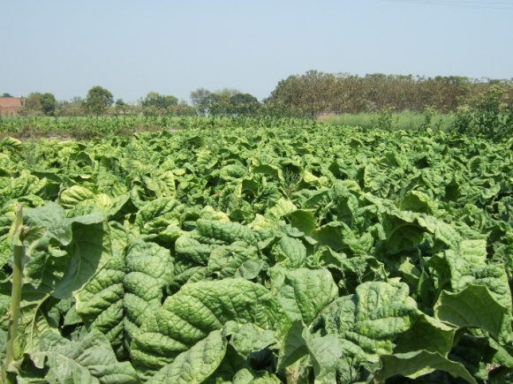
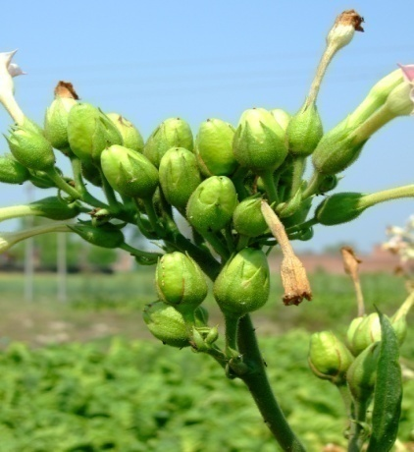
Fertilizer Input
Fertilizers like Diammonium phosphate [DAP],Urea and Organic manure/cow dung are widely used by the farmers.
The farmers often don’t use too much fertilizers for they fear that the landlord might evict them at any time after the harvest of tobacco, and use it for cultivating his own crops.
This sometimes has a negative impact on productivity.

Slide 9
Loans (Bank and Moneylenders)
The landless farmers tend to take loans from the Purvanchal Gramin Bank, which provides loans for cultivating tobacco with a limit of Rs 25000 at 11% per annum.
Incapacity to repay the loan debars the client from doing any further business with the Bank.
Moneylenders also form a source for borrowing money at 5% to 10% per month, depending upon the credibility of the client.

Slide 10
Results
The profit of farmers depends upon the quality, color and weight of the final product. Certain farmers have incurred losses due to pest infestation and price instability.
In many cases the buyers were reluctant to pay the price decided before the harvest with the farmer as the crop did not achieve the color and quality after curing process.

Slide 11
Conclusion
Need for reshaping financial services for the smallholders, especially landless farmers.
Adverse shocks often deplete already limited assets remain an area of concern.
Insurance can assist farmers in taking more risks in production and prevent shocks from depleting their assets.

Slide 12
Thanks to Prof. Bill Maurer for his insights and helpful inputs during the course of this fieldwork.
Thanks IMTFI!

