Slide 1
Untouchable Wealth:
The Moral Exchange of New Wealth among Women in an Urban Nepali Untouchable Caste Community
Presentation By:
Sepideh Bajracharya
IMTFI Conference for Funded Research
December 6-7, 2011

Slide 2
Dhukuti
“Treasury,” “Cash-Box”
An urban Nepali informal rotating savings and credit association (ROSCA)
A group of people who agree to contribute a monthly amount, the sum of which is given to each person in term

Slide 3
Three Types of Dhukuti
Lottery system (“lucky-draw”): a person’s name is randomly picked every month
Rotation system (“number system”): the next person on the list receives the collected sum
Bidding system (“chorera khane” “releasing and eating”): the person who bids, or “releases” the largest sum receives the monthly collection.

Slide 4
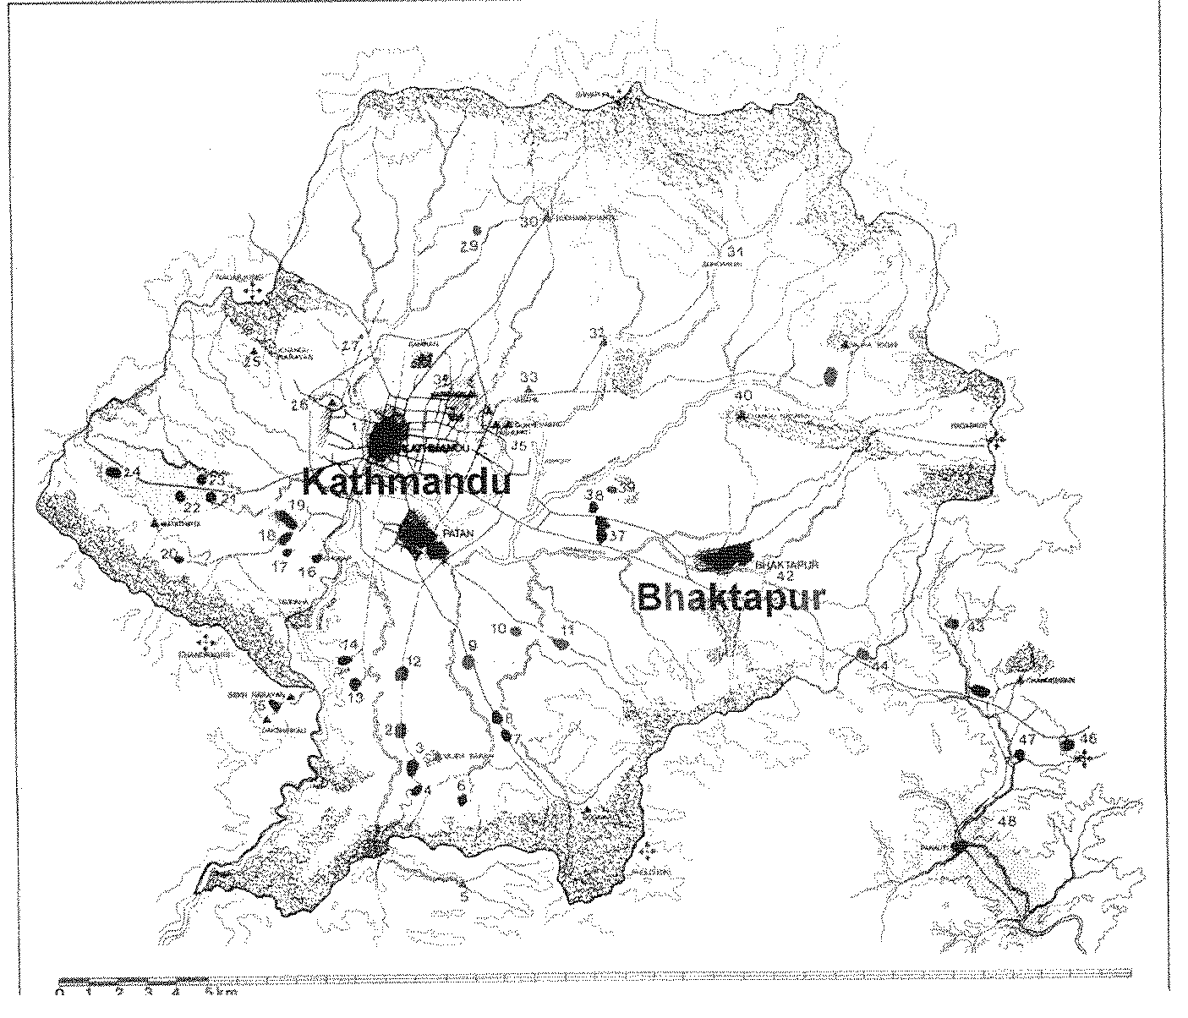

Slide 5
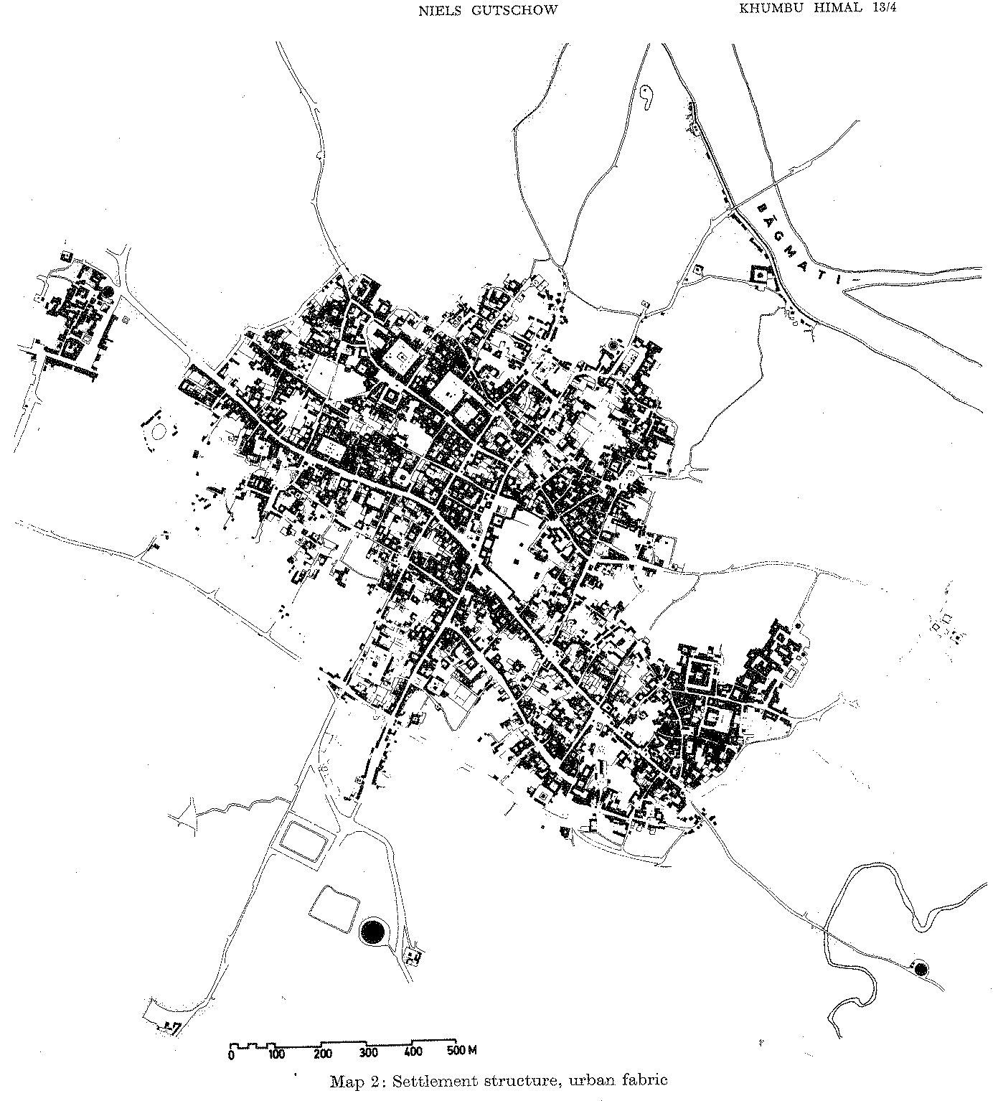

Slide 6
Emukhel (Pode Twa)
Dyahla caste (untouchable-sweeper caste of Newar ethnicity)
Before 1980s houses made of straw and mud
Public defecating ground
No regular source of income

Slide 7
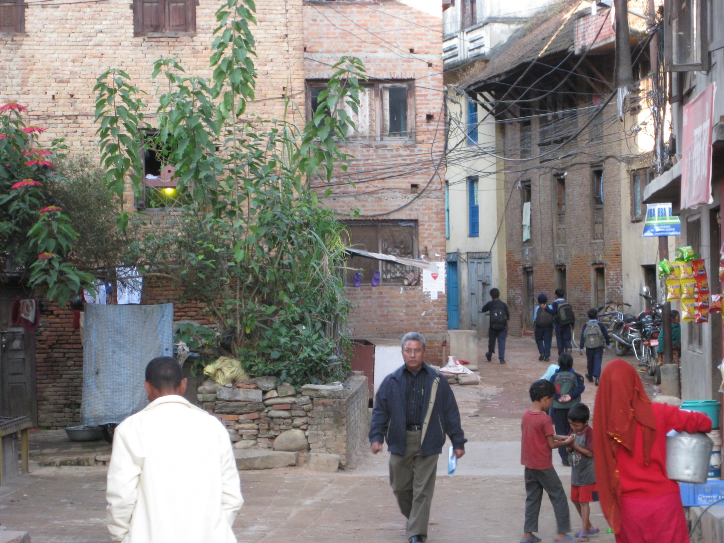

Slide 8
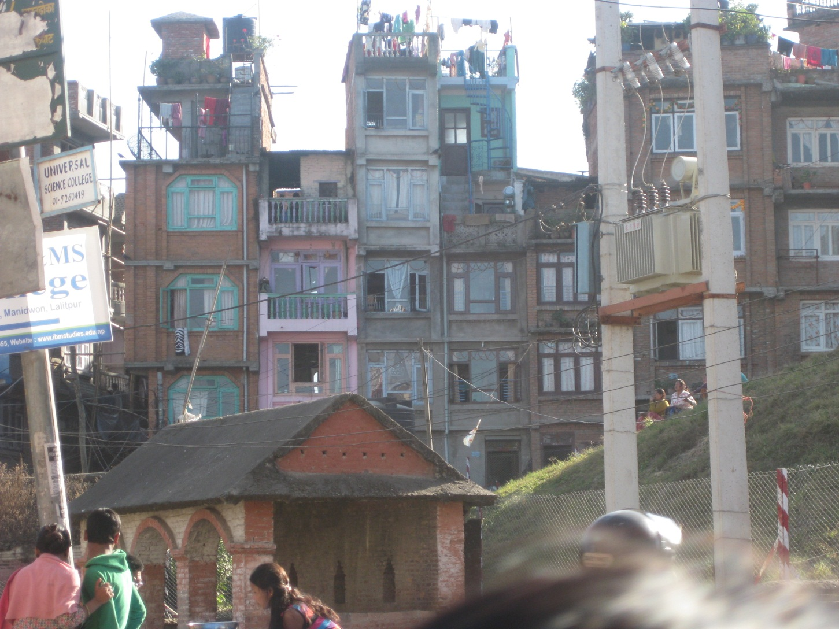

Slide 9
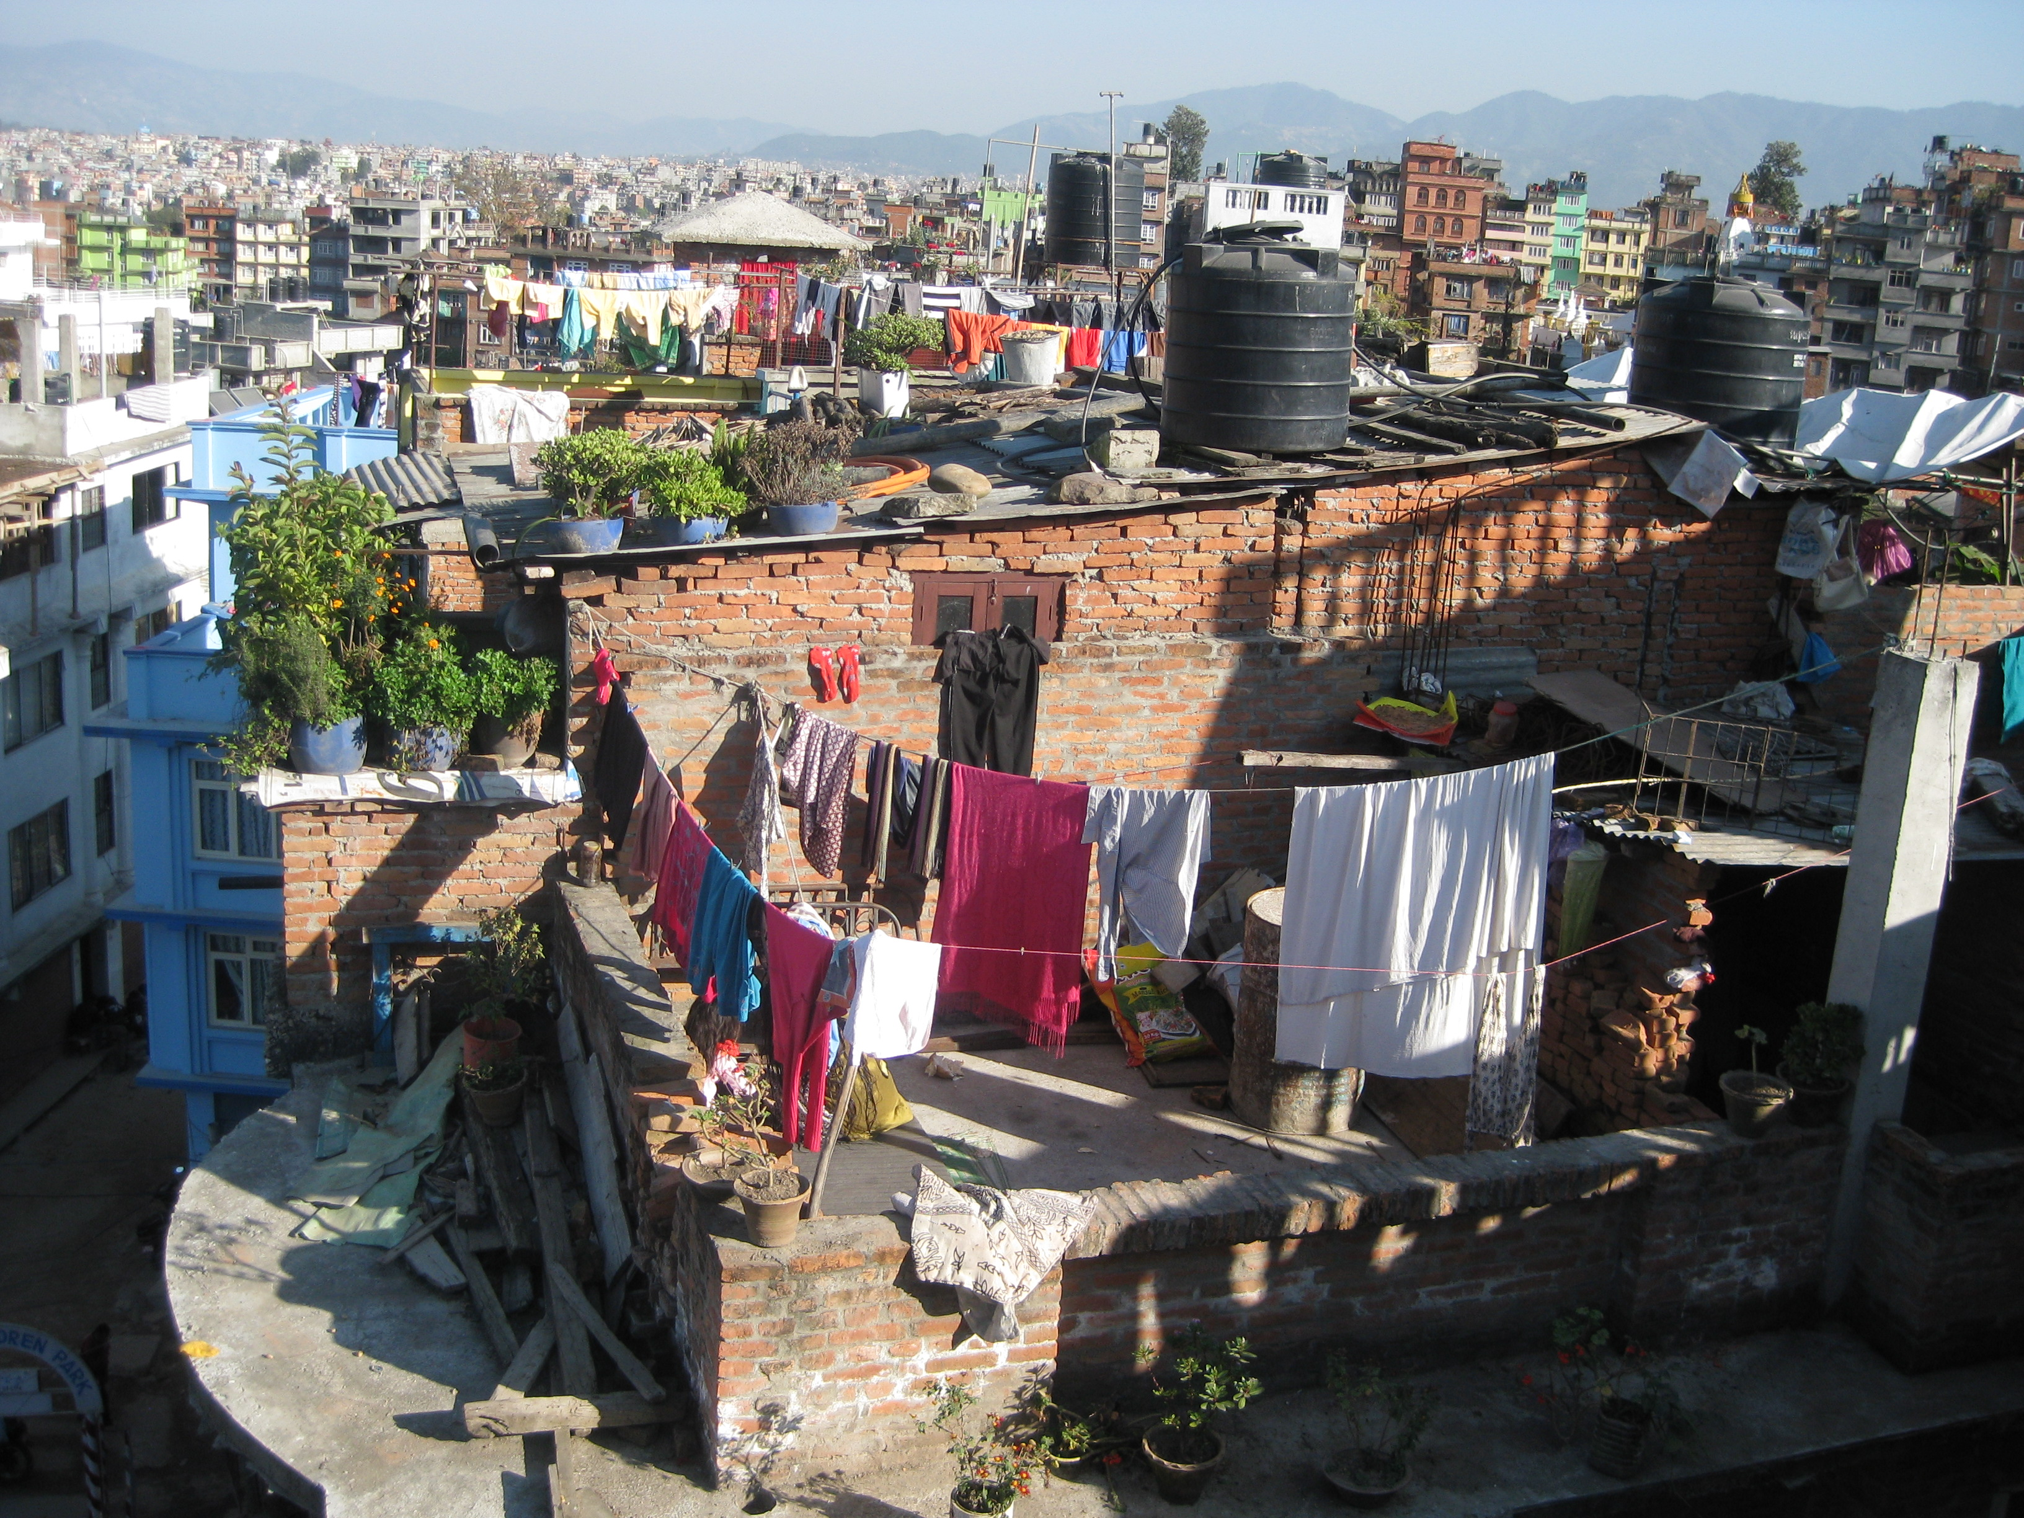

Slide 10
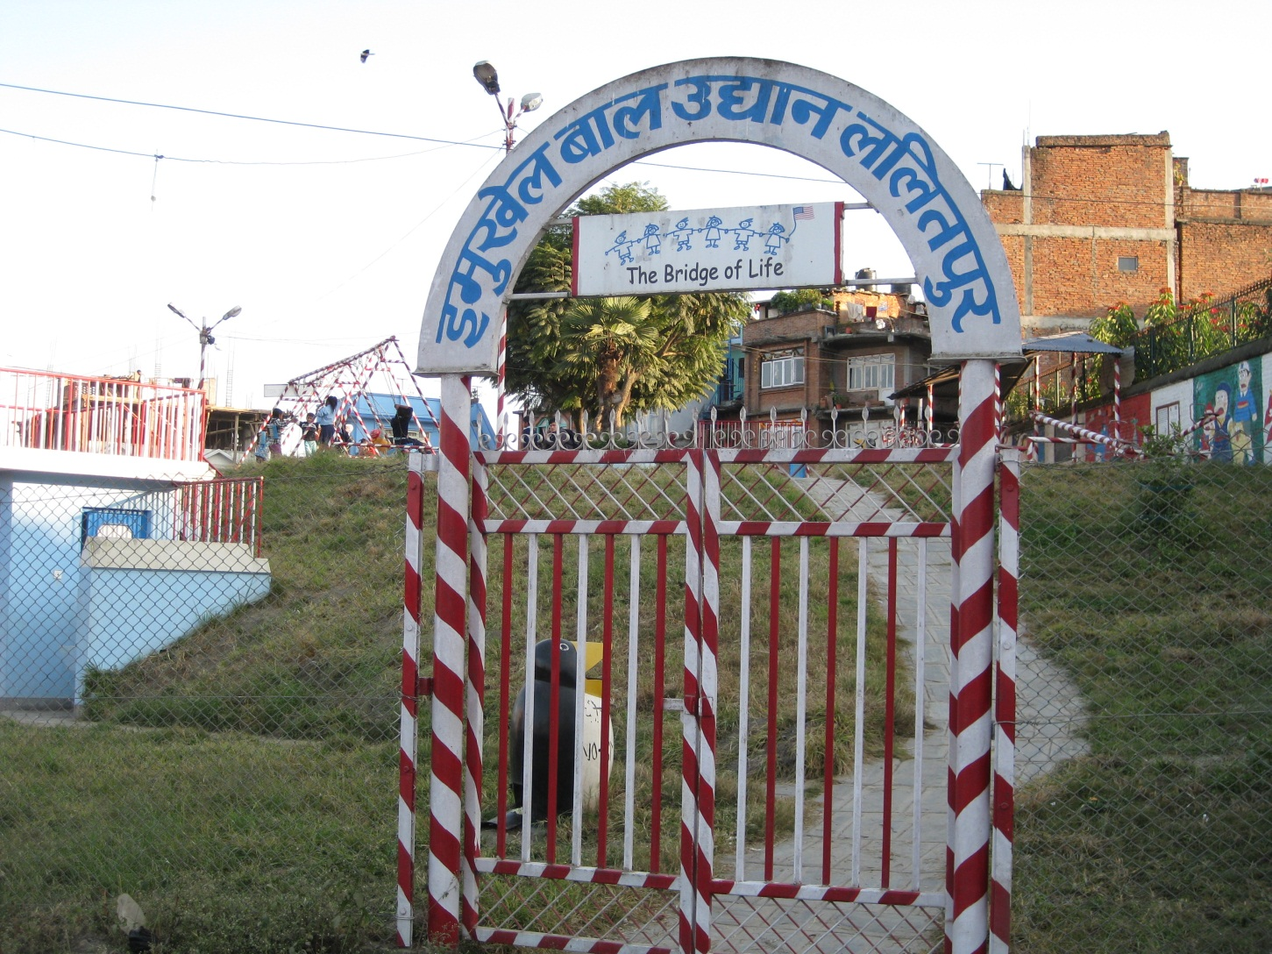

Slide 11
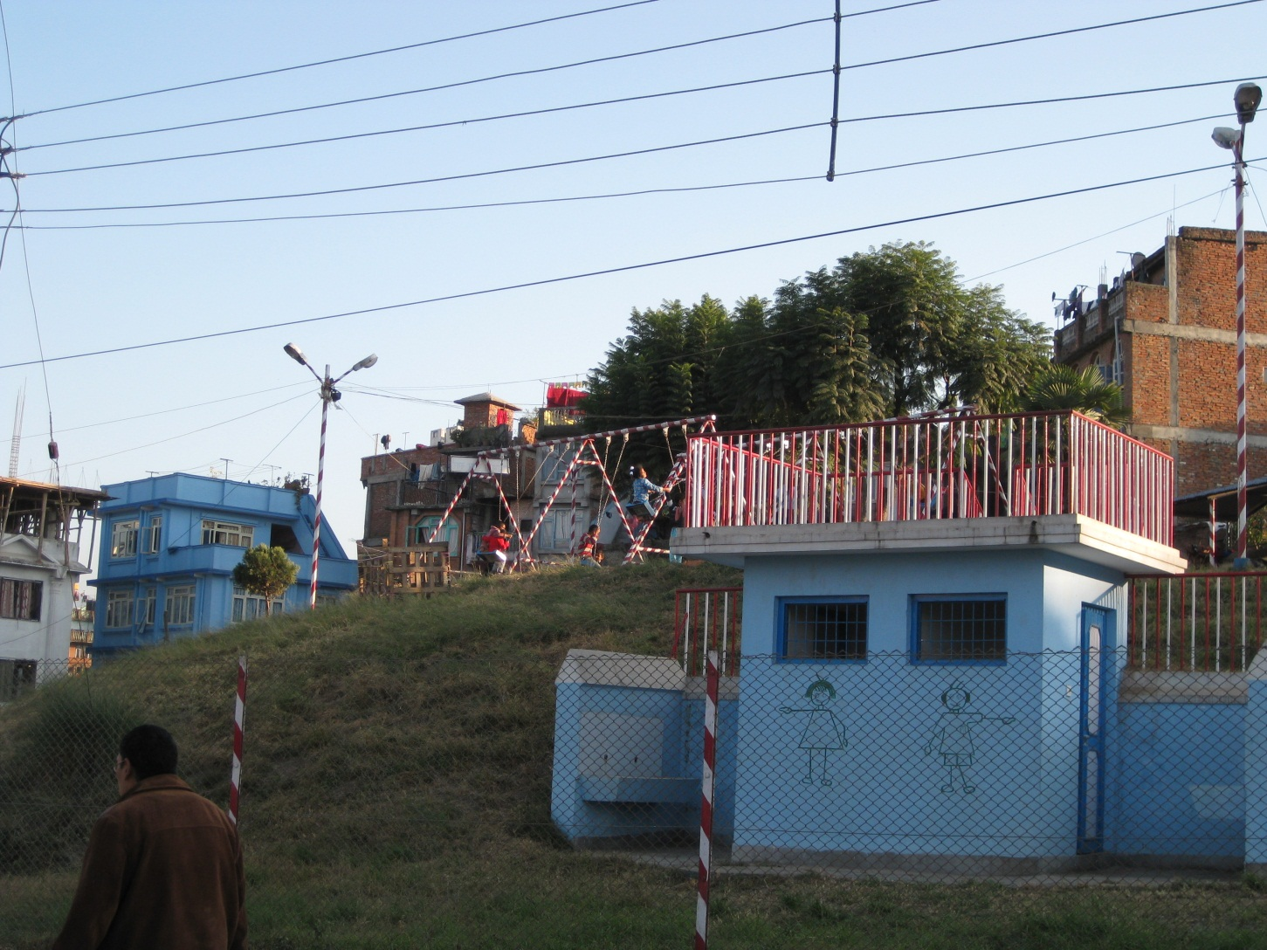

Slide 12
Changes since late 1980s
State and development-based interventions
Women and men hired as salaried and pensioned workers by the city municipality
Implementation of credit/savings, literacy, income generating projects that were being independently run by women in the community
Dhukuti allowed them to build and furnish their houses; send their children to boarding school; access consumer goods and services

Slide 13
“New Wealth” and “New Economy” in the context of Urban Nepal
Since the late 1980s
“Economy of Need”: The prevalence of an aid and development-based economy
“Economy of Pleasure”: Access to and desire for consumer products and services

Slide 14
Project Questions
How is dhukuti an indication of “new wealth”?
What kind of economic and social capital does it represent?
How does it mark a late neoliberal moral economy of need and pleasure?

Slide 15
Emerging Themes
The social capital—social context, values, relations—that shape dhukuti economics
An indication of how people interact with the formal and informal financial landscape
The pleasure element: risk, uncertainty, thrill, and fright

Slide 16
Social Capital
Existing Social Capital: Dhukuti in Emukhel
Four dhukutis based on rotation and number system
100-200,000 rupees ($125-300); 30-75 participants
Do not meet to “play” dhukuti
Payment in passing, during credit/savings meetings within two weeks of receiving salary on the first of the month
Based on “trust”
“Easy” and “Dependable”

Slide 17
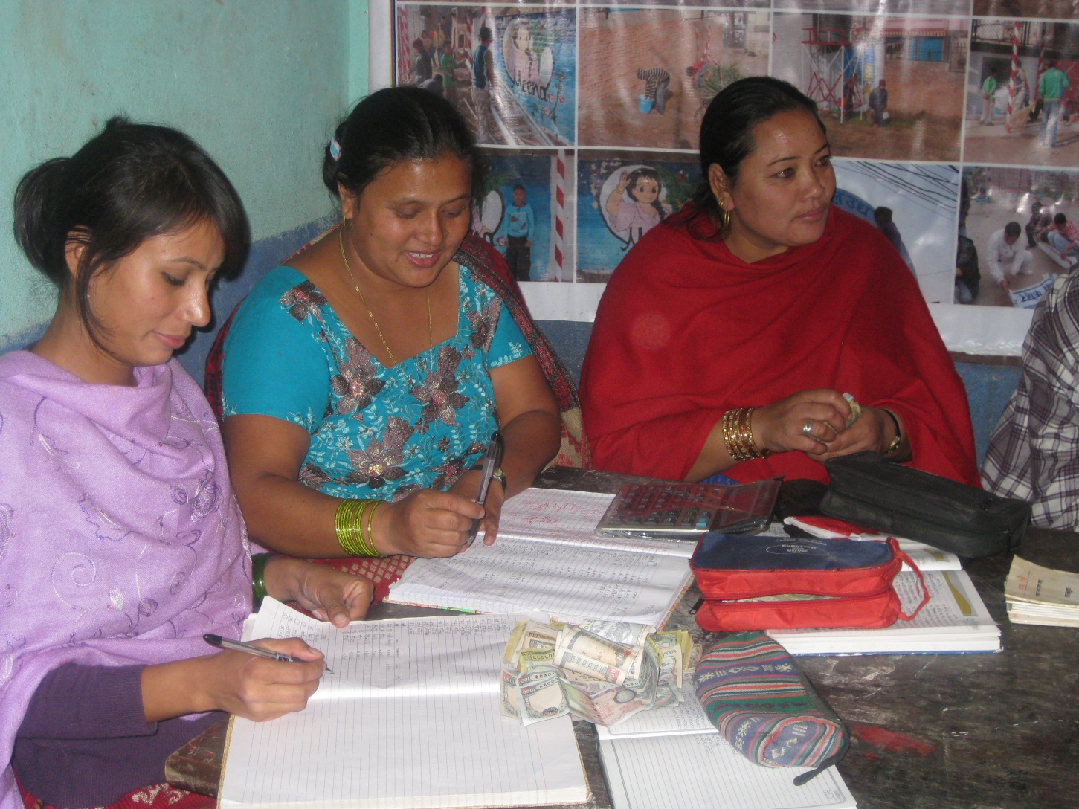

Slide 18
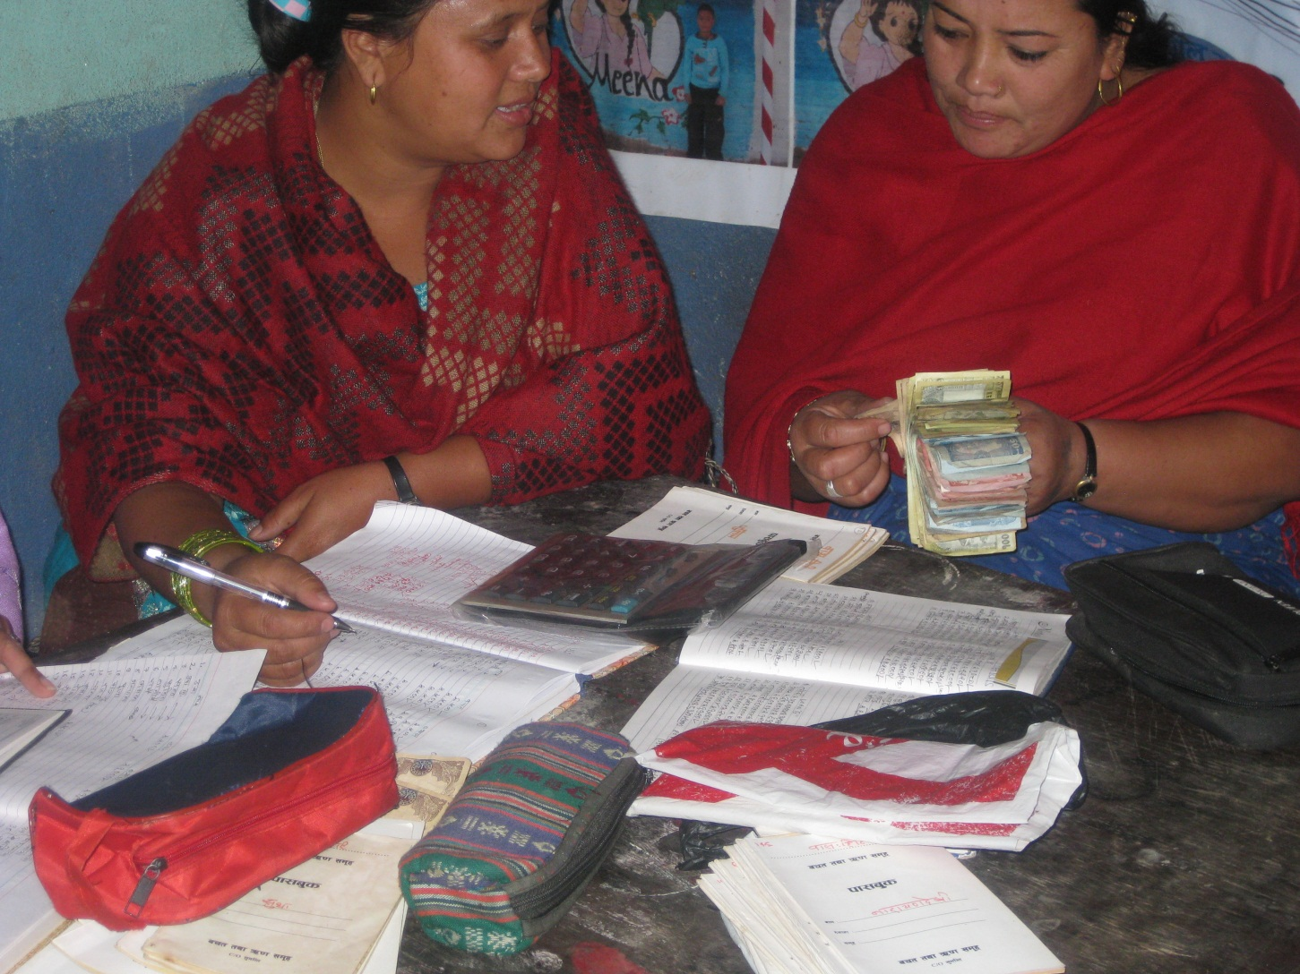

Slide 19
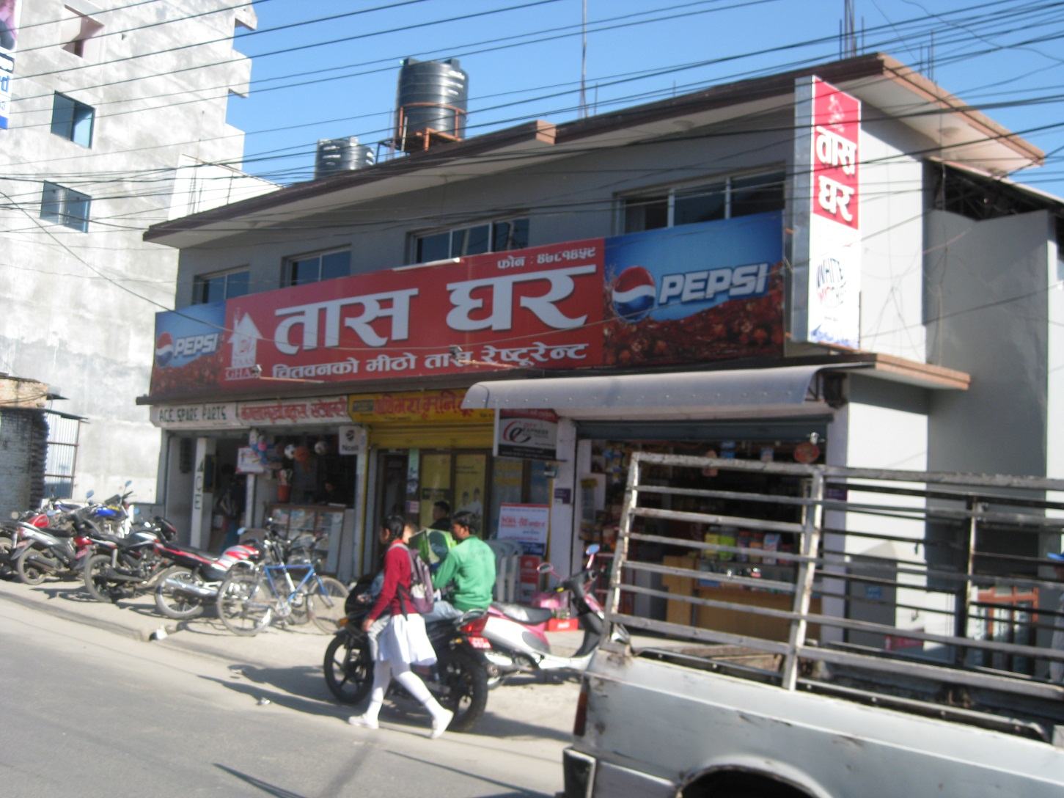

Slide 20
Aspiring Social Capital
“Restaurant” dhukuti: Tass Ghar (House of Cards)
Dressed in fine clothes; eating restaurant foods
500-1000,000 ($625-1250) rupees; 10-20 participants
Did not know more than two or three people in the collective; connection through organizer
“high profile,” “big”businessmen”
“fun,” “like fashion,” “frightening”

Slide 21
Preliminary Analysis
The more “love”—the more conscious of the labor that goes into the money invested in dhukuti—the less incentive to play high-risk “bidding” and the less social value/capital
Risk—losing large sums of money and playing with people unrelated by kin, caste, or association—entailed a higher “class” dhukuti
Dhukutis produced and thrived on risk and uncertainty

Slide 22
Engaging the Formal and Informal Financial Landscape
Engage both informal and formal financial sector
People most comfortable when their money is circulating, and being invested in multiple and various investment schemes and venues
Certainty associated with lack of trust (not trusting any one scheme) and risk (investing in multiple arenas)

Slide 23
The Pleasure Element
Same aura and allure as gambling
Vocabulary: “playing,” “eating,” “fashion,” “frightening,” “easy,” “trust”
Borderline Illicit: intersects indirectly with the law
The subject of dramatic murder and legal cases that appear in popular newspapers
People are not forthright about “playing”
Exciting: involves moving through social gatherings; eating; thrill of anticipating, receiving, using money

Slide 24
Further Research
Relation to “social capital”
Intersection of formal and informal landscape
Pleasure element
Historical dimension
Comparative perspective

