Slide 1
Does Microloan Repayment via Cell Phone Increase Client Confidence in Mobile Value Storage?
The Case of Green Bank in Mindanao, Philippines
Anatoly Gusto
Research and Innovations Unit Manager, MICRA
IMTFI 3rd Annual Conference
University of California, Irvine
December 6-7, 2011

Slide 2
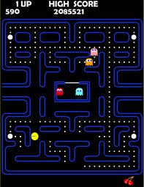
Current Situation
Microfinance clients seem to struggle to make sense of the richness of mobile technology which is available to them.
Pac-Man = RB borrower paying loans using mobile money
Ghosts = barriers to financial inclusion
Power pellet = mobile technology services to help him/her achieve better and effective access to financial services?
Notes:
Let me talk a little about what mobile money does. It is useful to think that there are two fundamental things that mobile money does: 1) it reduces the cost of transfers; 2) … reduces the cost of storing money. The storage part is the focus of this research.
2

Slide 3
Hypothesis
Text-a-Payment (TAP) usage
Increased confidence in mobile money
wider adoption of other financial services
savings
Notes:
HYPOTHESIS - Usage of mobile technology for loan repayment (Text-a-Payment or TAP) leads to an increase in client’s confidence in mobile money and brings about wider adoption of other services, particularly savings
3

Slide 4
Additional Questions
What are the current savings mechanisms utilized by TAP users?
How have attitudes on savings changed with m-banking?
Did the use of mobile technology lead to increase in savings in the form of mobile money or a mobile-money-linked account?
Notes:
Let me talk a little about what mobile money does. It is useful to think that there are two fundamental things that mobile money does: 1) it reduces the cost of transfers; 2) … reduces the cost of storing money. The storage part is the focus of this research.
4

Slide 5
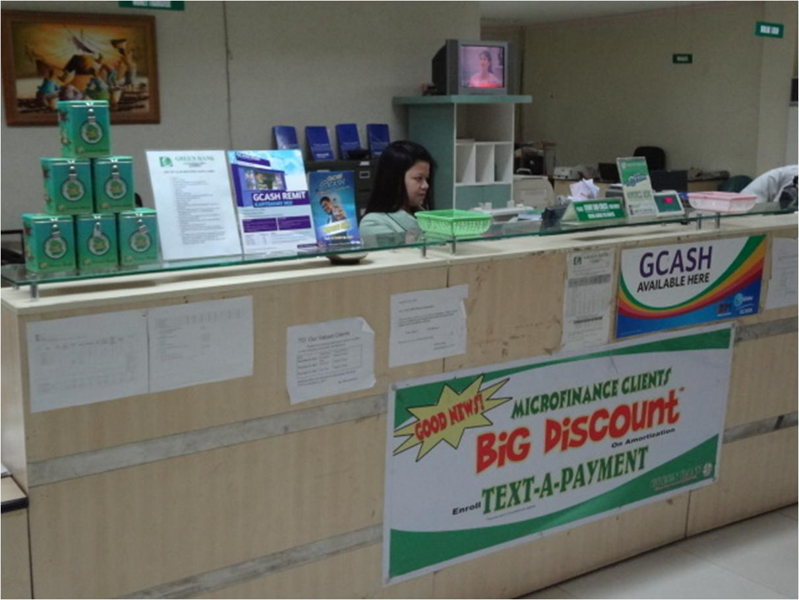
Defining Active TAP Users
Notes:
Play video

Slide 6
Defining Savings Mechanisms
Q. If you are poor but already have access to formal savings, credit and mobile money, will you have confidence to use mobile money for other purposes? For saving?
Keep money at home?
for emergencies and daily expenses
for additional capital in business
Save through a
traditional bank
account? ROSCA?
Save through a
mobile-enabled/ linked savings account?
compulsory savings and
voluntary savings
Save in kind or
(credit)
Save through a
mobile-money system?
Notes:
If you are poor, what are your options to access and store money to lead a healthy and productive life?
Banked Poor = with loan ranging from US$100 to US$1000 to the bank; characterized by low-medium volume of deposits;
6

Slide 7
Overall Methodology
Focus Group Discussions (FGD)
Active TAP Users
inactive users
non-users
Financial Diaries
5 TAP Users, all women*
*
Notes:
Indicate why no male respondents. In relation to this, indicate what qualifies as a TAP user (loan amount).
Active clients
active borrowers enrolled under the bank’s (Green Bank) text-a-payment mobile phone banking program; clients with existing loan amount below Php50,000 ($1,150 ++)
Inactive clients
enrolled in text-a-payment
clients with no existing loan
clients with pending loan application with loan amount below Php50,000
Non-users
clients not enrolled in text-a-payment
clients with loan amount above Php50,000
7

Slide 8
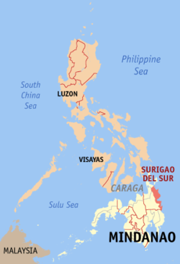
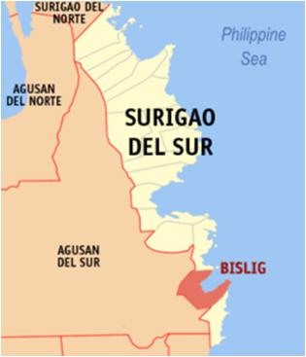
Site Selection Mangagoy, Bislig, Surigao del Sur
Legend
Source: bit.ly/rUnJEz
Notes:
Include in explanation why this site was selected. Introduce Green Bank as well
8

Slide 9
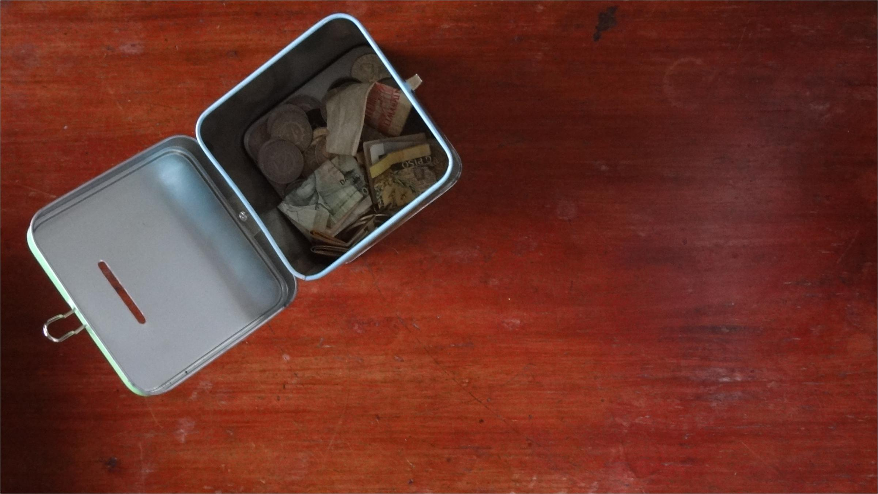
RESEARCH FINDINGS

Slide 10
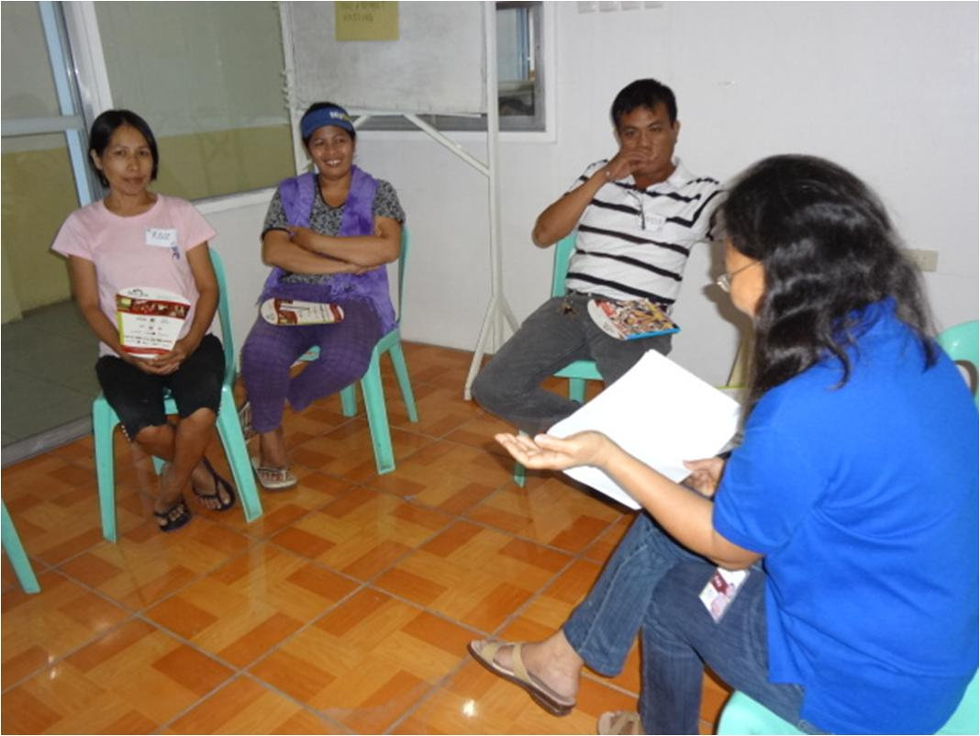
FGD Results
Savings practices
All have experience saving in a bank. Green Bank provided the 1st formal bank loan for most of them, who had no access to formal financial services up until then.
Majority keep some of their savings in their homes while others also save in ROSCAs.
Others claim that they would rather use any of their excess cash in their business.
Some non-users claim that they do not have the capacity to save.
Notes:
10

Slide 11
FGD Results
Remittance experience
Clients in general mainly rely on commercial channels such LBC, M-Lhuillier, and Western Union, banks; only a few used Mobile Money (Smart Padala or GCASH)
Bills Payment experience
Majority pay directly to the office or through a collector; no one has ever used mobile money to pay bills
Mobile Money experience
Smart has a 2:1 advantage in "which network do you use;" many clients say they are using multiple sims
Distrust of using the phone for m-banking remains high
Only a few of the participants use GCASH or SMART Padala when sending money.
Notes:
11

Slide 12
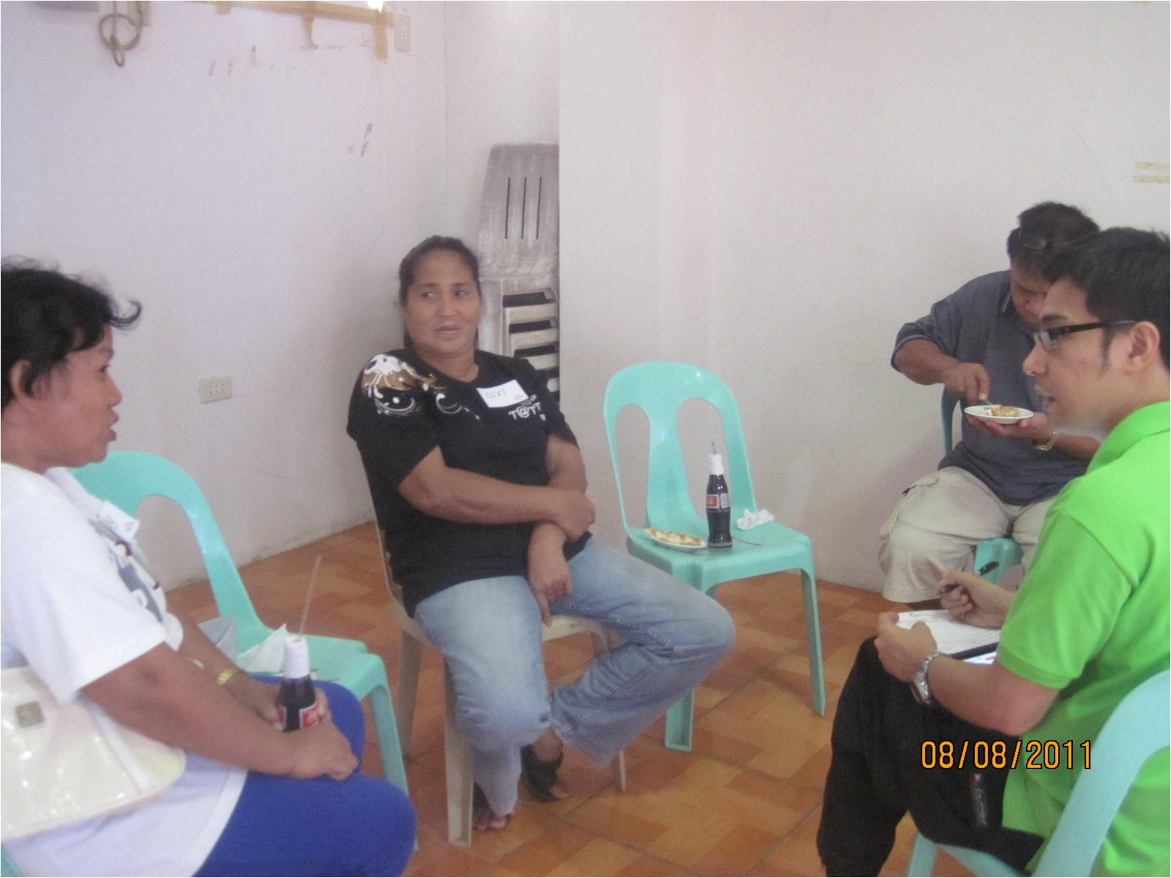
FGD Results
Active and Inactive users
clients are satisfied with the TAP service
mobile money = TAP (for most users)
No one directly uses TAP to pay their loan; All pay through the agent to send their payments to the bank; they were taught how to transact directly but clients did it for a short period of time.
Besides TAP, a few had experience using mobile money sending/receiving money and are still willing to use it when the need arises; Transactions are rare though
Non-users
Majority have heard about mobile money but have not used it. They expressed willingness to try to use it in the future
Notes:
Majority are not aware of any other use of mobile money besides TAP;
12

Slide 13
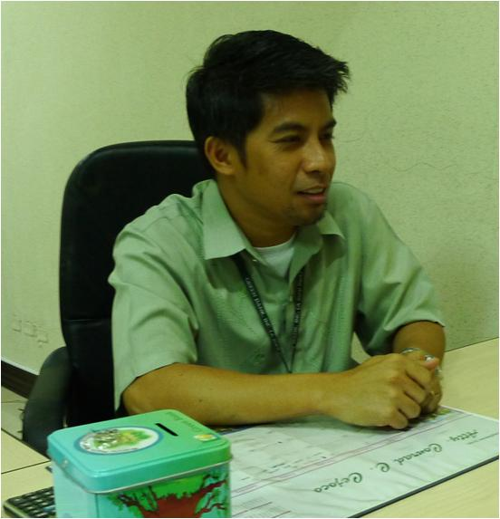
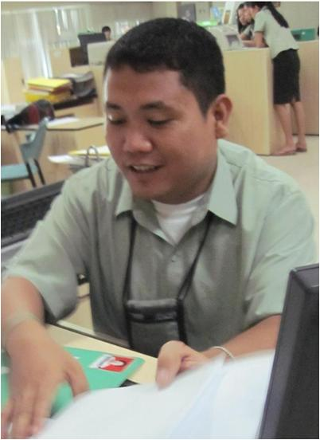
Financial Diary Site Selection Mangagoy, Bislig, Surigao del Sur
Branch
Head
MF Loan
Officer
Legend
Notes:
Include in explanation why this site was selected. Introduce Green Bank as well
13

Slide 14
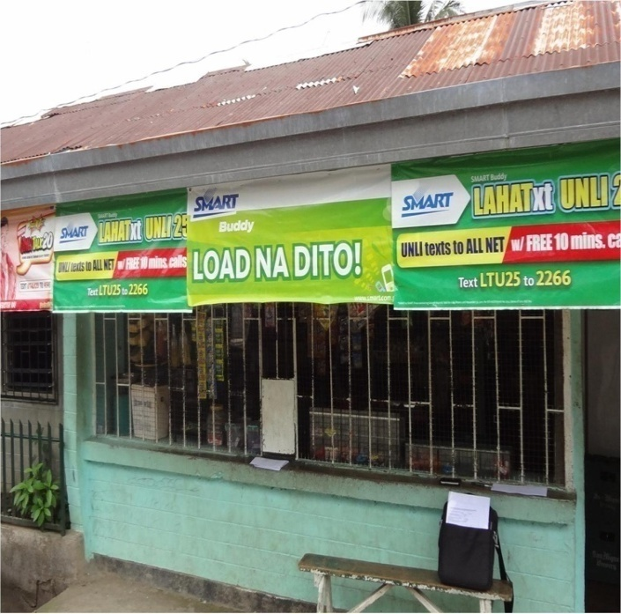
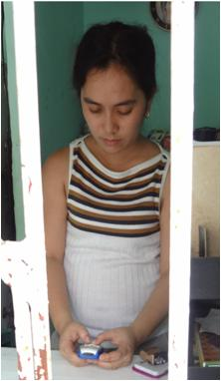
Merchant (E-Money Agent)
Financial Diary Site Selection Mangagoy, Bislig, Surigao del Sur
Legend
Notes:
Include in explanation why this site was selected. Introduce Green Bank as well
14

Slide 15
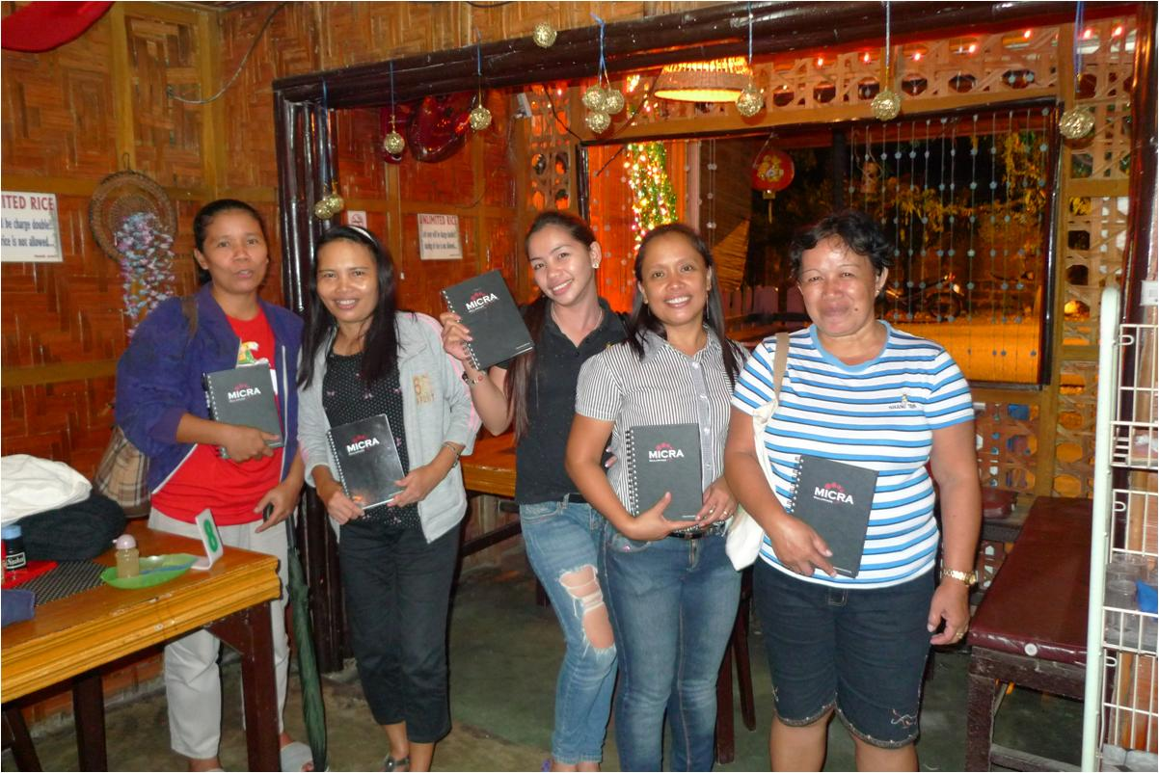
Financial Diaries - Profile of clients*
 | Deres | Susette | Ivy | Teresita | Imelda
Number of loan cycles | 3 | 3 | 10 | 6 | 7
Amount of 1st loan (Php) & Date released | 25,000 Sept. 2, 2010 | 25,000 Nov. 26, 2010 | 28,000 Feb 4, 2009 | 10,000 July 17, 2009 | 7,000 April 2, 2009
Amount of last loan (Php) & Date released | 40,000 Aug. 19, 2011 | 40,000 July 15, 2011 | 36,000 Oct 14, 2011 | 25,000 Aug 12, 1011 | 15,500 Oct 14, 2011
Sources of income | Shop (Motorcycle Parts and Accessories) Remittance | Lechon Haus (Roast Pig Maker) Electronic Load | Sari-sari store Tricycle (for rent) | Sari-sari store Meat vendor Fishing | Sari-sari store Tricycle (for rent) Electronic load
Total Net Income (Php) | 22,625 | 25,175 | 33,335 | 15,475 | 27, 390
*Active borrowers enrolled under the bank’s (Green Bank) mobile phone banking program: text-a-payment
Notes:
15
NOTE: need to be updated

Slide 16
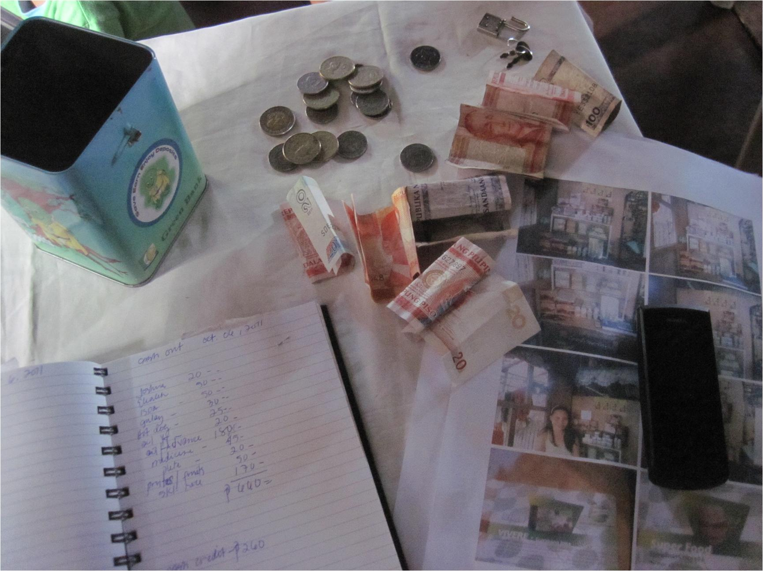
Savings Profile
Savings Mechanism | Deres | Susette | Ivy | Teresita | Imelda
Mandatory (Text-a-payment) | √ | √ | √ | √ | √
Voluntary (Text-a-payment) |  | - | √ | √ | -
Another Bank | √ | √ | - | √ | -
E-money (G-Cash) |  | - | - | - | -
At home (piggy bank, wallet, mattress) | √ | √ | √ | √ | √
In-kind |  | √ | √ | - | √
Credit (in-kind or cash) | √ | √ | - | √ | √
Notes:
16
NOTE: need to be updated

Slide 17
Savings Portfolio
Savings mechanisms used by respondents stayed the same before and after TAP, except for mandatory savings and more goal-oriented savings stored in piggy banks (but this might be because of MICRA intervention/training)
Notes:
Patterned from: Morawczynski, O. “Saving Through the Mobile Phone – The Case of M-PESA. MicroBanking Bulletin, Issue 19, December 2009, Figure 2, page 10

Slide 18
Clients’ voluntary and mandatory savings
Client | Loan Amount (Php) | Date of release | Weekly (monthly) loan amortization (Php) | Weekly mandatory savings (Php) | Weekly payment (Php)
Deres | 40,000 | Aug 19, 2011 | 1,867 | 187 | 2,053
Susette | 40,000 | July 15, 2011 | 1,867 | 187 | 2,053
Ivy | 36,000 | Oct 14, 2011 | 1,680 | 168 | 1,848
Teresita | 25,000 | Aug 12, 2011 | 1,167 | 117 | 1,283
Imelda | 15,500 | Oct 14, 2011 | 723 | 72 | 796
Notes:
Principal = loan amount/ (6x4)
Interest = (loan amount x 12%)/ (6 x 4)
Weekly loan amortization = Principal + interest
Mandatory savings = weekly amortization x 10%
Weekly Payment = weekly amortization + weekly mandatory savings + weekly voluntary savings

Slide 19
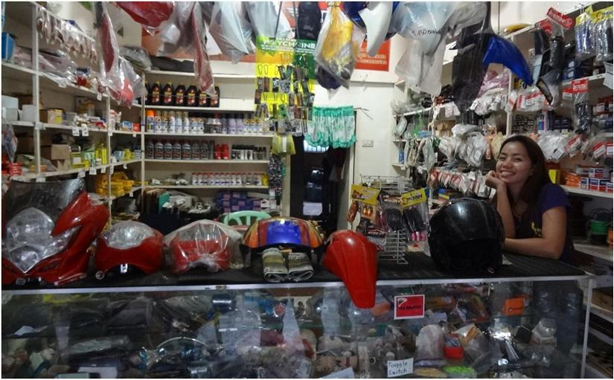
Client 1: Deres
Legend
Notes:
Include in explanation why this site was selected. Introduce Green Bank as well
19

Slide 20
Trend in GCASH TAP Usage (Aug-Nov 2011)
Did TAP usage lead to increase in savings in the form of mobile money or a mobile-money-linked account?
Notes:
Patterned from: Morawczynski, O. “Saving Through the Mobile Phone – The Case of M-PESA. MicroBanking Bulletin, Issue 19, December 2009, Figure 2, page 10

Slide 21
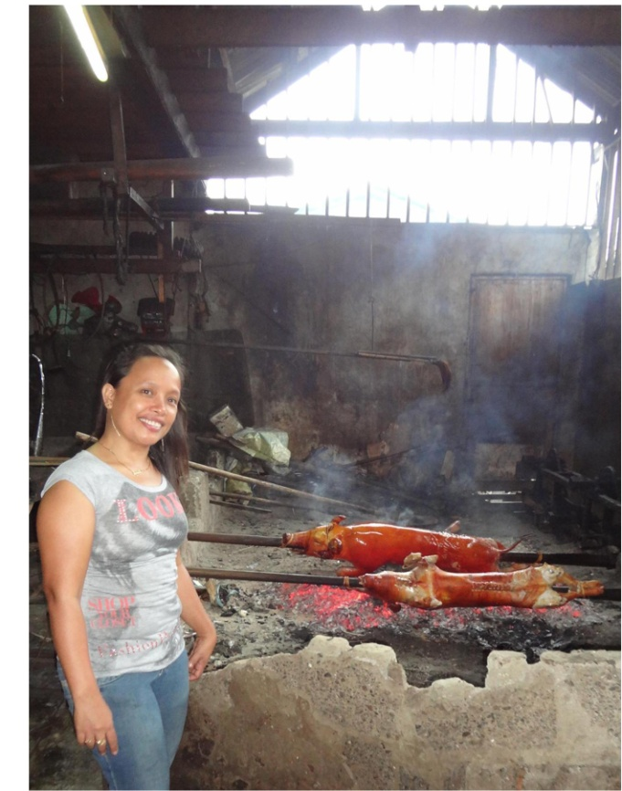
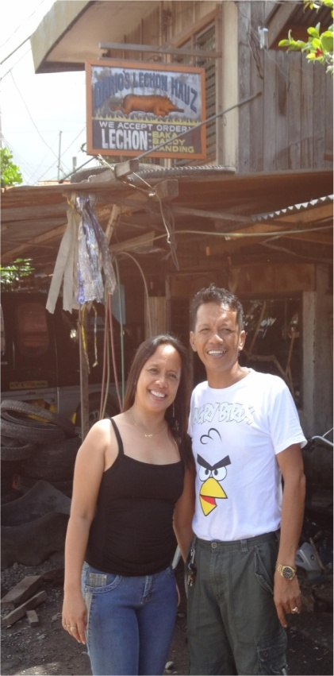
Client 2: Susette
Legend
Notes:
Include in explanation why this site was selected. Introduce Green Bank as well
21

Slide 22
Trend in GCASH TAP Usage (Aug-Nov 2011)
Notes:
Patterned from: Morawczynski, O. “Saving Through the Mobile Phone – The Case of M-PESA. MicroBanking Bulletin, Issue 19, December 2009, Figure 2, page 10

Slide 23
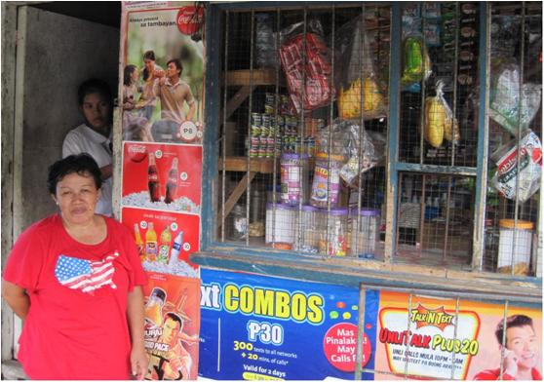
Client 3: Imelda
Legend
Notes:
Include in explanation why this site was selected. Introduce Green Bank as well
23

Slide 24
Trend in GCASH TAP Usage (Aug-Nov 2011)
IMELDA
Notes:
Patterned from: Morawczynski, O. “Saving Through the Mobile Phone – The Case of M-PESA. MicroBanking Bulletin, Issue 19, December 2009, Figure 2, page 10

Slide 25
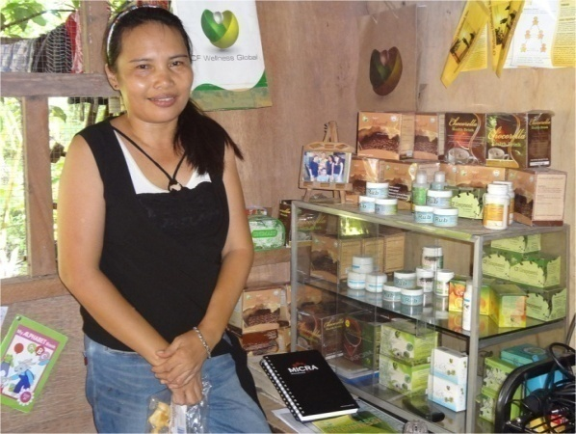
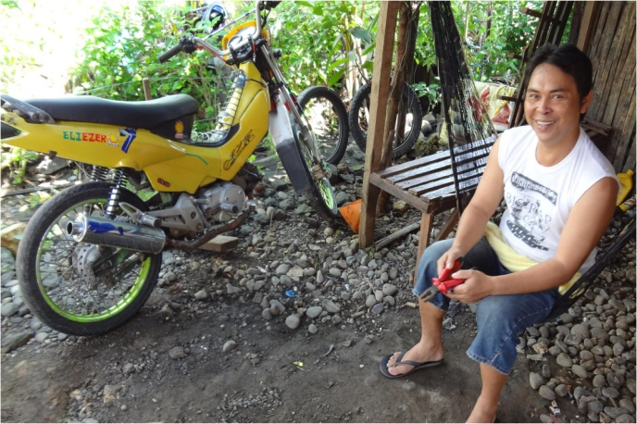
Client 4: Teresita
Legend
Notes:
Include in explanation why this site was selected. Introduce Green Bank as well
25

Slide 26
Trend in GCASH TAP Usage (Aug-Nov 2011)
Mobile-enabled compulsory savings account actually allowed clients to save tiny amounts (less than 2US$) more frequently and more easily.

Slide 27
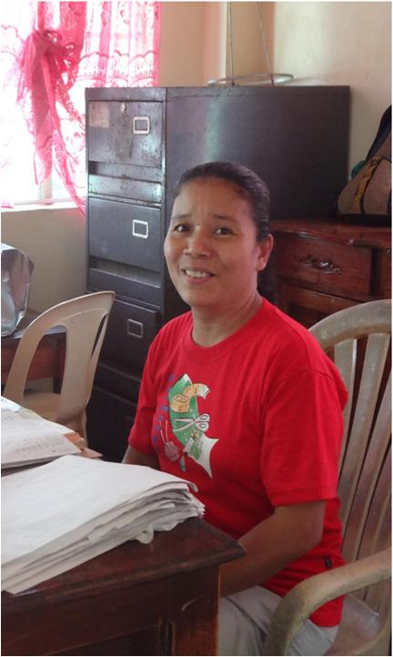
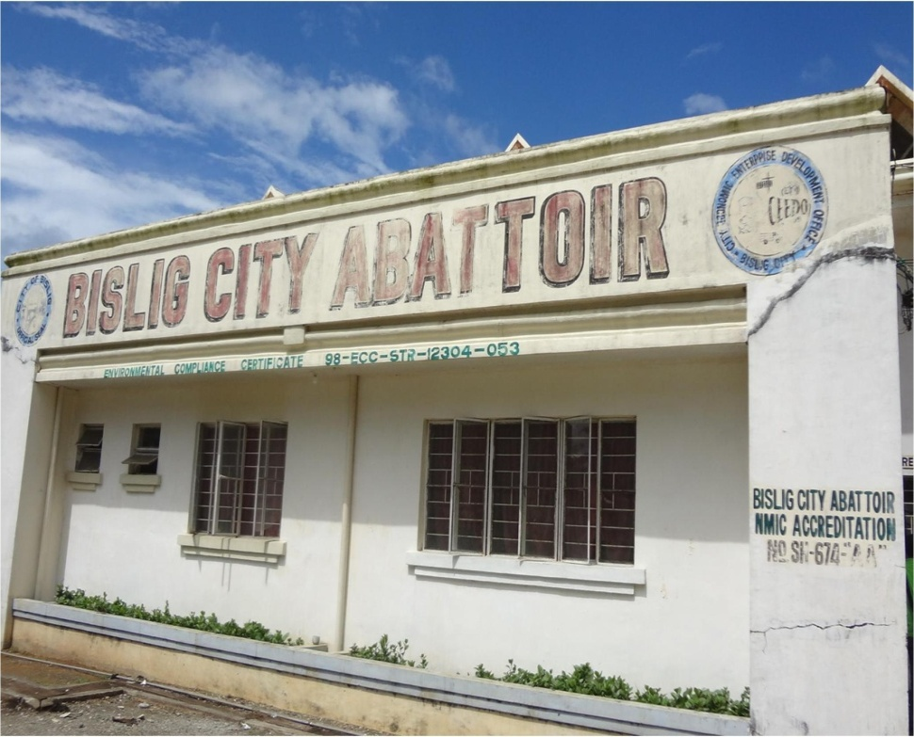
Client 5: Ivy
Legend
Notes:
Include in explanation why this site was selected. Introduce Green Bank as well
27

Slide 28
Trend in GCASH TAP Usage (Aug-Nov 2011)
Notes:
Patterned from: Morawczynski, O. “Saving Through the Mobile Phone – The Case of M-PESA. MicroBanking Bulletin, Issue 19, December 2009, Figure 2, page 10

Slide 29
FINDINGS in summary
Savings mechanisms stayed the same
Green Bank promotes one type of mobile service (TAP)
Putting in savings in a voluntary account through TAD may be more costly (client will incur additional air-time and cash-in costs to do the transaction) and creating more work than they solve.
Savings added through TAP not easily accessible (part of compulsory account)
Actual usage of mobile money did not translate to improved customer experience and increase in confidence in technology
Network preference & context
confidence in merchant is higher (than confidence in self)
Limited experience in mobile money among clients and the clients’ household: only 1 (Teresita) had experience of GCASH before TAP; this increased her confidence in using mobile phone for financial transactions; number of transactions through TAP is quite limited (at most 4 times a month)

Slide 30
Conclusion
Usage of mobile technology for banking services has a weak effect on diversifying use of mobile money and on inducing clients to save (at least in this study)
Savings mechanisms used by respondents stayed the same before and after TAP, except for mandatory savings
There are signs that mobile-enabled compulsory savings account offer the simplicity clients require and actually allow clients to save tiny amounts (less than two US$) more frequently and more easily.

Slide 31
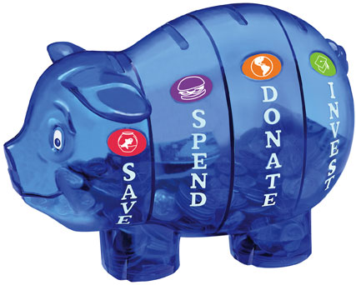
Some Thoughts
Technology is not enough: projects failed to address the human and organizational aspects of financial transactions/practices.
Barriers to technology adoption <> Barriers to financial inclusion
Interoperability;
interactive services on personal assistance and consumer education targeting end-clients and influencers (agents; other family members)
Create technologies that allow people to engage in life and work spontaneously and effortlessly: The best device fits into the flow of one’s savings practices and that the savings experience, not the device, should be the central focus.
Challenge is not only to improve customer experience but to create perspective-expanding experiences.
http://www.msgen.com/assembled/money_savvy_pig.html
Notes:
31

Slide 32
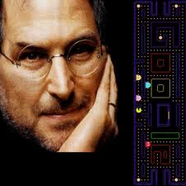
“You’ve got to start with the customer experience and work back toward the technology – not the other way around.”
Steve Jobs, May 25, 1997, Worldwide Developers Conference
THANK YOU.
Image source: bit.ly/t41llX

