Slide 1
Exploring the use of mobile banking services by the poor:
Case of Wizzit Bank, South Africa
Mildred. P. Makore
Masters in Development Studies,University Of KwaZulu natal

Slide 2
Purpose of study
To explore the factors that have enhanced use or inhibited use of a mobile banking initiative in the selected deprived communities in Johannesburg, South Africa.
Research on use and contexts of use of mobile banking facilities can feed into the understanding of the impact of these mobile banking interventions.
Study will contribute to the ICT for development debate and contribute to literature on financial inclusion

Slide 3
Research objectives
Study seeks therefore to:
Assess patterns and context of usage of the WIZZIT mobile banking facility by the urban poor
Explore reasons for use or non usage of the mobile banking facility

Slide 4
Research questions
What is the actual usage of the mobile banking platform by the urban poor?
For what purposes and in what situations is the mobile banking facility being used?
What are the factors that have enhanced or inhibited use of the mobile banking facility?
What are the benefits, opportunities and/or challenges that mobile banking has presented for users?

Slide 5
Work to date
Literature review
  Exploration of the Context of study
  Selection of theoretical framework
  Selection of research methodology
  Research Instrument development
Preliminary meeting with Wizzit Bank

Slide 6
Literature review findings

Slide 7
ICTs,poverty alleviation & development
ICTs can contribute to poverty alleviation (May 2010, Marker et al 2002)
ICTs are merely instruments and cannot singlehandedly solve the complex global challenge of poverty but access can change lives (Brown 2001)
Access to ICTs will not solve the problem of poverty but can be instruments in the fight against poverty (Arunachalam 2002)
Positive impact of ICTs on economic growth (Roller & Waverman 2001, Djiofack-Zebaze & Keck, 2009 & Ssewanyana 2007).
Positive relationship only in the developed world and not in the developing world (EIU 2004, Indjikian &Siegel, 2005).
Focus should be on the use of ICTs & contexts of use and not the supply of technology as ICTs are not ends in themselves (Arunachalam 2002,Soeftestad & Sein 2003)

Slide 8
Mobile phone technology
Mobile phone technology has been shown in various studies to
contribute to nations’ GDP more significantly in developing countries (UNCTAD 2010 & World Bank 2009).
improve communication with suppliers and consumers reducing costs,increasing productivity and efficiency (Jensen 2007, Abraham 2007, Mittal, Gandhi, & Tripathi 2010, Ovara 2006, Esselaar, Stork, Ndiwalana & Deen-Swarray 2006, Donner 2009 & Duncombe & Heeks 2001).
change business and social relationships and networks (Donner 2005).
revolutionalise business processes (Donner & Escobari 2009) and enhance competitiveness (Jagun & Heeks 2008).
ICT’s that can be harnessed for social and economic development (Best & Kenny 2009)

Slide 9
Financial inclusion
Source: World Bank Financial inclusion 2010

Slide 10
Mobile banking
An estimated one billion people in the world that have no access to a bank account but own a mobile phone (CGap 2009a).
Studies on mobile banking usage show that :
Usage depends on geographical location of members of households(Morawczynski & Pickens 2009)
trust impacts usage ( Morawczynski & Pickens 2009) &
usage also depends on price structures (McKay & Pickens)
however distance from banks/agents can impact cash availability & usage (Morawczynski & Pickens 2009)
Lack of understanding and perceptions of technology can result in limited adoption and use (Ivatury and Pickens 2006)

Slide 11
Wizzit bank
Launched in 2005 –pioneer in SA
Offers transactional bank accounts to the unbanked in the low income market
A subsidiary of the Bank of Athens and has arrangements with ABSA & Postbank to accept deposits
Issues a MasterCard’s Maestro debit card & the account holder can:
Transfer money
Withdraw cash money from ATM;
Purchase prepaid electricity and airtime
Facilitate bill payments
Recently – access to credit

Slide 12
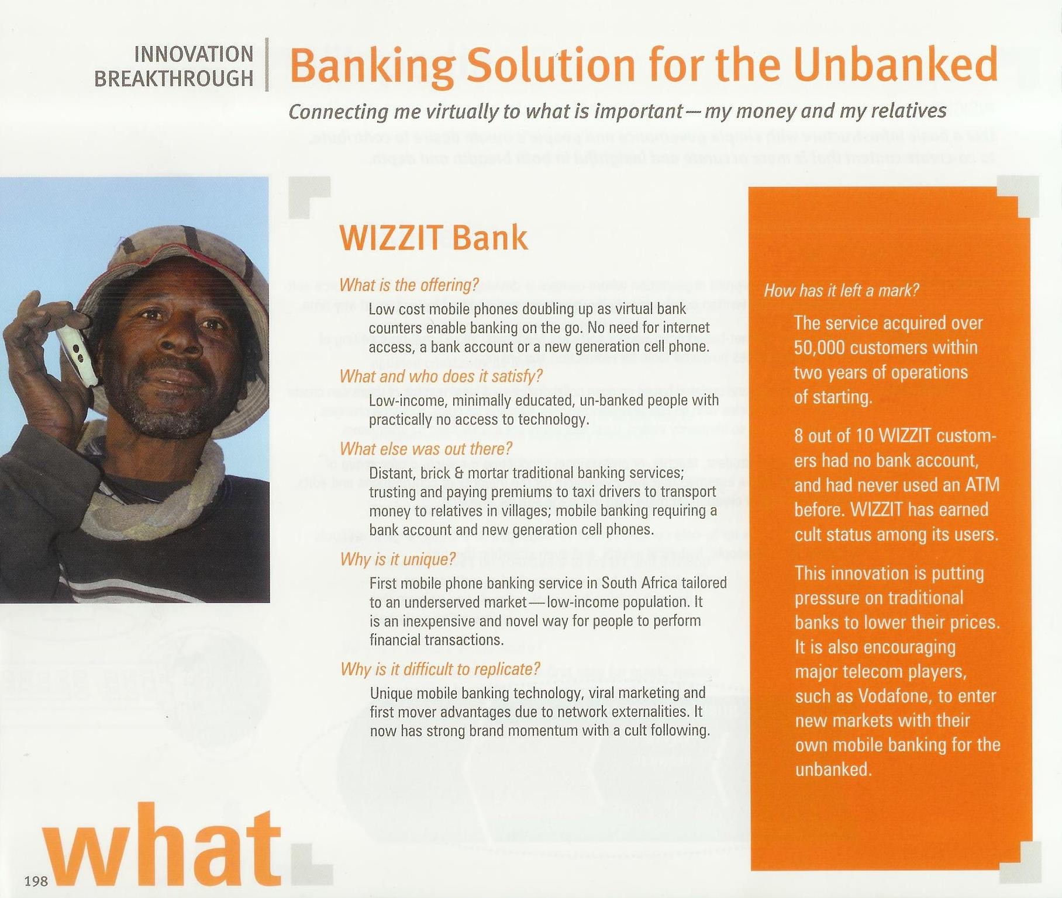
Source;101 Innovation Breakthroughs(Courtesy Wizzit)

Slide 13
Wizzit Bank(ctd)
Over 500 0000 clients (Farm Workers, security guards, miners, domestic workers, factory workers)
Operates on all networks
High transactional activity at the end of the month – last & first weeks of the month
Most clients and activity in Gauteng
Model replicated in Tanzania with
National Micro-Finance Bank (NMB), Zambia with ZANACO bank and Romania with BCR.

Slide 14
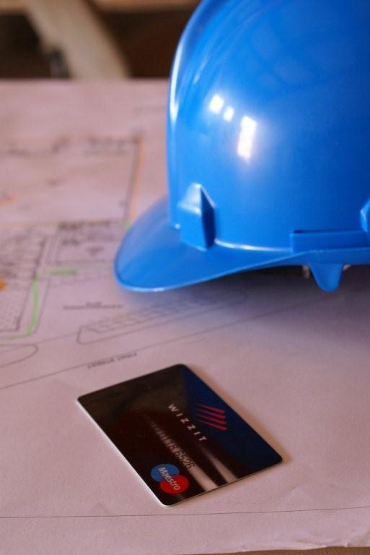
Photo credit: Wizzit

Slide 15
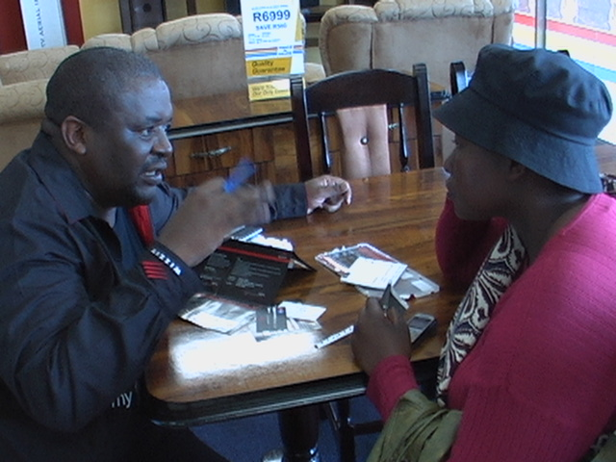
Photo credit: Wizzit

Slide 16

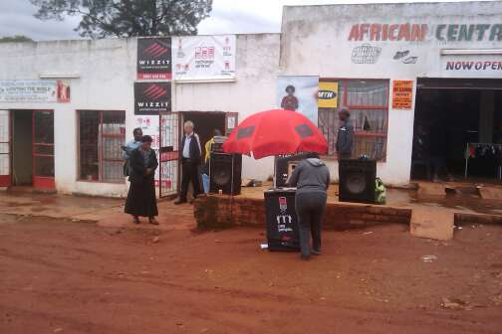
Photo credit: Wizzit

Slide 17
Context of study-South Africa
One of the most unequal societies in the world
Most developed financial system in Africa(Collins 2010).
An estimated 60 percent of SA’s 45 million population own mobile phones but about 40% of the population remain un-banked or under-banked (World Bank 2007).
Rapid urbanisation-In SA 65% of the population reside in urban areas (Finscope 2010)
Financial inclusion efforts : Financial services charter, Mzanzi account

Slide 18
Theoretical frameworks evaluated
Technology Acceptance Model(TAM) in mobile banking use
TAM does not capture reasons of non use of mobile applications by mobile phone users and is limited in analysing adoption intentions in usefulness, ease of use and social norms areas only(Lee and Jun 2007)

Slide 19
Theoretically framework selected:
Capabilities Approach
Analysis of the social, technological, and economic contexts of use will have imperative input into the adoption and impact research in mobile banking (Donner & Tellez 2008).
Amartya Sen refers to the social and economic issues that affect freedom of choice and impact use of any goods and services (Sen 1999).
Important in development terms is what people can be and can do given access to goods and services (Gigler 2004).
Capabilities -the alternative combinations of the functionings that are feasible for her to achieve (Sen1999:75).
Functioning’s - things that a person may value doing or being (Sen 1999:75)
Capabilities enable the achievement of these functionings (Sen 1999).
Versatile ,flexible & holistic approach

Slide 20
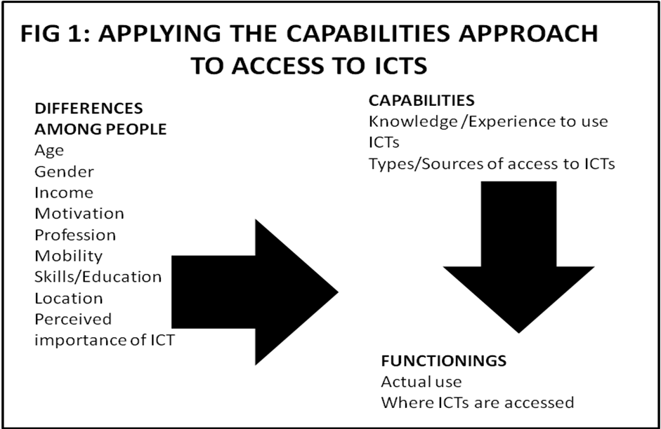
Source:Alampay 2006

Slide 21
Sampling & Methodology
Sampling
15 Wizzit users and 15 non users
Purposive sampling & snowballing to identify further respondents
Methodology
In depth interviews
Focus groups
Participant Observations
Research instrument – interview guide with open ended semi-structured questions

Slide 22
Methodology justification
Morawczynski & Pickens (2009) study employs the use of financial diaries that reveal the volume and value of mobile banking activity complimented by a survey.
Most studies of mobile banking in South Africa used more quantitative approaches through surveys to understanding the use of mobile banking by the poor.
Ivatury and Pickens (2006) employ a telephone survey whilst Porteous (2007) uses a questionnaire survey of both users and non users of mobile banking services.
Limited in-depth understanding of the underlying factors that determine the non use and use decisions using qualitative methods.

Slide 23
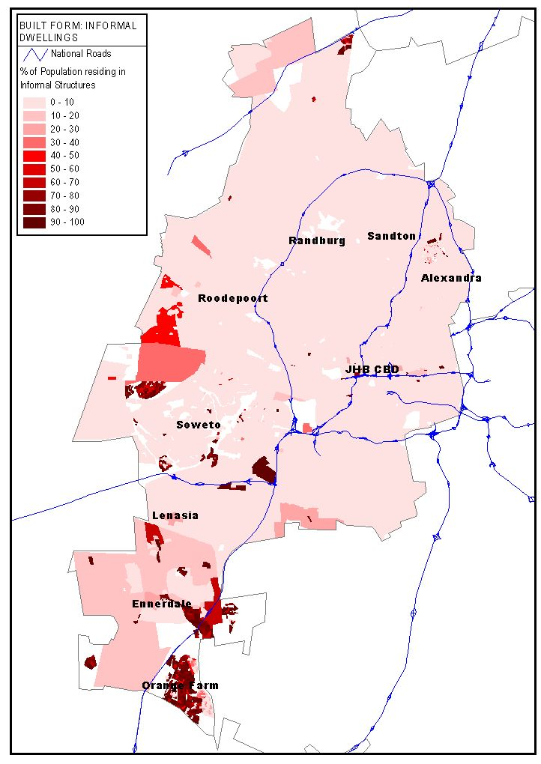
Proposed Areas of study

Slide 24
Proposed Areas of study(ctd’)
Alexandra - a township located in Johannesburg close to the plush neighbourhood of Sandton.
Orange farm - a township located just outside Johannesburg considered largest informal settlement
Kahlekong- an overcrowded township in the Ekurhuleni Municipality with informal settlements

Slide 25
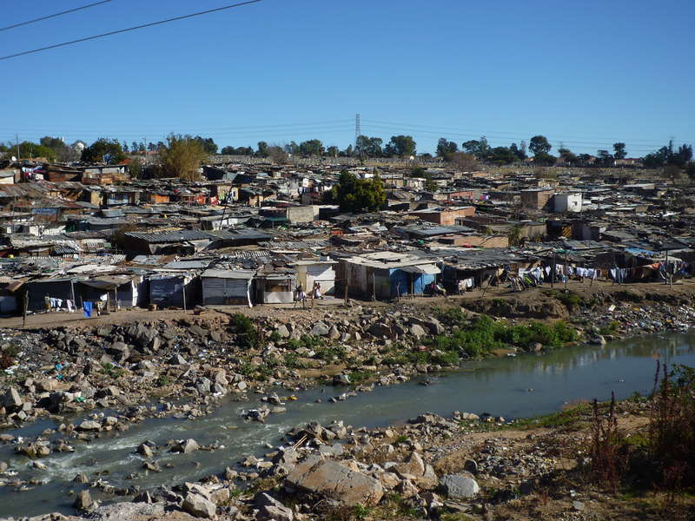
Credit:

Slide 26
Outstanding work
Complete sample selection
Data collection: in-depth interviews & focus groups
Data analysis
Compilation of report

Slide 27
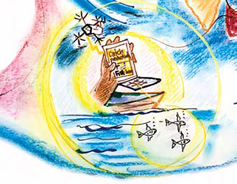
‘When technology allows ordinary people to become more productive, it gains economic traction, proliferates widely and yields a host of benefits in the process, setting off a virtuous cycle’.(Quadir 2010 :24)

Slide 28
References
Alampay,E.A. 2006. Beyond access to ICTs: Measuring capabilities in the information society. International Journal of Education and Development using Information and Communication Technology(IJEDICT). 2(3):4-22.
Arunachalam, S. 2002. "Reaching the unreached: how can we use information and communication technologies to empower the rural poor in the developing world through enhanced access to relevant information?" Journal of information Science 28(6): 513- 522.
Best,M and Kenny,C.2009. ICT’s, enterprise and development in Unwin,T (ed). Information and Communication Technology for Development. Cambridge University Press.
CGap 2009. Measuring Access to Financial Services around the World.
Collins, D., J.Morduch, S.Rutherford and O.Ruthven. 2009. Portfolios of the Poor: How the World’s Poor Live on $2 a Day. New Jersey: Princeton University Press.
Djiofack-Zebaze, C & Keck, A.2008. ‘Telecommunications Services in Africa: The Impact of WTO Commitments and Unilateral Reform on Sector Performance and Economic Growth’.World Development.37(5): 919–940
Duncombe. R and R.Heeks. 1999.Information, ICTs and Small Enterprise: Findings from Botswana. Development Informatics.7: 1-16
Economist Intelligence Unit. 2004. Reaping the benefits of ICT. Europe’s productivity challenge. Reportsponsored by Microsoft Euromonitor International, GMI Database. Acessed 8/11/2010.http://graphics.eiu.com/files/ad_pdfs/MICROSOFT_FINAL.pdf
Finscope 2010 Finsope South Africa 2010 Survey .Accessed 10/02/2011. http://www.mfsa.net/new/public/FinScope_2010_Brochure.pdf
Gigler, B.S. 2004. Including the excluded—Can ICTs empower poor communities? Towards an alternative evaluation framework based on the capability approach, Paper presented at Fourth International Conference on the Capability Approach, Pavia, Italy (5–7 September).
http://www.finmarktrust.org.za/accessfrontier/Documents/transformational_mbanking.pdf
Indjikian, R. and Siegel, D. 2005. “The Impact of Investments in IT on Economic Performance: Implications for Developing Countries.” World Development. 33(5): 681–700.
Ivatury,G and M. Pickens.2006. Mobile Phone Banking and Low-Income Customers: Evidence from South Africa. Washington, D.C: ConsultativeGroup to Assist the Poor.
Jensen, M.2001: Afriboxes, Telecenters, Cypercafes: ICT in Africa, in: Cooperation South.1: 97-109
Lee, T.M and J.K. Jun. 2007. The role of contextual marketing offer in MobileCommerce acceptance: comparison between Mobile Commerce users and nonusers.5 (3): 339–356.
Marker, P., K. McNamara and L. Wallace. The Significance of Information and Communication Technologies for Reducing Poverty. London, DFID.
May, J., 2010. Digital and other poverties: Exploring the connection in four East African countries. Paper presented at the CPRC Conference: Ten years of 'war against poverty'. What we have learned since 2000. What we should do 2010-2020. 8-10 September 2010, Manchester, UK. p1-27 (27p).
Mbogo.M.2010.The Impact of Mobile Payments on the Success and Growth of Micro-Business: The Case of M-Pesa in Kenya. The Journal of Language, Technology & Entrepreneurship in Africa.2(1)
Morawczynski, Olga and Mark Pickens (2009). Poor People Using Mobile Financial Services: Observations on Customer Usage and Impact from M‐PESA. CGap Briefhttp://www.cgap.org/p/site/c/template.rc/1.9.36723/
Ndiwalana.A & Popov.O. 2008. Mobile Payments: A Comparison between Philippine and Ugandan Contexts. Accessed 09/09/2010 http://dspace.mak.ac.ug/bitstream/123456789/182/3/ndiwalana-dicts-res.pdf.
Porteous, D. 2007. Just how transformational is m-banking? Accessed 1/11/2010
Quadir,I.Z.2010. Mobile Technology: One core lesson, many possible solutions. Development Outreach.1:22-24
Roeller, L and L. Waverman.2001. “Telecommunications Infrastructure and Economic Development: A SimultaneousApproach”. The American Economic Review. 91(4): 909-923.
Sen, A. 1999. Development as freedom. Oxford: Oxford UniversityPress
Soeftestad, L.T and M.K, Sein. 2003. "ICT and development: east is east and west is west and the Twain may yet meet", in Krishna, S., Madon, S. (Eds),The Digital Challenge:Information Technology in the Development Context, Ashgate Publishing Ltd, Aldershot,
Ssewanyana J.K. 2007, ICT Access and Poverty in Uganda. International Journal of Computing and ICT Research.1(2): 10-19.
UNCTAD. 2010. Information Economy Report.

