Slide 1
Third Annual Conference of Funded Researchers
Institute for Money, Technology and Financial Inclusion,
University of California, Irvine, December 6 – 8, 2011
Impact of EKO’s SimpliBank on the Saving Behaviour and Practices of Low Income Users:
The Indian Experience
Mani Arul Nandhi
Associate Professor
Jesus and Mary College,
University of Delhi, India

Slide 2
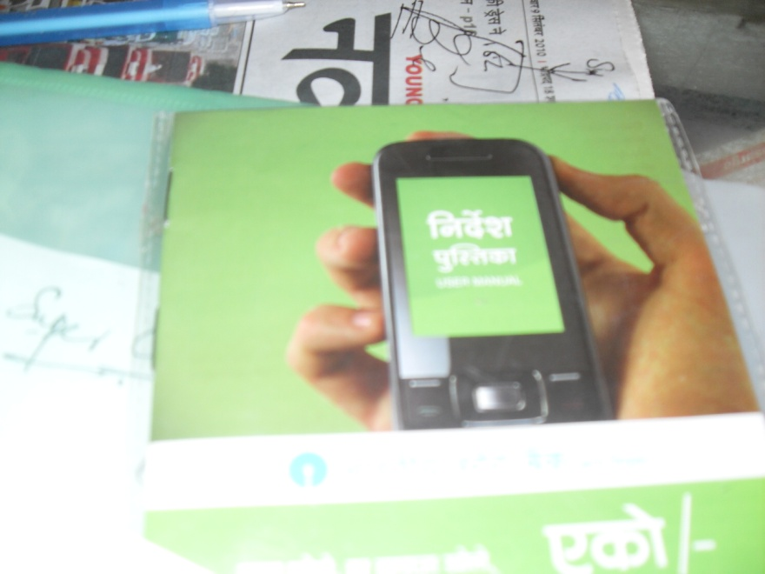
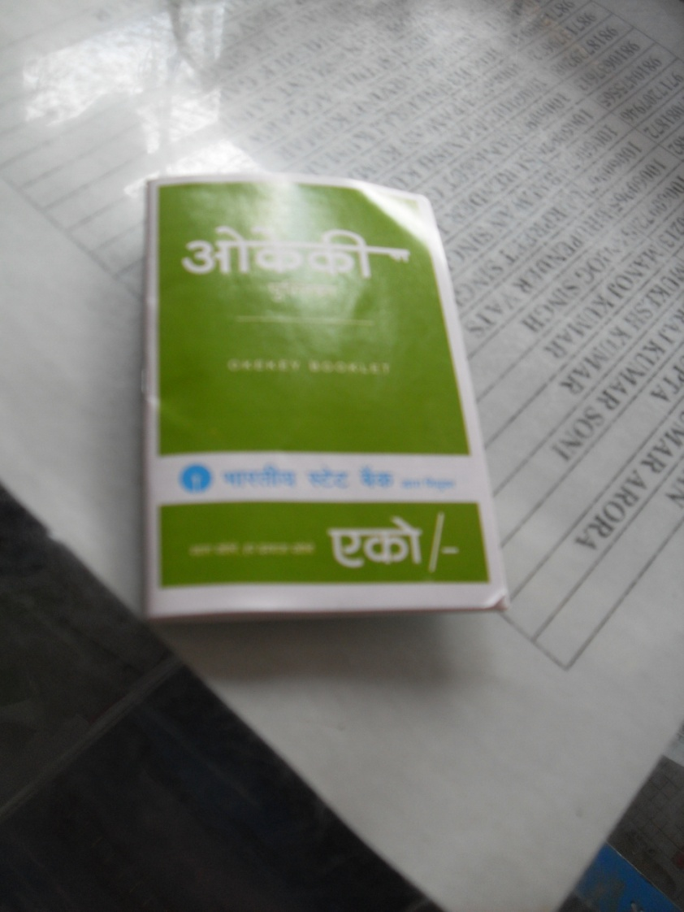
An Outline
Context
Research Objective
Research Questions
Methods and Sample
Work done so far
Field Report and Observationsns
Work ahead – lots to be done!

Slide 3
Context
41% of India’s population is unbanked;
51% of population is financially underserved.
Urban poverty is over 25% with over 80 million poor living in cities and towns.
Large number of financial players but bank accounts penetration is low with a high level of financial exclusion of the urban poor.
Urban poor are highly dependent on costly and risky informal mechanisms and social arrangements to save and access other financial services.

Slide 4
Context (continued)
India has near universal telecom access with one of the lowest cost retail distribution networks in the world.
Over 500 million mobile connections across India, many mobile banking initiatives underway in India.
EKO Aspire Foundation’s model is a pure cell phone based model on a core banking platform called SimpliBank.
EKO as a business correspondent of the State Bank of India (SBI) operates through a network of neighbourhood retailers in Delhi and some districts of Bihar, Jharkhand.
Mobile number is the bank account number of the customer facilitating transactions in their ‘No Frills Account’ and the money deposited remains with the SBI, earning an interest rate of 3.5%

Slide 5
Research Objective
Study looks at EKO mobile money’s transformative potential from the ‘individual’ users perspective.
Major research objective is to investigate the impact of EKO’s mobile money on the savings behaviour and existing informal practices and social arrangements of low income customers in the urban metropolis of Delhi (and the neighbouring Noida).

Slide 6
Research Questions
What is the socio-economic impact of EKO’s mobile money on the savings behaviour of low income users?
What is the customer perception of EKO’s usage in terms of existing informal arrangements/practices?
Has EKO replaced or displaced or dispelled the need for using informal saving mechanisms and storage practices?
Has EKO become a superior savings substitute or a complementary tool to their time tested informal savings practices in terms of its speed, convenience and reliability?
What are the characteristics of EKO customers in terms of their adoption behaviour and usage practices? Is there a match between their needs and EKO’s offering?
What is the pace of uptake, trust and ability to transact among its users and levels of awareness?

Slide 7
Methods and Sample
Structured in-depth questionnaires –for EKO users and agents
Semi-structured key informant interviews
Case studies
Following were intended methods but could not be implemented due to inaccessibility of subjects at the field:
Focus group discussions
Unstructured market watch surveys in selected locations.
Time line for field survey exceeded by one month already.

Slide 8
Sample Coverage
EKO’s information relating to agents / EKO counters formed the basis of sample covered.
Field survey in West, East and South Delhi districts where 16 agents’ customers were covered.
In some areas availability of low income customers was problematic because many agents’ customer base had melted due to some policy changes relating to transaction charges and closure of counters by EKO to bring about due diligence requirements for retail agents. These developments were prior to our field survey.
160 EKO customers interviewed during 4th August 2011 till 7th November 2011.
13 retail agents and 2 field officers interviewed so far.
Key officials of EKO and SBI are yet to be met with.

Slide 9
EKO customers covered
Nature of Occupation | Number | Percent
Tiny business | 19 | 12%
Shopkeepers/petty traders | 16 | 10%
Salespeople/shop assistants | 25 | 17%
Housewives | 18 | 11%
Casual/factory workers | 23 | 14%
Professional workers | 15 | 9%
Domestic workers | 17 | 11%
Service | 3 | 2%
Pavement vendors | 5 | 3%
Other occupational workers | 8 | 5%
Teacher/home tutors | 5 | 3%
Students | 5 | 3%
Miscellaneous | 1 | .6%

Slide 10
A rapid dip into the data
Data cleaning and entry in progress, but a quick peep into the interviews of 20 EKO customers is presented.
Also some issues concerning policy changes relating to service charges, commission and business focus of EKO are areas of concern in the field.
Mostly literate / middle schooled or above barring one uneducated.
13 customers average monthly income was $102 (Rs5076) (sales assistants, casual labour, tiny enterprise, pavement vendors including 2 housewives, one retired maid and a student).
6 customers (small/tiny business) with monthly income $527 (Rs.26333);
One with a substantial high income of $10000 (Rs.500000).
Notes:
3 house

Slide 11
Rapid data (contd)
8 had no bank account and 12 had a bank account (2 salary accounts).
2 street vendors never tried for a bank account as EKO is convenient; one uses EKO more than bank account: One street vendor not using EKO since December 2010.
except for 7 bank account holders, rest had depended predominantly on informal savings practices:
Keep at home/ self = 70%; Remit home/save with relative = 25%, No savings = 10%
Those with only EKO account, now deposit their income or savings in EKO only.
Average period of starting EKO account – 20 months: 80 % happy and comfortable with EKO but 20 % happy but not comfortable with it.

Slide 12
Happy to own EKO mobile account
Reasons | Frequency | Percent
Easy to save small amounts | 16 | 80
Avoid spending on nonessentials | 13 | 65
Found safe place to save, no tension | 9 | 56
Can save without anyone’s knowledge | 4 | 20
Easy to withdraw anytime | 16 | 80
Save in it because i do not want to withdraw it now | 4 | 20
No rigid rules like in a bank account | 6 | 30
Uncomfortable with EKO Account
Deductions on transactions | 4 | 20
Server problem | 2 | 10
Withdrawal problem | 2 | 10

Slide 13
Some snapshots
Frequency of deposit :-daily to weekly (35%); monthly (45%)
Do not withdraw from EKO account – 30%
Minimum amount deposited ($2) and maximum amount ($200) last time.
14 (70%) keep deposited amount in EKO always.
19 (95%) keep depositing small amounts till it becomes a lump sum.
50% choose to save small amounts in EKO whenever there is extra/surplus money available.
17 (85%) reported that having EKO has increased their resolve and capacity to save.
Two major reasons: One, EKO money is safe unlike cash on person that gets spent (75%) Two, EKO account has made them consciously cut down expenses on nonessentials (80%).
EKO account has become one more method for savings (100%)

Slide 14
Snapshots (continued)
Other informal savings practices (cash on person, cash at home, cash with relative, savings in a committee) used along with EKO account for various needs/expenses.
Given a choice between EKO and other informal savings methods, 65% preferred EKO and 40% had no preference because they keep money at different places/methods for different needs.
95% considered EKO as a good substitute for other informal savings methods. Major reasons for it:
1. Helped to shift from unsafe saving practices (45%).
2. Helps to save more than earlier and to save in smaller amounts (50%).
3. Helps resist temptation to spend on non-essentials (60%)
4. Secrecy of savings (45%); 5. No fear of risk of loss (75%)
5. Reliable as it is a bank account (65%) and better than a bank account (90%).
Can transact at any EKO counters (95%)

Slide 15
Snapshots (continued)
EKO superior tool for saving lump sums that are built up in small amounts first using informal saving practices (savings at home (20%).
Save little by little (save in money box) and then deposit in EKO for specific purposes (loan repayment).
EKO money used for sending loan amount, money to supplier / agent, gift /festival money to relative.
EKO money useful for reciprocal borrowing and lending through instant transfers (15%) and need for reciprocal borrowing reduced after saving in EKO (25%). But 55% reported practising reciprocal borrowing/lending in cash.
While 50% reported dependence on risky informal methods reduced after EKO account; another 50% stated that dependence on other methods can not be reduced because they are useful in their own ways.
EKO facilitates receiving small amounts from family/friends for unexpected needs.

Slide 16
Snapshots
Alongside EKO need for keeping liquid cash at home/on person for meeting emergencies is high.
Given a choice for saving a lump sum of (between $ 20 and $40), 75% preferred to store in EKO account.
Ability to save has definitely improved (50%). Improved sense of pride in owning EKO account, self respect and sense of freedom to plan for a better future
Field observations:
Customers unhappy with transaction charges levied since September 2010.
Commission to CSPs also changed and introduction of security deposit for D2C transactions started in September 2010 by EKO also seem to have dampened the enthusiasm for EKO transactions by retailers.
New found divergence of focus on remittance market of EKO and interest on EKO saving accounts seem diluted?!!!

