Slide 1

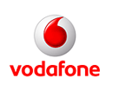
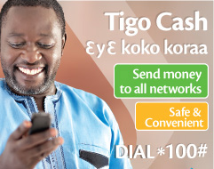

Does Mobile Money Matter? Exploring Mobile Money Adoption by Ghana’s Urban Poor
Vivian Dzokoto, Virginia Commonwealth U
Edwin C. Mensah, U of NC @ Pembroke
IMTFI Conference, Dec 7 2011

Slide 2
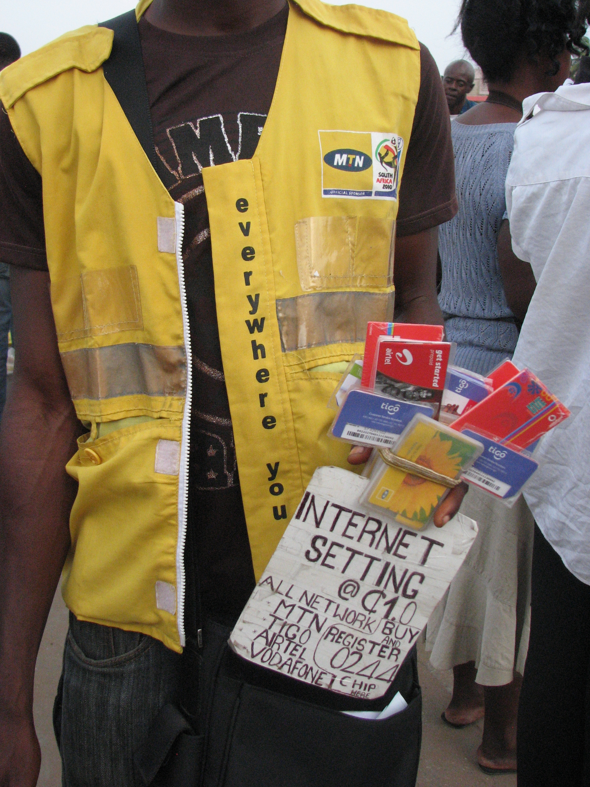
Mobile Money in Ghana
Background of mobile money
Initial introduction by MTN poorly received. Re-introduced in 2009. At the time of data collection, 3 telecom companies (MTN, Airtel (formerly Zain), and Tigo) had launched MM products (in 2010), and a 4th (Vodafone) was getting ready to do so.
Ghanaian “Moneyscape”
Consumer resistance to new money products (redenominated currency, ezwich, visa)
Accessible mobile phone technology
~ 74%
BOG mandated Regulation (based on recommendations from USAID training)
  Bank partnership, KYC, P2P, transaction limits, hopefully P2B (airtel), cross-service provider transfer capability

Slide 3
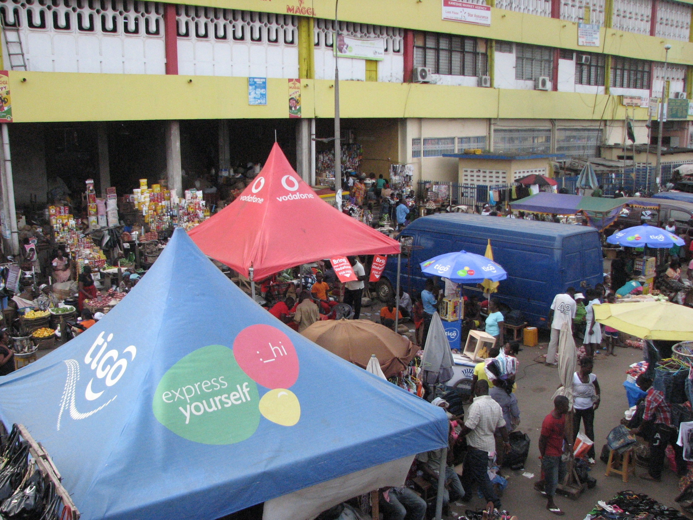
Our Study
Goals: Awareness, attitudes, uptake, barriers, impact of MM, 1 year post (re)launch
Interviews
  Location: Accra, Ghana, June – August 2011
  Sample:
    35 Low income, 35 Non-poor, lower middle class income Ghanaian adults
    Added due to preliminary findings: 25 Merchants, 25 market women, MM vendors, MM payee locations, 1 MM company rep
Document review
  Newspaper and magazine advertisements, brochures, etc
Scouting
  Location scouting for billboards, MM ads

Slide 4
Will you Use MM? Absolutely NOT
“It is like when you have many dresses but you prefer one to the rest”
22 y.o. female orange seller
As for me, I would like to keep my money in the bank. I cannot trust MM. If someone pays and send you money but it never comes, you lose.”
19 y.o. vulcanizer

Slide 5
Yes, I will use MM
I can’t tell how they send the money, that is why. I am amazed by it. But if I try it and it is able to go through, then I would say that their claims are true (hawker)
At (bank or Western Union) if the cashier is angry or you make an error on the form you can imagine what will happen,… but you can transfer at your convenience with MM (public servant)

Slide 6
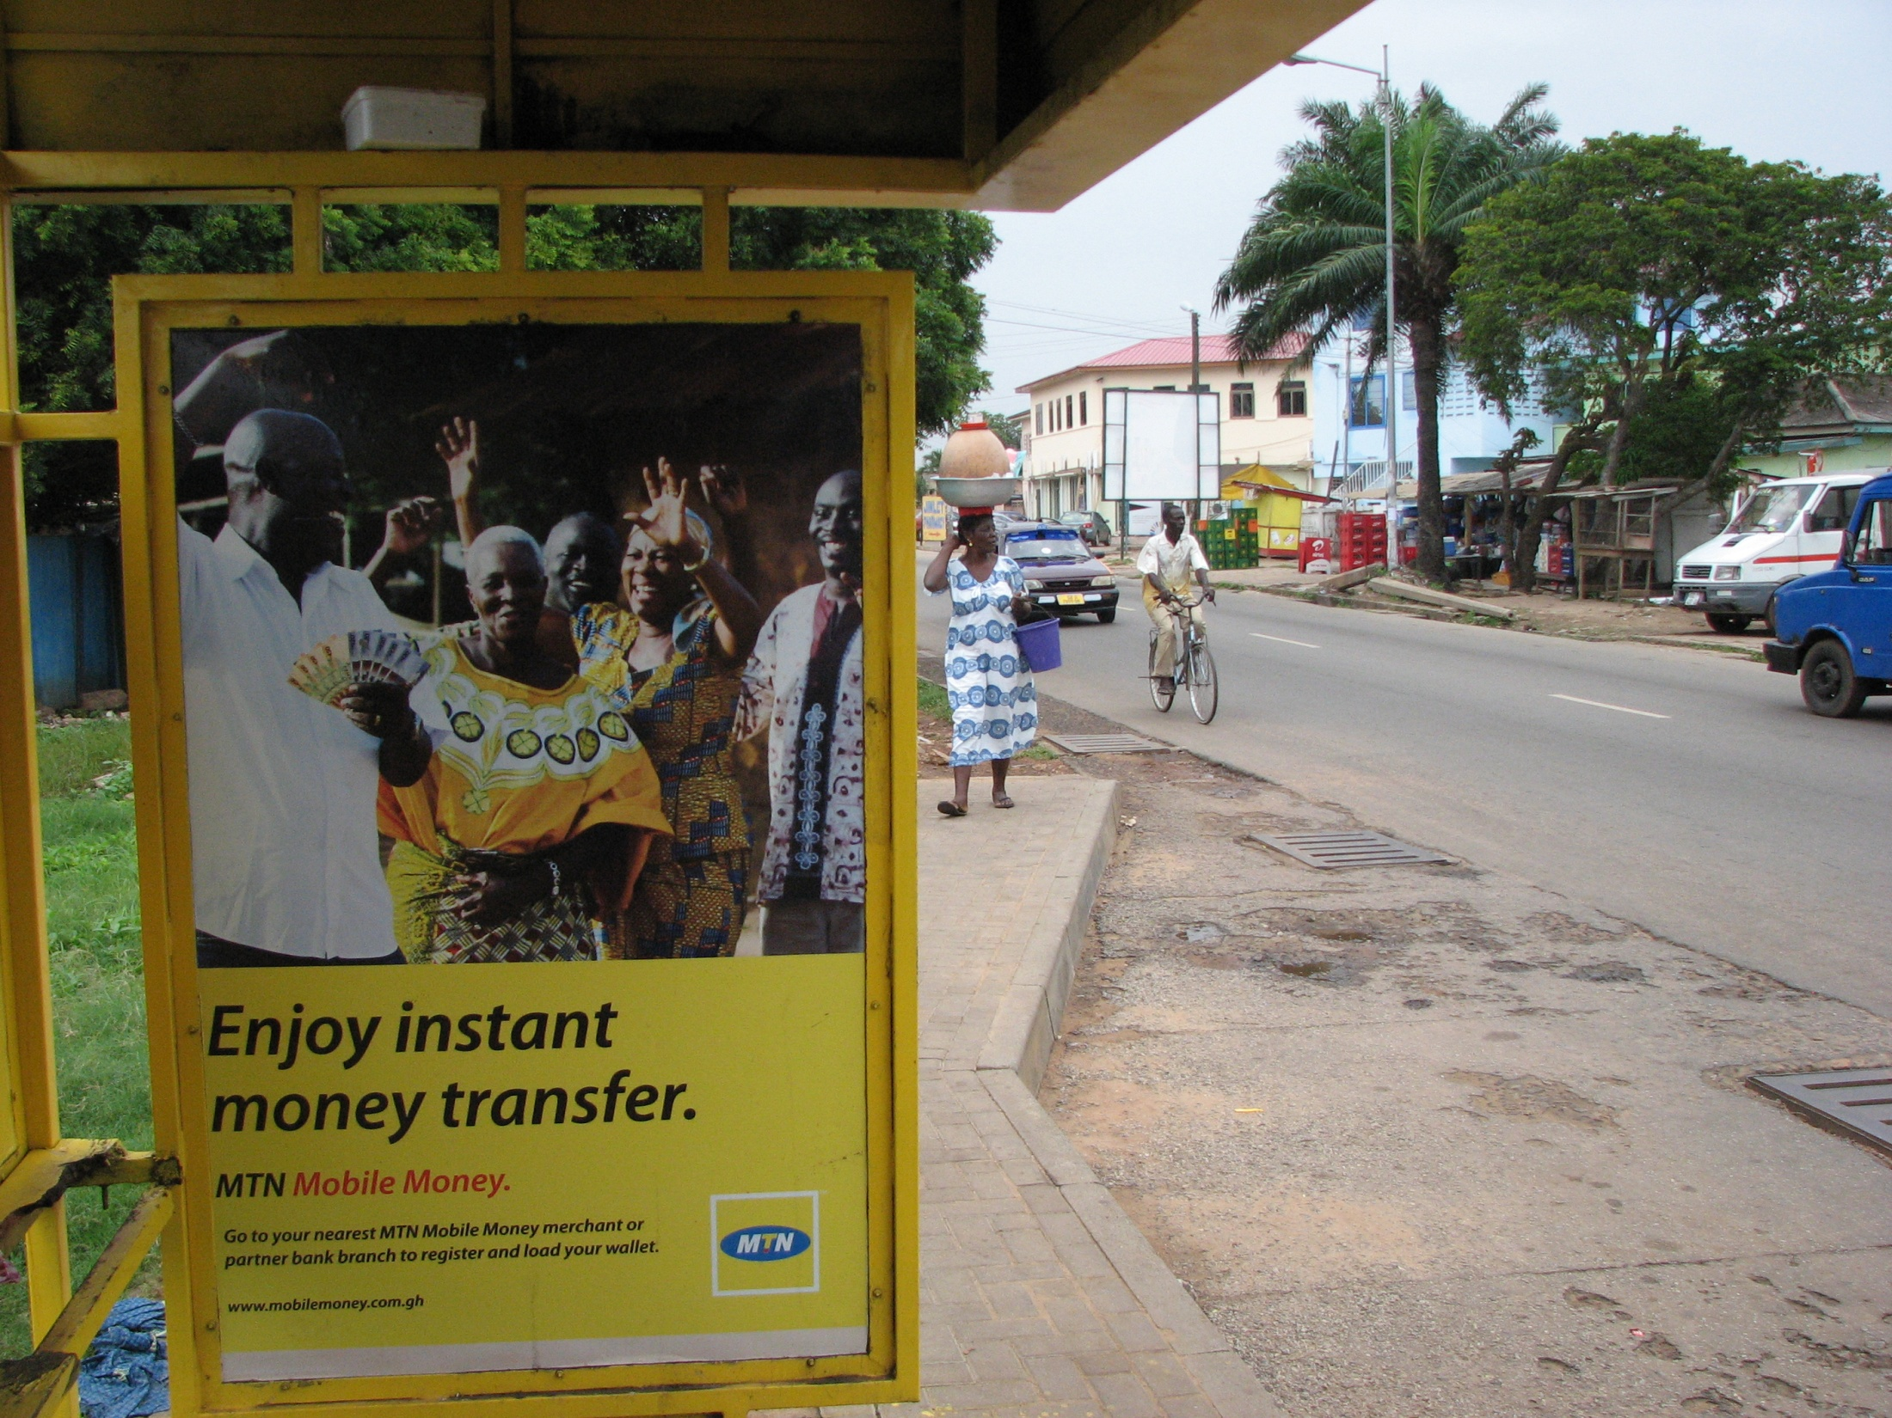
Ambivalence about MM
“Somehow it is good, but somehow it is not good”
(35 y.o. female food hawker)
“I think every system has its advantages and disadvantages”
24 y.o. female public servant
It is convenient …..(but) the truth is Mobile Money will be my last resort”
(25 y.o male public servant)

Slide 7
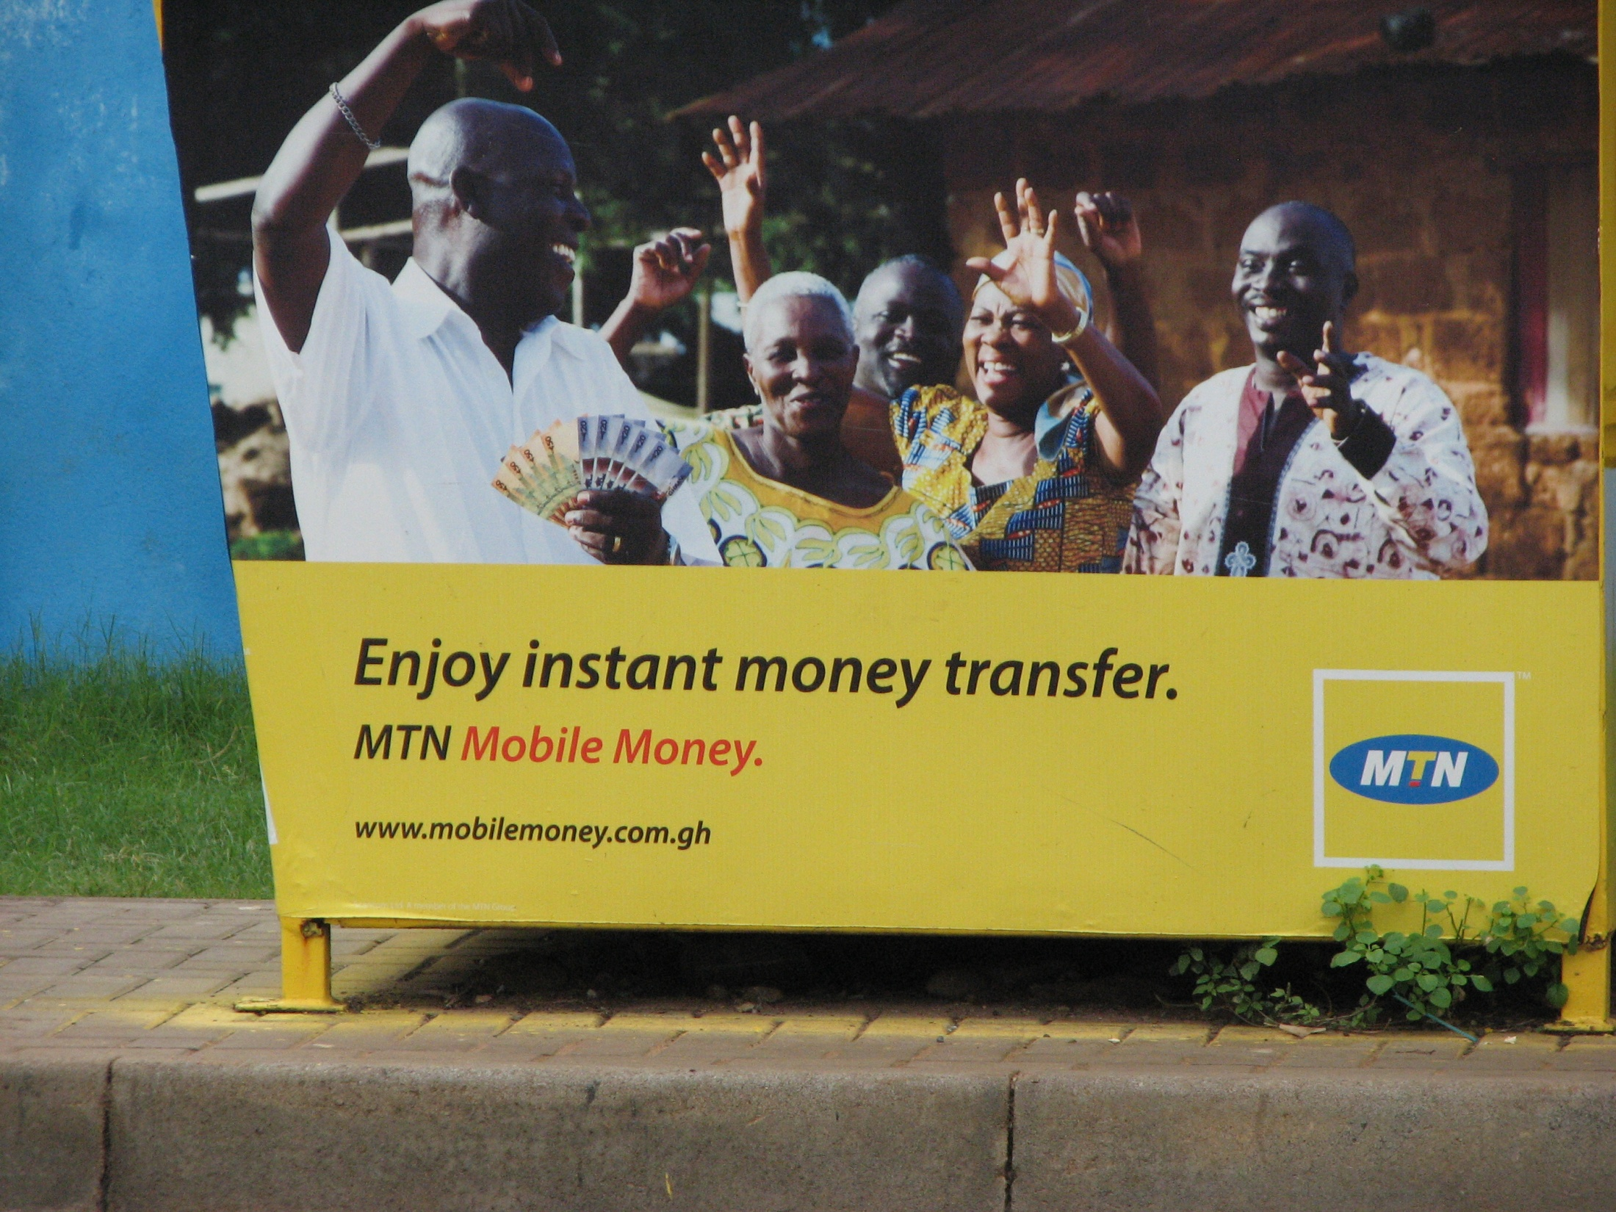
Barriers to MM Use
No money
Not enough knowledge about product
Lack of trust of product (ranging from convinced it is not safe to not sure it is safe)
Access to vendors/proximity
Confusion about role of banks
Other Reasons For Non-use
MM will cause them to spend more money
No one to remit money to
Preference for cash
Just haven’t gotten around to it yet
What if I lose my phone?

Slide 8
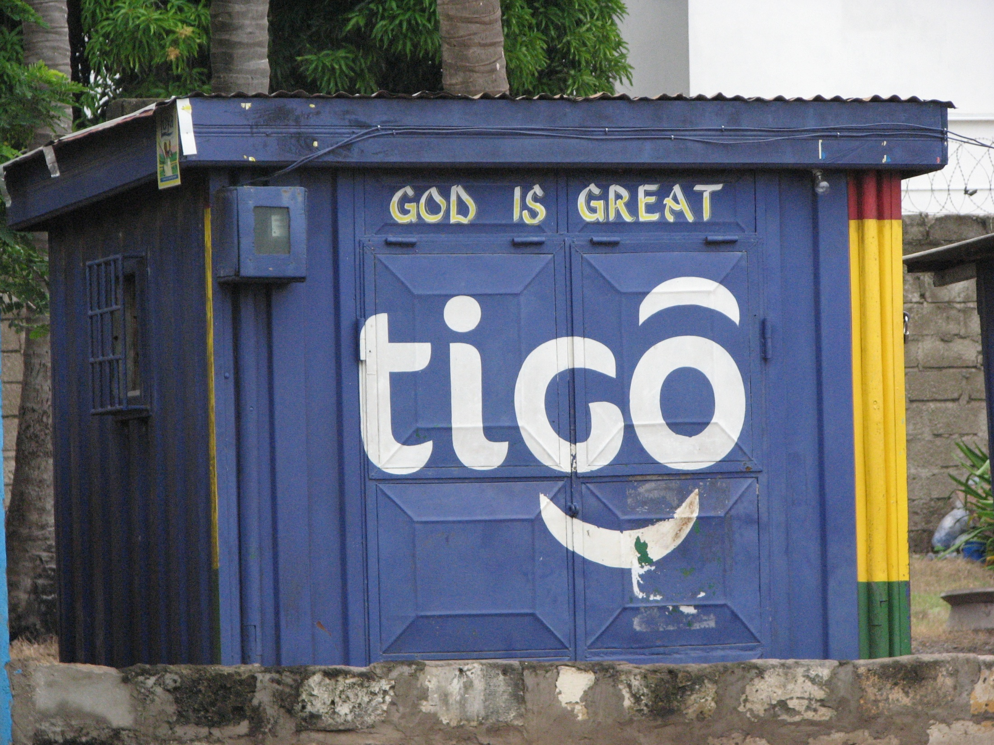
Levels of MM Knowledge
Knowledge of companies offering MM
Knowledge of vendors/agents
Knowledge of uses
Knowledge of product name
Knowledge of process
Knowledge of other countries using MM
Previous personal use
Knowledge of MM user

Slide 9
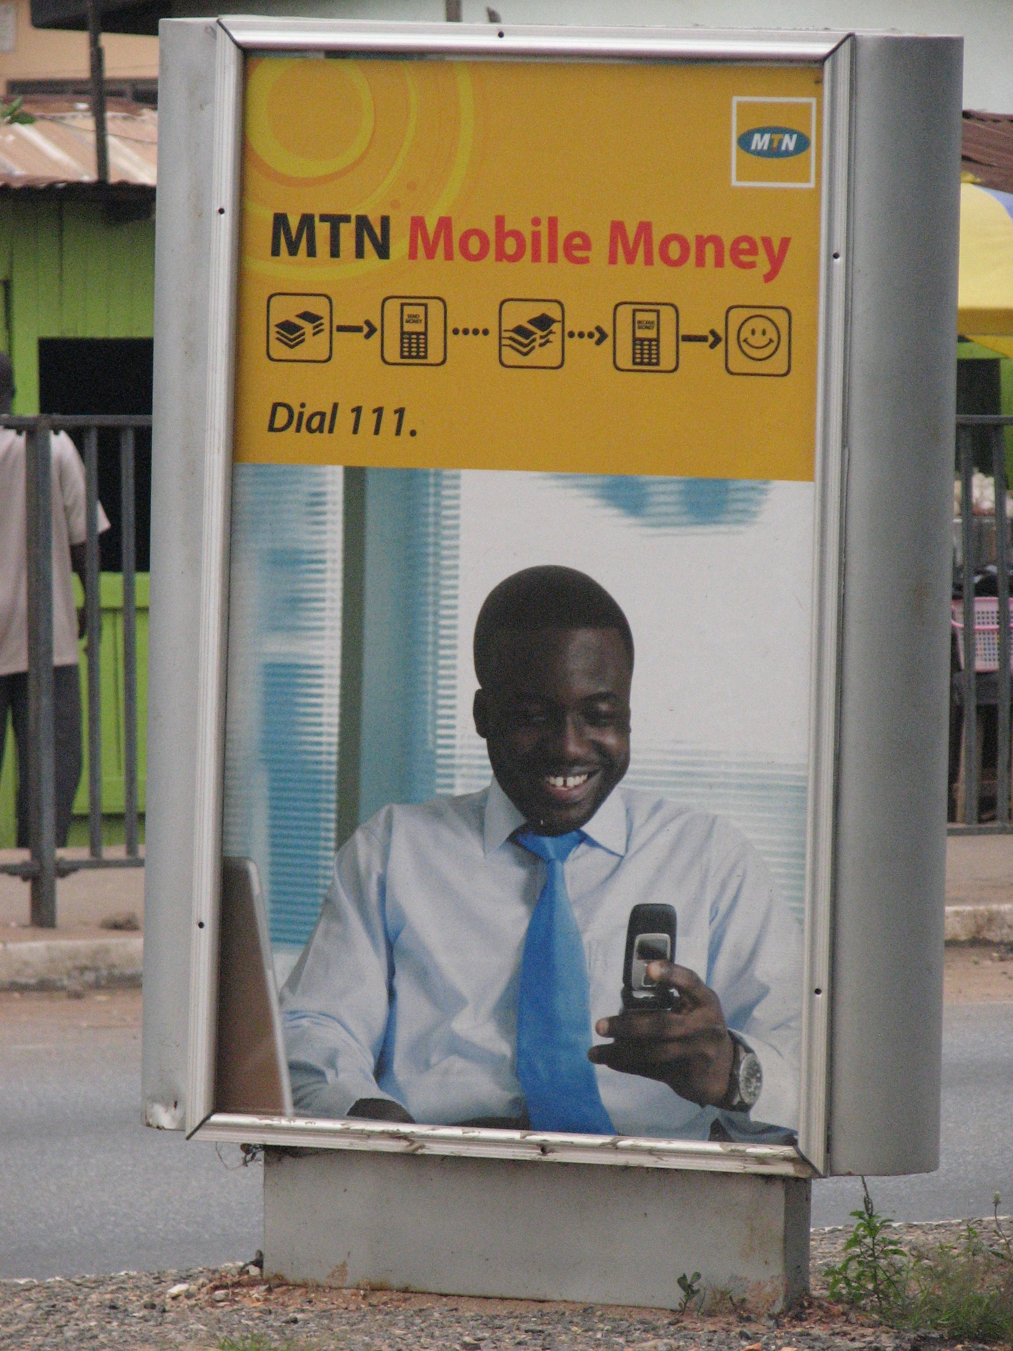
Higher Income Group
“It is cool, safer, and faster (than other forms of money transfer). When you are paying utility bills, you can just sit in the comfort of your home”
                25 y.o. male
  Less than 10 had used MM
  Concerns with technology, susceptibility to fraud (sakawa), human error, and logistical hitches (including users).
  Low awareness of global context of MM
  Recognition of non-remittance potential

Slide 10
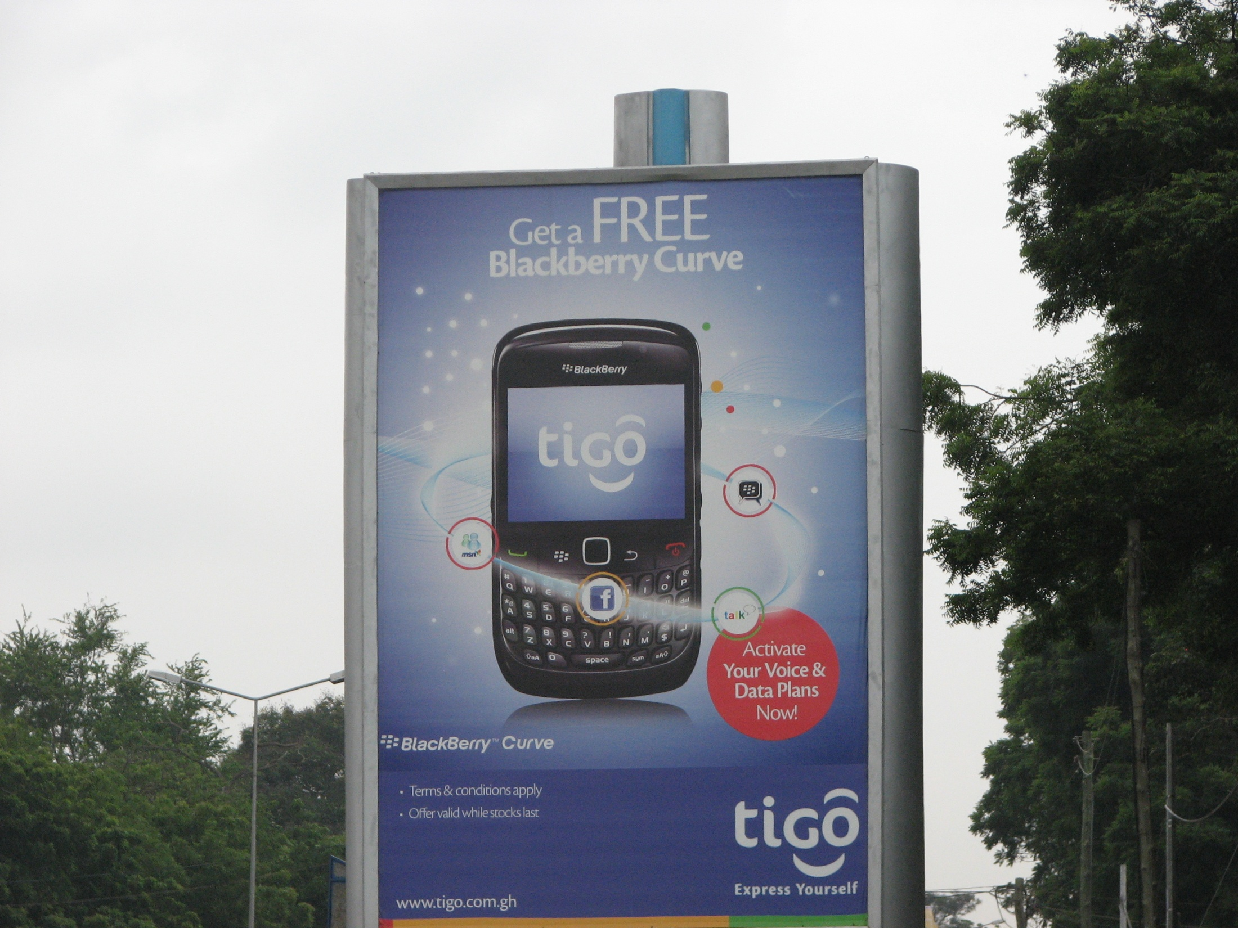
Low Income Group: Knowledge Gap
“I have heard of it, but I don’t understand it” (29 y.o. unemployed male)
  Only 1 interviewee had used MM
  Lower level of knowledge of MM
  Less awareness of non-remittance capabilities of MM
  Concerns dealt mostly with belief in possibility of MM, trust in product, technology (higher income group raised issues with network, fraud, logistical problems)

Slide 11
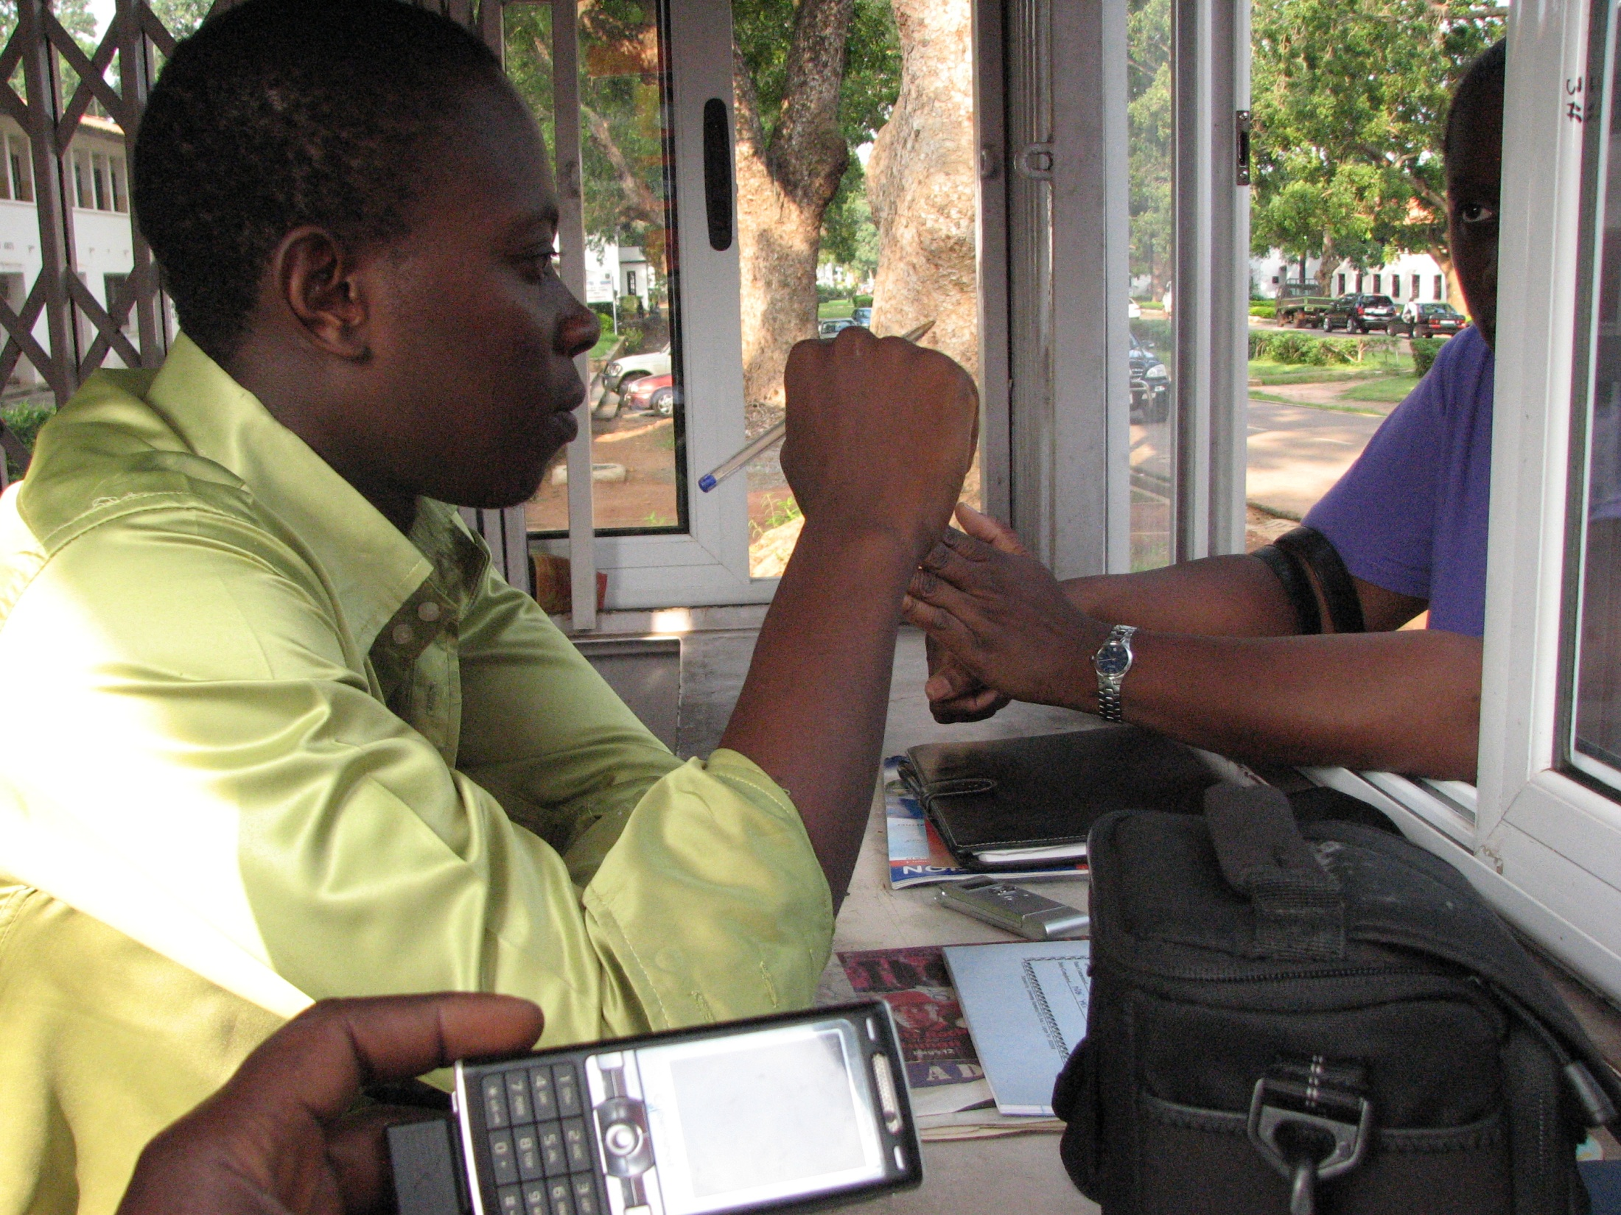
Interviews with….
MM Vendors
Bill Pay
Low patronage of MM (about 1 a day in 1 location)
We do not accept MM here”
“They took the ezwich machine away and have not brought it back”

Slide 12
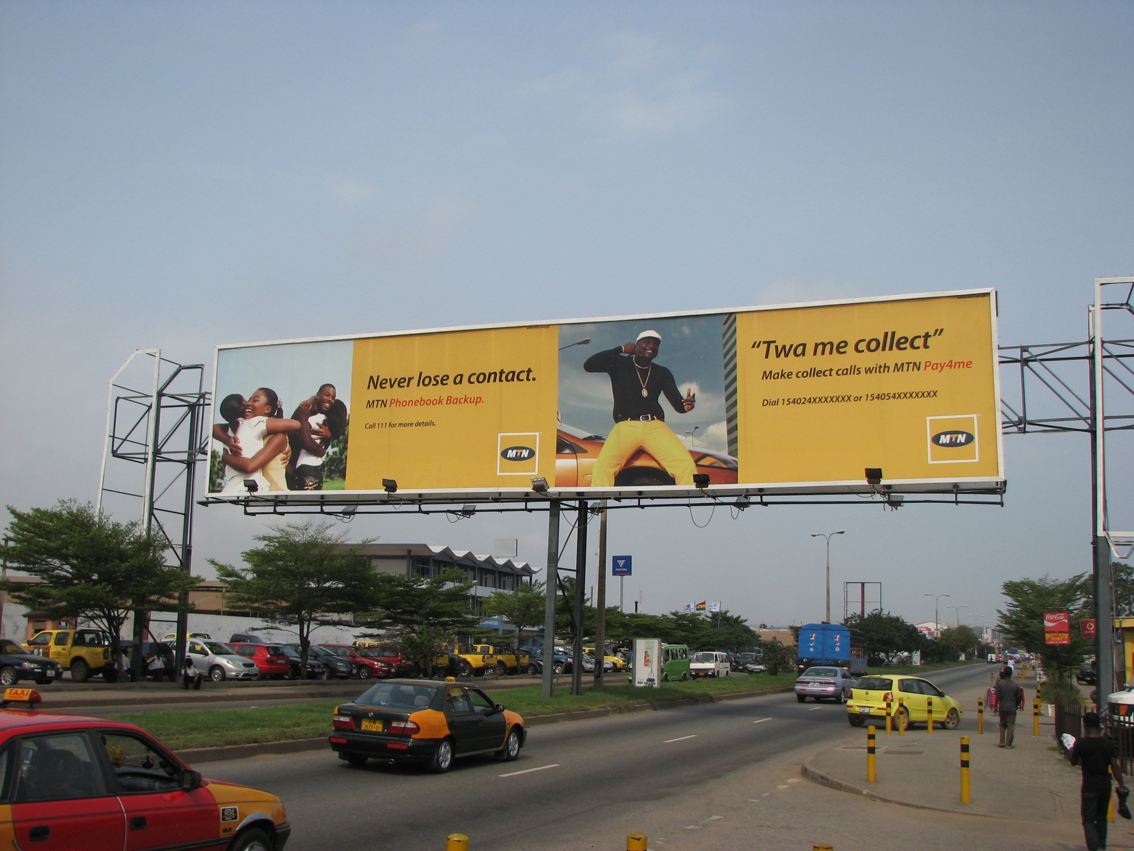
Ad search
Visible Marketing, Low awareness
Regular Adverts on tv, radio, magazines, billboards, banners, bus stops, and other ad media on major commercial streets in Accra’s capital city
No person-to-person marketing
Unanswered question: Are people not paying attention to these ads just because they assume they are generic phone company ads?

Slide 13
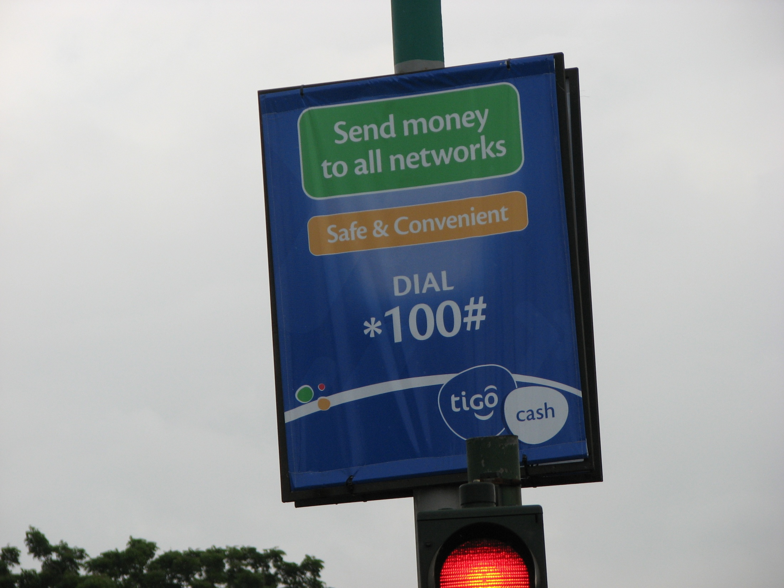
Interview with Mobile Money Rep; Document Review
AIRTEL
2 Mil phone subscribers only 1% of registered for MM BUT subscription ≠ usage
Hands-on workshop for journalists (Nov 2011)
TIGO
Post-launch marketing campaign underway to increase awareness
Recognition of large market potential
Differentiating between table top phone credit vendors and MM agents to promote trust in MM

Slide 14
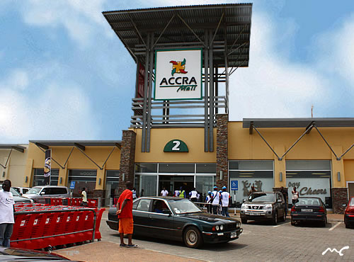
Merchants’ Perspective
Location: Oxford Street and 2 Malls
“All I have heard is “Mobile Money, Mobile Money”; I do not know what it is” (Oxford Street store manager)
“I think it will be a good way of doing business” (Accra Mall)
  No success in cashless forms (visa, ezwich) due to technical and fraud problems
  Some considering moving back to cash even though it is less convenient
  MM sounds like a very good idea in theory, but is it really going to work?
  No marketing: no information available about MM

Slide 15
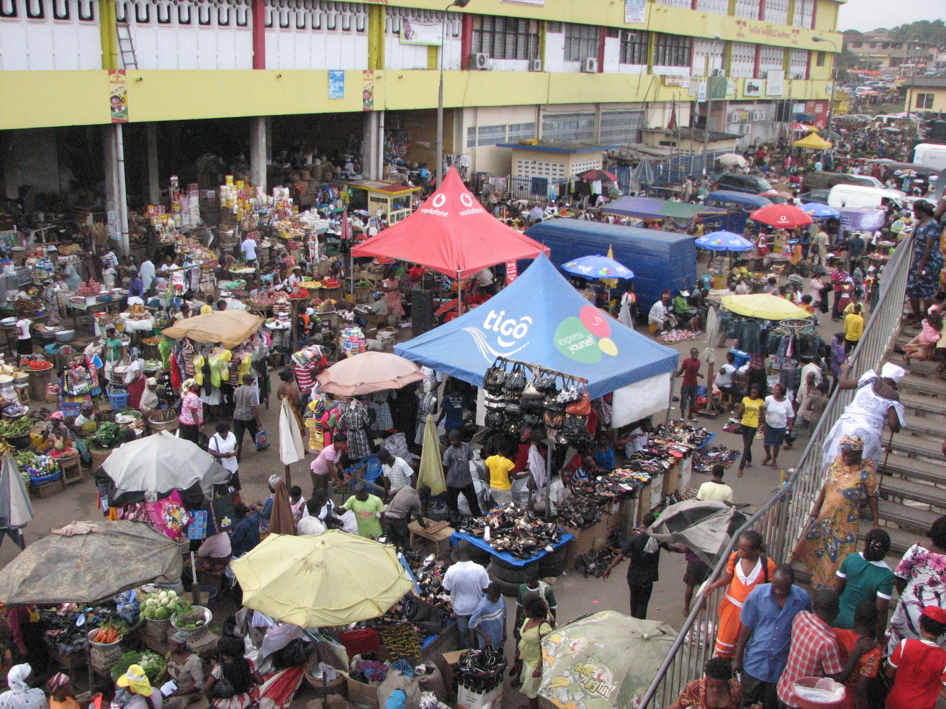
Market Women’s Perspective
SHOE LEATHER COST
“I am the only one here and I cannot leave my goods to go and get the money if somebody pays me with MM……..If they will come here or open a store here it will help so that I can easily go and get the money……”
LIQUIDITY ISSUES
  “Mobile Money is a good idea, but as for me, I prefer cash” (Hair products seller).
“It will be ok for the big time businesses. Those who deal in wholesale and bulk trading. So instead of carrying more cash in hand, when they transact their business with mobile money, it will be safe for them.
But as for mine, mine, it is a small one. I need the cash so urgently in order to go and purchase goods for sale, I don’t think it s good for me.” (Saucepan market seller)

Slide 16
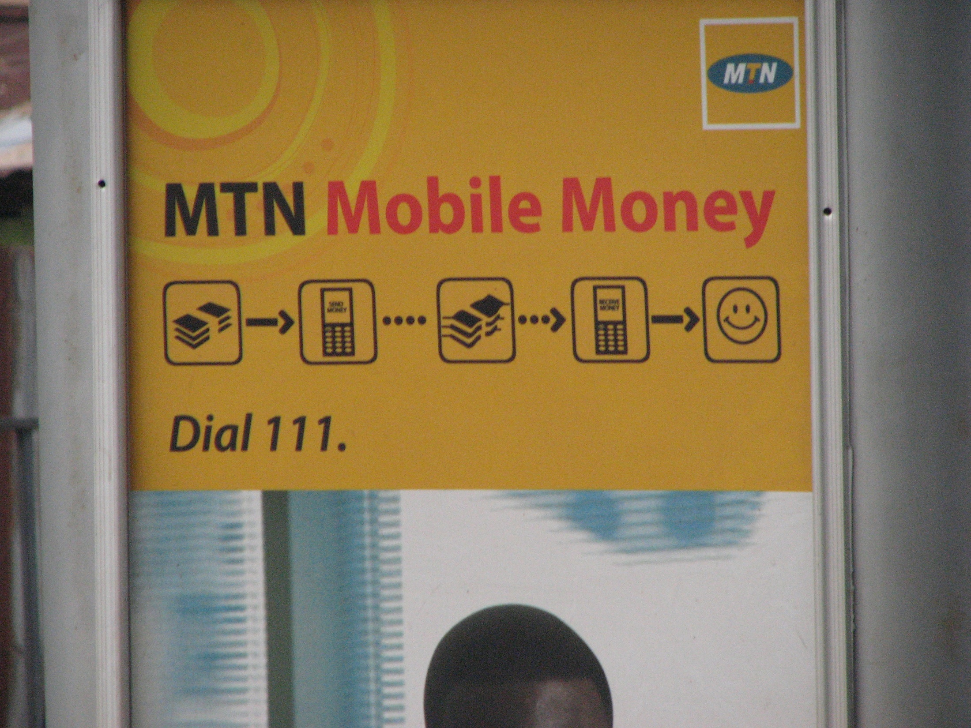
General Conclusions
In Ghana, Cash is still King
Ghanaians slow to accept new forms of money, including MM
“Maybe …trying something new is always difficult for us” (39 y.o. female public servant)

Slide 17

Will this change?
“I think it is a good initiative and great innovation. I just hope that in terms of awareness creation, more information is given about it, then more and more people will like to use it”
(25 y.o. public servant)
*Person-Person Education
*Proximity of Vendor to Potential Users (Traders)

Slide 18
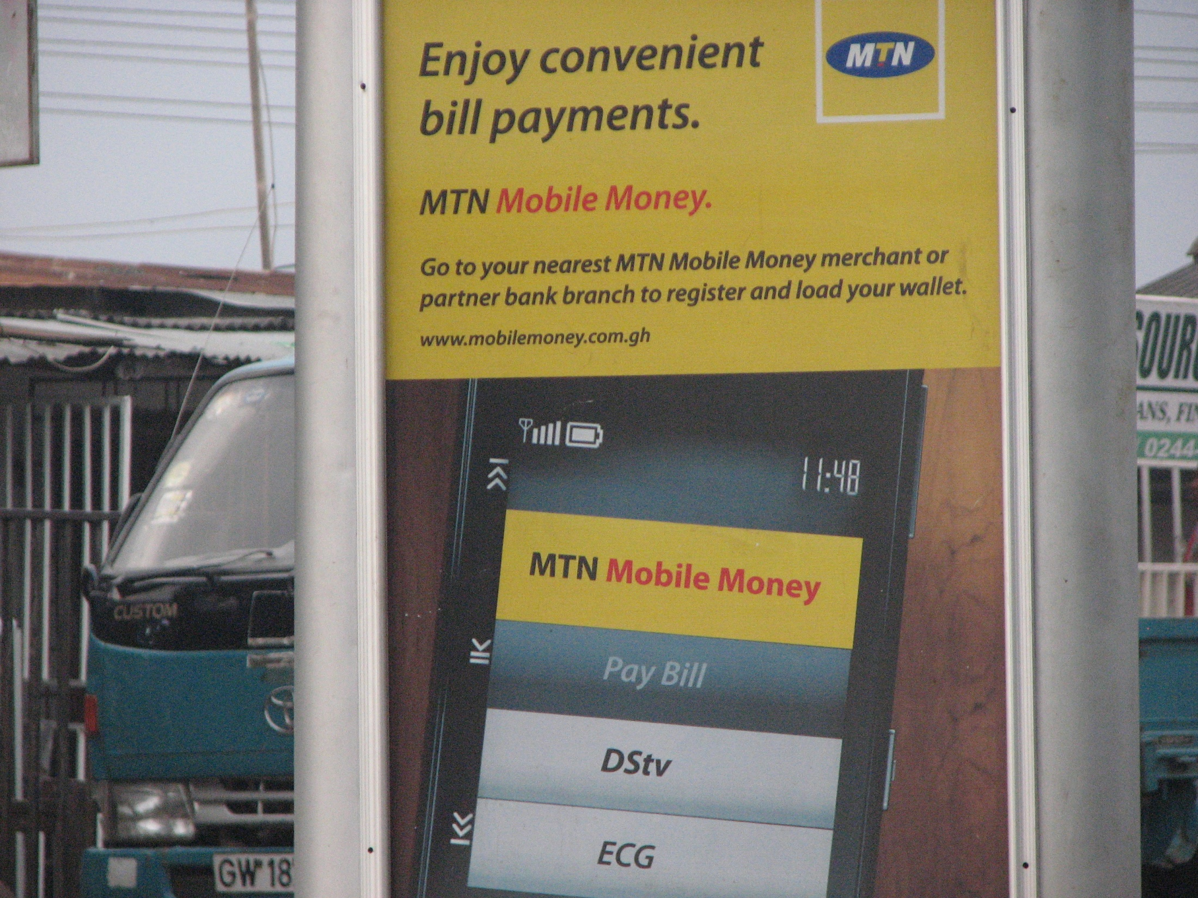
Conclusions
Merchants see benefits and problems with MM
Market women largely ambivalent about use, prefer cash
MM companies have a lot of work to do with regards to marketing their products, and may possibly have to consider different strategies.

Slide 19
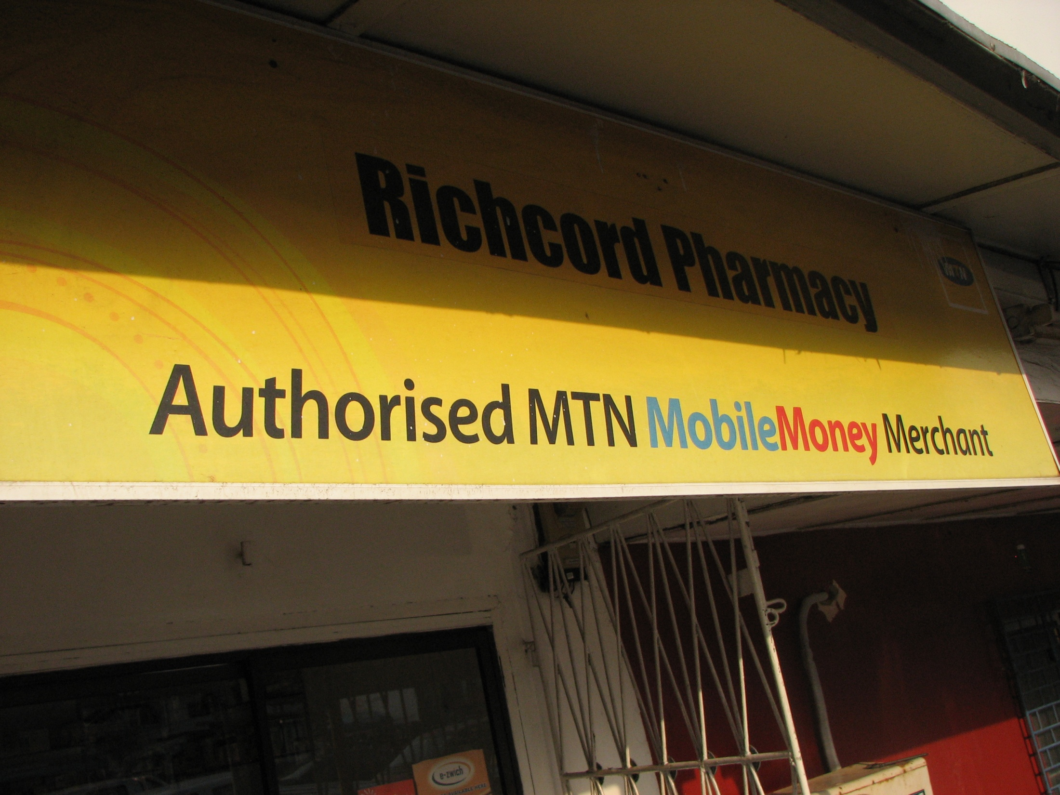
Conclusions
MM = Ghana’s AFLAC (it’s there, but very few people know): different marketing needed.
Does MM matter?
Ghanaian Answer, per our data: YEA….BUT
Despite it’s potential, it’s adoption is nowhere near full

Slide 20
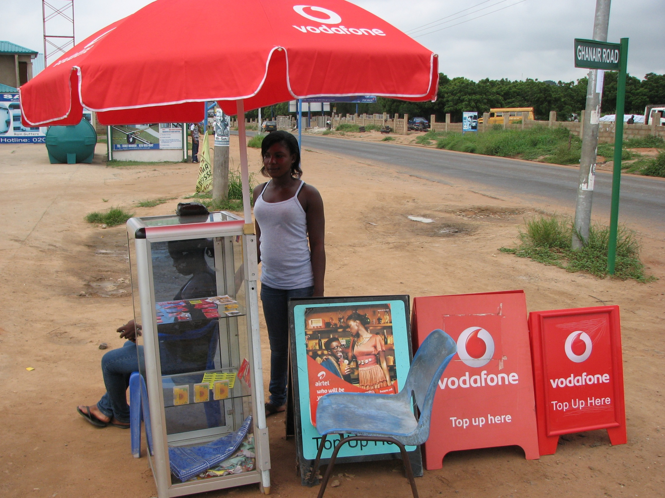
Conclusion
Low and high income groups are at different stages of awareness/adoption.
There is a lack of knowledge among Ghana’s urban poor.
Unaware
Awareness
Understanding
Knowledge
Trial
Regular Use
HIGH INCOME
LOW
INCOME
Customer MM Journey Model
McCarty, 2011

Slide 21
Future Directions
Provide an update of the current MM products
Use quantitative measures to:
  Evaluate the attitudes towards MM products
  Investigate the extent/intensity of adoption of MM
  THANK YOU

