Slide 1



Impact of Mobile Money Services on MFI´s Operational Costs in Tanzania
IMTFI
INSTITUTE FOR MONEY, TECHNOLOGY & FINANCIAL INCLUSION
Research Team: Casey Conzett, Patricia Rodríguez Pulido, Maricruz Lacalle-Calderón, Javier Alfonso Gil

Slide 2








Objective
Impact of Mobile Money Services on MFI´s Operational Costs in Tanzania
Impact
?
MFI - Tanzania
?
?
?
?
?
?
Notes:
What impact does mobile banking have on the operational cost structure of microfinance institutions?
This study set out to measure the impact that mobile phone banking services had on microfinance institutions across Tanzania.
Operating expenses represented 62 percent of charges to borrowers, 23% of financial expenses, 10% of profits, and 5% of the losses from defaults according to a study of the MIX in 2006 involving 1003 MFIs in 84 countries (Gonzalez, 2007).
“We believe branchless banking can offer basic banking services to customers at a cost of at least 50 percent less than what it would cost to serve them through traditional channels” observes Ivatury and Mas (2008).
“On the part of the institution, there are significant savings since the bank will not have to field as much loan officers to make actual collections of payments” (Jimenez and Roman, 2005: p6)
GONZALEZ (2007): “Efficiency Drivers of Microfinance Institutions (MFIs): The Case of Operating Costs”, MicroBanking Bulletin, Issue 15.
IVATURY and MAS (2008): The Early Experience with Branchless Banking, CGAP Focus Note 46, Washington D.C., USA.
JIMENEZ and ROMAN (2005): “Case Study on the Philippines. Electronic Banking: Delivering Microfinance Services to the Poor in the Philippines”

Slide 3


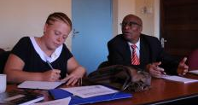
Methodology
design
field visit
January
April
August
October
On-line survey + OC 2010
Survey design
MFIs Responses
Follow-up
Coordination with local researcher
Verify online data received
Interviews + OC 2011
Tanzanian Institution Visit
Re-verified information
Obtain detailed OC 2010 & OC second quarter 2011
Contact with MFIs
Literature review
Local researcher hire
Contact with MNO
Impact of Mobile Money Services on MFI´s Operational Costs in Tanzania
data
Report
Notes:
METHODOLOGY
January to March 2011: Online survey designed for MFIs to gather introductory information and basic ratios, like those commonly reported to the MIX Market (www.mixmarket.org)
April to June 2011: Participating microfinance institutions (MFIs) completed an introductory online survey for institutional information.
July 2011: An Excel spreadsheet was sent to capture detailed operational cost information for year ending 2010 for each MFI.
August/September 2011 (Field Visit): The information received by the institutions was verified in person. At the same time, the Excel spreadsheet was filled out to capture operational cost information for the second quarter of 2011 to view any preliminary changes that may have been as a result of the implementation of mobile

Slide 4
Methodology
sample
Tanzanian MFIs
Tigo
37 Institutions
Zantel
MFIs
Airtel (Zain)
Vodacom
Our population:
MFIs Tigo clients
4 MNOs
Our sample:
Impact of Mobile Money Services on MFI´s Operational Costs in Tanzania
Notes:
CHALLENGES (MNOs)
The other three Mobile Network Operators (MNOs) in Tanzania were contacted and invited to participate in the research.
Zantel was not currently work with microfinance institutions.
Zain had recently been bought out by a foreign investor (Bharti Airtel) and was in the process of rebranding and remarketing.
Vodacom, although working with microfinance institutions (MFIs), did not specifically target MFIs as part of their strategic plan at the beginning of the research, though this appeared to be changing during the field visit in August/September 2011
MFI PROJECT PARTICIPATION
Of the original 13 MFIs, one (Meru Community Bank in Arusha) was still awaiting license from the Bank of Tanzania to operate and had not begun banking operations, let alone mobile banking operations at the time of the research.
Uchumi Commercial Bank did not secure Board of Director approval for the participation in the research project and was therefore excluded.
Dar es Salaam Community Bank lacked institutional interest over time and although began the research process, did not complete the online survey nor were able to be contacted during the time of the field visit.
As a result, these three institutions were removed from the list of participating MFIs, bringing the number of fully participating MFIs at the time of the fiel

Slide 5

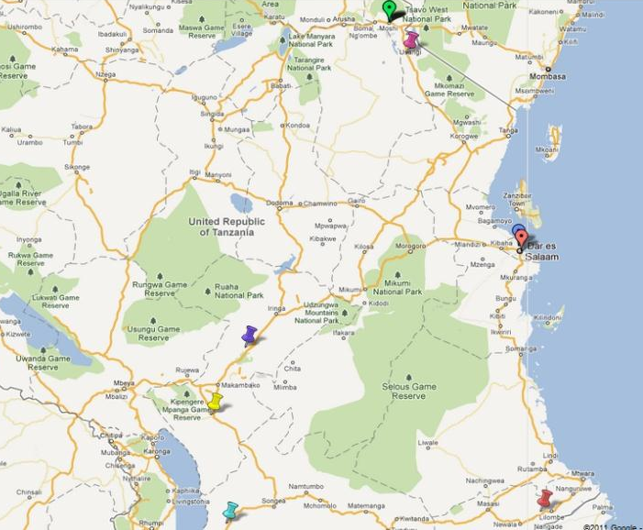
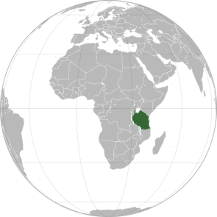

MFIs
Kenya
Kilimanjaro Cooperative Bank
Mwanga Community Bank
Moshi Rural Teachers SACCO
USAWA
(SACCOs network)
Tanzania
Efatha Bank
YOSEFO
Impact of Mobile Money Services on MFI´s Operational Costs in Tanzania
Mufundi Community Bank
Njombe Community Bank
Tandahimba Community Bank
Zambia
Mbinga Community Bank
Mozambique
Malawi

Slide 6

MFIs profile
Impact of Mobile Money Services on MFI´s Operational Costs in Tanzania

Slide 7
MFIs profile
# active borrowers
1,240
MRTS
SACCO
11,398
USAWA
Rural Unit Bank
15,000
Yosefo
Impact of Mobile Money Services on MFI´s Operational Costs in Tanzania
NGO
120
KCoB
50
TaCB
Regional Bank
233
NjCB
180
Efatha
Commercial Bank
9,000
MbCB
2,040
MwCB

Slide 8
Preliminary results
interviews
1. Benefits for MFI
Flexibility to adapt to client needs (44%)
Greater outreach to rural areas (30%)
New sources of revenue by commission (30%)
Greater number of clients (15%)
Impact of Mobile Money Services on MFI´s Operational Costs in Tanzania
44% of institutions responded that the flexibility to adapt to client needs leads to greater convenience for both the client and the bank, especially the ability to receive payments 24/7
Notes:
BENEFITS OF USING MB FOR MFI
44% of institutions responded that the flexibility to adapt to client needs leads to greater convenience for both the client and the bank, especially the ability to receive payments 24/7.
30% thought that mobile banking would lead to a greater outreach in rural areas.
30% said mobile banking would lead to new sources of revenue by commissions.
15% responded that the provision of mobile money services would lead to a greater number
Based on responses from three qualitative interviews carried out during the field visit in August/ September 2011 when asked “What are the advantages of using mobile banking in your institution?” to loan officers, a member of the financial department and the general

Slide 9
Preliminary results
interviews
2. Challenges
Network issues: from stability to IT integration (52%)
Training and marketing: who is going to assume the costs? (49%)
Forced loyalty: working with only one MNO
Implementation of MB: when will it start for loan repayments?
Impact of Mobile Money Services on MFI´s Operational Costs in Tanzania
Notes:
CHALLENGES of Mobile Banking in MFIs
52% of those interviewed thought technological issues were the biggest challenge: electricity is unstable, the network is slow and unreliable, there is the chance of human error and the lack of IT integration of mobile banking systems into the record keeping of the MFI.
49% felt that there would be increased cost in capacity building and other costs for the MFI:
Marketing: Creating user awareness of the service
Training (Internal and External): Staff training and user training – user training lowers loan officer efficiency
Forced loyalty – When MFIs are obliged to only work with one MNO, they risk losing clients (as well as commissions) as clients may be using another operator
Agent only mobile banking
An important challenge was the lack of full implementation of mobile banking in the participating microfinance institutions.
Due to a variety of constraints, the MFIs had, at the time of the field visit, begun implementing mobile banking as an agent - for clients of the institution to send and receive money with the MFI collecting a commission for these transactions, but not for the disbursal and collection loans.
Further information about how mobile banking may affect the operational cost structure such as transport, marketing, telecommunications and more should be more prominent once mobile banking is used with greater frequency for the disbursal and collection of loans. Furthermore, the opportunity cost for clients not having to travel to the bank should also be considered.

Slide 10
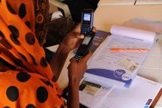


Conclusions
So far there have not been any studies on the impact of MB on OC of MFI
        This study could be the first one!
Limitations
        Lack of full implementation of mobile banking in Tanzania
        Time and resources
Good information and data for future studies
        Data base line study (2010) – before MB implementation
        Complementary data needed after implementation (2013? / 2014?)
Impact of Mobile Money Services on MFI´s Operational Costs in Tanzania
Notes:
NO MOBILE BANKING
An important challenge was the lack of full implementation of mobile banking in the participating microfinance institutions. Due to a variety of constraints, the MFIs had, at the time of the field visit, begun implementing mobile banking as an agent - for clients of the institution to send and receive money with the MFI collecting a commission for these transactions, but not for the disbursal and collection loans.
Only agents in Tanzania. Just only 1 institution with disbursal/collection loans: Tujijenge.
Two pilots: USAWA and Josefo

Slide 11
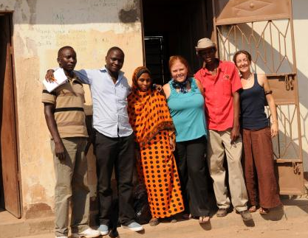
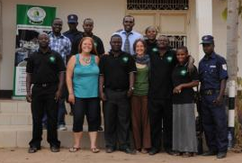
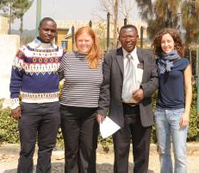
Thank you !
Impact of Mobile Money Services on MFI´s Operational Costs in Tanzania
Our sincere appreciation goes to:
Miguel Beer (Grant Proposal Assistant in Belgium)
Peter Martin Kivumbi (Local Research Assistant in Tanzania)
Chris Statham (Mobile Money Consultant in Tanzania)
Jaime Duran (Country Expert and Survey Assistance in Spain)
Eric Meijer (Innovation Manager at MIC Tanzania, Ltd.)

