Slide 1
Best Practice in Mobile Microfinance
Fatima Yousif
IMTFI Annual Conference for Researchers
6-7 December, 2011
IMTFI, University of California, Irvine

Slide 2
Table of Contents
Background
Objectives of the Study
Scope & Methodology
Definitions
Key Challenges
Key Opportunities
Summary of Key Findings
Guidelines for MFIs

Slide 3
I. Background
Mobile technology is one of the fastest growing industries of the last decade.
In 2010
2.7 billion (72%) of adults living in developing countries were unbanked.
1 billion unbanked own a mobile phone
By 2012
1.7 billion unbanked adults will own a phone
Source: 2010 CGAP report “Measuring Financial Access Around the World”

Slide 4
I. Background
For MFIs, mobile technology has the potential to provide a a cost effective manner to increase their outreach.
Yet, only a limited number of MFIs have managed to convert a significant number of their clients to using mobile services.

Slide 5
II. Objectives of the study
Using qualitative and quantitative survey techniques (focus groups, direct interviews, online survey, and literature reviews) the study aims to:
Identify best practices for enabling new microfinance adopters to advance innovation faster;
Understand the best approach and business model for bringing clients on board;
Understand which products and services have been successful using the mobile channel to meet the poor clients’ needs;
Provide research-based guidelines to inform mobile microfinance practice and policy; and
Identify factors critical to successful mobile microfinance adoption and to develop guidelines and recommendations for MFIs.

Slide 6
III. Scope & Methodology
The study targets MFIs that have rolled out mobile financial services for at least a year.
An online survey was sent to over 100 MFIs world-wide.
Direct interviews were conducted with MFIs and financial institutions in Kenya, Cambodia, Pakistan, South Africa, Tanzania and India.

Slide 7
III. Scope & Methodology
MFIs interviewed
Faulu (Kenya) Musoni (Kenya) SMEP (Kenya) Kadet (Kenya) Opportunity International (Kenya) MicroAfrica (Kenya) Keef (Kenya) Bee (South Africa) | Tujijenge (Tanzania) ACLEDA Bank (Cambodia) Tameer Bank (Pakistan) NWTF (Philippines) SOMESH (India) Cashpor (India) AMK (Cambodia World Vision Fund (Cambodia)

Slide 8
IV. Definitions
Mobile financial services (MFS) – encompass a range of financial services:
Mobile banking services
Domestic and international remittances
Mobile payments

Slide 9
V. Key Challenges
Low agent penetration. Few countries have a sufficiently developed agency network to effectively support mobile financial services.
Diverging business strategies between MFIs and MNOs. MNOs are focused on first stage products such as transfers or bill payments thus microfinance services are not a priority.

Slide 10
V. Key Challenges
Mobile phones are frequently shared. This poses a challenge for properly identifying and implementing the necessary checks and controls, including KYC measures.
Low literacy levels– Current applications rely on text, which poses a challenge to microfinance clients.

Slide 11
V. Key Challenges
Low transaction limits. The ceiling on both transactions and virtual wallets are kept low by regulators in order to mitigate risks (fraud, ALM, CFT). This in turn limits the MFIs ability to fully answer to the demands and needs of their clients.
Lack of funding and/or capacities for market research. Few of the MFIs have the resources or the capacity to conduct a full cost-based analysis (CBA) or in-depth market study prior to implementation.

Slide 12
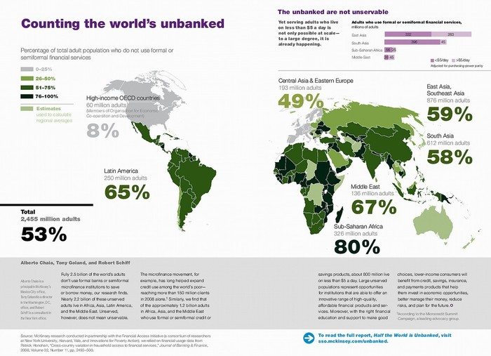
VI. Key Opportunities
A fast growing mobile subscription rate coupled with a still high number of unbanked adults in developing countries.
Source: McKinsey – FAI study (2009)

Slide 13
VI. Key Opportunities
A fast growing mobile subscription rate coupled with a still high number of unbanked adults in developing countries.

Slide 14
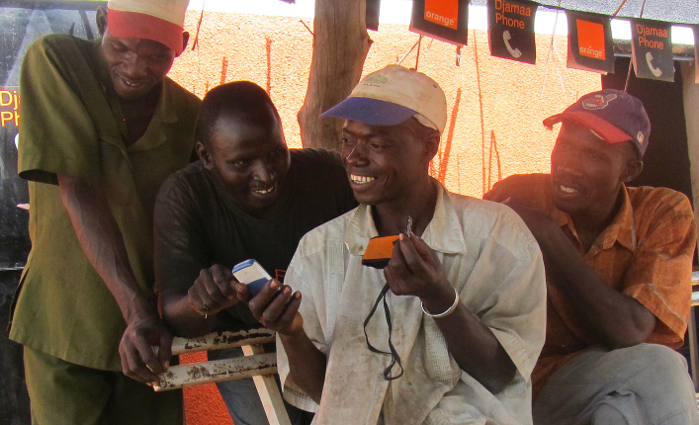
VI. Key Opportunities
Client innovation. Clients are the greatest source of ideas for developing mobile products.
Innovations in technology of mobile devices. Mobile device development and innovation is among the fastest in the IT industry.

Slide 15
VII. Summary of key findings
A market led by mobile network operators (MNOs).
68.75% of the respondents of our online survey were operating in markets where MNOs had led the development of mobile payments.

Slide 16
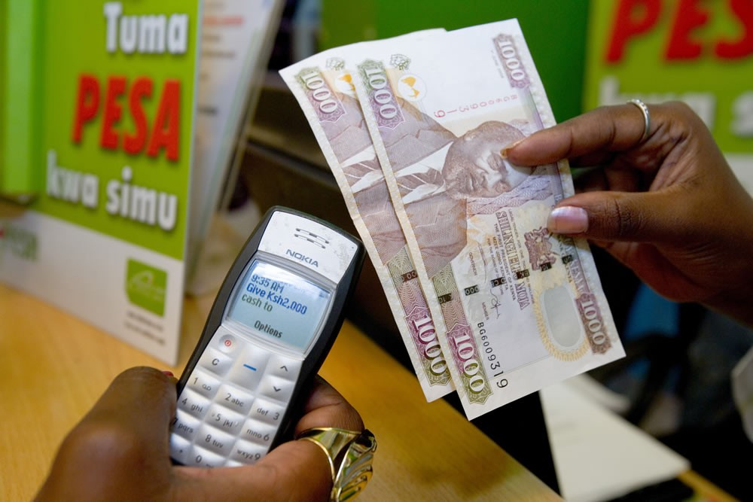
VII. Summary of key findings
A market dominated by money transfers. The provision of loans and savings products remains shy compared to money transfers, with only a handful of MFIs having rolled out loans and credit services.

Slide 17
VII. Summary of key findings
A market that is urban and peri-urban. MFS clients are primarily located in proximity to agent distribution points, most of which are located in cities or around cities.
IT/MIS integration is one of the greatest challenges faced by MFIs today. In order to successfully implement mobile financial services, MFIs need to have stable core banking system which then needs to link into the transactional payment platform. This is a challenge both in terms of funding and capacities.

Slide 18
VII. Summary of key findings
Insufficient investment in market research and pilots. Few MFIs take the time to carry out cost-based analyses, market research or pilots prior to implementing MFS.
Insufficient in-house training and communication. The lack of sufficient training and communication strategies has led to adverse effects on the uptake of mobile services.
A “wait-and-see” approach by MFIs. MFIs tend to observe market leaders in order to follow in their footsteps.

Slide 19
VIII. Guiding principles
Have all 10 on the same screen and give talking points. No two market environments are exactly the same
Business models are not always easily transferable
What works in a particular country at a particular point in time is not necessarily replicable in another
Do not copy & paste
Understand your market environment
Communicate, communicate, communicate
Choose your implementing partner wisely

Slide 20
VIII. Guideling principles
Have all 10 on the same screen and give talking points. No two market environments are exactly the same
Business models are not always easily transferable
What works in a particular country at a particular point in time is not necessarily replicable in another
Invest time in developing your distribution network
Test your product
Monitor your product
Collaborate with regulators

Slide 21
Thank You!
Fatima Yousif
IMTFI Annual Conference for Researchers
6-7 December, 2011
IMTFI, University of California, Irvine

