Slide 1
Families, Groups and Mobile Money in Kenya
Sibel Kusimba
Northern Illinois University
Harpieth Chaggar
Maseno University
Brenda Kingi
Resident, Tezo
Gabriel Kunyu
Egerton University
Mercy Masika
Resident, Naitiri
Andrew Nakhisa
Moi Girls School, Kamusinga, and Kenyatta University
Brian Njalale
Moi University
Social Network Analysis:
Elizabeth Gross
University of Illinois-Chicago

Slide 2
Mobile
Money
Kinship Networks
Uses and Cultural Meaning of Remittances
Cultural Practices around Wealth and Money
Changing Family Relationships

Slide 3
Research Locations
Western Kenya:
Kimilili, Bungoma County
Naitiri, Bungoma County
Kitale, Trans-Nzoia County
Coast Province:
Tezo, Kilifi County
USA: Immigrants from Western Kenya in Chicago, Kansas, and Philadelphia
Collected between 50-100 questionnaires in each study area
Interviews with more than 100 persons

Slide 4
Families of Western Kenya
Patrilineal descent and inheritance
Rapid social and economic change
Extended family bonds
10% of urbanites have bank accounts
More than 50% of adults have a phone
80% are subsistence farmers

Slide 5
Mobile Money in Western Kenya
MPESA and others
Began 2007
More than 15 million subscribers
Common Uses
Send money to friends and relatives
Uncommon Uses
Pay business partners, suppliers and employees
International partnership with Western Union
Buy / send airtime using mobile phones
Phone “bank”
Link to banking services, e-commerce
Pay fees and bills

Slide 6
Remittances in Western Kenya
Urgent Needs
Transport,
Food, Medical, Debt, Airtime,
School fees
Everyday Expenses
Food,
Rent, Airtime
School fees
Social Payments
Funerals,
Coming of Age

Slide 7
The Social Value of Airtime

Slide 8
“He is very useful around here. He takes care of me. The other day he bought me a gas cooker. He can call even once a week. Sometimes we can talk for one hour.”
---64 year-old in Kimilili, son in Kansas

Slide 9
Personal/Private
Collective/Group
“Me”
“Us”

Slide 10
Personal/Private = “Me”
Individual /private decisions regarding spending, saving, family remittances
“Empowerment of Women”
International Remittances – “Broker” role

Slide 11
Social Network Analysis
In the past year….
5-9 persons
Kin, friends
To whom do you send money?
From whom do you receive money?
Repeat questionnaire with MM partners

Slide 12
Atieno Family

Slide 13
Juma Family

Slide 14
Juma Family
GEneration
Types of Kin

Slide 15
Sides of the Family
Maternal ties
Paternal Ties

Slide 16
MM networks show “uterine kinship”
--Margery Wolf, 1972
Men and women participate equally
Expands to relatives often on mother’s side
Based on mothers, their children and grandchildren
Includes close friends
Contrast with patrilineal claims to tangible resources

Slide 17
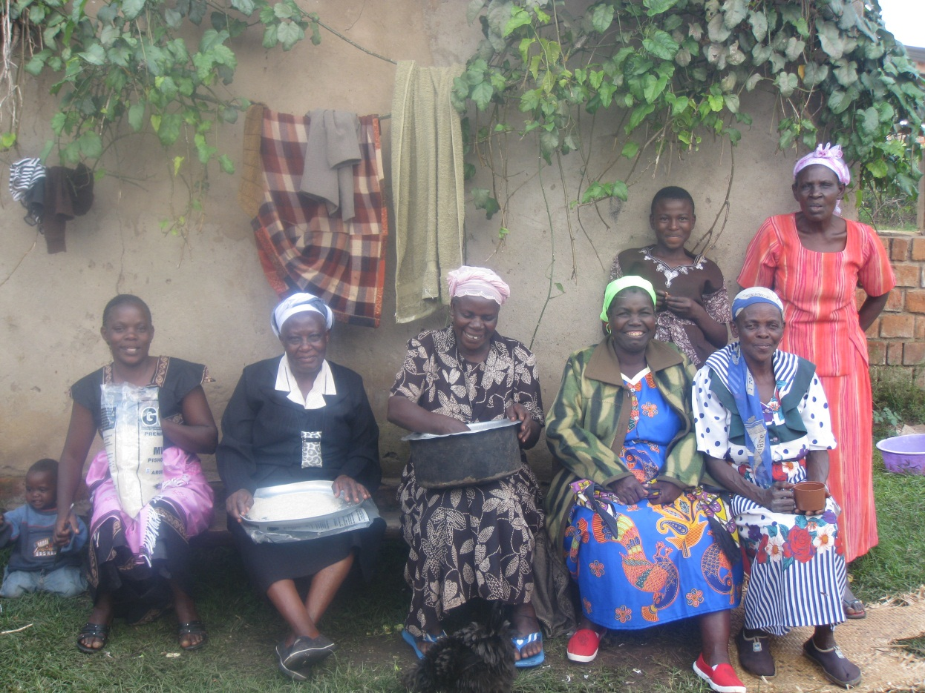
“Us”: Family Associations

Slide 18
ROSCAs

Slide 19
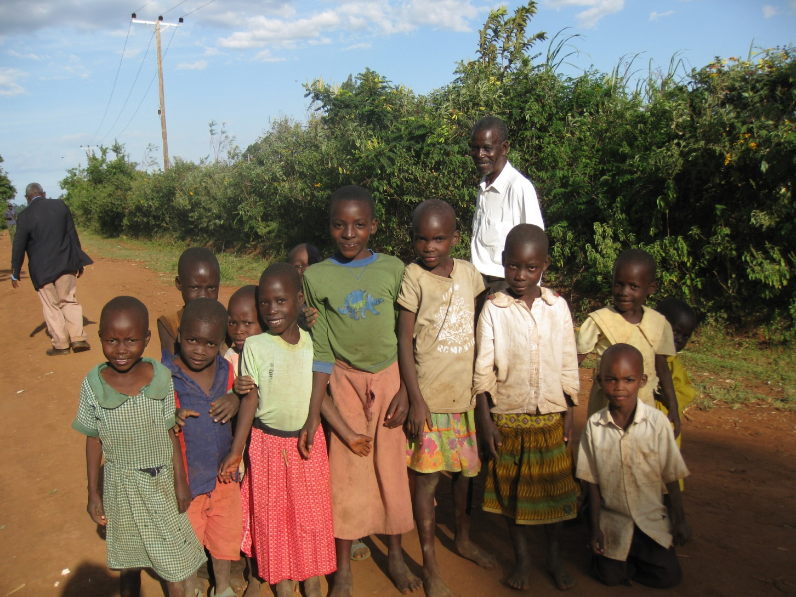
The Future of Mobile Money: ROSCAs and Family Associations

