Slide 1
Revisiting the fishers of Kerala
Jenna Burrell
Richa Kumar
Janaki Srinivasan
Notes:
Explanation in relation to IMTFI session on “mobile money”…looking not at mobile phone as platform for actual transfer of value (ala mobile money) but for disseminating timely ‘information’ about the value of goods, in particular - price information – as variable and fluctuating element in decision-making about trade. Of what utility is this ‘pure’ information?
Our first encounter with our field site (fisheries and fisherfolk of Kerala) through an influential journal article, a journal article that notably is not in our own discipline, but in economics - JENSEN. One that has become canonical in the field of ICTD.
Q – how many have heard somewhere (mass media or in academic work) this assertion – that mobile phones help farmers / fishermen to get better market price information
Q – how many have heard of Rob Jensen’s study of the fishers of Kerala?
We see a connection between the concern of this article with … a pithy statement in widespread circulation (in the field of ICTD research and practice) – that farmers or fishermen (agricultural laborers) use mobile phones to acquire market price information and are thereby able to (a) get a better price for their goods and (also sometimes claimed) (a) bypass exploitative middlemen. We wanted to investigate this notion further in light of some doubts about the universality of this claim raised in our own fieldwork in other sites.

Slide 2
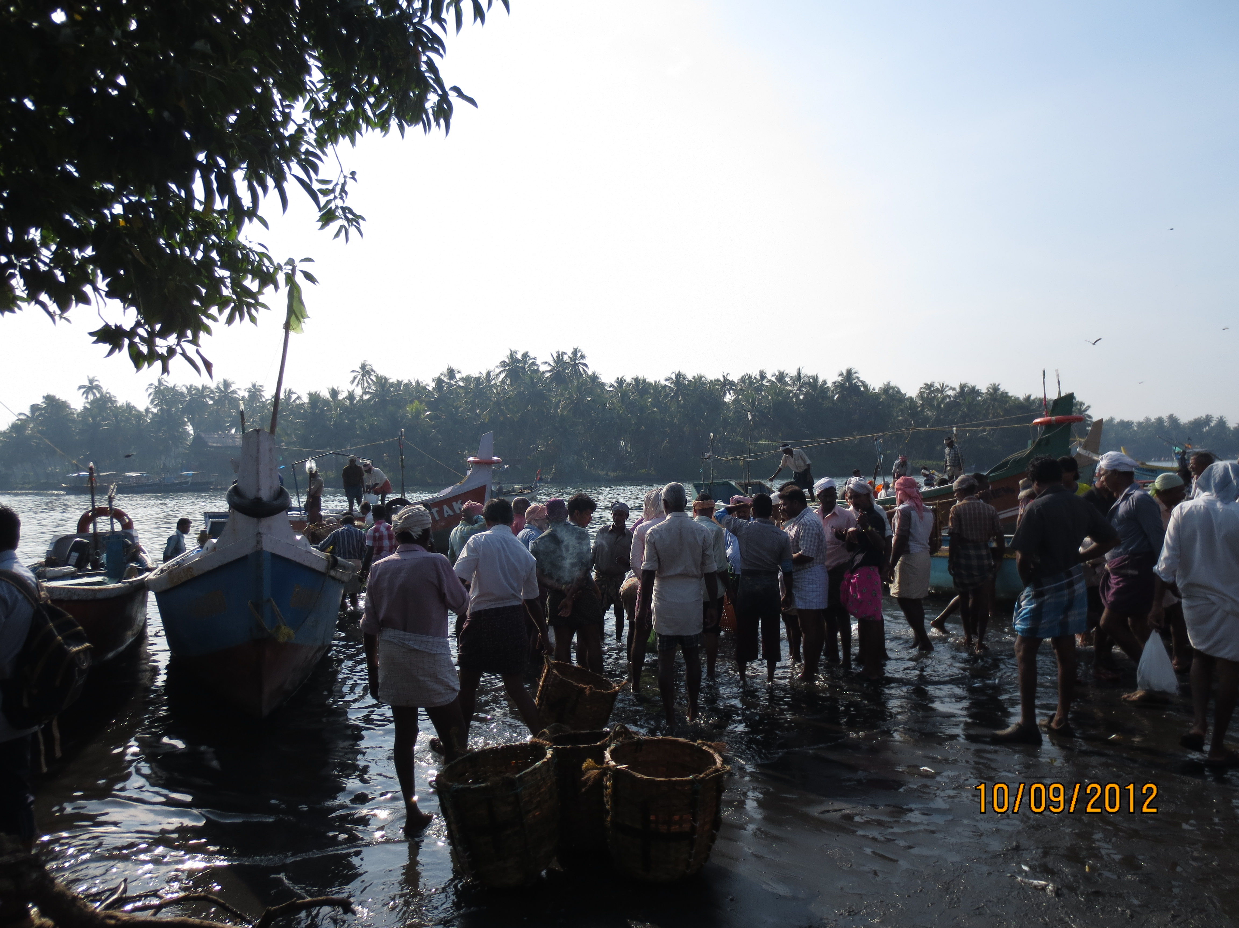
A parsimonious model
representing a complicated reality
Notes:
Explanation of the Jensen piece – “the Digital Provide”… a parsimonious model.
Where and what did he do?
Findings: Reduction of price dispersion
Reduction of wastage
Increase in total welfare – large fishing units benefit, but so do small fishing units in terms of higher profits, whether or not they actually use a phone
We used this article as a starting point … in particular, we were attentive to its way of representing that field site. Setting ourselves up to be surprised as we pursued a kind of comparative analysis between the model (which set our initial expectations and understanding of fishing in Kerala) and the field site, the empirical situation from which the model was derived.
Pursued as an ethnographic case study, recently returned from the field (last month) and only begun delving into the analysis.
One difference was our attempt to apprehend more directly the actual practices of phone use (whereas Jensen works backwards from indirect evidence to determine the practice that generates it, through measures of price acquired for sardines changing before and after the phone). Toward ethnographic holism – trying to account for the whole story of the region, economic, political history, as situated in the world. Moving along spatial as well as temporal dimensions. To unpack the elements, to render complex.
Not a ‘check’ on forms of economic accounting for the purpose of ‘disproving’ … the parsimonious model and the ethnographic case study are not directly commensurable… but can be put in dialogue.
But for what purpose would we make a mess out of a compelling and clear model? To address the question of generalizability, a conversation perhaps closed down and concluded prematurely (or perhaps never really seriously undertaken).
We raise and attempt to answer a question that is by no means unique to our own disciplinary approach, that interests economists as well… what are the conditions that make the mobile phone useful for sourcing and comparing market prices in ways that improve trade-related decision-making and have an effect on market efficiency? Finding ultimately that fishing in north Kerala is a quite special case, growing list of those ‘conditions’ inclusive of many issues that go beyond what Jensen identified. We examined fishing in south Kerala to find that these conclusions did not always hold there.

Slide 3
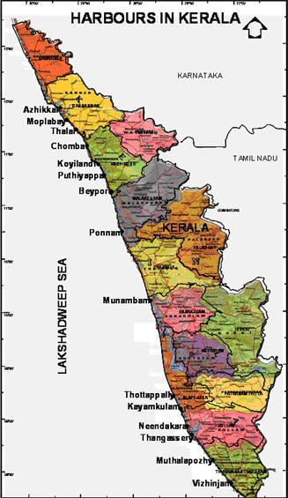


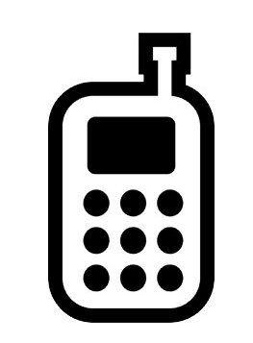
The setting and the actors
(from Jensen’s paper)
North Kerala
Producer/ seller
sardine
Consumer/ buyer
Notes:
Based on jensen’s study, these are the actors, and the categories they represent that populate a fish market in north Kerala. It is in this scenario that mobile phone make an appearance.
Two things to note: the focus here is on a single fish variety, Sardines, that were/are mostly consumed domestically and therefore were not part of the fish export supply/marketing chain. Second, gender is not accounted for in the model, and where gender is mentioned, actors are presumed male.
We will bring up these themes and complicate the broad categories of Jensen’s paper in the following slides.

Slide 4
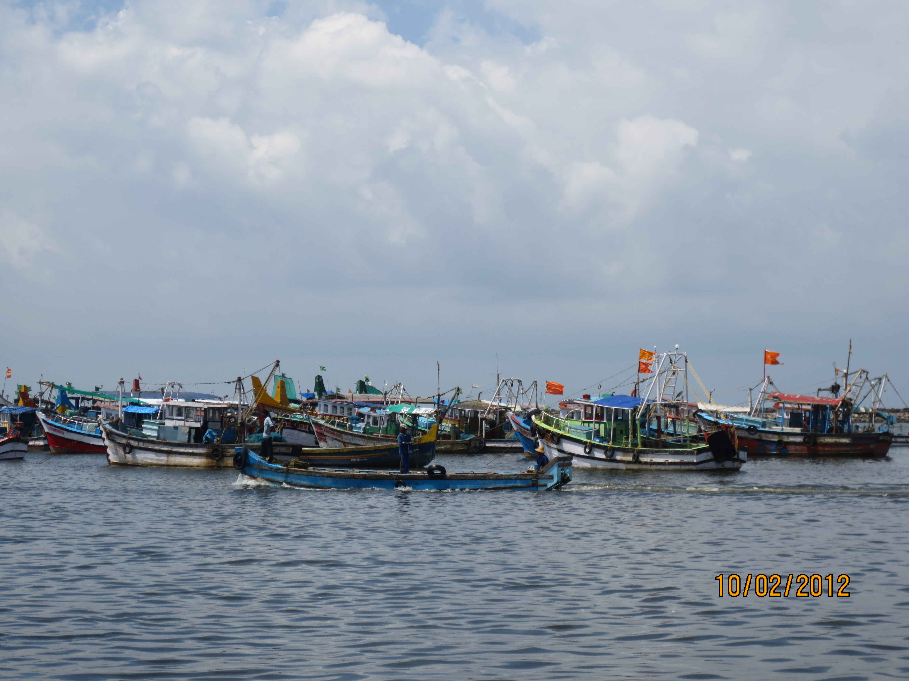
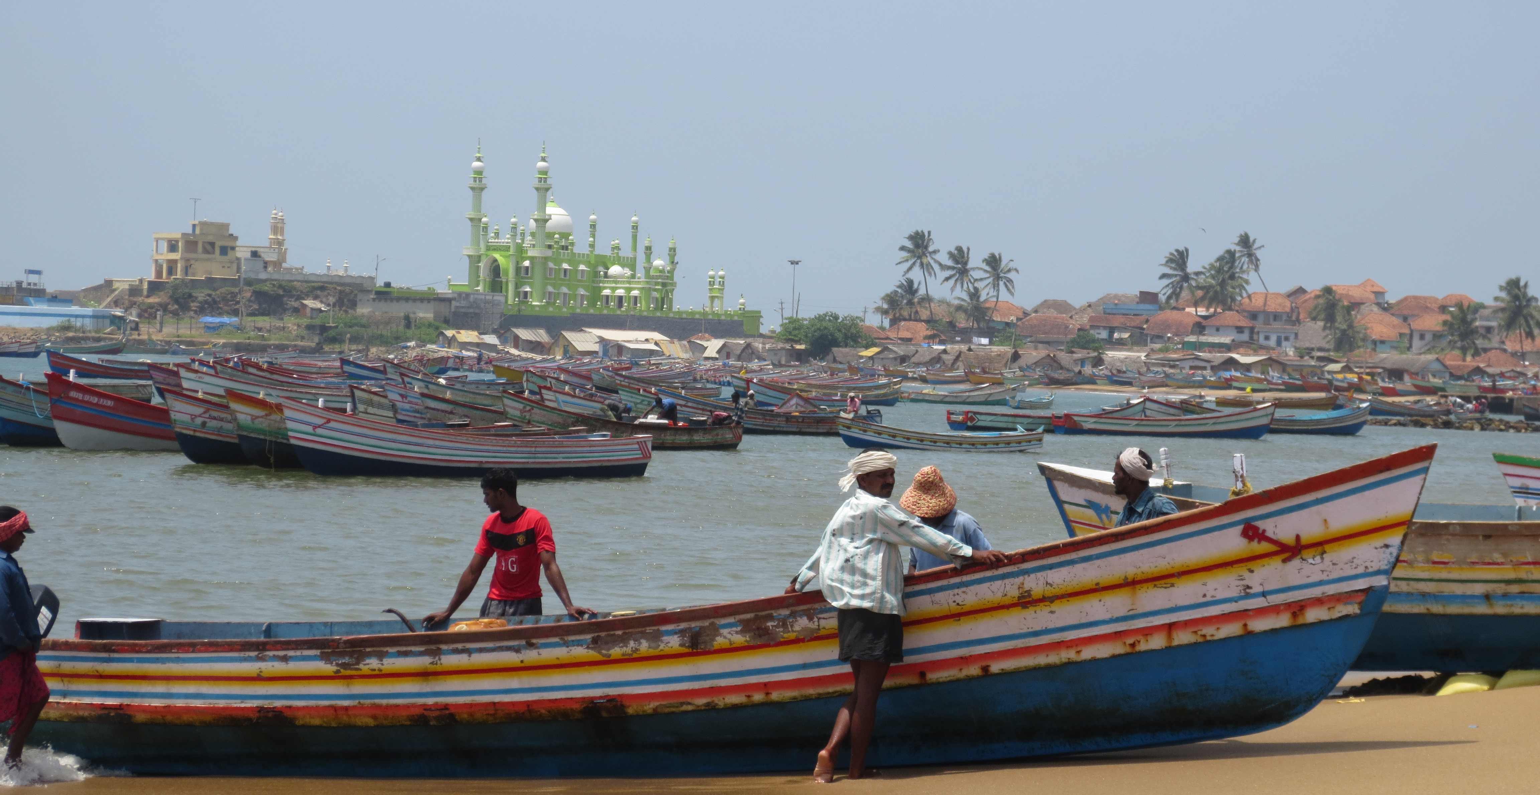
Our Field Sites
Notes:
With our research, we set about doing two things. To understand a more complex picture of the fishing sector in north Kerala itself. And then to see whether/how that was different than in other places even within Kerala. To do this, we spent three months understanding the dynamics at a fish landing center in north Kerala, in Kozhikode district and another in south Kerala in Trivandrum district.
Two important differences between fishing in north and south Kerala to keep in mind from the start:
The northern coastline is sandy, while the southern is rocky. The south also faces more adverse conditions during the monsoons, making many of its fish landing centers seasonal.
The fishing communities in the Northern Kerala district are predominantly Muslim, while in southern Kerala are Christian.

Slide 5
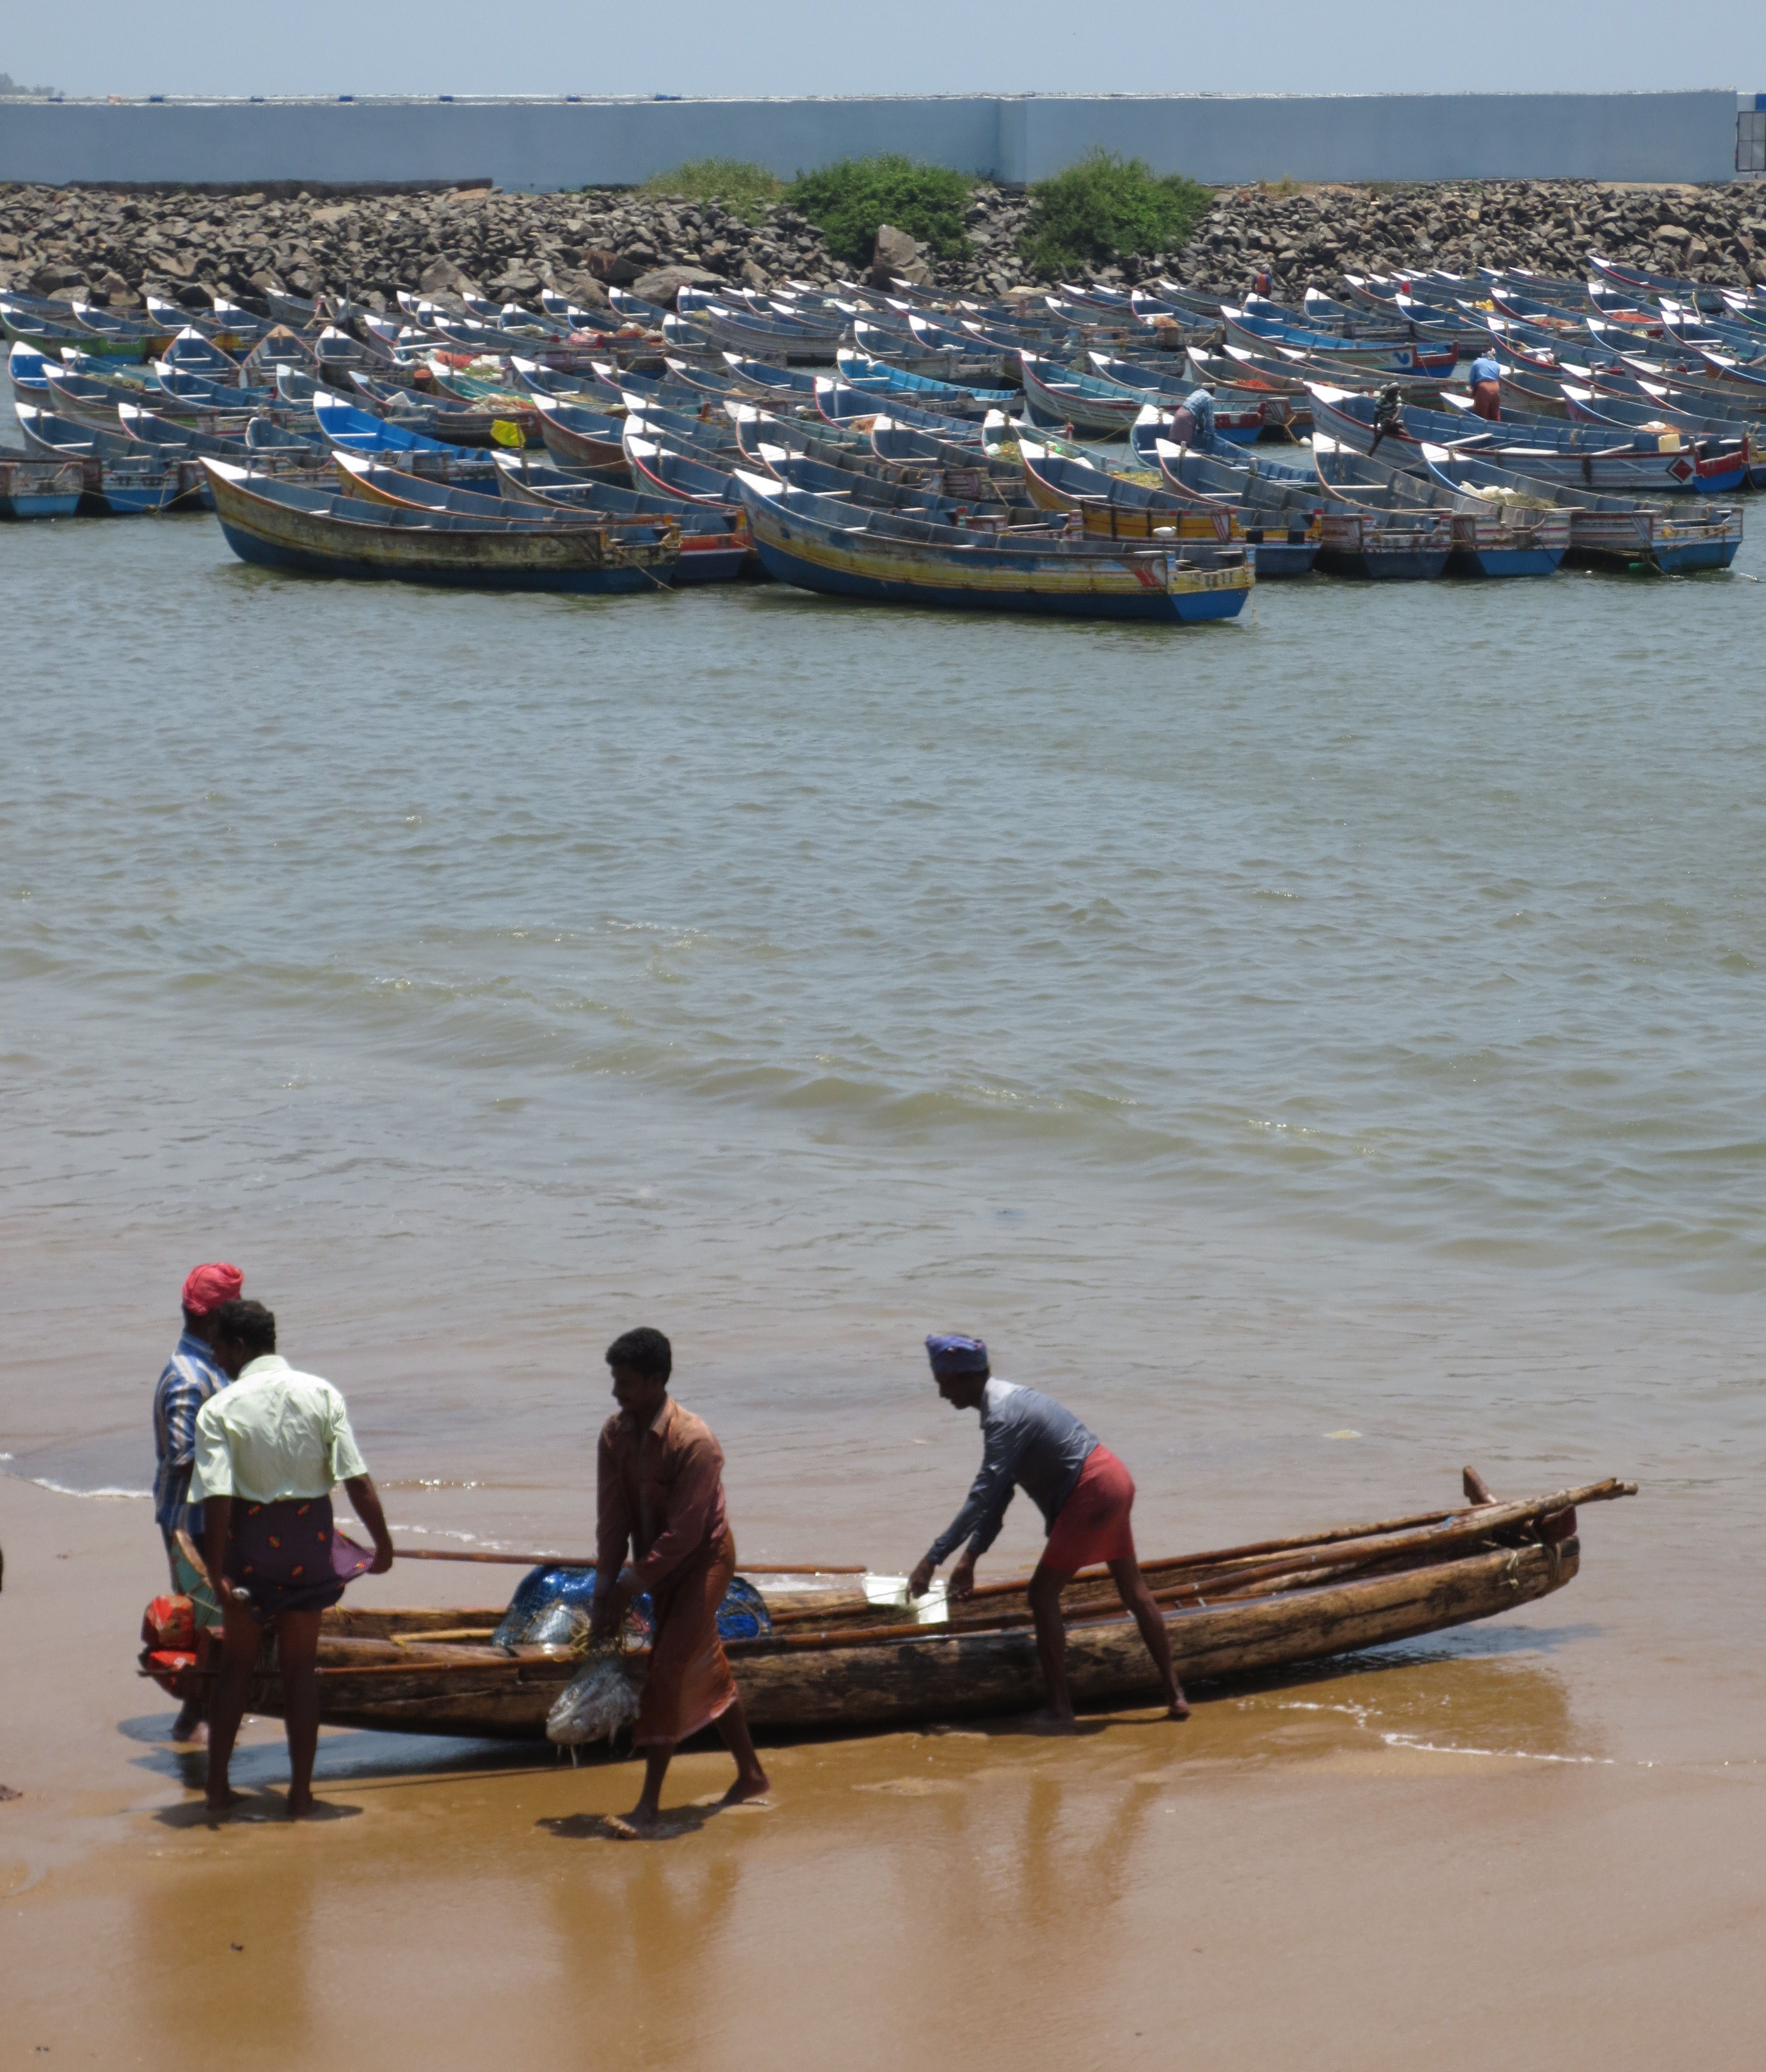
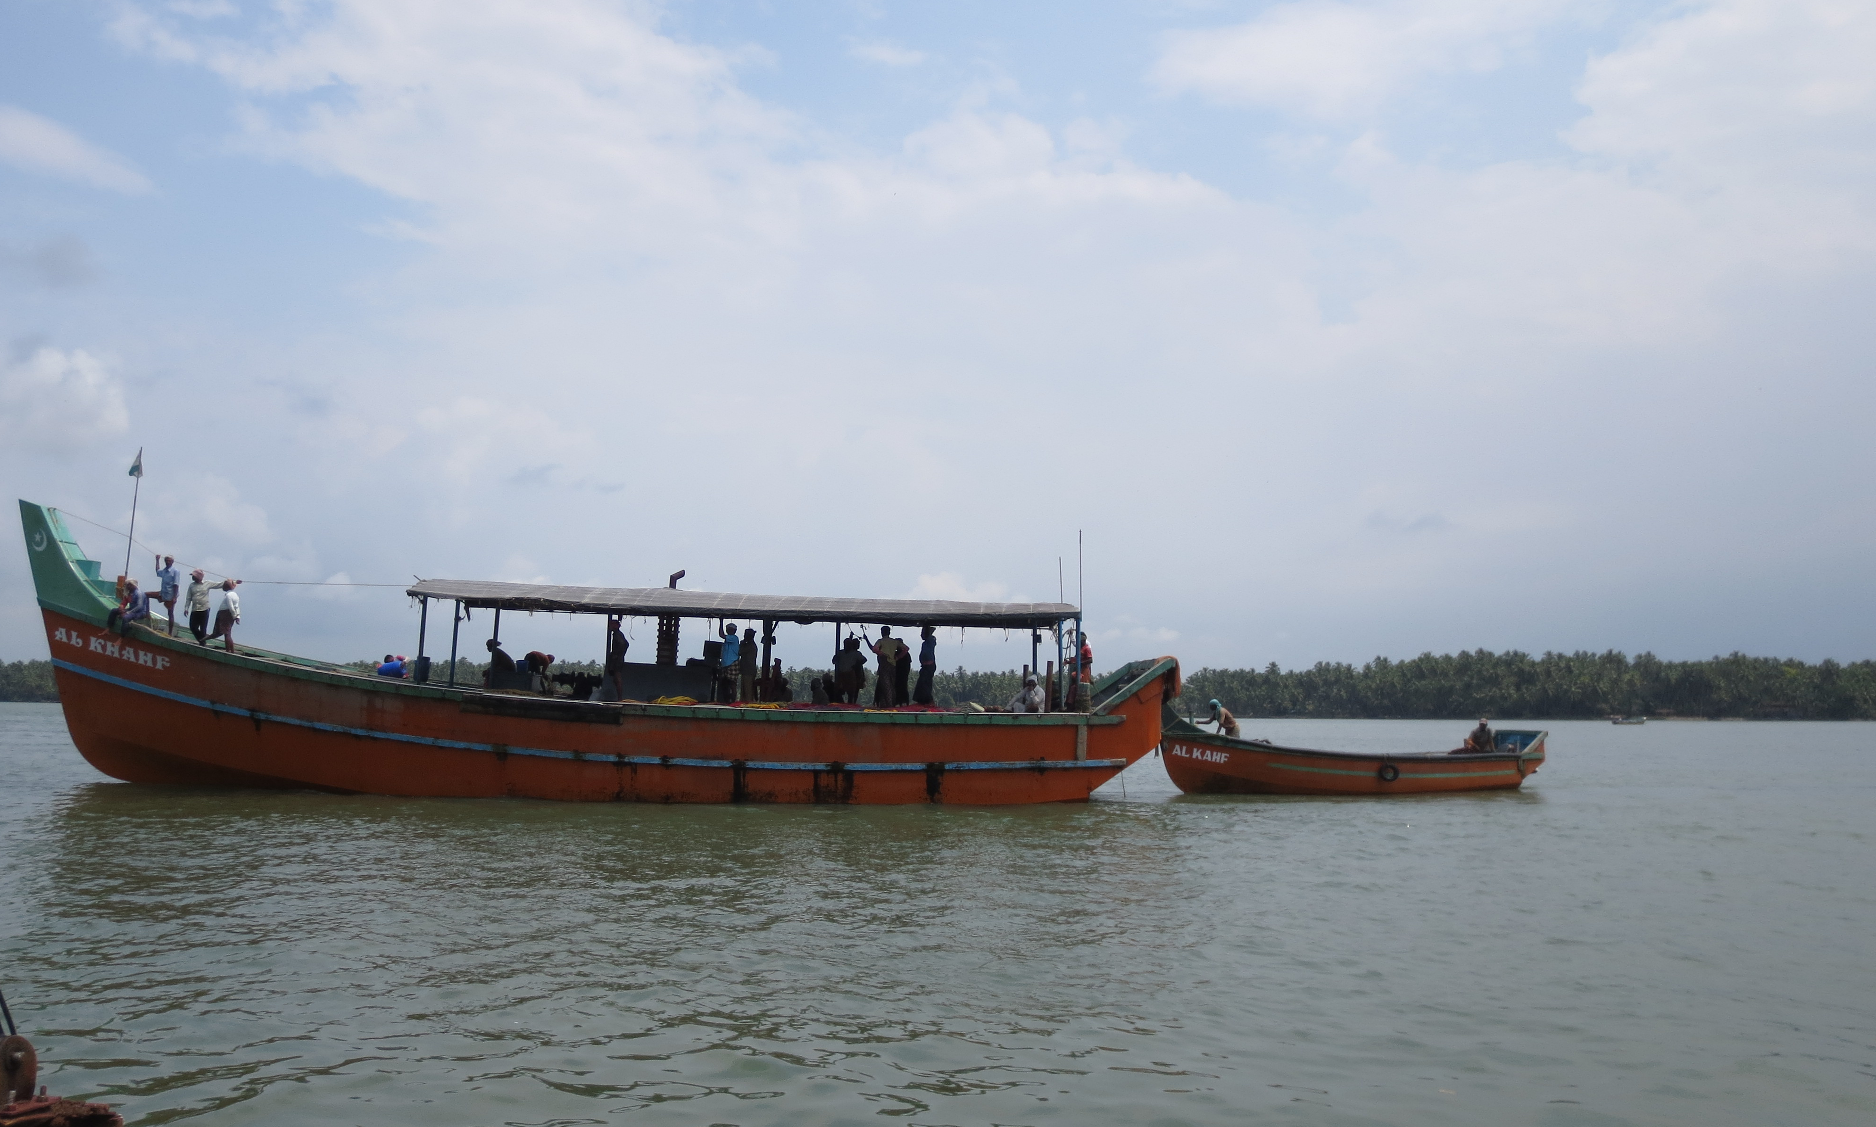
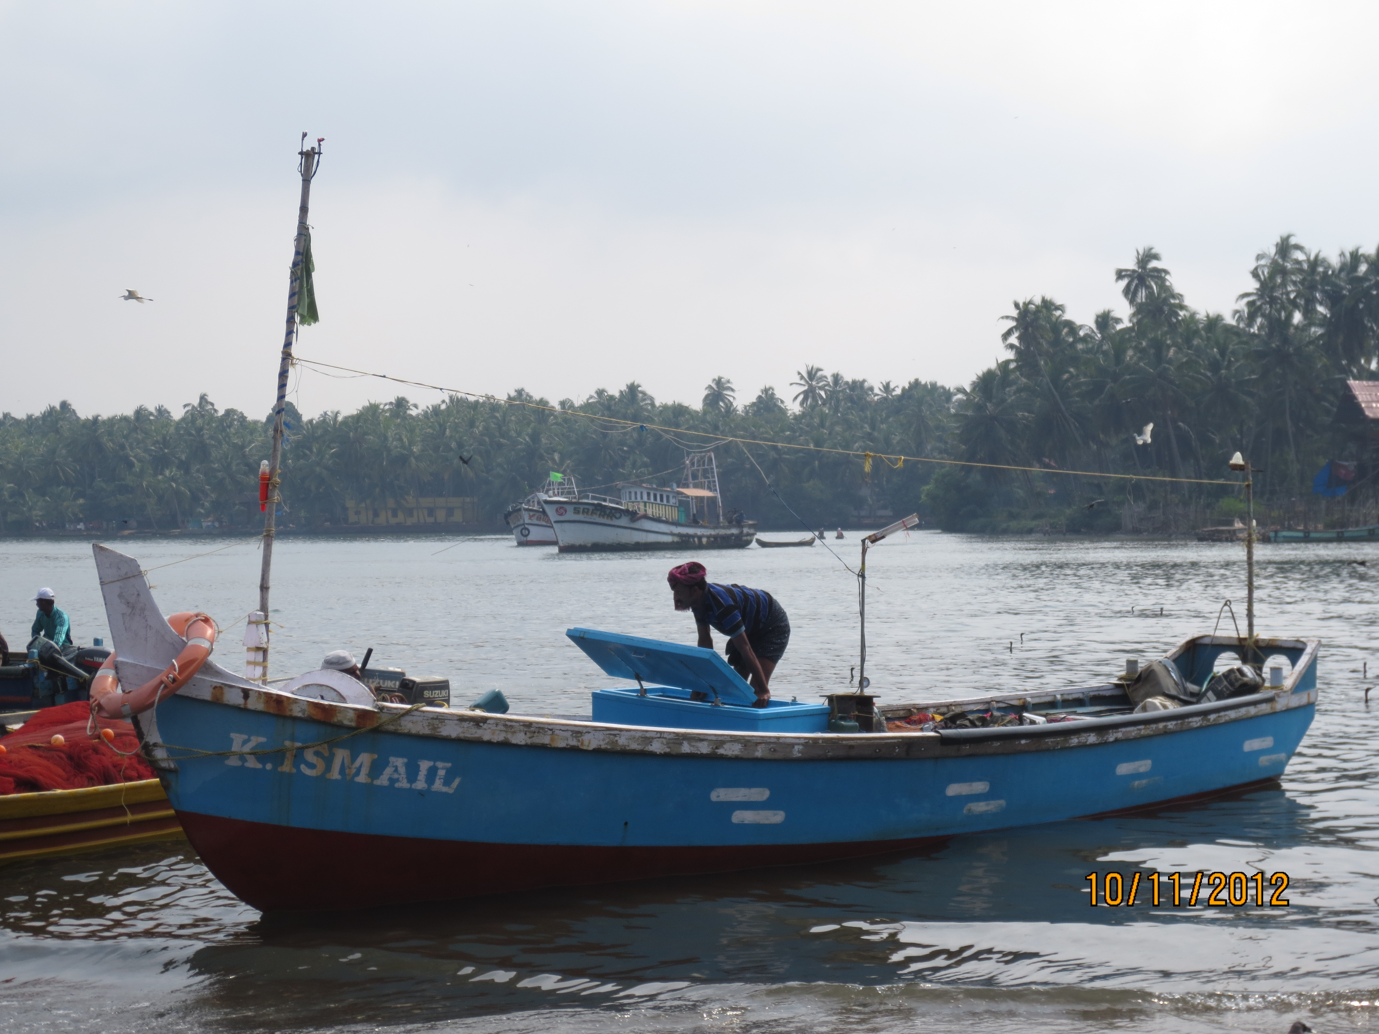
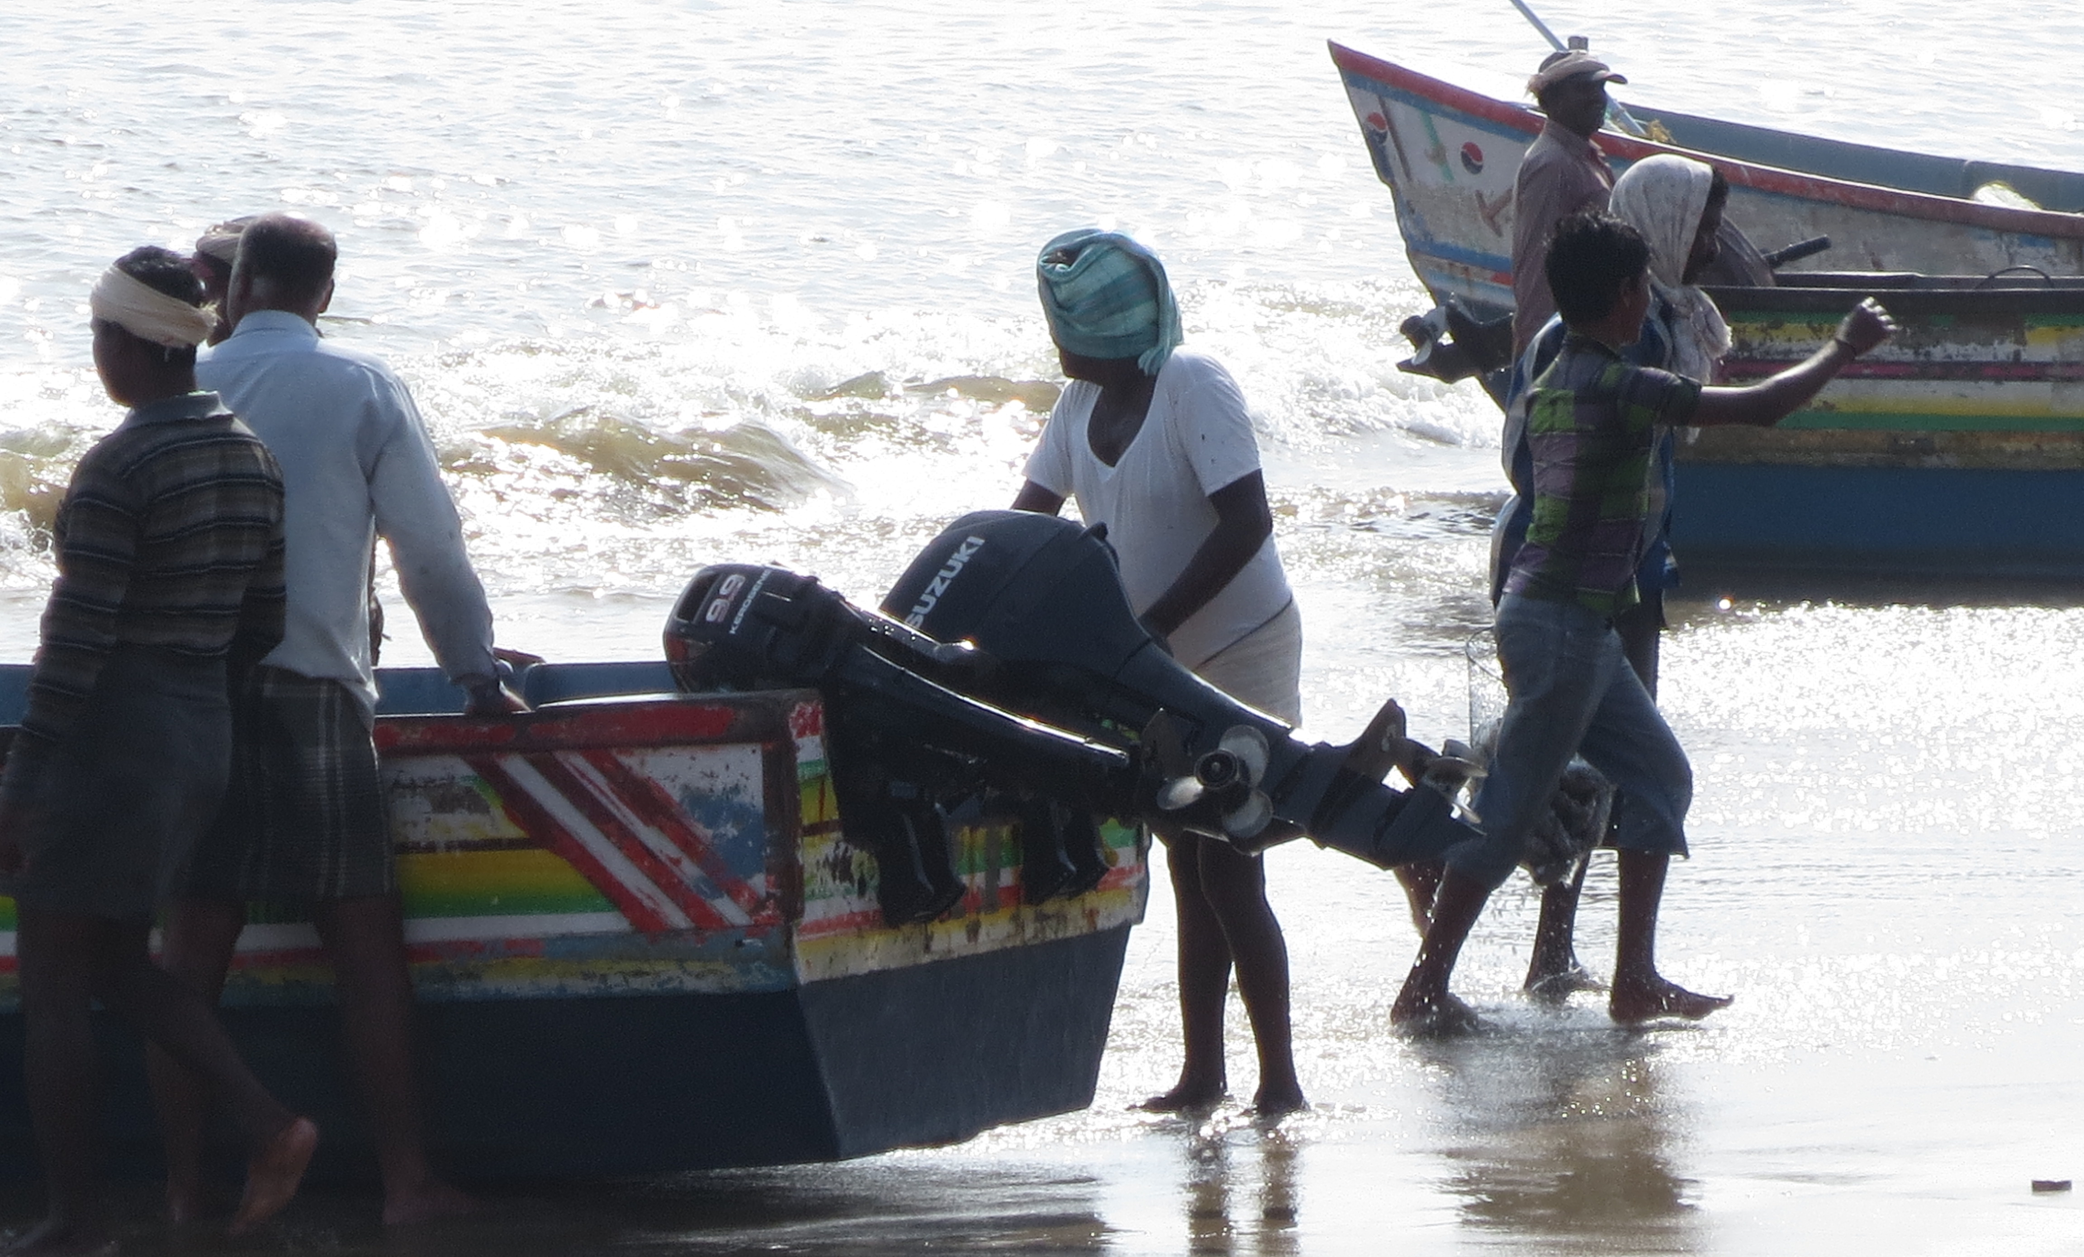
“Producer/Seller”
Notes:
At both sites, we found that producers/ sellers or buyers/consumers were hardly a single category. “Sellers “ may be fishers operating any of these fishing crafts (catamarans, ring-seine, gillnetters with internal engines, plywood boats with outboard engines, also trawlers not shown here) and using a variety of gear- hook-and-line, gillnets, ring-seines, trawlnets that catch different fish varieties that inhabit different depths (pelagic, demersal). These different craft-gear combinations bring in different loads, as well different varieties, and are purchased/operated based on different credit relationships. For a variety of historical and geographical reasons, north Kerala fishers use larger boats that draw larger catches than in the south. You can see in the top row a ring-seine boat, which has a crew of 60-70 people and can have catches of between 3-12 tons, mostly sardines. The other boats used in the region are the mechanized gillnetters that have a crew of 3-4 people, and bring in 1-1.5 tons of fish, including different varieties like tuna, prawn, squid and larger fish. The south coast has much smaller boats that have a crew between 2-10, where the catch is at most in 100s of kilograms and consists of greater variety in every boatload. The investment on the larger boats of the north is correspondingly more and per trip sales is also more.
*going back to the idea of differences within the category of producer/seller, there is also the difference between a boat owner and boat crew. The boat belongs to a boat owner who has invested some money in it and also arranged for other investments on the boat. The crew does not own the boat. This is important to keep in mind because the revenue from the sale of fish accrues differently to owner and crew.
*The North Kerala shoreline is muddy (not rocky) and the continental shelf in this region slopes gently and extends a longer distance. The southern shore has a rocky bottom, and the shelf drops sharply- trawlers and larger boats can’t be used here. The monsoons beat down harder in the south, making some landing centers unusable during the monsoons and also making it necessary to have much hardier sea crafts (the cattamaran).

Slide 6
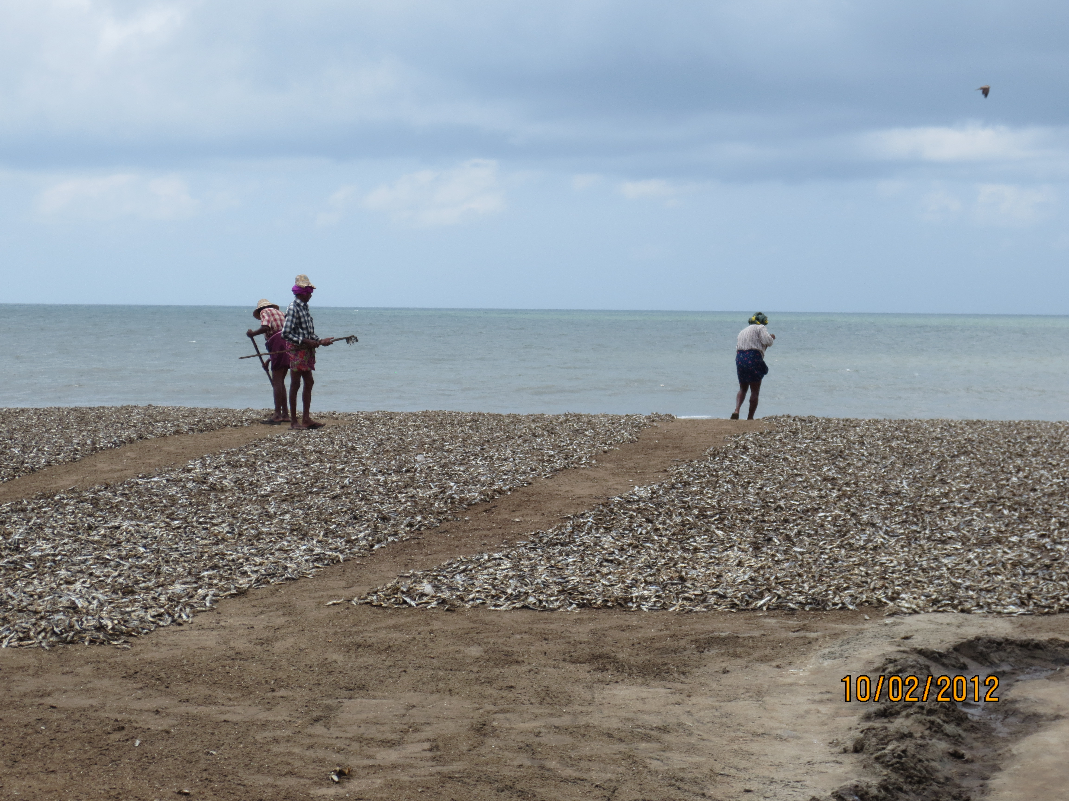
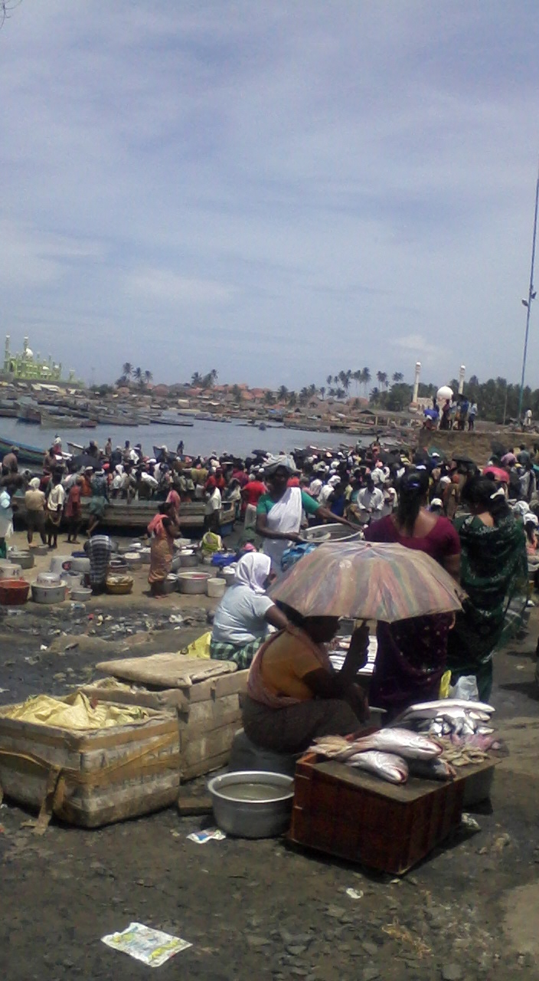
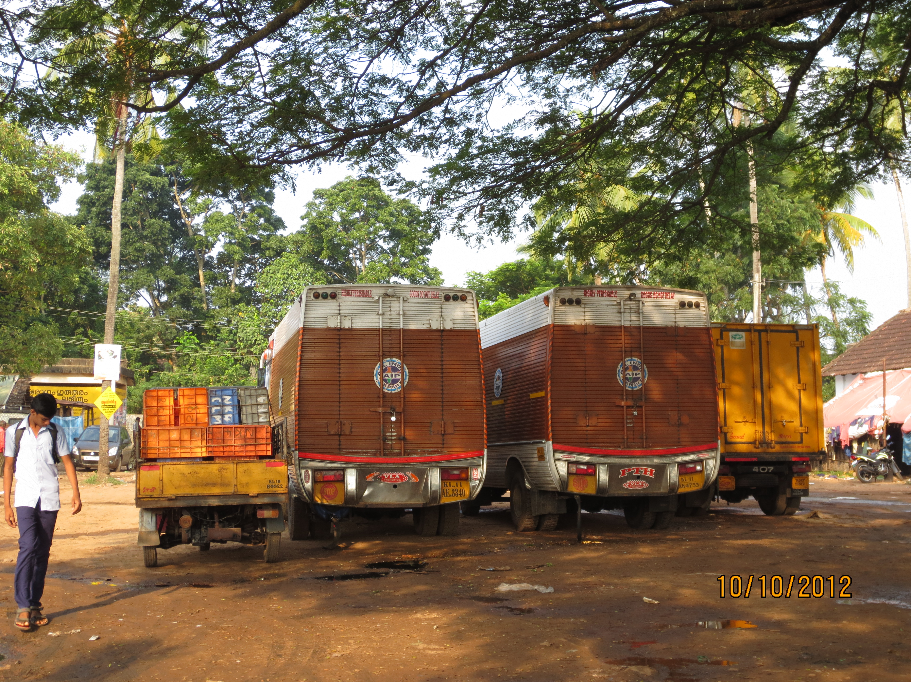
“Consumer/Buyer”
Notes:
If producers/sellers are not a single type, nor are buyers. In both the south and the north, these may be small vendors, who sell on the beach, in retail markets or go house to house selling. May be people who salt or dry fish,or take fish to waste processing factories. It may be wholesale merchants or exporters who take the fish in large insulated trucks.
Here again, there are differences between the predominantly Muslim north and the Christian south. Women are not engaged in the sale of fish in the Muslim fishing communities in the north, while a large number of women are fish vendors in the south. This also possibly explains why women are never mentioned in Jensen’s paper since he focused on the north. Gender is an important factor for us because we saw that the constraints and resources available to women were very different than for the men in the fishing sector, and because these differences these individuals’ activities as fish vendors, including their use of mobiles.

Slide 7
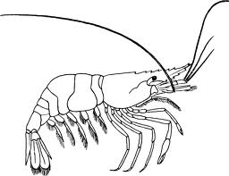
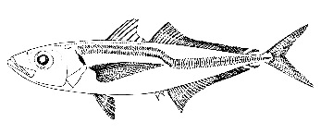
Categories of Producers
Types of fish
Categories of Consumers/Buyers
Producer
Sardine
Consumer
Scavenger
Church tax collector
Export agent
Invests
Auctions
Wholesale agent
Investor- Auctioneer
Fish vendor
Waste processors
Notes:
We found that the actual picture of the transactions at both sites looked more like this. There was a producer, who could belong to one of several kinds of producers that were different in north and south Kerala. There could be many kinds of fish, again somewhat different in the two sites. In both and north Kerala, these fish would be auctioned not by the producer but by an auctioneer, a new actor and one we didn’t see in Jensen’s paper. This auctioneer in most cases was a person who had invested in the producer’s equipment- boat, motor, nets, repair- in return for the right to auction and a % commission on the sale of fish. while the fisher-auctioneer relationship is not the strictest of creditor-debtor relationships, fishers are expected to sell their fish mainly through their auctioneers (unless there’s no fish in the area). When an auctioneer auctions the fish, it is then bought by a range of buyers, who we have already talked about .
Another new actor- scavenger, perhaps the only actor who wasn’t part of an auction. An extra actor in the south was a tax collector who collected a church tax from both seller and buyer on every transaction.
Not all of these categories of buyers and sellers even possess mobile phones, and undoubtedly, those who do use it in strikingly different ways.
Before we get to the use of mobile phones, let us examine how important price information is in these transactions. It is different for different actors. Let us examine just the fishers and see how these differ between north and south Kerala, and between small and large fishers in a region. Now, as I mentioned earlier, investments in the north tend to be much higher because of the larger boats in use (can be 12-15 times the investment in the south). Each boat thus has multiple investors. These investors are often drawn from multiple markets, so that the fishers have a trusted auctioneer in different markets. In addition, all-season landing centers are also closer together on the northern coast than in the south. What all of this means is that fishers find it feasible to consider selling at other nearby markets if the difference in profits by doing so is large enough. For the boats bringing in larger catches, even a small difference in price in two markets can make a huge difference; not so much for the smaller boats. As a result, the fishers for whom price is most important even in the north are those fishing in ring-seine boats and trawlers. A minor point is that the fishers who wish to find price, call their auctioneers or the tax collector, and not the buyers directly.
In the south, where investments are lower, most boats have only a single person invest in them and auction for them. As a result, they are expected to sell at the auctioneer’s beach to the extent possible (seasonal changes in fishing grounds is excusable). As a result, these fishers are not really interested in prices at other markets.
Similarly, there are difference between buyers in the north and the south, as well as between small and large scale buyersin both sites.
*Note also that while I am talking only of actors in the beach market today; the sale of fish is a much longer chain beyond these first points of sale. At each of those points, the question of how price is determined/ how important it is/ how phones are used in the process will have to be considered.

Slide 8
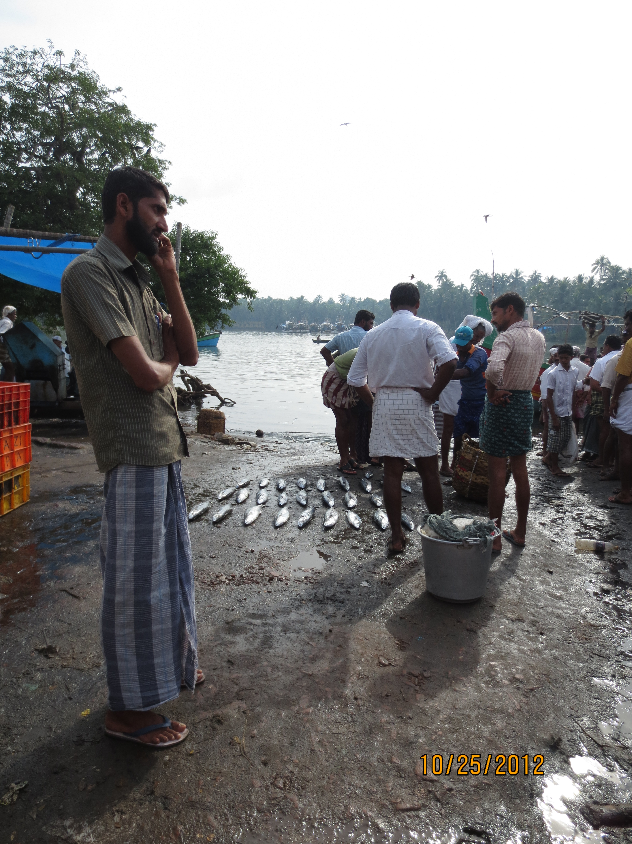
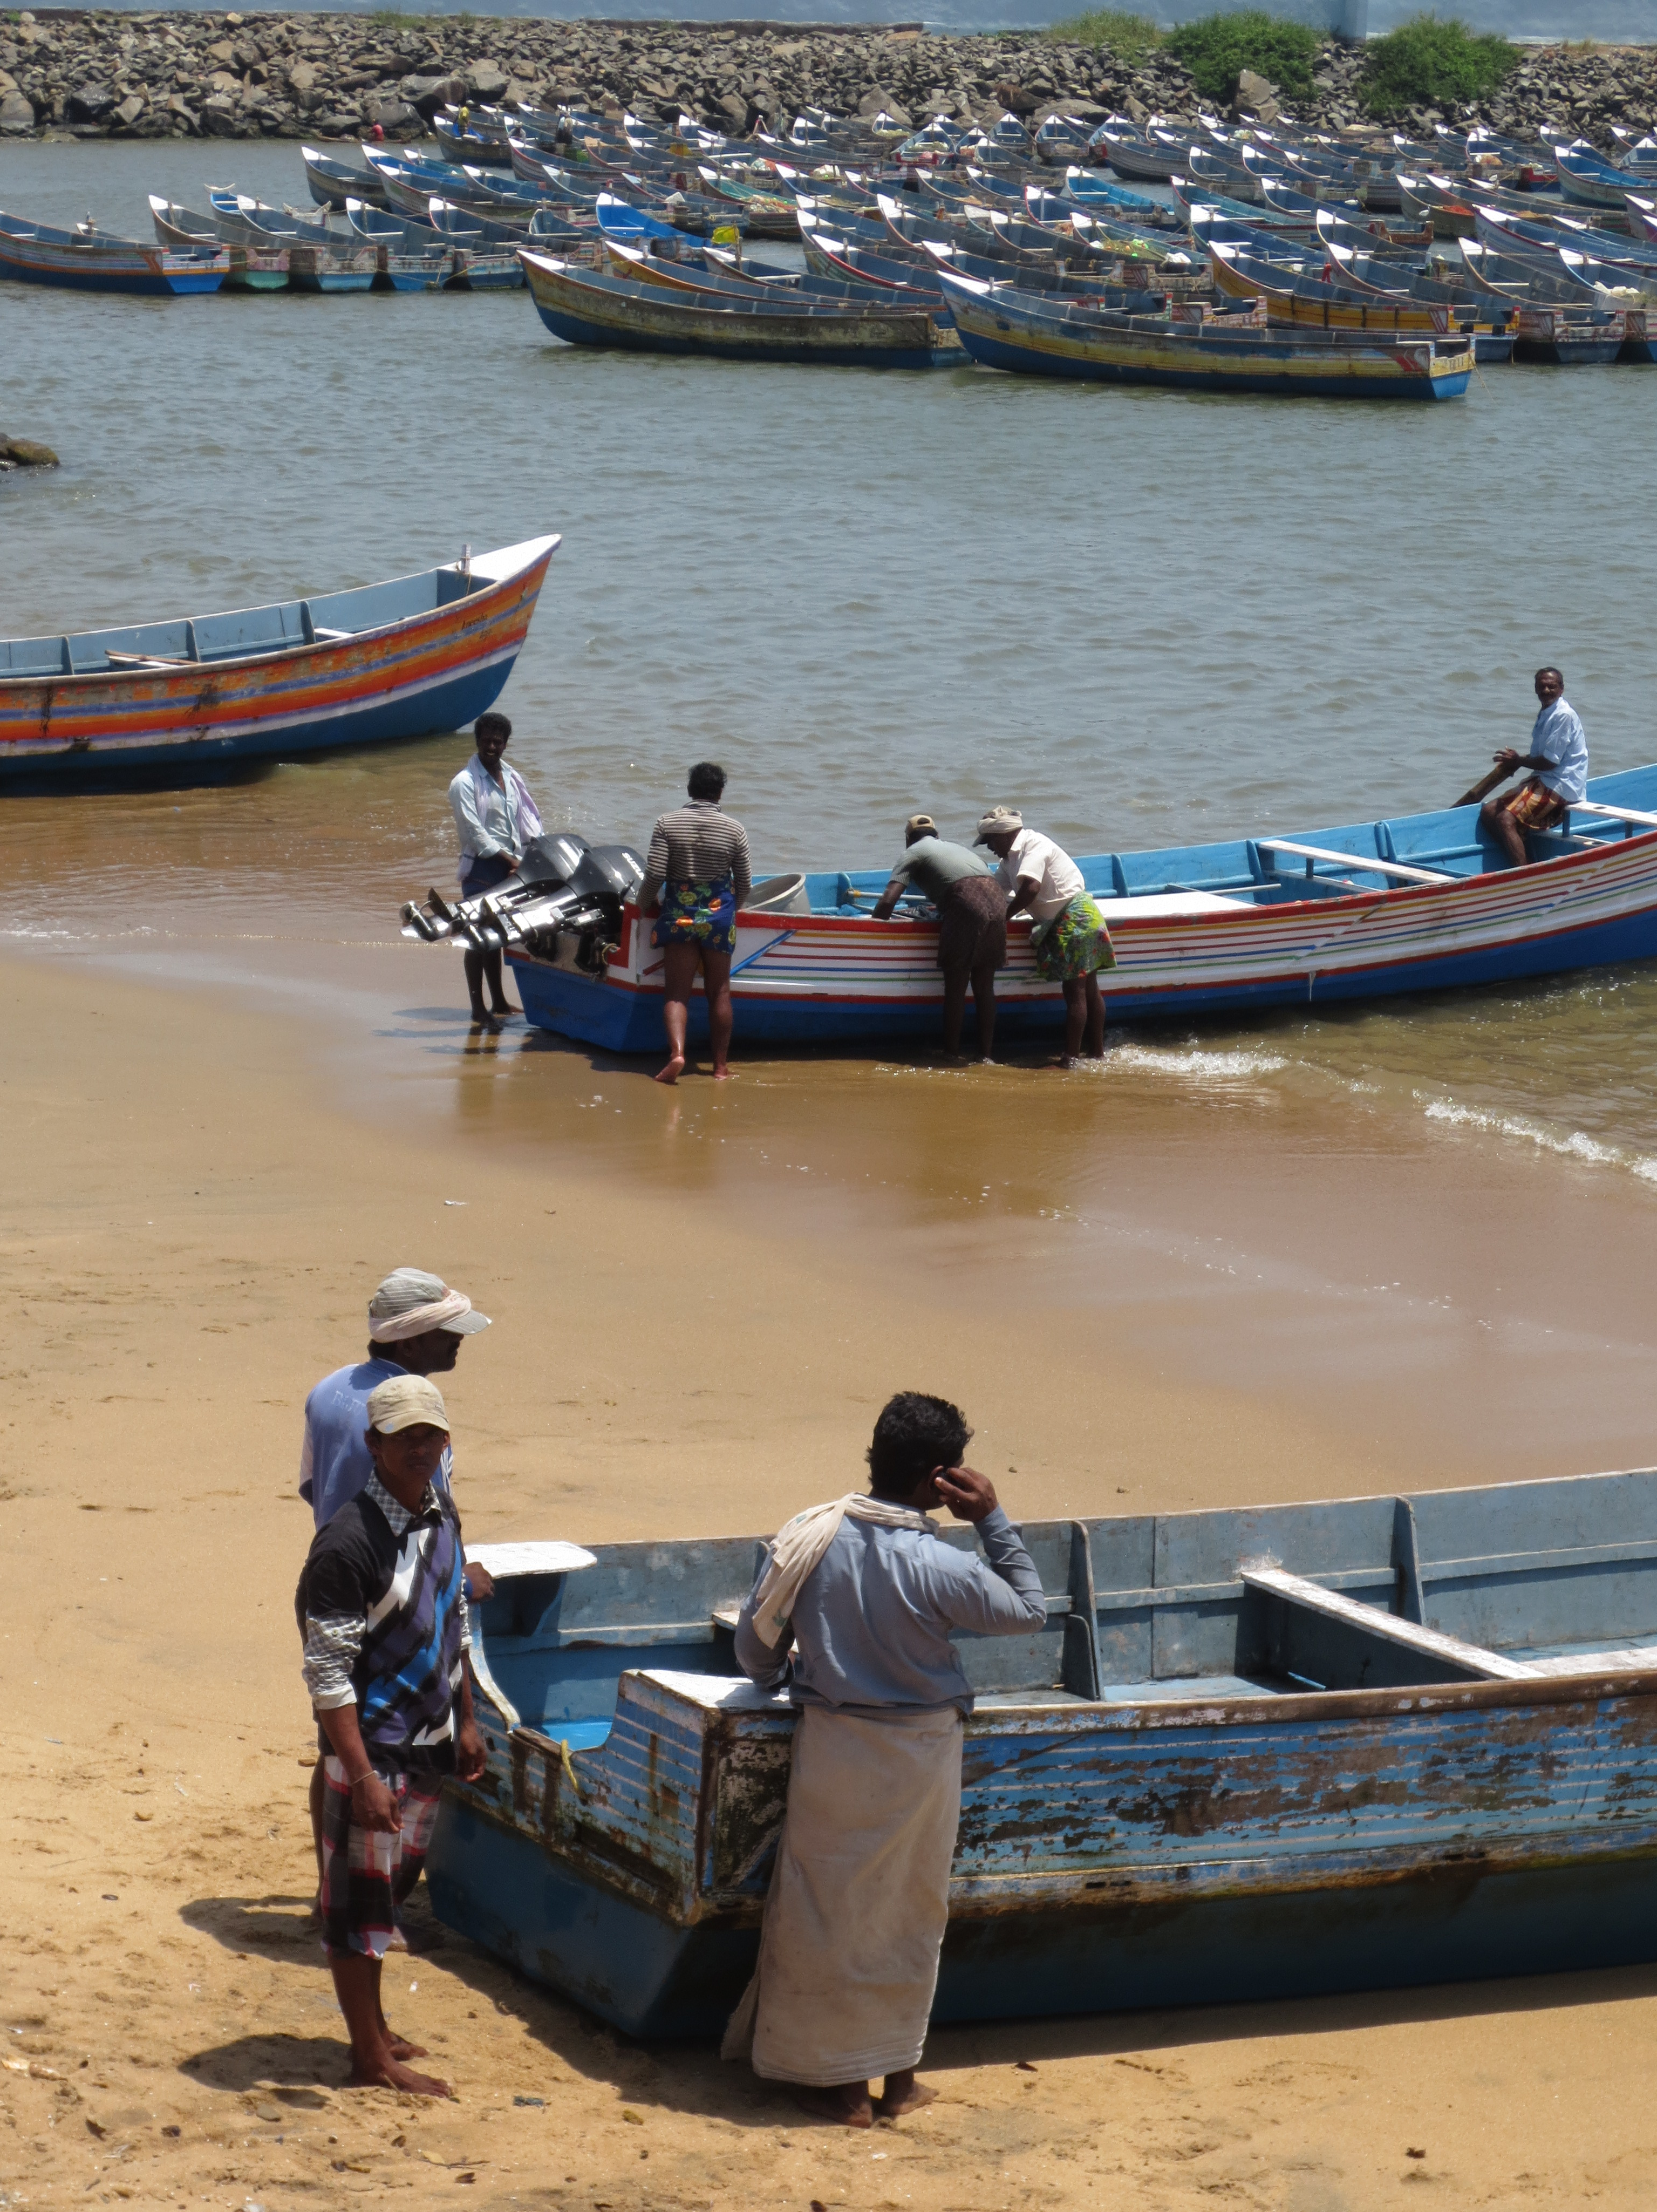
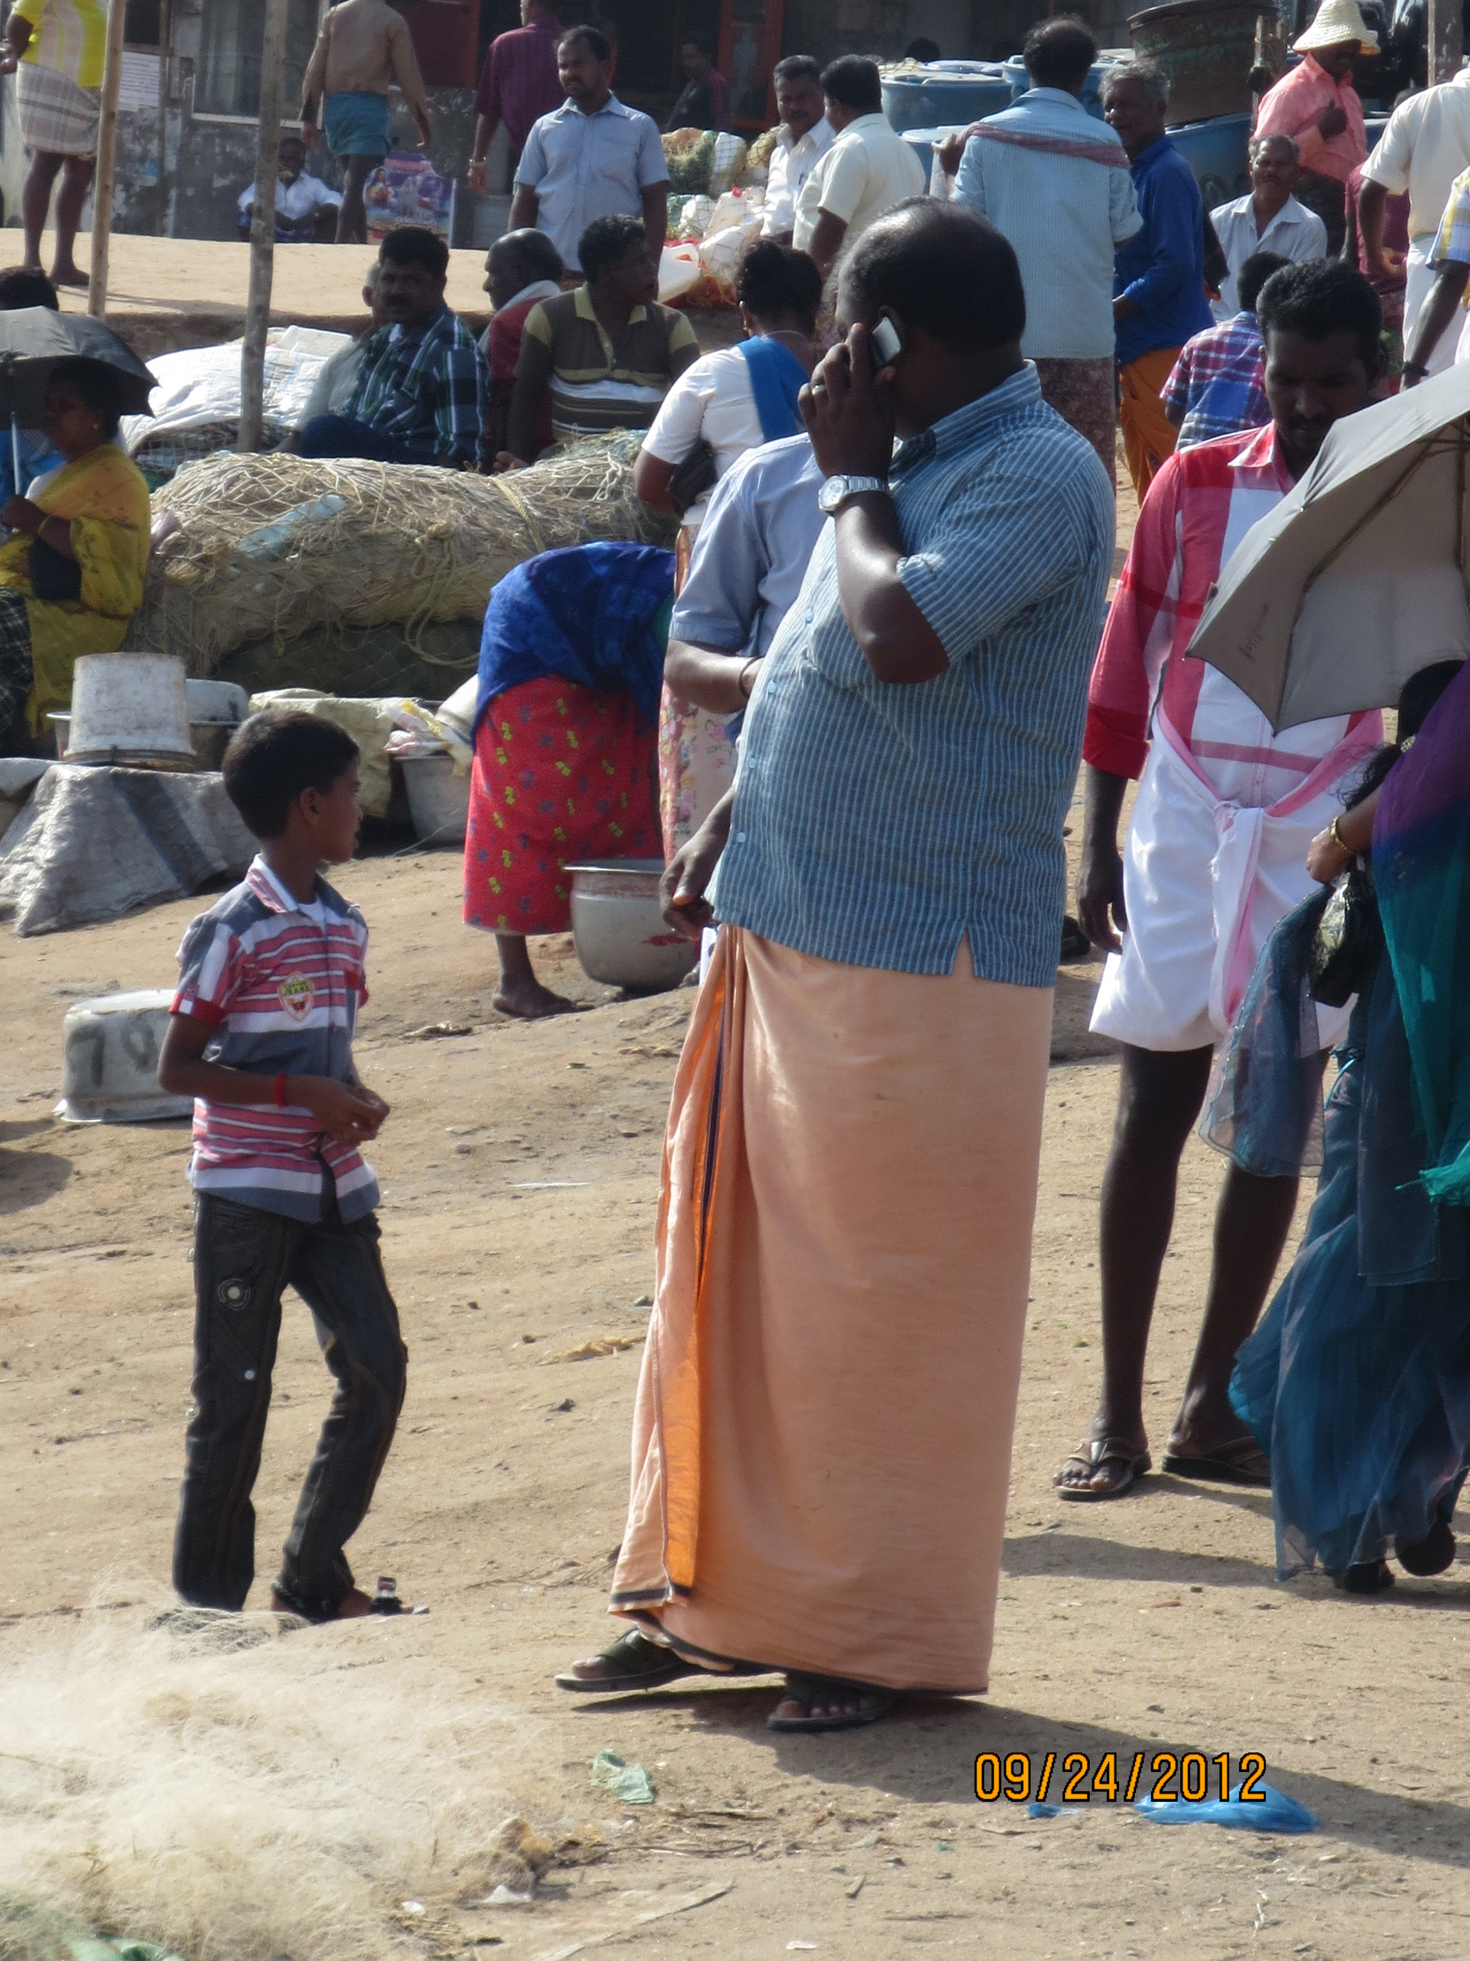
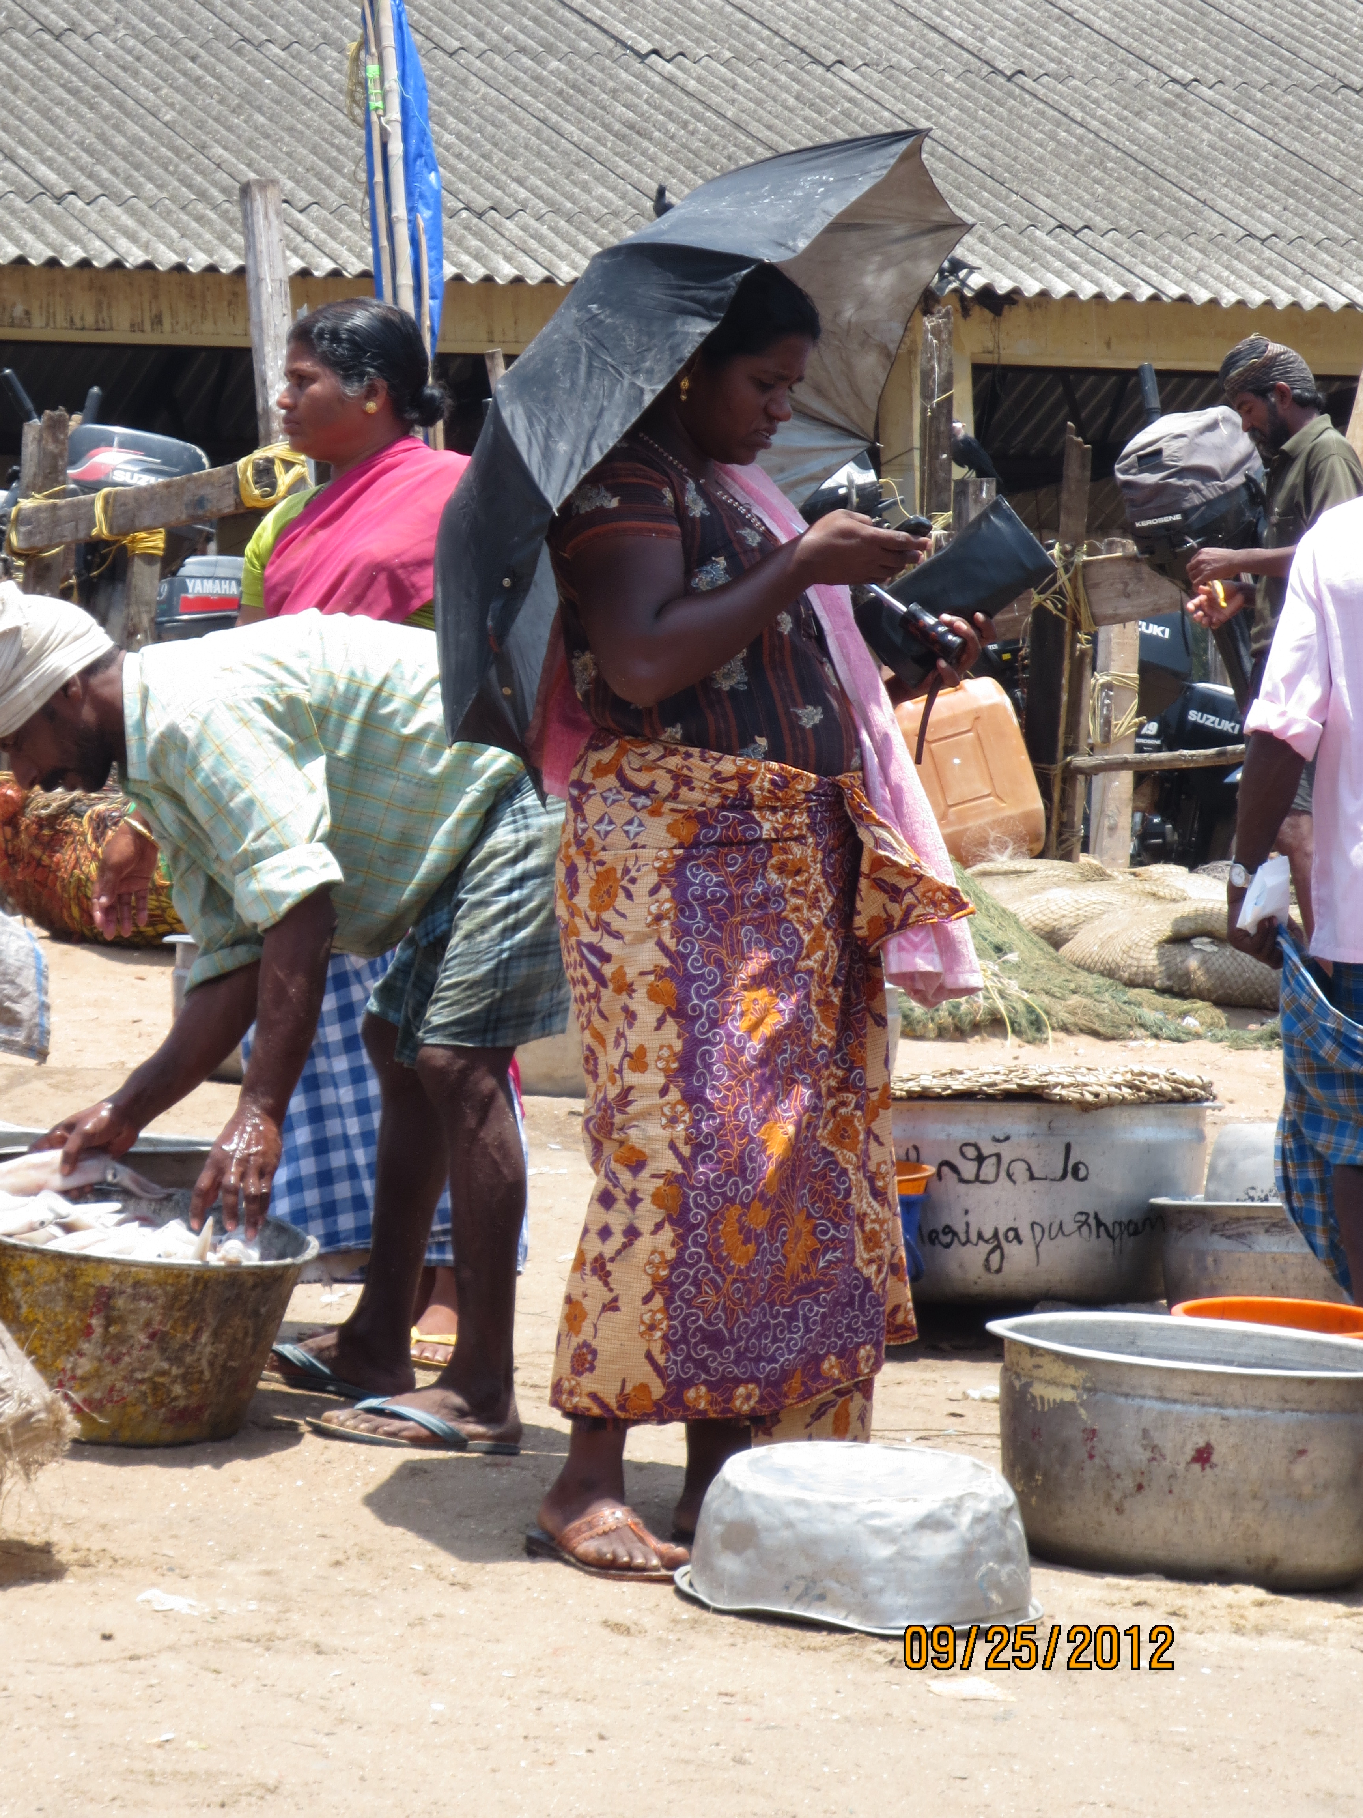
Price information not the only use for phones
  Sharing fish locations
  Coordination
  Emergencies
  Checking up on family
Different definitions of “welfare”
  Not only about income change
Notes:
While price information might not be why a majority of people are using phones, phones are undoubtedly in use by almost everyone in their fishing-related livelihood. What do different actors use them for? Here are a few examples:
1. Fishers mentioned most often that they called their friends and kin who were at sea in order to find out fish availability at particular locations, esp on days when they themselves were unable to locate fish. They would use the phone in conjunction with a GPS to trace that location and go there to fish themselves. Fishers also mentioned using the mobile in case of emergencies (like a malfunctioning engine) to call the shore for help. Coordination work, cooperative work.
2. When Fishers approach their shore with fish, they call up their auctioneers as they are pulling up. They do this in order to ensure the auctioneer is present at the beach, and that in case of large catches can arrange for ice. Coordination work.
3. Large-scale purchasers, and especially export agents operate with a target in mind every day. Export companies inform them in the morning what varieties and quantities of fish they require. Agents then use mobile phones to find out the quantities available at different markets, and then consolidate these to achieve their target. They use phones to stay in touch with their truck drivers who transport the fish to the export company for processing. Coordination work.
4. Women vendors are another interesting case among the fish purchasers. As women, these vendors have primary responsibility of their children and households. As fish vendors, they need to manage their householding tasks alongside a 12-14 hour workday that keeps them out of their houses, on the road and at markets. A unique feature of the fishing community is that the fathers too are seldom home, either being out at sea or elsewhere once they are on land. As a result, women are constantly worried about their family, especially their children’s whereabouts and well-being. The phone seems to have offered some of them a way to stay in touch with their families, relieving this stress somewhat.
Summary of uses:
Diff defn of welfare- whereby welfare is not only about an increase in income. It’s not about optimizing, but about coping with the vulnerability encountered by fishers while out at sea, the risk of death (emergencies).

Slide 9

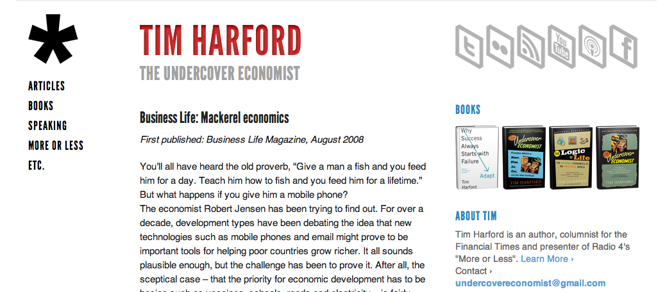
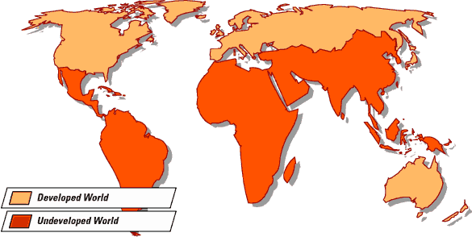
Many uses of phones
Many fish varieties
Auctioneer
Many types of sellers/producers
Many types of buyers/consumers
“Jensen…was able to see clearly what happened when the mobile phone masts came to Kerala… prices fall but fishing boat profits rise, and spoilage of fish becomes a thing of the past.”
Phones used for price information
Producer
Sardine
Consumer
Mobile phones lead to better prices, reduce wastage
Kerala
Developing regions
Fishermen
Fish
Notes:
In wrapping up, we would like to return to the ways in which the empirical reality of fish landing centers have been transformed in academic and popular writing.
We suggest that in going from the situation on the ground to Jensen’s article, further to how that article is cited or makes news, three types of generalizations occur:
the actors involved went from being a range of producers, buyers, fish and an auctioneer TO a buyer, sardine and producer TO fishermen and fish
The findings related to mobiles went from the multiple uses they were put to by different actors TO price information becoming the core use/ use in focus, TO descriptions of mobile phones as leading to increased total welfare of buyers and producers
3. In terms of region of analysis/conclusions- goes from north kerala TO kerala/developing regions
Brings us to the idea of how modalities get deleted at each stage of analysis
Latour and Woolgar refer to ‘deletion of modalities’ whereby a statement a claim situated in time and place becomes a generalized fact stripped of this context… our own informal observation of the dissemination of this idea. The will to scale interventions (see Gates Foundation).
An outcome in the domain of design practice and development intervention work is the proliferation especially of SMS based market price info platforms (Luisa’s list) in a multitude of sites and for a huge variety of commodities.

Slide 10
In Conclusion
problems of aggregates and averages, what they conceal
conditions in North Kerala that make it a very special case
narrowing of ideas in the mobile app design space … see markets.ischool.berkeley.edu for list of projects.
Notes:
(1) Importantly the use of such categories as ‘fishers’ or ‘buyers’ conceals the range of economic and social circumstances within those broad groups. Jensen in his conclusions steps into this mode when he argues that mobile phones bridge the digital divide by “suggesting that benefits of ICTs can be found among fishermen or farmers, not just software engineers or call center workers.”
Lower-income groups most frequently obscured when relying upon aggregates and averages.
Limits on scholarly imagination (of these necessary conditions) in the absence of a comparison
(3) and overly broad application of few select ideas…
But there’s a real need to differentiate their qualitatively different uses of the mobile phone (often for lower income groups related not to optimization, but to managing risk and vulnerability) in order to design for and reach such groups (who are typically the ones who are meant to be targeted by ICTD interventions…not middle to high-income fishermen)

