Slide 1
“E–SUSU” Operation:
Can Mobile Money Revolutionise an Ancient Saving System Among Indigenous West Africans?
Evidence from Ghana
Presented @ IMTFI Conference, 2012
By
Eric Osei-Assibey (PhD)
University of Ghana

Slide 2
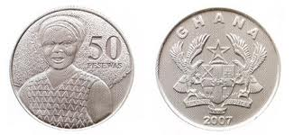
Presentation Outline
Introduction: objectives and significance
Overview: Mobile money services / Susu operations
Research & Sampling Design and Methodology
Preliminary Survey Results: Susu Operators
Preliminary Survey Results:Susu Users
Findings from Focus Group Discussions
Future Tasks to Completion

Slide 3
Intro: What is Susu?
Low income earners in Ghana, such as traders, poor farmers; make daily savings of their income with certain individuals in trust. Their daily deposits depends on how much they can afford, but should be consistent for, at least, a month before withdrawal;
Under this scheme, clients do not earn any interest on their deposits, neither do they usually access loans.

Slide 4
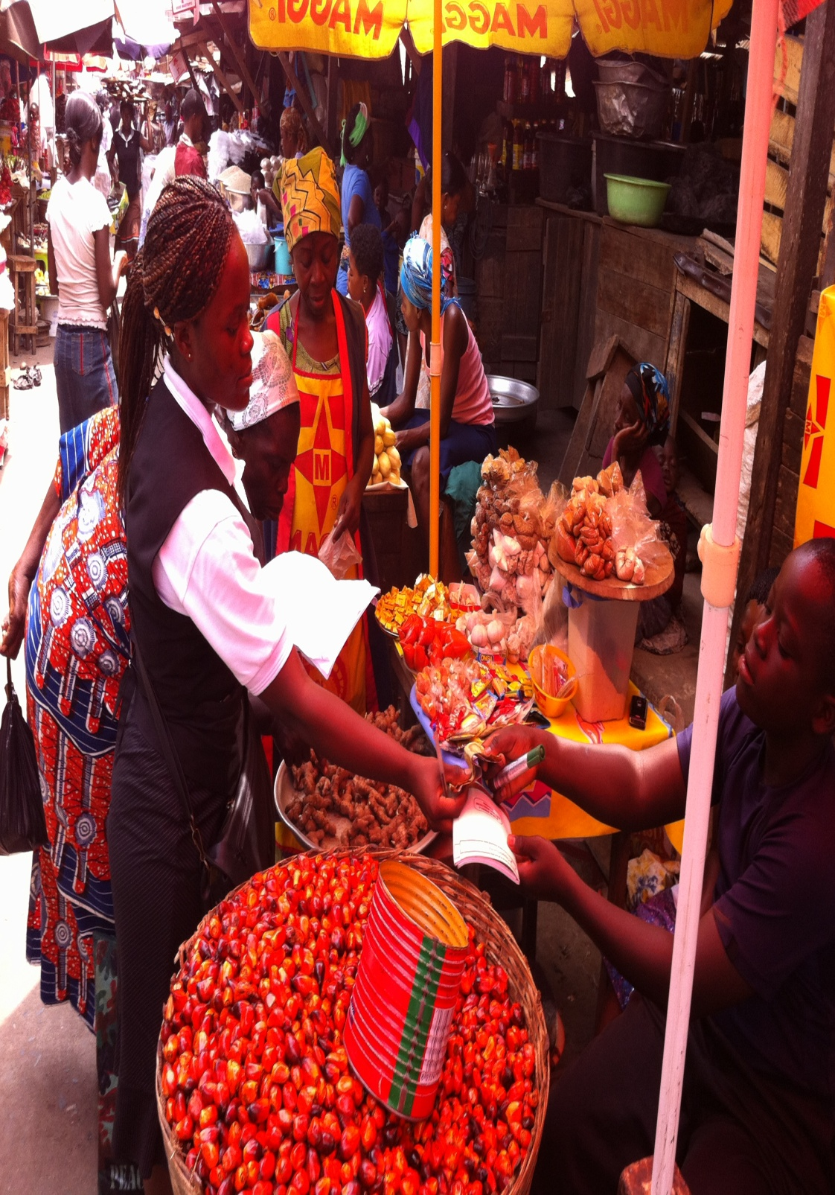
Feature of Susu: Merits
Good knowledge of the local market
Convenient outreach to clients (doorstep service);
Very little or no bureaucracy and paperwork;
Flexibility to adjust to changing circumstances, as in emergencies;
Quick turn-around time
Micro-savings

Slide 5
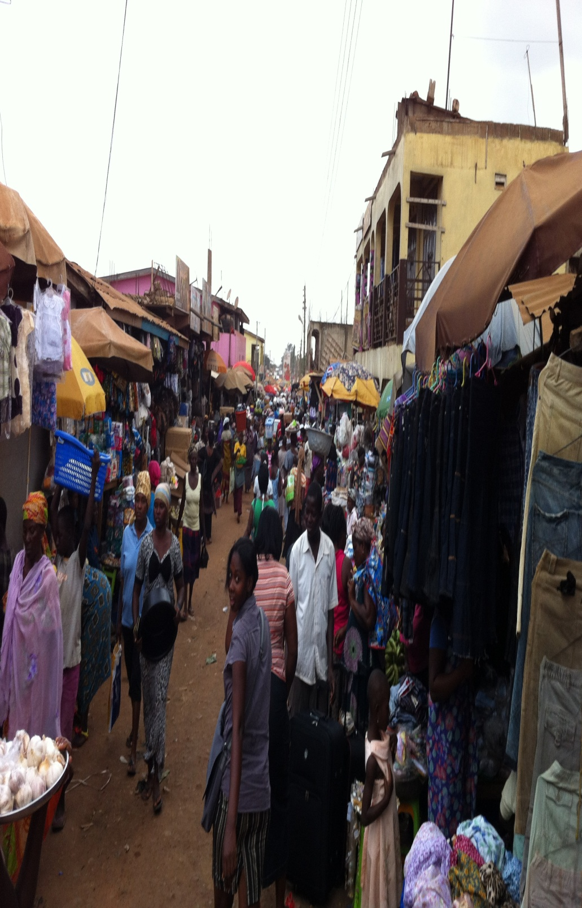
Susu: Demerits
Overdependence on trust,
No legal recourse to deal with defaulters or, for savers, fraud;
It does not involve any legal documentation or paperwork; except for a piece of card/book where daily collections are recorded;
These obvious operational inefficiencies, have culminated in the following (see next slide)

Slide 6
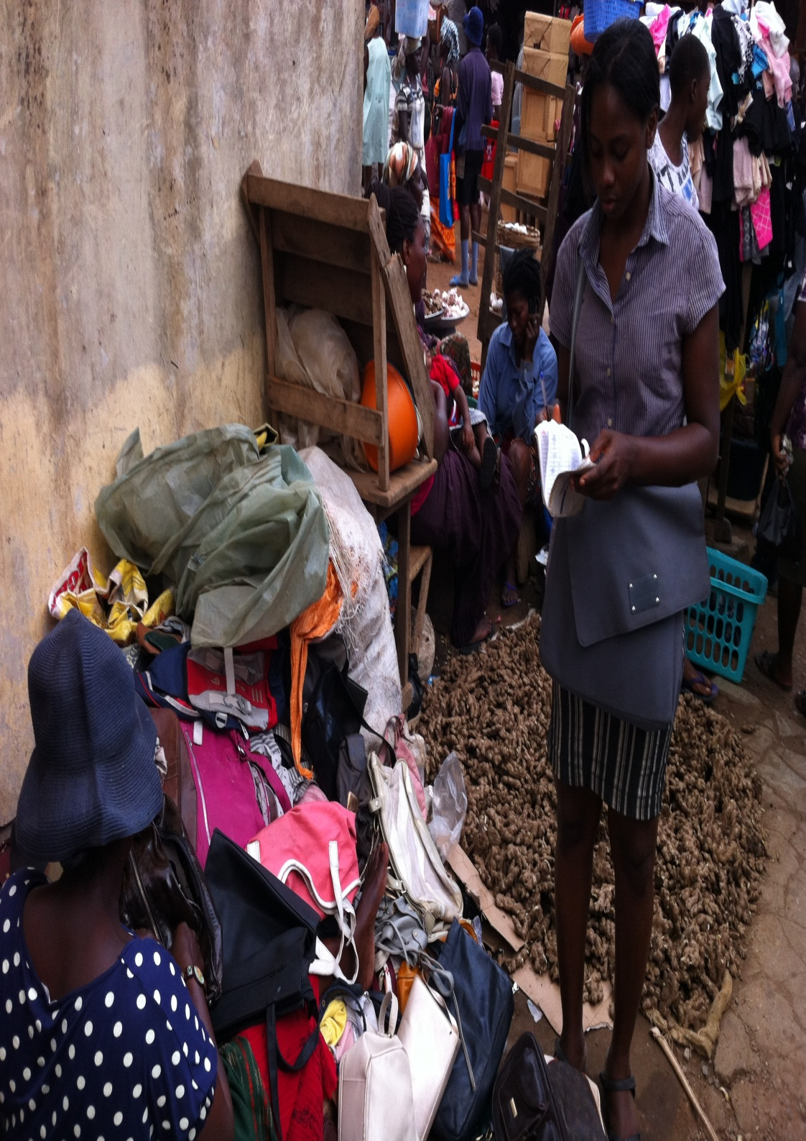
Demerits
high transaction costs ;
restricted scale;
limited scope of operations;
operates on foot, bicycle or motor bikes;
they are prone to robbery attacks;
inability to work due to illness, laboriousness or unforeseen circumstances
Thus unable to solve the saving needs of the large unbanked population within the informal sector. (86%)

Slide 7
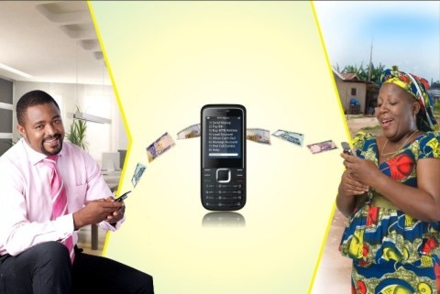
Is Mobile Money The Solution?
With the rapid diffusion of technological infrastructure and advancement, the issue is how the Susu operation can leverage this modern technology to reduce these costs and inefficiencies and still make savings much easier for the urban poor.

Slide 8
The State of MM in Ghana
Steep increase in Mobile Phone subscription – 99.7% (as of Oct.2012)
MM a key driver to the expected cashless or cashlite society
But only 9% Mobile phone users in Ghana had MM account between 2011 and 2012
The rate has since increased to 16.5% (over 4.1 million)
There are three MM in Ghana:
MTN Mobile Money –5% (active users of 2 million accounts)
Tigo Cash -13% (active users of 1.2million accounts)
Airtel Money – 2 % (active users of 900,000 accounts)

Slide 9
Specific Research Questions:
What factors are influencing the use of SUSU as a store of value/ micro-saving infrastructure? Are there any social or cultural practices that bind people to these services?
What is the extent of usage or knowledge of mobile money within the SUSU operation by both operators and savers?
What factors will determine the Susu operators, and the users’ willingness to accept or use mobile money in place of the traditional practice?
Will the use of mobile money complement or substitute the work of Susu operators?

Slide 10
Conceptual Framework of Analysis
Diffusion of Innovations is a theory that seeks to explain how, why, and at what rate new ideas and technology spread through cultures (Rogers 1962)
Rogers (1995) pointed out that diffusion of an innovation occurs through a five- step innovation-decision process:
knowledge of an innovation;
to forming an attitude towards the innovation;
deciding to adopt or reject the innovation;
implementing the new idea; and
confirming the innovation decision.

Slide 11
Technology Adoption Framework
1
Knowledge
Persuasion
Decision
Implementation
Confirmation
Potential Users/ individual Heterodox Characteristics
Regulatory Framework/ Policy Context
Reject
Accept
Competition, Marketing, Cost & Price
education and promotional campaigns
Advisory Services
Education/Training
Research &Development
Subscriptions/Users
Consequence
Economic: Productivity gains
Social: Welfare gains

Slide 12
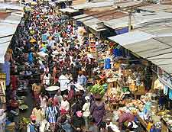
Sampling Design and Methodology
The study uses a three pronged approach: Surveying
Traditional Susu operators
Susu Users
Telecom operators
Location & Stratification
Accra – The Capital -10 local markets
Kumasi – 6 local markets
Sampling Methodology
Structured Questionnaire
Focus Group Discussions

Slide 13
Preliminary Results- 90 Susu Operators
1

Slide 14
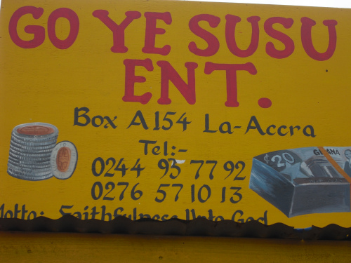
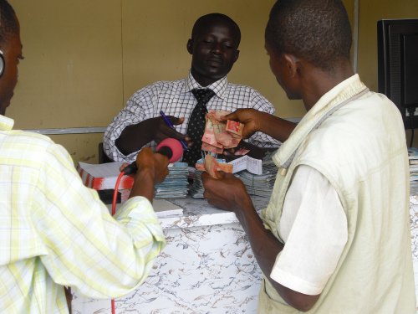
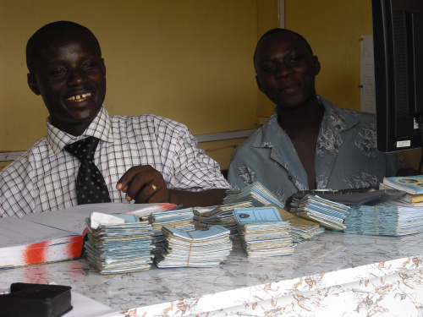
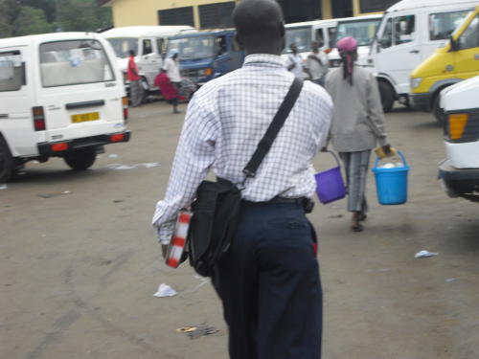
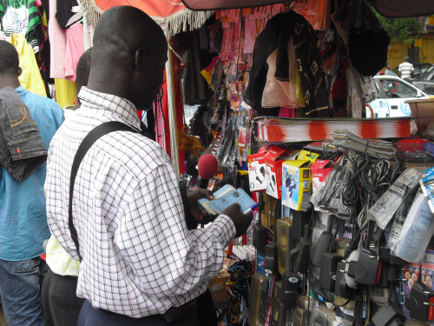

Slide 15
1
1

Slide 16
SUSU USERS: Sampled 174 Susu users – 84% Female
1

Slide 17
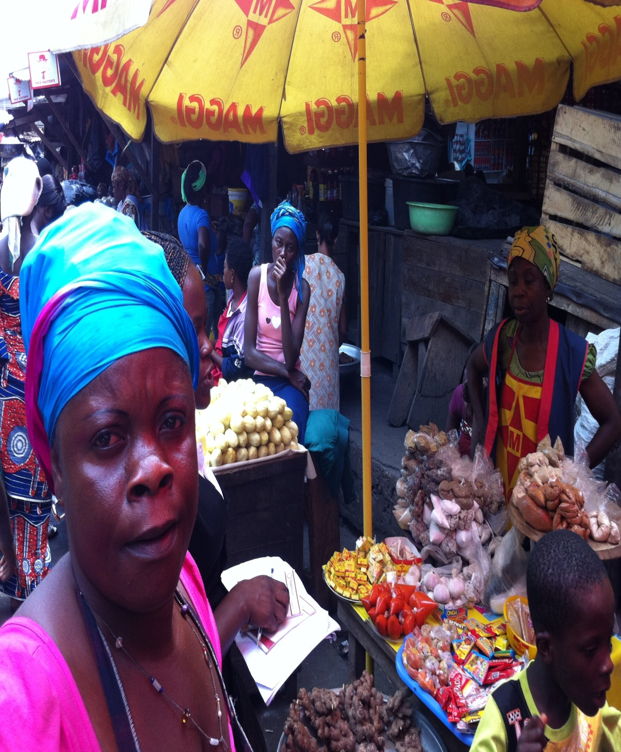
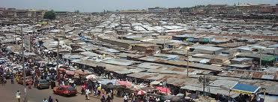
1
1

Slide 18
1
1

Slide 19
Findings from FGD (Susu Operators)
No Technology use – purely paper work
Users have absolute trust because of proximity
Many operate night shifts in order to keep their collected money away from robbers.
Pessimism
knowledge in mobile phones and safety
Mobile Susu operators unsure of role
Possible Irregularity of payments and diminish trust
Optimism
Many are hopeful of becoming agents, particularly the immobile ones.

Slide 20
FGD: Susu Users
It prevents incessant demands from relative and attacks by thieves.
Many hear of defraud by the Susu operators. -The Susu operator make huge promises of which they could not fulfill and run away with their money.
A higher percentage does not know where the operators reside or operate.
They prefer if the operators work every day including holidays
They doubt the reliability of the mobile money transfer:
Concerns of what happens if the phone get lost and SMS charges/fees were raised.
Although they heard about mobile money, they wouldn't be comfortable using it since many are not conversant with the functions of mobile phones

Slide 21
TASK TO COMPLETION
Conduct interviews with the three main telecom companies currently involved in MM
Undertake a quantitative analysis of the survey data to determine factors that are important in explaining willing to accept or reject mobile money by operators and users of Susu.
Draft the final report
Submit a paper for publication in an international journal

Slide 22


