Slide 1
Generating, storing and exchanging value
Comparing financial practices in Mexican and Indian rural communities

Slide 2
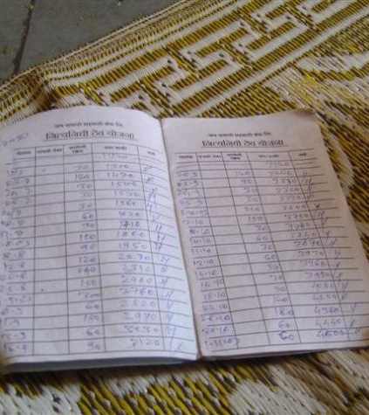
Aims
Compare processes of
  generation,
  storage,
  accumulation,
  mobilization
  and exchange
  of monetary and non-monetary valuables
Frameworks of calculation
Financial instruments

Slide 3
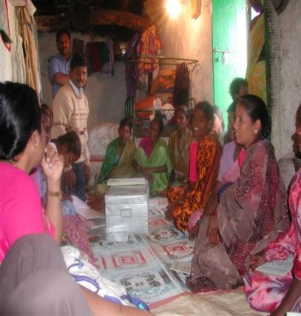
Tamil Nadu in South India
Marginal farmers and landless laborers migrate locally
Caste as a fundamental feature
Owning land, housing, livestock and jewels provide status
Investment in rituals (marriages, festivals)
Recent emergence of Self help groups

Slide 4
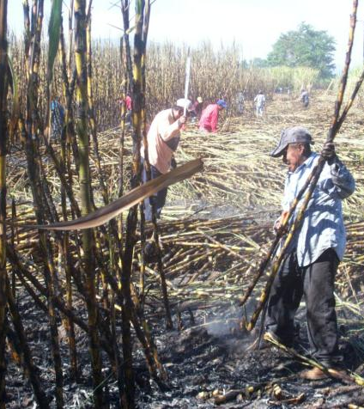
El Grullo in Western Mexico
Irrigation district
Maize, sugar cane, horticulture
Cattle as store of value
Investments in vehicles, shops, musical instruments
Remittances from the US
History of cooperatives and savings associations

Slide 5
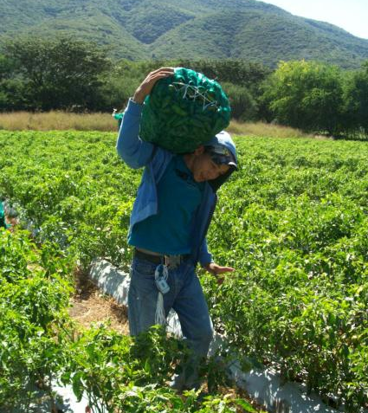
Generation of value
Production
Migration
Financial practices
Different kinds of resources and currencies
Monetarization and financiarization

Slide 6
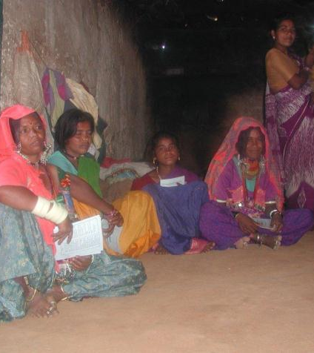
Storage of value
Gold as saving and as social capital
Cattle
Roscas/ Chit funds
Lending
Credit and Savings Associations
Banks and financial inclusion

Slide 7
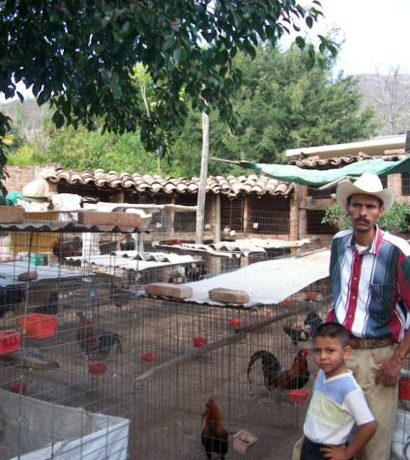
Value mobilization and debt
Debt, protection, exploitation and solidarities
Debt as a marker of hierarchies
Processes of valuation
Social arrangements
How debt is signified
  Estimates
  Predictions
  appraisals

Slide 8
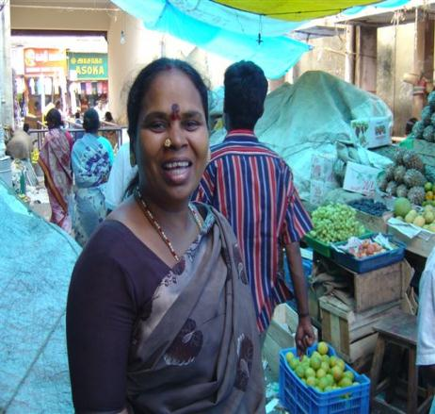
Transactions and forms of exchange
Social differentiation
Social status
Segmentation
Access
Strategies
Financial regulation
Non monetary elements intertwined with monetary value

