Slide 1
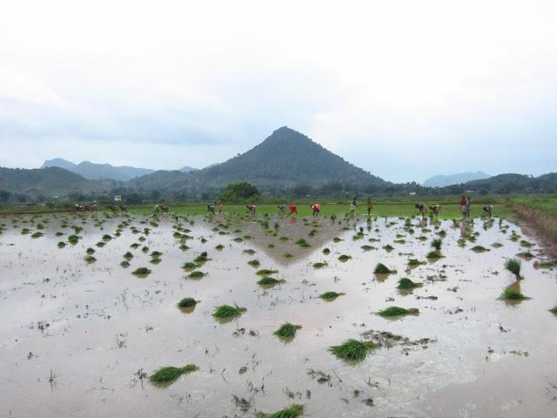
Material Cultures of Financial Literacy Among Rural and Urban Poor in Odisha, India

Slide 2
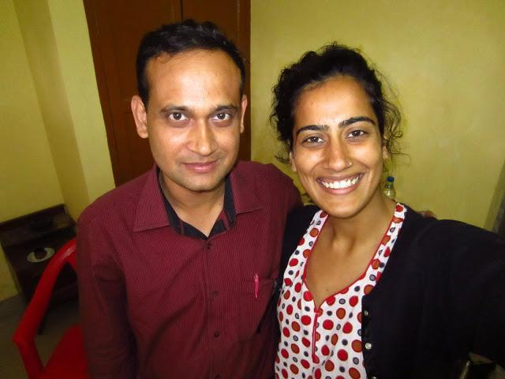
Researchers
Nishita Trisal, MA
ntrisal@gmail.com
PhD Student, University of California-Santa Cruz
Pradeep Baisakh, MA
2006pradeep@gmail.com
Journalist based in Bhubaneswar, India
Katherine Martineau, MA
kbmartin@umich.edu
PhD Candidate, University of Michigan
Faculty Sponsor:
Professor Webb Keane
Department of Anthropology
University of Michigan
We offer our sincere thanks to IMTFI for its support of this project. We are also grateful to the IMTFI Administrator, Jenny Fan, for her kind assistance.
Notes:
Personnel, contact info, affiliations, and acknowledgements

Slide 3
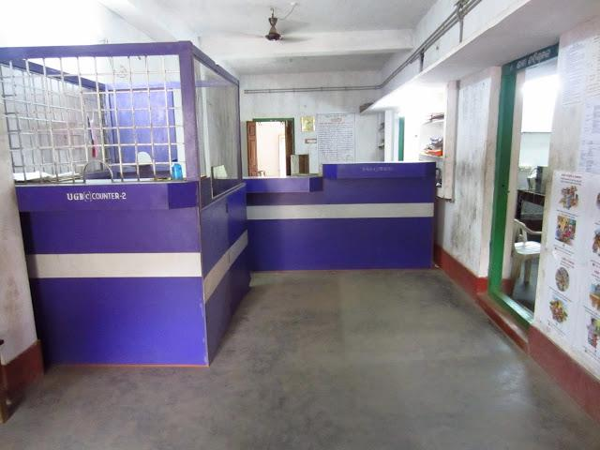
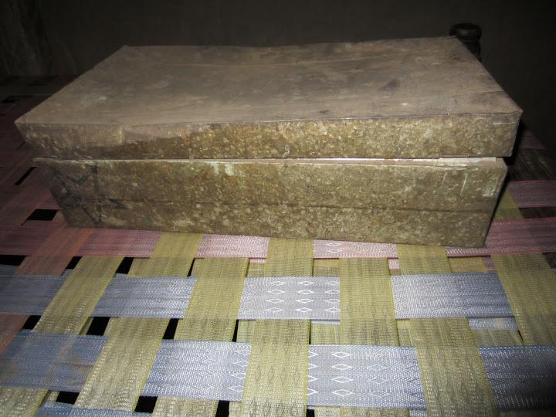
"Unbanked" India
Notes:
Erased: Various forms of financial inclusion have been encouraged by the Indian government since Independence in 1947. Yet, xx% of India's savings are "unbanked" — why?
This needs a title and a caption.

Slide 4
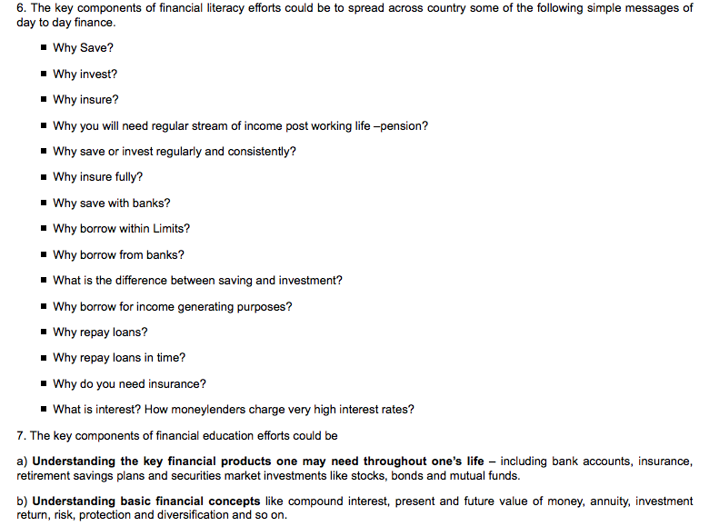
from India's National Strategy for Financial Education (2012)
But what economic management skills do poor people already have?
Notes:
OECD version of financial literacy?

Slide 5
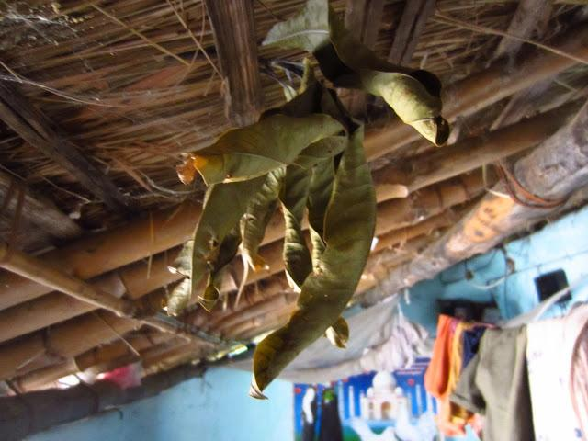
The ethnography of material culture provides a method for understanding resource management cross-culturally.
-What objects and material practices do people use to organize, make sense of, store, transfer, and protect their resources?
-Which qualities of those objects matter most?
-How do those objects fit into broader social and cultural contexts?
Notes:
Revise slide to include a quote? A statement that summarizes our methods and assumptions?

Slide 6
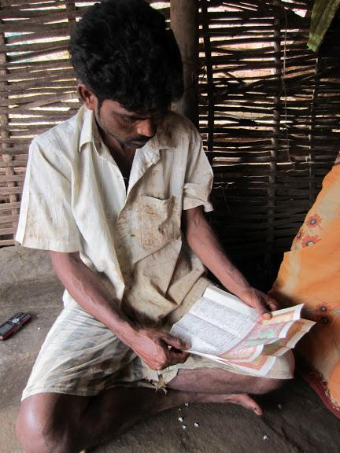
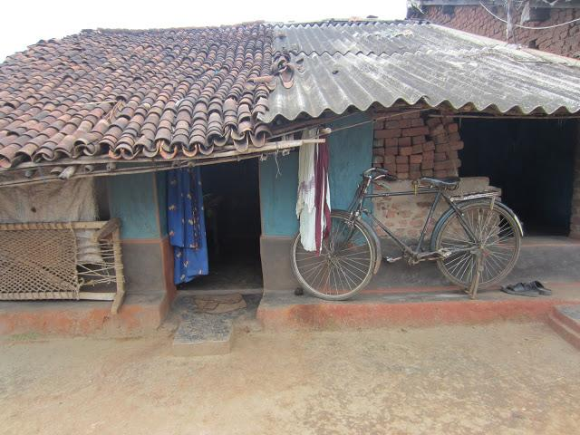
Case studies of material culture
An object is multifunctional
when it has multiple uses that everyone knows about.
Notes:
I'm not yet sure if we should use "RMT" or "resource management technologies" in our argument. Nishita thinks it isn't necessary and that we can just offer a wider definition of financial literacy. I'm trying to write the argument out so that I can see how it goes together. Pradeep, does RMT help you make sense of our work, or is it unnecessary?
Alternative: 2. Drawing on economic anthropology and material culture studies, our research explores an alternative understanding of resource management strategies.
P: Refer the pic: Today I saw similar practice by an elderly women of family-5. She is a blind lady. She keeps the money like this, though she first ties the money on a corner of her Saree and then pushes near her waist. I got the pic and a video.

Slide 7
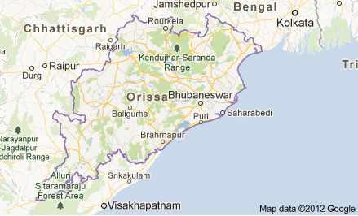
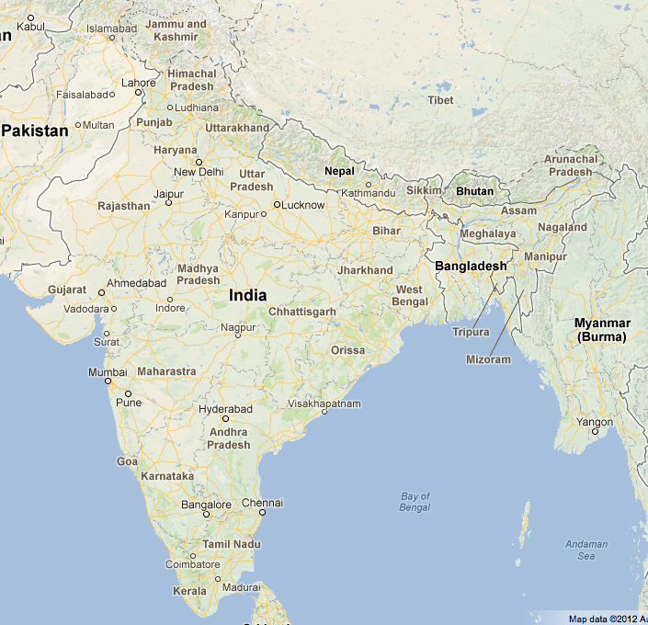
Research Sites
India's eastern coastal state of Orissa or Odisha has been considered one of India's poorest regions for over two centuries.
Bhubaneswar
State capital
Population approx. 1 million
"Old Town" is 40-50,000
Bariguda Village
in Rayagada District
Multi-caste and multi-ethnic village of 240 households
4 KM from a market town
Notes:
map of Orissa with two locations shown, image from each?

Slide 8
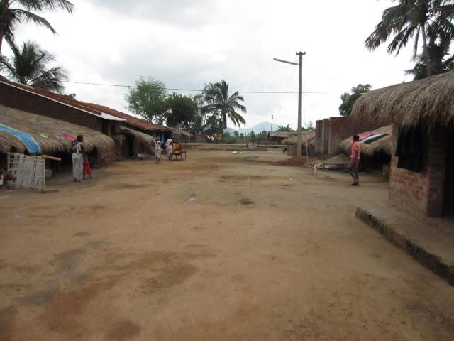
Bariguda Village
Residents consist of Kondh "Scheduled Tribe", Domb "Scheduled Caste", and "Other Backward Class" (Paiko and Sundi)
Approximate income of households is 150 rs/day
Institutions: 1 local bank branch. Numerous NGOs work in the area, and many residents participate in Self-Help Groups.
Long-form, open-ended interviews with 8 households
  3 Scheduled Tribe
  3 Scheduled Caste
  2 Other Backward Caste
Notes:
Bariguda is a multi-caste and multi-ethnic village a few kilometers away from Chatikona, a small but significant market town in the southern Odisha district of Rayagada. Bariguda consists of Kondh ST, Domb SC, and OBC (Paiko and Sundi) households as well as one "General" household. Each community lives in a different part of the village; each area, in turn, is named after the community that resides in it.
Working with a research assistant who also was a full-time employee of an NGO working in the village, I conducted five rounds of interviews with eight households (three ST, three Domb, two OBC (one Sundi and one Paiko) over a period of six weeks. Barring one or two families, most households seemed fairly untroubled by our conversations into details both intimate and banal of their financial lives; each household received a small sum from these conversations, more than a day’s wage for an hour of discussion. Moreover, the presence of my research assistant meant that the selected families could potentially receive some extra attention from the NGO for which she worked. The few families that seemed reticent to talk with us were those who seemed unsure of our motivations in inquiring about finances – these were people my research assistant felt were trying to hide how much they really had – as well as others who were on edge because of the brewing Naxal movement in the region.
Daily wage income varies considerably because of various forms of profit arrangements. For wage labor, daily income per household is approx. Rs. 100-150 during harvest season and considerably less in the off season. Alternate forms of employment such as driving local transportation vehicles, selling from a small shop, or working as a liaison for a local income provide boosts to one's household income. Lastly, self-help groups provide a great deal of up-front money as well to make investments in home repair, purchasing capital for a new enterprise, or to pay for a wedding or education.

Slide 9
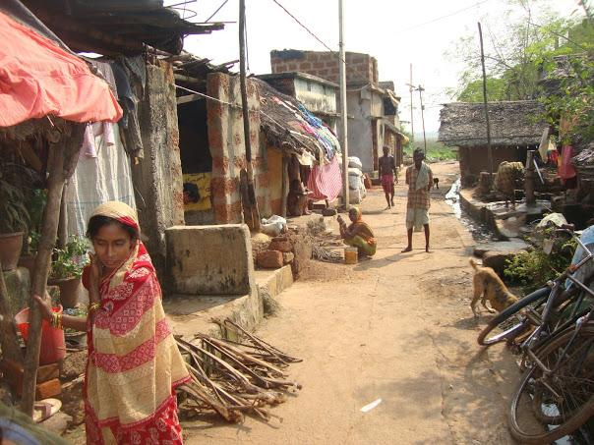
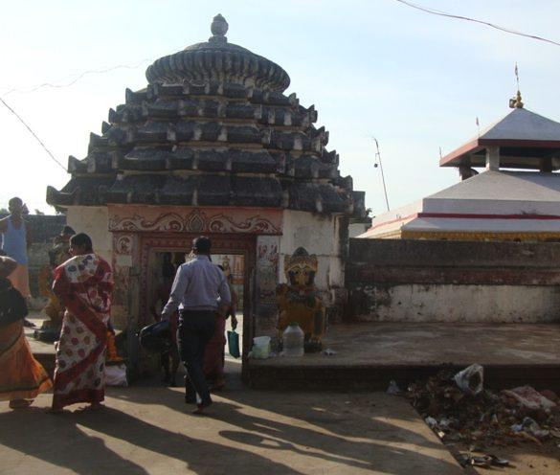
Bhubaneswar, Old Town
Residents are historically related to temple service
Approximate income of study households is 6000-10,000/mo
Households rely on unskilled labor and domestic service
Numerous nearby banks. Numerous NGOs work in the area, and many residents participate in Self-Help Groups.
Long-form, open-ended interviews with 5 Scheduled Caste households
Notes:
switch for photo of Old Town

Slide 10
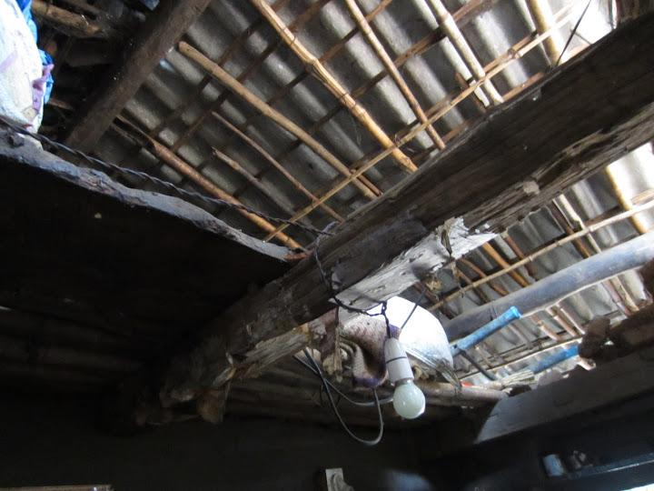
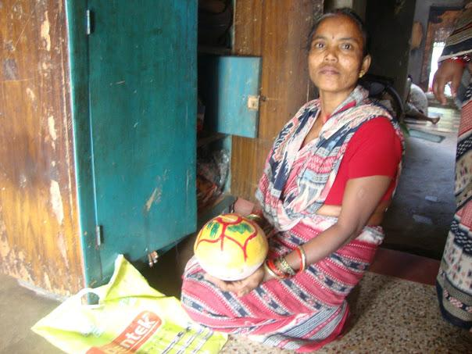
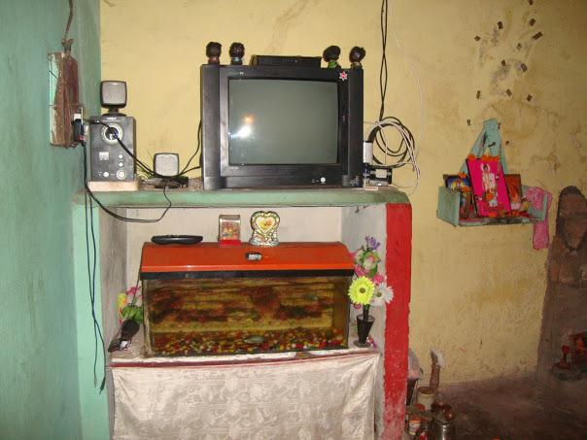
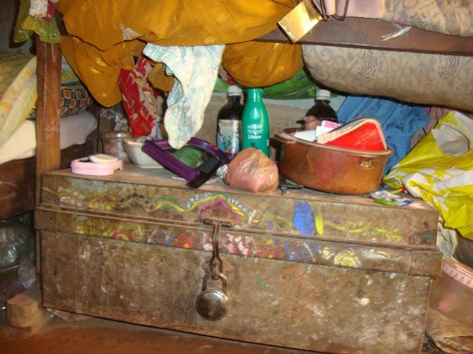
Objects
Notes:
Though most houses in Bariguda are not under lock and key--partially because someone from the household is usually in them--these houses are indeed seen as secure spaces in which one can store and stash away things, like grain, cash, gold. Also important is that not everyone--namely a person of a lower caste or adivasi too--can enter your home comfortably, forming another form of "security," if you will.

Slide 11
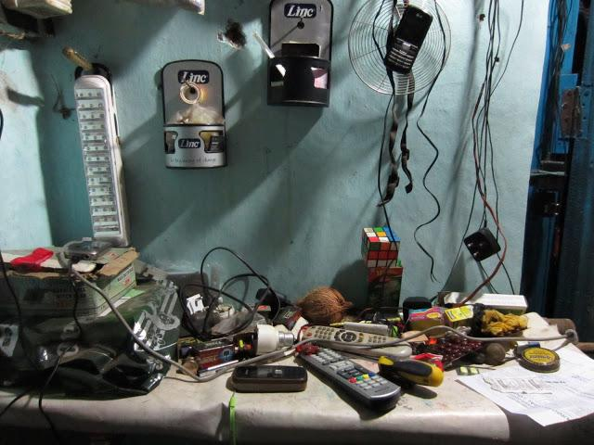
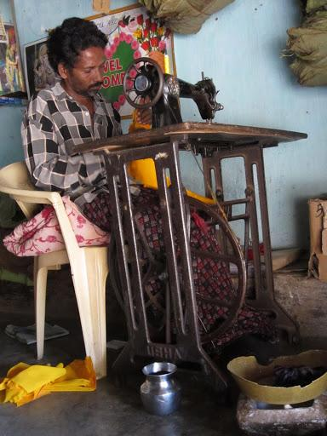
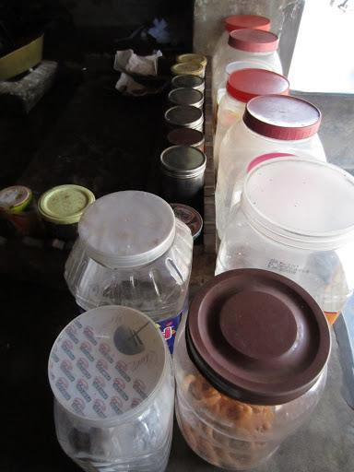
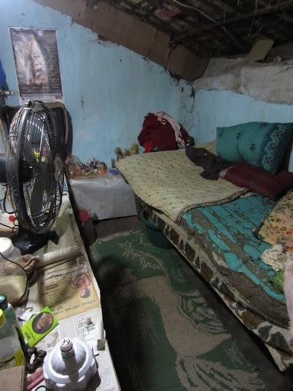
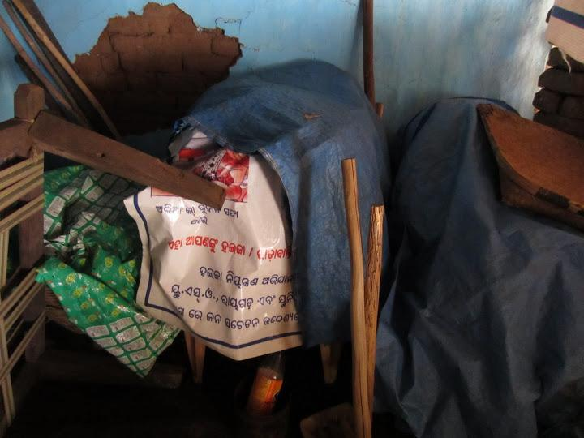
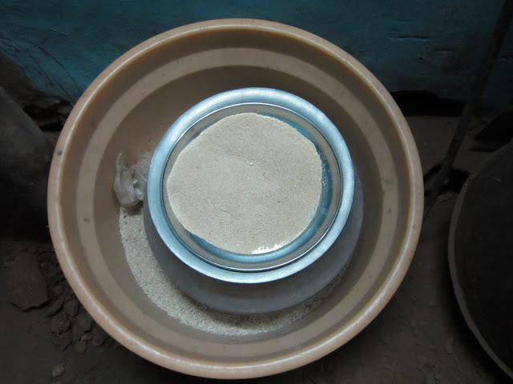
The shop
Electrical Repair
Purno's
House
The son's room

Slide 12
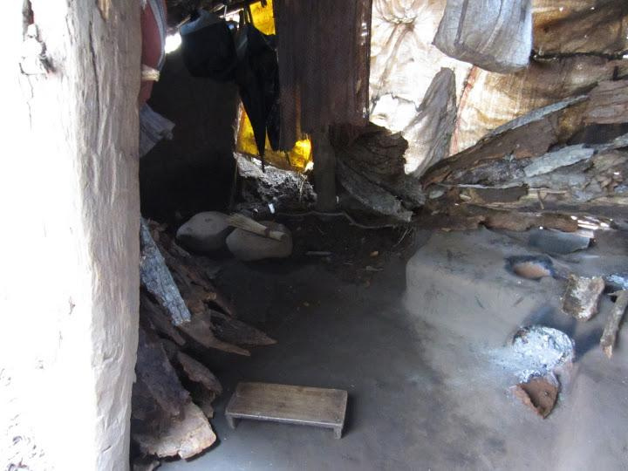
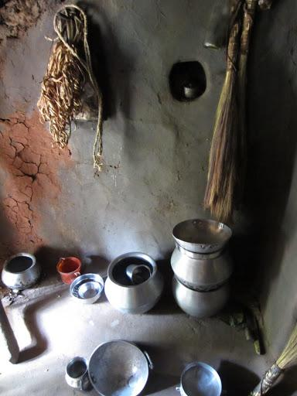
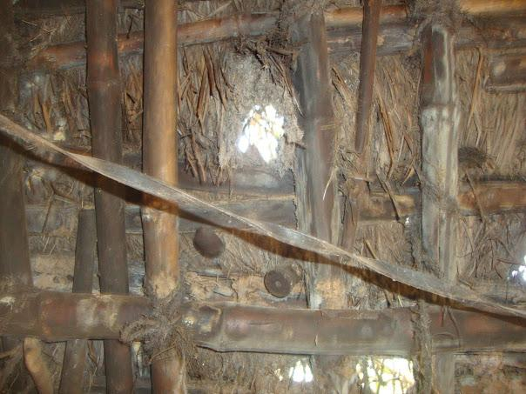
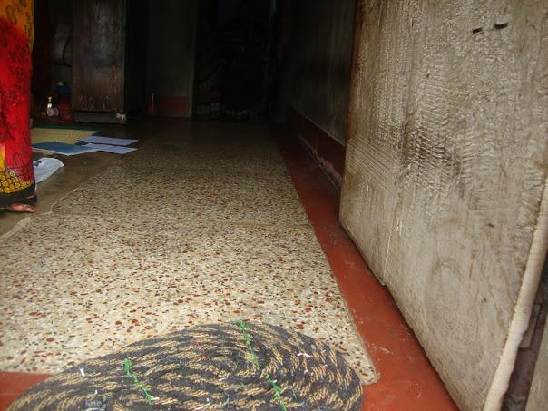
Area designated for menstruating women
Cooking area for non-menstruating women
Houses embody social relations and value
A new floor, built with a microfinance loan.
A roof that needs fixing, but is too expensive.
Notes:
houses as the media of social reproduction
Awesome. Houses relate dialectically to social norms: the social norm of "bahar hona" (menstruation) warrants the building of a structure where the woman (wife, daughter) can remain during her cycle. And the structure itself serves to perpetuates this social norm, as there is a built space meant for women and women alone. I didn't catch many stories of the transgression of this space, but I'm sure that's there.

Slide 13
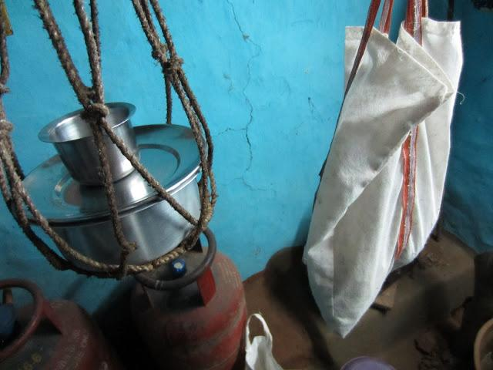
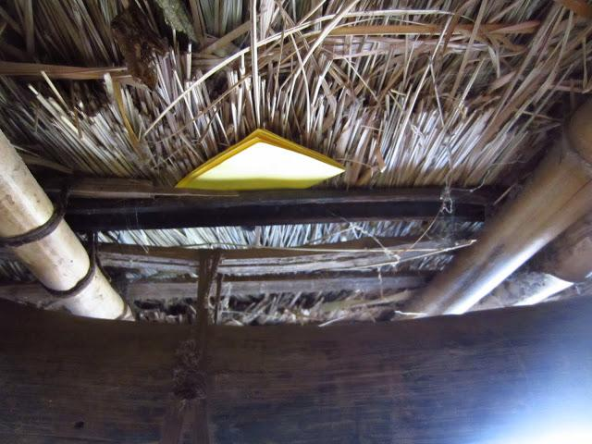
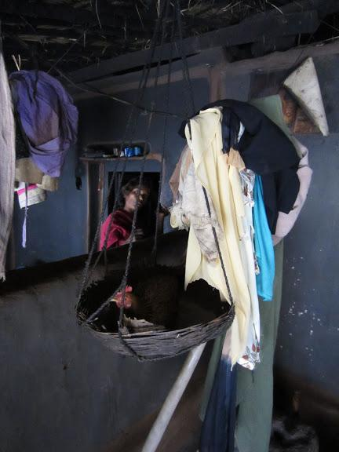
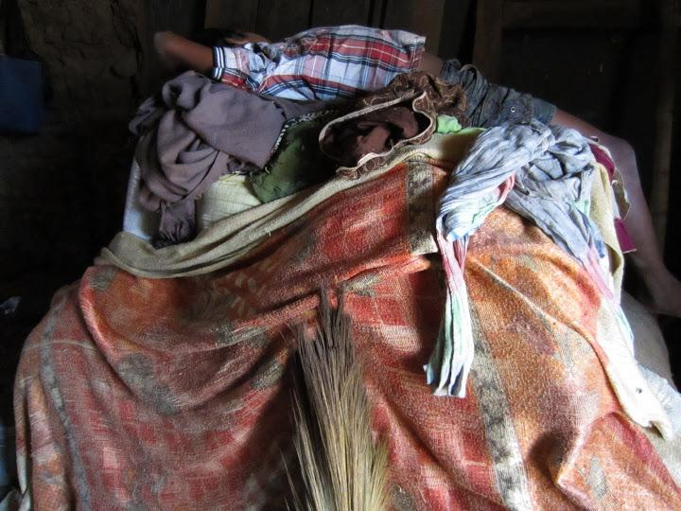
Separating/Earmarking
Reminding
Storing
Houses manage resources
Protecting/Caring
Concealing
Notes:
Houses as RMT

Slide 14
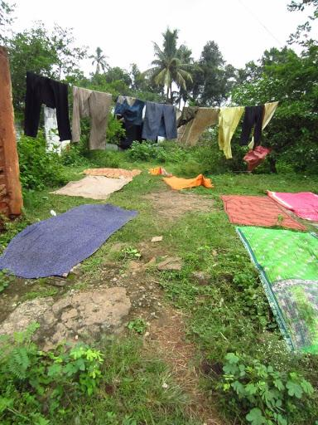
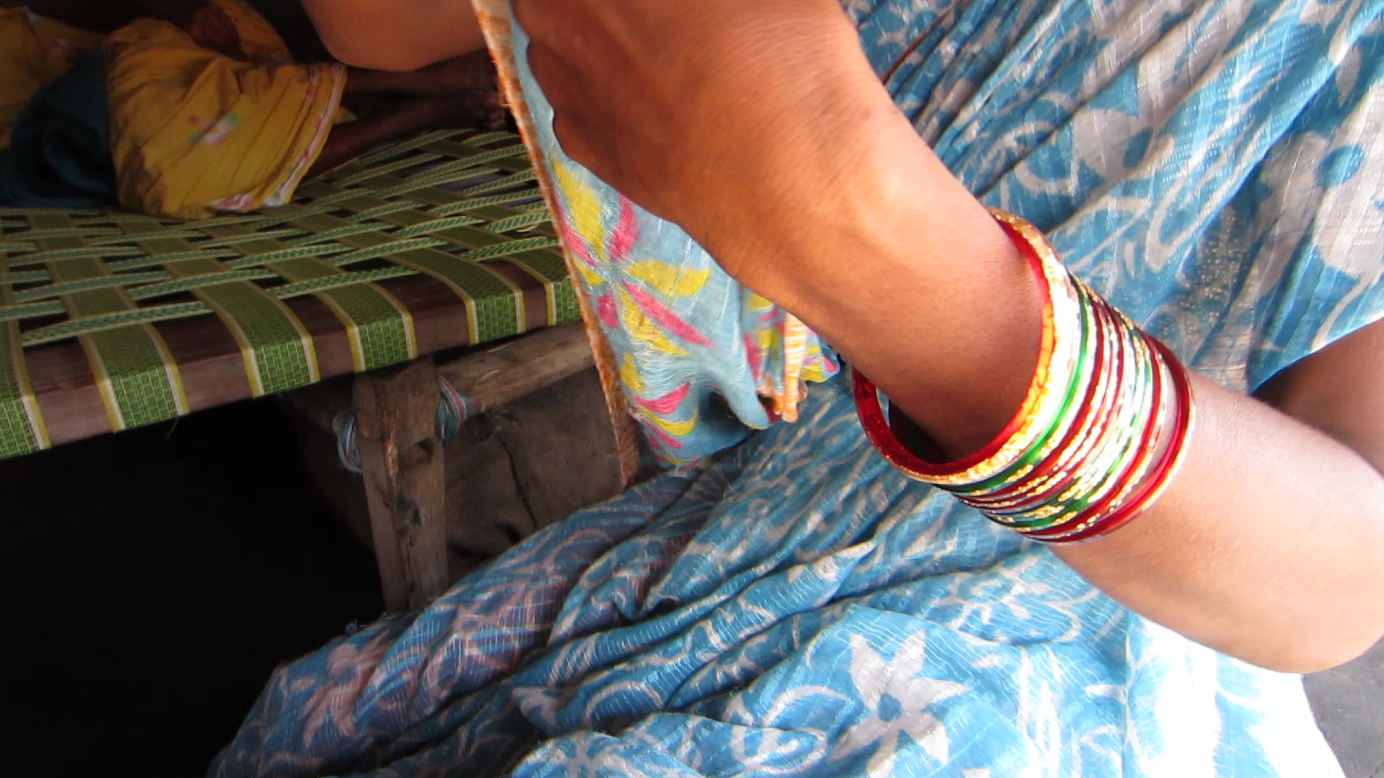

Slide 15
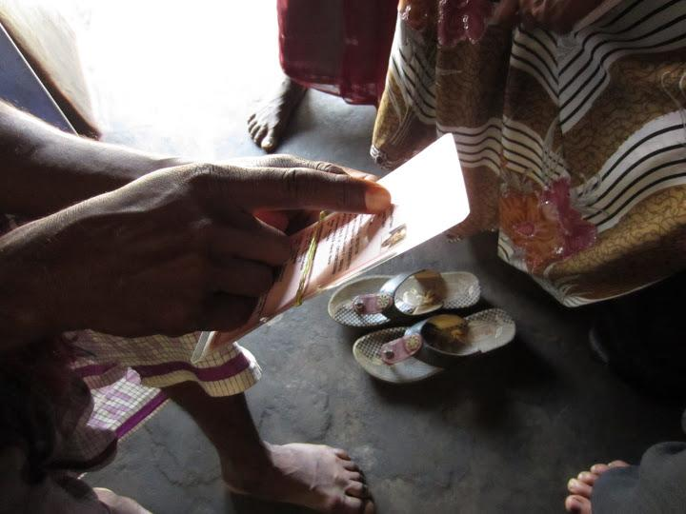
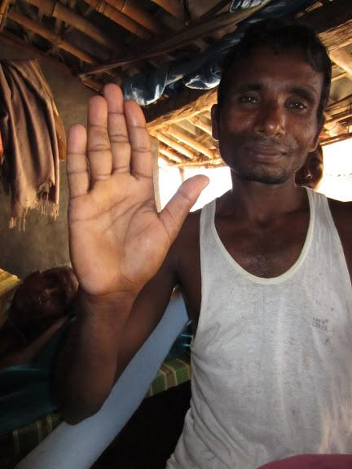
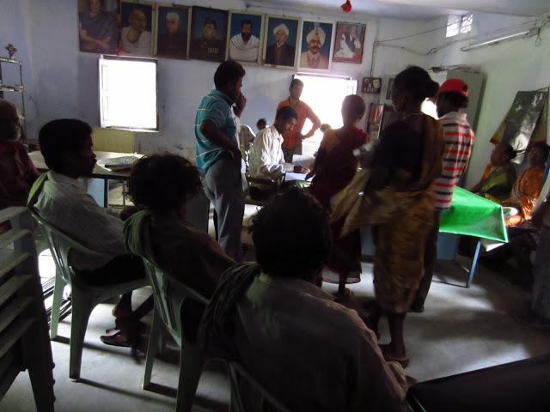
Gobinda explains the details.
Gobinda's BPL or "Below Poverty Line" Document
Panchayat headquarters
How to hold the BPL Card.

Slide 16
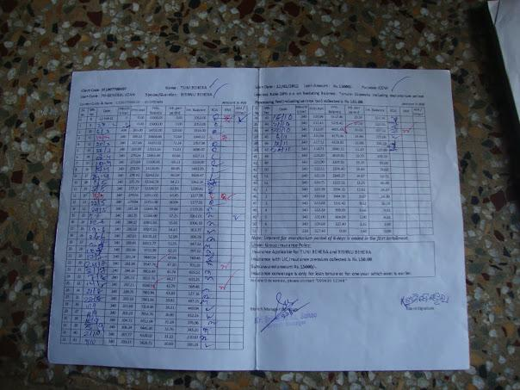
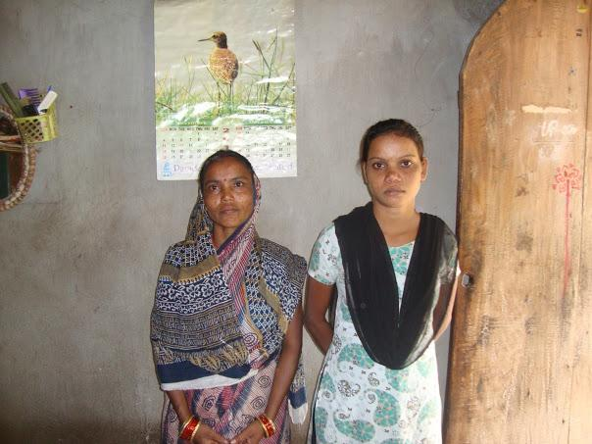
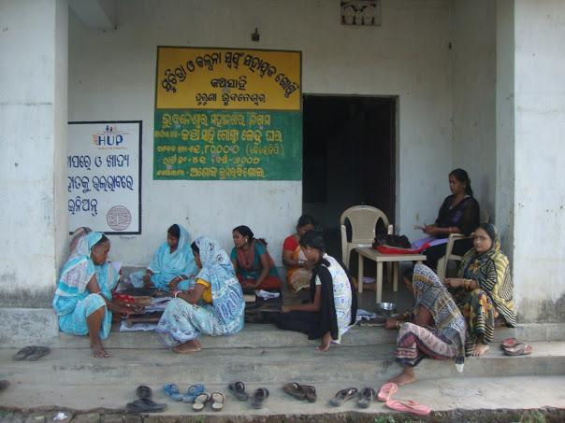
Tuni and her daugher
Tuni's Loan Papers
Several members of Tuni's Self-Help Group also witness her microfinance loan

Slide 17
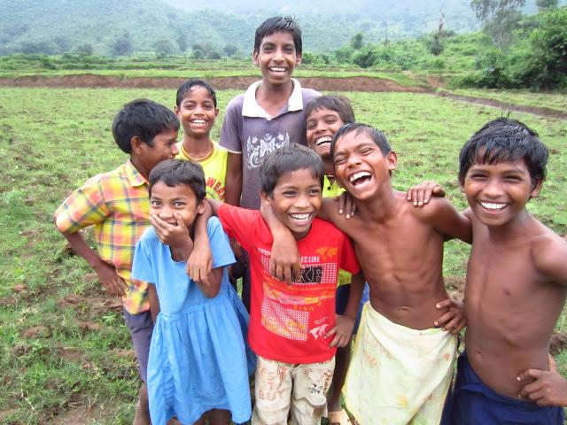
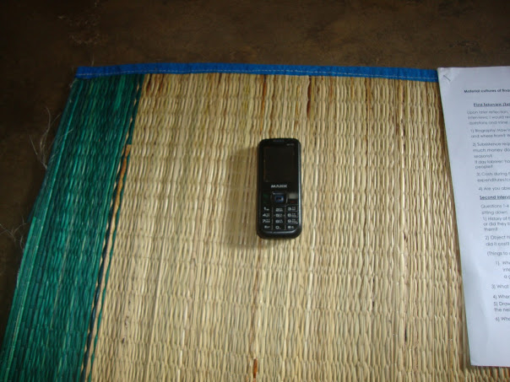
Designing for Multifunctionality
The design of financial inclusion programs must create a balance between a public stage for general participation and techniques that allow participants to hide their specific actions.

Slide 19
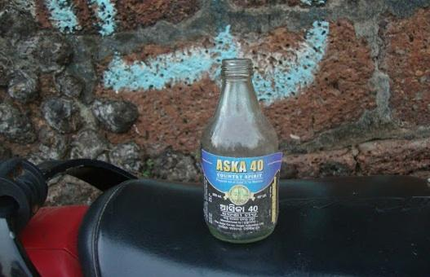
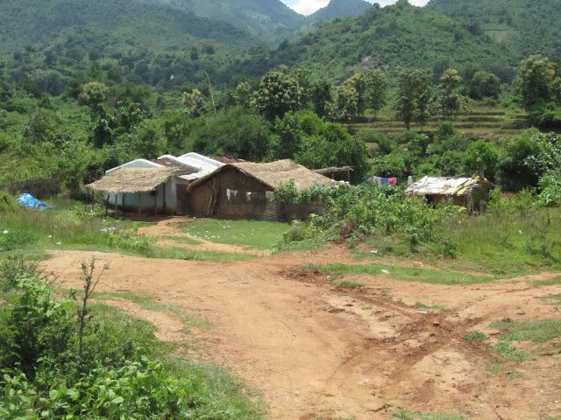
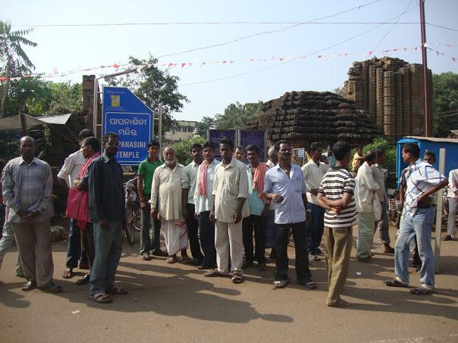
Object 3: Booze
Illegal "country-made" liquor is an essential part of social networking for Bhubaneswar's day laborers:
builds reciprocity among known contacts
extends social network to new men
intoxication makes disgusting and undignified work more bearable
30Rs./bottle: it is affordable for laborers by the bottle, expensive by the night

Slide 20
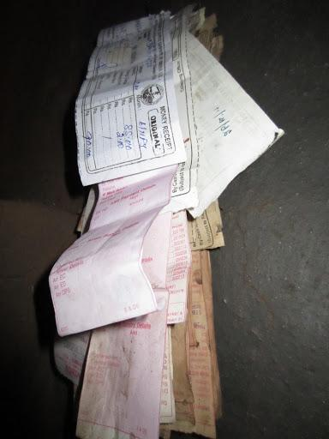
Financial Literacy
Top-down
Limited local application
Value-ignorant
Erases local knowledge
Resource Management Techniques
Bottom-up
Based on local practice
Value-sensitive
Recognizes local knowledge/skill
Notes:
this slide has animation
May eliminate this slide if we don't stick with "RMT"
N: I agree -- this worked really well for me as a visual. Not sure what an alternate neologism to RMT can be. I like that you changed technology to technique. What about resource bundling? Resource bundling techniques? Too clunky? I like the idea of bringing in bundling early if it central to our argument.
N: Ok, just saw the slide that follows soon after ("Our argument") and now understand how you bring together RMT and Bundling. Works. I'm wondering, though, about the argument. Do these informants prefer these management techniques or is it just "what they do"? The latter is how I experienced their relationships to the things that were mediating livelihood and everyday life. Perhaps this is my wariness with the term "management," which feels very purposeful.
K: Hm, interesting! I guess, in order to contradict the financial literacy ideology, I have been overcorrecting on the argument that "these are valid intentional strategies too." We could use something like "Resource Media" or "Resource Mediators" ? The "management" in RMT was merely to indicate that we were talking about things that act on other things -- so that we aren't necessarily talking about, for instance, the saved money itself but how it is held and counted. Not the rice, the container the rice is stored within. (Of course you know that since it's entirely based on your research about it!) I was looking for language that would appeal to institutions that like the idea of "financial literacy," while also opening them up to cross-cultural contexts.
I will take out the language around preference -- that is a good point!

Slide 21
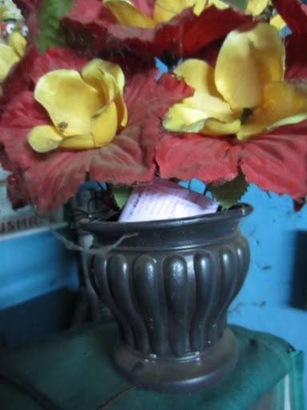
Qualities That Matter
1. Visibility/Invisibility
Valuables are safest when no one can see them. Moreover, invisibility may protect one from social obligations to others that can result from savings.
2. Durability
Resource management techniques must be able to withstand the extreme wear and tear of precarious daily life.
3. Sociality of Access
Who controls access to a resource? Poor Odias prefer to maintain control rather than have it dictated by an institution.
4. Bundling of Uses
The multifunctionality of objects and material practices is itself an important quality. It also relates to each of the above qualities.

Slide 22
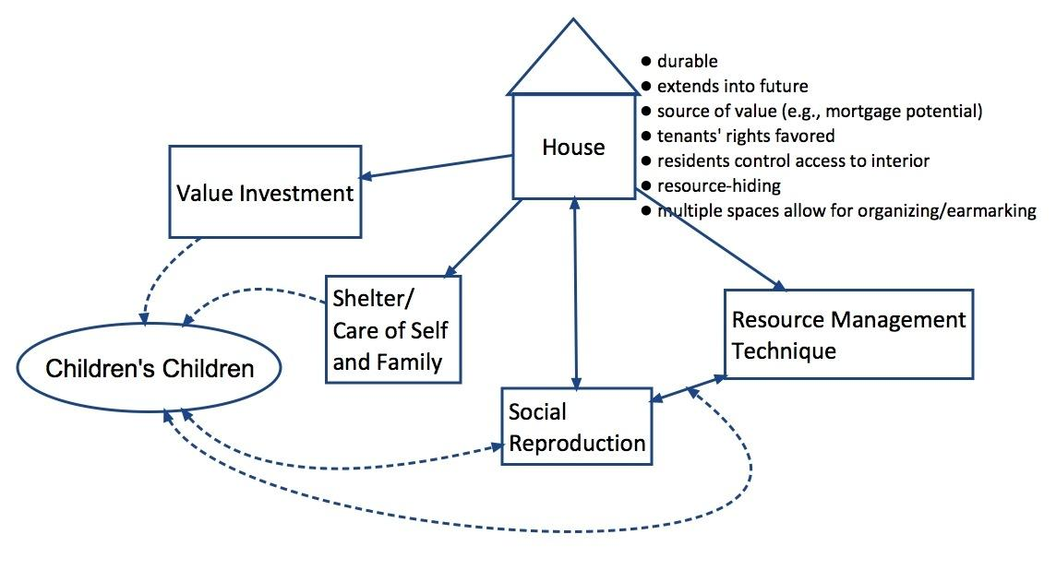
Summary: Houses

