Slide 1
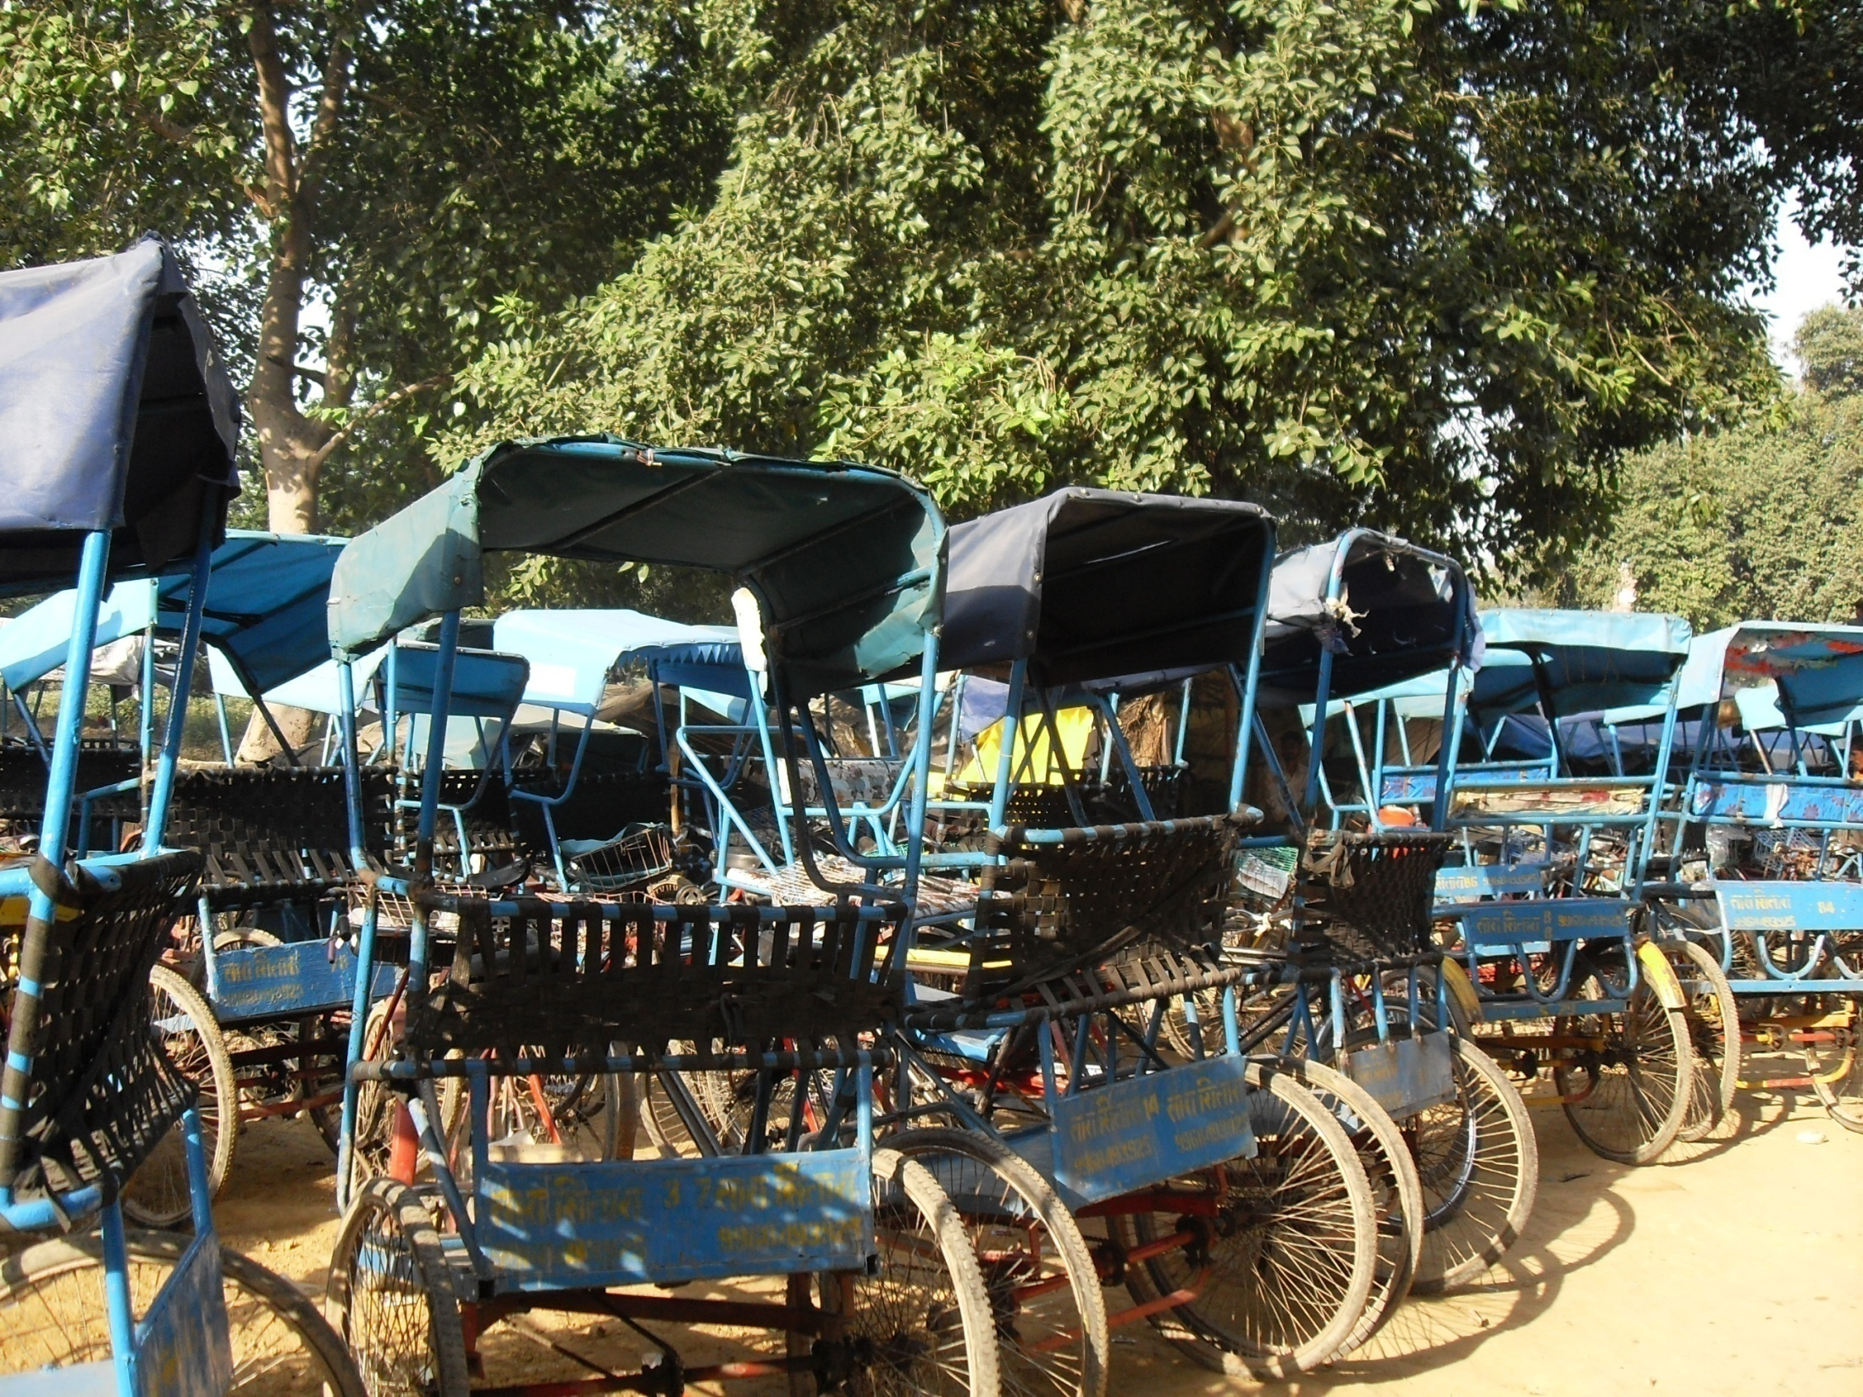
Annual Conference of Funded Researchers, IMTFI, University of California, Irvine, 4-6 December 2012
Evolving Participatory Relationships for Uplifting the Urban Poor Pullers: Next Step Forward
Mani Arul Nandhi
University of Delhi
New Delhi, India
&
Deepti, K.c
Centre for Microfinance
Chennai
Notes:
Title Slide (Mani) Very Good afternoon to all of you. I am Mani Nandhi and I am privileged to be participating here again to present my third study. I would like to introduce my co-researcher of this study . I would take you through the path we have travelled so far in our attempt to bank the unbanked rickshaw pullers in Delhi.

Slide 2
Pedalling with rickshaw pullers for banking them.
Route Map
Context
RICKSHAW PULLERS ARE HOMELESS MIGRANTS
Large marginalised group in Delhi
Bankable but left out by banks
95% SAVE INFORMALLY (Nandhi, 2010)
31% save with money guard
55 % save on person
~ 90 % HAVE NO ADDRESS PROOF in Delhi
49 – 53 % no ID at place of origin
→ Barrier to KYC Compliance
66% of pullers evinced interest in getting a bank account (Nandhi,2010)
Context
Research Objective and Planned Strategy
Ground Reality
Notes:
Slide # 2: –Rickshaw pullers is a strong group of marginalized poor migrants and are bankable in terms of their saving potential as documented in an earlier IMTFI study. 95% depend on informal saving methods due to lack of KYC norms which act a barrier to banking them.

Slide 3
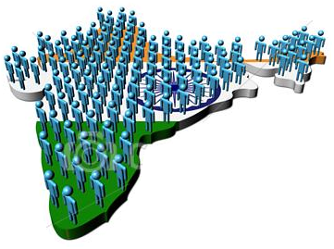
Introduction to the Study
Unorthodox Method = Social Activism + Experimental Research
Unique Identification (UID) AADHAR Cards By The Indian Government
Research strategy:
Pullers’ willingness to participate = Evidence of Hand-holding Support In Opening Bank Accounts and UID AADHAR cards
Social Mobilisation
2nd level
Obtaining the UID AADHAR card
3rd level
Linking with Mobile Banking Account
1st level
Notes:
Slide 3 - Using an unorthodox route to bank these pullers through social activism ,hand holding support and financial education, it was aimed to use the Indian Government’s AADHAR cards, which is an unique identification scheme expected to be game changer in financial inclusion. Research strategy was three pronged – social mobilisation of pullers, obtaining them AADHAR cards and to link them with mobile bank/ bank account. Sample area is an illegal slum settlement with many clusters of pullers living there. Our target population is drawn from two clusters of pullers from Madhya Pradesh.

Slide 4
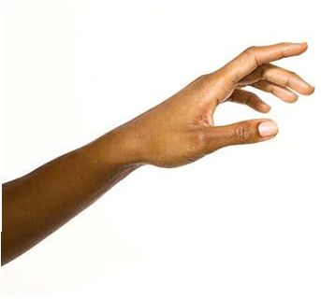
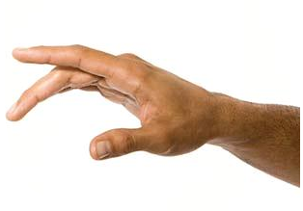
Pullers Wait and Watch Where the Track leads to…
Cynicism
Work Time is precious, Time = Money
Disbelief
Prior Empty Promises
Lack of Enthusiasm
Show us Proof of getting Bank accounts and UID cards!!!
Distrust
Any
Expenses?
DOES THE PASSAGE HAS A LIGHT AT THE END?
Notes:
Slide 4:– At the social mobilisation stage, we sensed / faced utter disbelief, cynicism, distrust and lack of enthusiasm for participating in the project by the pullers. This stemmed from 4 critical reasons –
One, earlier they were misled by some groups/organisation about getting a bank account.
Two, pullers’ singular focus during the migratory period was to maximise earnings.
Three, their queried about the monetary and non-monetary cost get bank account.
Four, they confessed that their willingness to participate is subject to demonstrating getting UID cards and bank accounts.

Slide 5

When Banks, Government do not bother about us, why should we?
Who are we? Why should they believe us? Why should they trust us?
We are ‘strangers’ with a purpose?
Notes:
Slide 5, Deepti – Pullers’ mindset raised questions in our minds and forced us to think of a strategy change in our goal.

Slide 6

Willingness to be Banked !!!
Demonstration of Opening Bank Accounts
Notes:
Slide 6: Deepti – Realising we faced a ‘Chicken first or Egg first’ situation, we changed the planned route from mobilisation to getting bank accounts first.

Slide 7
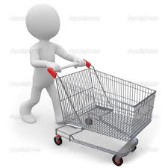
Change in Field Strategy
Track # 1 – Linking with SBI-EKO Mobile Banking
ACCOUNT LINKAGE 3RD-8TH SEP, 2012
AVERAGE TIME = 6 DAYS
ACCOUNT ACTIVATION
TIME
NORMAL TIME = 15 DAYS
ACTUAL TIME = 61 DAYS
FIRST DEPOSIT ON 59TH DAY
FAILED TRANSACTION
TECHNICAL GLITCH
Pushing the Cart to Move
SOCIAL
ACTIVIST
EKO
CONTINUOUS LIAISION WITH EKO TO GET ACCOUNTS ACTIVATION
Notes:
Slide 7:– Changing the strategy, we focused on getting the bank accounts first to overcome their reservations. To start with, 6 pullers with ‘Voter’s ID of their state’’ were linked with SBI-EKO’s mobile banking saving account.
This, done at an average time of 5-6 days for mobilisation and bank linkage, we had to push the ‘EKO cart’ to ensure account activation. At present, normal time is 2 weeks for account activation, but it took 61 days to activate these 6 accounts compared to ‘same day account activation’ nearly 1 and half year ago. First puller attempted deposit but his transaction failed because EKO account was not migrated to SBI’s CBS platform, which was done after the EKO cart was pushed again
Next encouraging the pullers to deposit, when the first puller went to deposit on 59th day, transaction failed due to the account’s non-migration to CBS platform.

Slide 8

Ground Reality
Bank Led Mobile Banking (Saving Account) Rail wobbles on?!!
Mobile Bank Saving A/c
CSP
EKO (BC)
TSP
Bank
Brand
ON THE SPOT CSP TRAINING.
MESSAGE IN ENGLISH
SERVER PROBLEMS
BACK END OPERATION OF EKO LAID BACK
LIMITED TRANSACTION POINTS IN DELHI OR NONE IN VILLAGE
MINIMAL KYC NORMS
Pullers own mobile phone.
DELAYS IN KYC VERIFICATIONAND SYNCHRONISATION WITH CBS PLATFORM
LACK TRAINING
LACK PRO-POOR TRAINING, SENSITIVITY.
FOCUS/TIME FOR SAVING PRODUCT CUSTOMERS IS WEAK.
Notes:
Slide 8: – Mobile banking account of SBI was chosen because it requires minimal KYC norms. However, we experienced certain concerns at several steps.
For instance, at the only SBI- EKO counter in the sampled area , lack of training and lack of pro-poor sensitivity of the CSP were revealing. Also, the CSP’’s primary focus was on the remittance product and not saving product.
– More revealing was at the BC level. Pullers precious earning time was considerably spent on account opening day. Because CSP was trained on account opening formalities ‘on the spot’ ‘on the same day’ at the ICICI-EKO counter. Curiously enough, account related SMS alerts were in English and not all handsets with different airtime providers received messages smoothly. Server connectivity problems delayed messages about the first deposit made. Besides, handsets with one telecom operator were found to receive messages promptly. More crucially, EKO’s back end operations for saving product is weak due to its spotlight on remittance product. This is compounded by the SBI’s delays in verification and synchronisation of EKO accounts with CBS platform.

Slide 9




Ground Reality
Account Activation
CUSTOMER
SBI
EKO
CSP
Notes:
Slide 9:– Irritants and pain points at different levels in the mobile banking rail reminded us of a ‘football game’ .

Slide 10
Change in Field Strategy
Track # 2 – Linking with ICICI-EKO Mobile Banking
OUTCOME OF MOBILE LINKAGE WITHOUT KYC NORMS
BASIC
SAVINGS A/C
- A/C OPENING & ACTIVATION SAME DAY
- 3 DEPOSIT SAME DAY
- WEEK LATER ONE DEPOSIT.
PERIOD
10 DAYS AFTER POST PURCHASE ANXIETY AND DITHERING TO DEPOSIT
‘I want to save but in a counter on way to work’
MOBILE BANKED
PULLERS
‘BC counter does not look like a bank branch’
Notes:
Slide 10: – So we changed the track towards mobile banking the pullers through the ICICI –EKO route, because ICICI, a large private bank offers KYC free ‘Apna Savings account’ requiring a photo only and permits maximum cash balance of inr 50,000 .
8 pullers accounts were opened and were activated immediately.
First day, 3 pullers deposited 2 dollars each. Subsequently, the Pullers’ Cart was pushed, and we faced post delivery blues with a number of queries and doubts.

Slide 11



Outcome of Social Mobilization of Pullers
Number of pullers enlisted = 75
Number finalized = 30
Tentative number in village or busy with pedaling or waiting and watching = 45
Notes:
Slide 11:– After opening mobile accounts, new faces approached inclined to volunteer and our social mobilisation was like these ants gathering food. We enlisted 75 pullers, finalized 30 and have 45 pullers waiting in the wings to participate depending on our progress in UID and bank account opening.

Slide 12

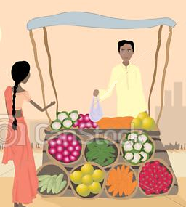

Post Purchase Anxiety of Mobile Banked Pullers…
?? BANK !!!!
IMPRESSIVE
BC (EKO)
COUNTER
BANK BRANCH
NO TRANSACTION CHARGES WITH
ATM CARDS
WHY TRANSACTION CHARGES &
NO ATM CARDS?
Notes:
Slide 12:– Going back to know what kind of Post purchase anxiety was exhibited by the pullers? Some of the responses of the pullers were:
One, BC counter is only a shop (poor cousin to the ‘bank’) and does not resemble an impressive bank.
Two, Bank does not charge for deposits and withdrawals but why should EKO shop charge if we are going to be saving there?
Bank gives ATM cards BUT ATM CARDS are not given at the EKO shop

Slide 13


WHICH WAY PENDULUM SWUNG 10 DAYS AFTER ?
Saving in Mobile banking account or Habitual Savings Mode ?
CONCERNS
MONEY FOR BASIC NEEDS
GOING HOME
REMITTED MONEY
REPAY DEBT
NO TIME FROM WORK TO DEPOSIT
P
BEHAVIOUR
SO, I PREFER TO STORE WITH ‘TEKEDAR’
OR
KEEP MONEY WITH SELF (CONVENIENT)
DEPOSIT LATER IN MOBILE ACCOUNT
Notes:
Slide 13:– Gently pushing the pullers to deposit in the accounts, the pendulum seemed to swing towards the ‘informal storing practices’ for various reasons.
Be it for current consumption needs that needed to be sent home or for meeting the ongoing festival expenses, pullers stored with the ‘tekedar’ / rickshaw contractor who is an ‘on the spot deposit collector or local bank’ or preferred to keep money with self.
When money had to be sent home through a fellow villager or to repay a sudden debt incurred due to gambling – a past time in the pullers’ slum, depositing in the account was far from their mind.
Importantly, their focus in earning with ‘No time’ to go that extra bit to the EKO counter’ and storing with ‘doorstep tekedar’ is convenient.

Slide 14
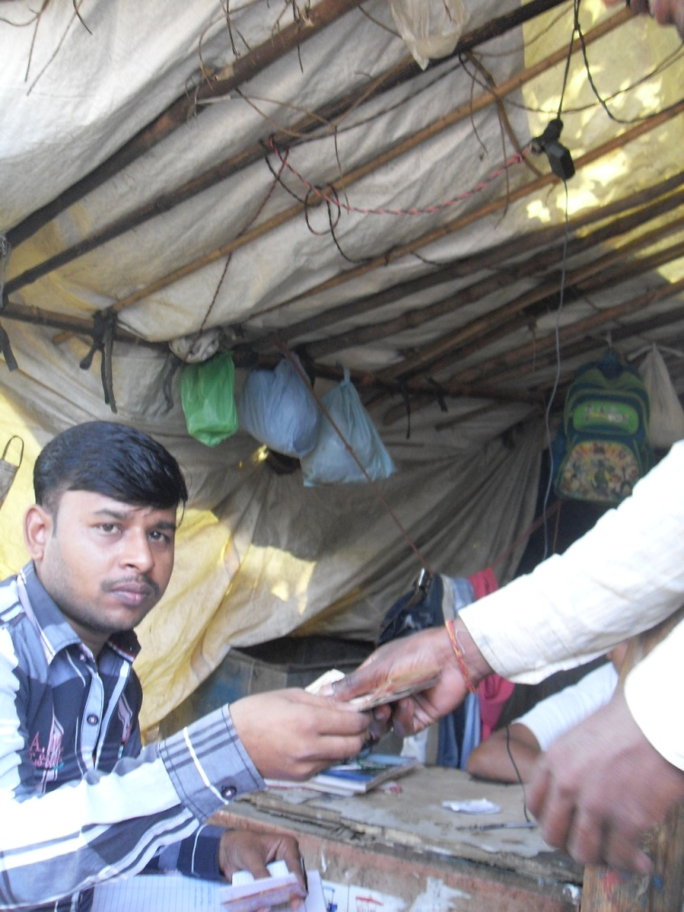
Post Purchase Anxiety – any plausible triggers?
Which Way the Scales Tilt now?
On the Spot ‘Pullers’ Mobile Bank’
MOBILE BANKING
EKO COUNTER FAR
KNOWN BRAND, UNKNOWN SUB-AGENT
SAVING WITH ‘TEKEDAR’ OR WITH SELF
NO CHARGES
DOORSTEP
TIME TESTED
TRANSACTION CHARGES
‘TEKEDAR’
(CONTRACTOR)
DEPOSIT
COLLECTOR
Notes:
Slide 14: Mani – Were there any elementary triggers that seem _ at the moment – to tilt the scales towards ‘on the spot pullers’ mobile bank’, 3 basic triggers
Brand recognition about the bank is strong but uncertainty about the BC or the sub-agent as against the ‘Time tested’ and known ‘tekedar’.
Eko counter is not on their route to work as against easily available ‘tekedar’s services at their place of stay.
Tekedar does not charge any fees (it does not matter even if he does pay them interest) while Eko shop charges for transactions.

Slide 15
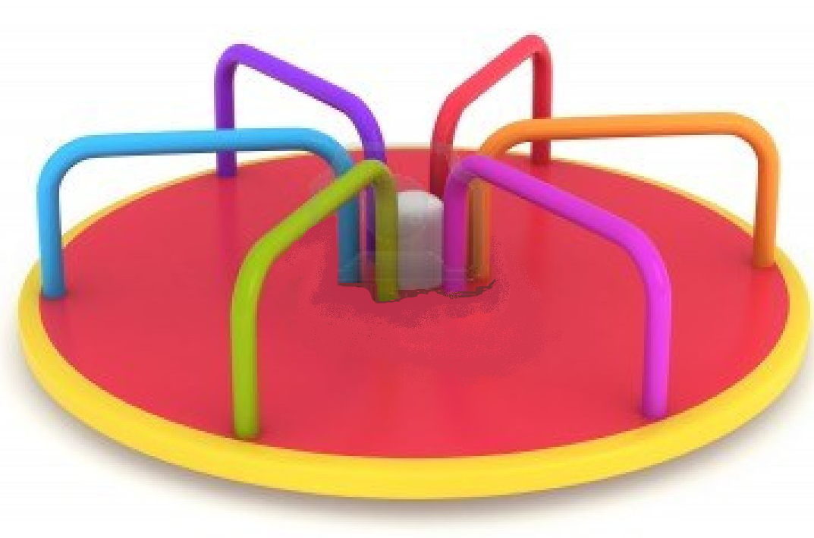
So far, It’s a Merry Go Around in our route…
Gaps in A/c Activation; & Pullers’ Expectations from Bank account.
* BANKING THE UNBANKED PULLERS.
Initiative in mobilizing pullers
Opening Mobile Banking A/c
Pullers’ Need to Earn Fast & Quick due to Uncertain and Varying Migratory Period
Time versus Trust in getting a Bank account.
Notes:
Slide 15:– While concerns are there, our experience has been like ‘going on a merry go around’ so far.

Slide 16
Change in Field Strategy
Track # 3
Getting the Pullers’ AADHAR Identity enabled
Enrolment
Introducer
AADHAR
NUMBER
MANI enrolled ON 6TH SEPT
PI -MANI’S AADHAR #
15TH OCTOBER 12
UID
PAPER WORK
ON 26TH OCT,12
CERTIFICATE FROM MANI’S INSTITUION
8TH NOVEMBER 12
CERTIFICATE
SENT ON 9TH NOVEMBER
STATUS YET TO BE RECEIVED!
Notes:
Slide 16:– Getting the pullers UID enabled started with enrolling 3 pullers with voter’s Id. However, for other homeless pullers, a prerequisite was to get ‘an introducer’ who will act as guarantor. Not wanting to seek the help of any NGO who acts as ‘introducer’, Mani as the PI and being in Delhi had to become an introducer. By pushing the UID cart from the top levels, first Mani enrolled on 6th Sept, received the AADHAR NUMBER on 15th october. Then completed some formalites on 26th October but the UID Registrar for Central Delhi demanded a certificate from my employer, which I sent on 9th September but UID INTRODUCER status is unknown till 26th November.

Slide 17
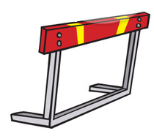

Banking
UID
Mobilisation Stage
a.
b.
c.
REGROUP
a. AIM FOR BANK A/C
d.
REMOTIVATE
POST UID cards
c…..
c.
d…..
d.
The Race to Bank the pullers is to continue………..and gaps to be filled and challenges to be understood ------
Notes:
Mani : Finally, we say Thank you for your attention and we end with the next 3 slides to let you know our unsaid thoughts in our efforts so far...

Slide 18
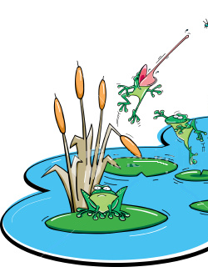
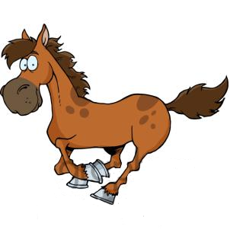
Banking the unbanked puller is like ?!!
Next step is to get bank accounts after AADHAR cards
Then, to track the financial behaviour , challenges …
PULLER
SAVING BANK
ACCOUNTS
Notes:
Mani

Slide 19


Banking the unbanked, is like
pushing the mountains.
BC
PULLERS
BANKS

