Slide 1
“I’ve heard about it, but I don’t know how to use it”
“As for me, I prefer cash”
“I have no need for it”
“I need more information”
“I have it, but have never used it”
“Ei. What if I lose my phone?”
“I’ll use it when others do”
“We have a long way to go, but we have just started”
Making Sense of Mobile Money in Urban Ghana
Vivian A. Dzokoto, Ph.D., Virginia Commonwealth University
Elizabeth Appiah, PhD, Pentecost University College
“Life is now easy with Tigo Cash”
“I use it for airtime and DSTV,
but I don’t trust the other utility companies”
“I used it to send money to my mother”
“I don’t trust it”
“Everybody knows that we don’t use it here (Market)”
“It’s for rich people”
“There is NO WAY you can convince a Kwahu woman not to use cash”
“It’s 666, oh”

Slide 2
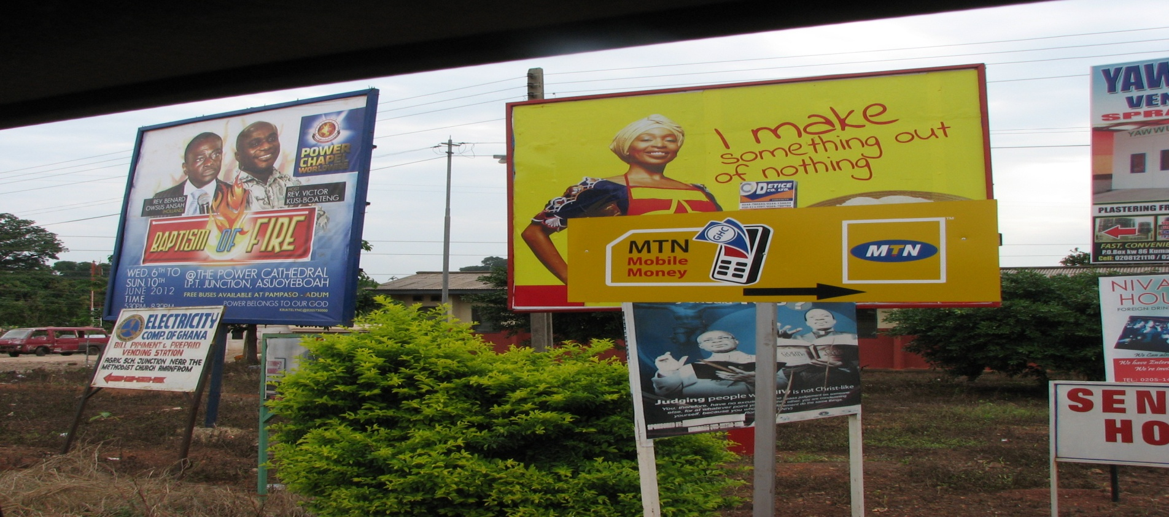
The Issue
Low rate of Mobile Money uptake in Ghana compared to other markets, e.g. Kenya

Slide 3
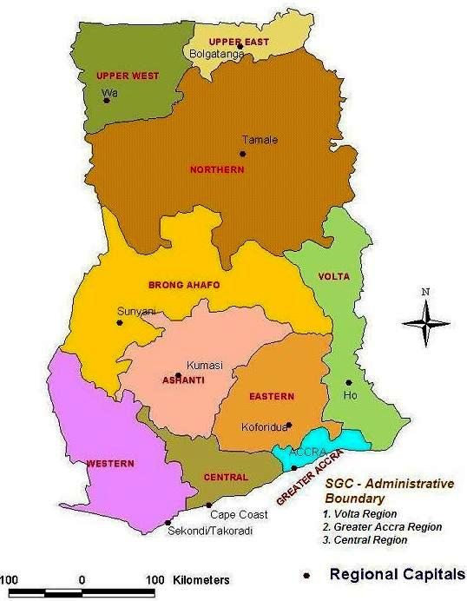
Research Goals
Exploration of
              Personal
              Business
              Social and
              Financial Inclusion
Prospects of Mobile Money in Ghana

Slide 4
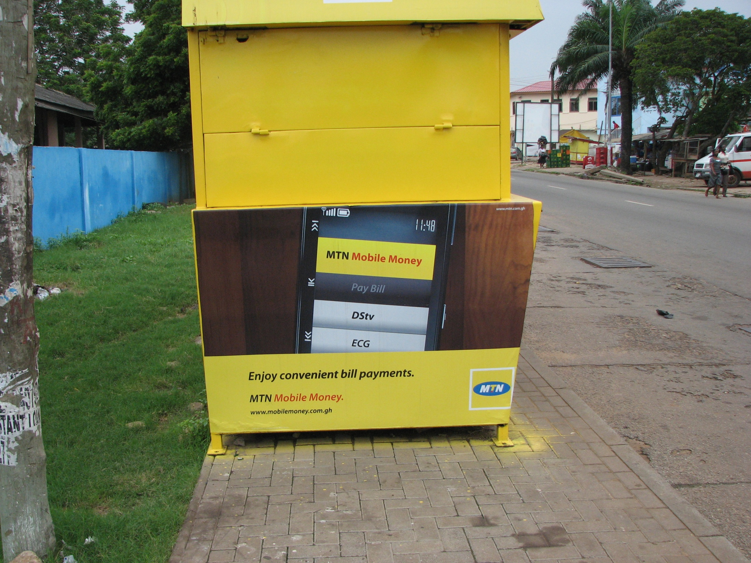
The Study
1250 people polled on MM use, 10 in-depth interviews of users
9 industry Interviews
500 college students: exploring preferences for cashlessness via Spending Diaries, Pair-wise comparisons, and Loss-Gain hypothetical scenarios.
40 Merchants and 20 Market women interviews
80 Low and Middle income interviews

Slide 5
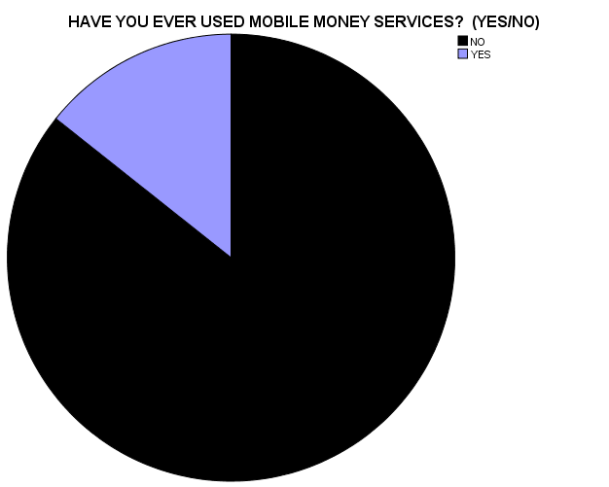
MM POLL
Sample Size: 1250
Location: Accra
# of Sites: 20
# per site: 50 +
Poll Questions Asked
Have you ever used MM?
Age
Sex
Company used
MM used for _______
15% of sample had used MM
“I now send Mobile Money to all my business partners easily and they receive all the cash”

Slide 6
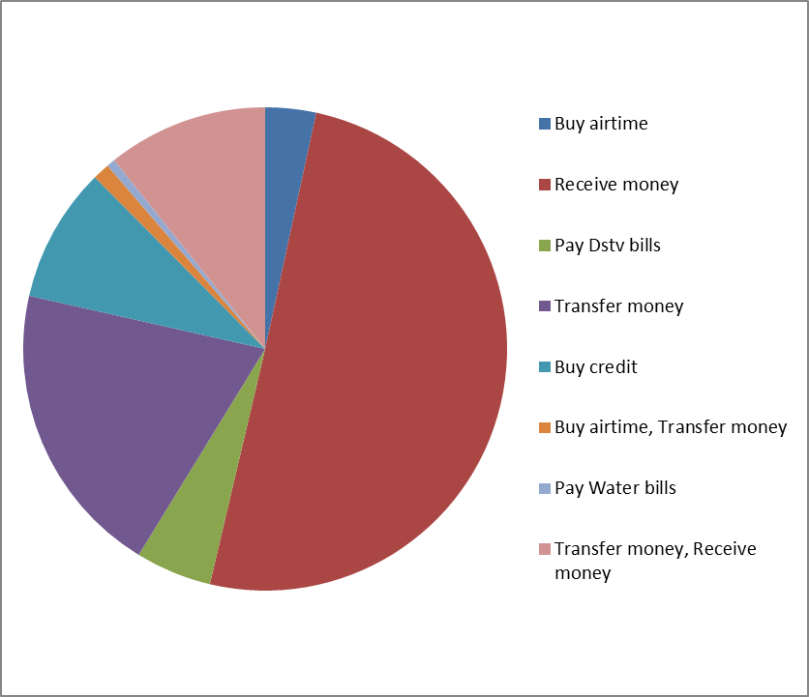
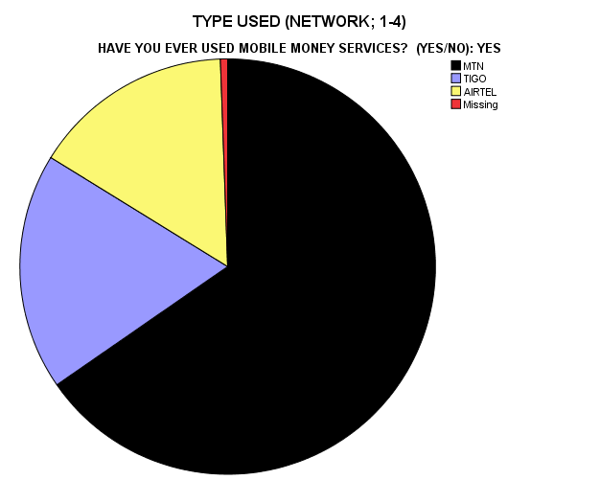
MM USERS
MM was used to:
Ghanaian users trust mobile money, but non-users do not (CGAP, 2012)

Slide 7
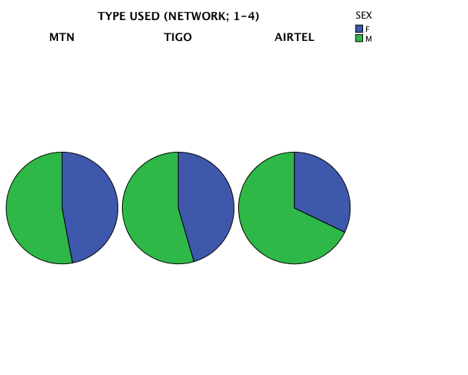
Types of Companies Used
Gender Distribution

Slide 8
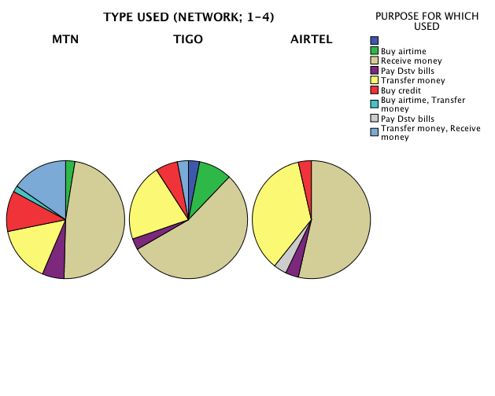
Across networks, receiving money was #1

Slide 9
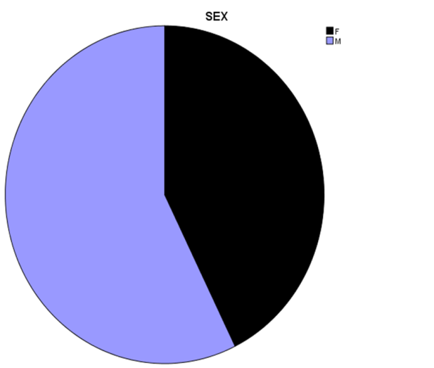
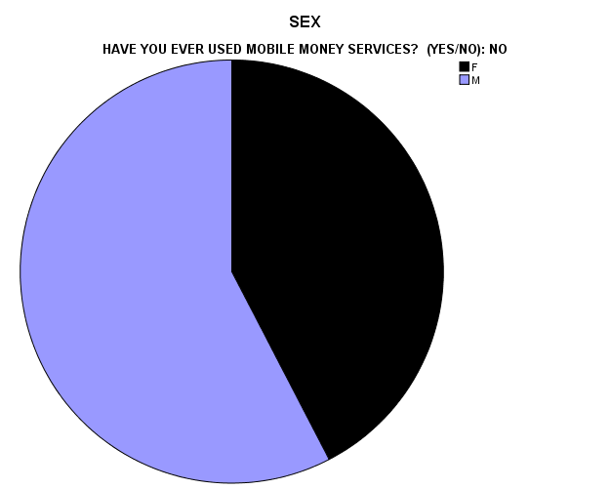
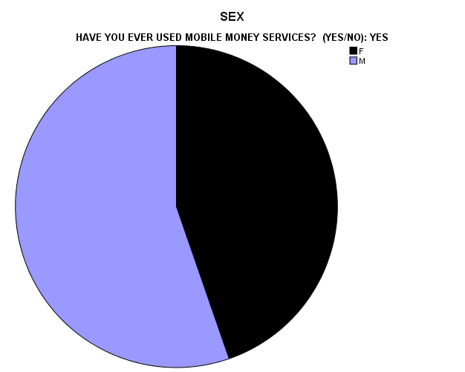
SEX (USERS AND NON-USERS)
Total Sample,
Gender Distribution
MM Non-Users gender distribution
MM Users gender distribution
“There is NO WAY you can convince a Kwahu woman not to use cash”

Slide 10
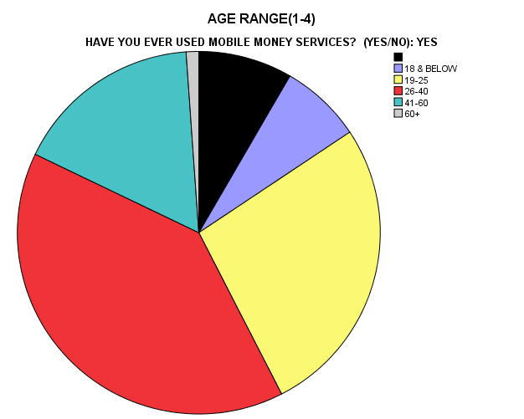
AGE DISTRIBUTION OF MM USERS
“As for me, I am old. I like my cash and dealing with what I know. Maybe the young people will use it”

Slide 11
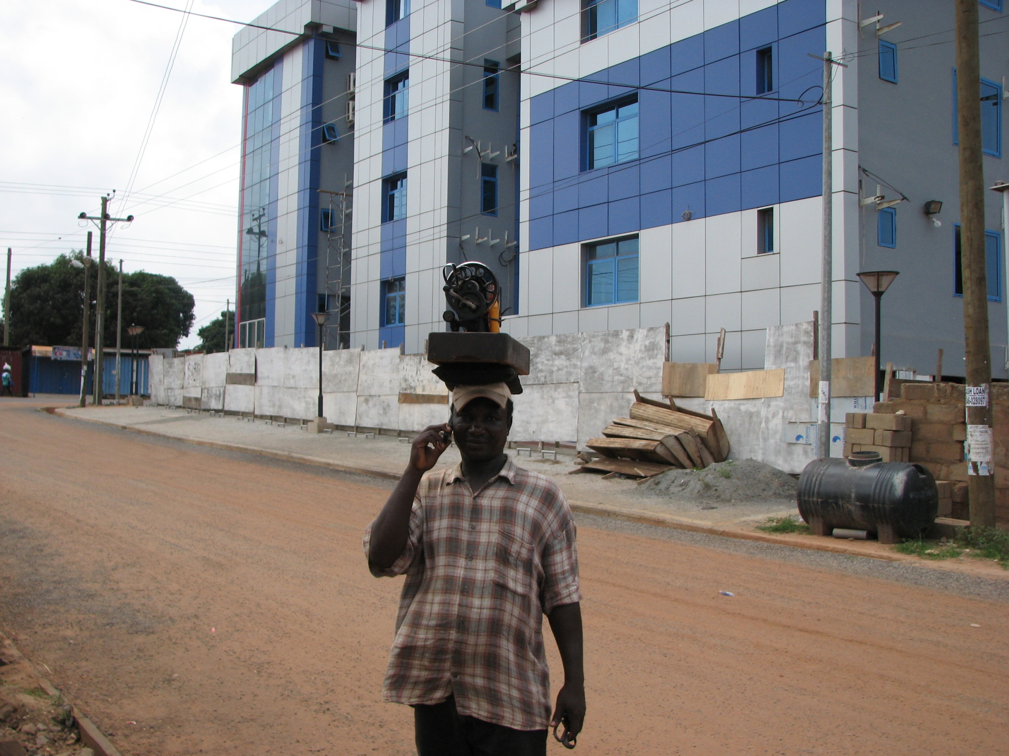
Early Adopters?
10 in-depth interviews
Not more tech savvy
No obvious lifestyle indicators
First time MM use driven by situation in each case
“I needed to send money to … urgently, and … advised me to use MM”

Slide 12
Industry Data:
Mobile Money Transaction Volume
Log of transaction frequencies

Slide 13

Industry Interviews
Limited Utility
Agent Issues
Information Gap
Bank Partnerships and Other Regulatory Issues
Financial Inclusion?
Competition between MM companies
Potential For Growth

Slide 14
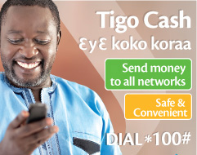
Limited Utility of MM
Airfare, DSTV, Electricity, Money Transfer, Top up, Insurance, 2nd cycle institutions, investment banks
Shops have not started using it yet, but accept ezwich, a biometric smartcard
Connection to ATMS not started yet
MM company employees were forced to use it due to low patronage
Stonewalling of innovation: MM driven online shopping business initiative not patronized, other business ideas not bought into.
Church and funeral donations? Not likely!!!!
“We will have to build an entire MM payment ecosystem”

Slide 15
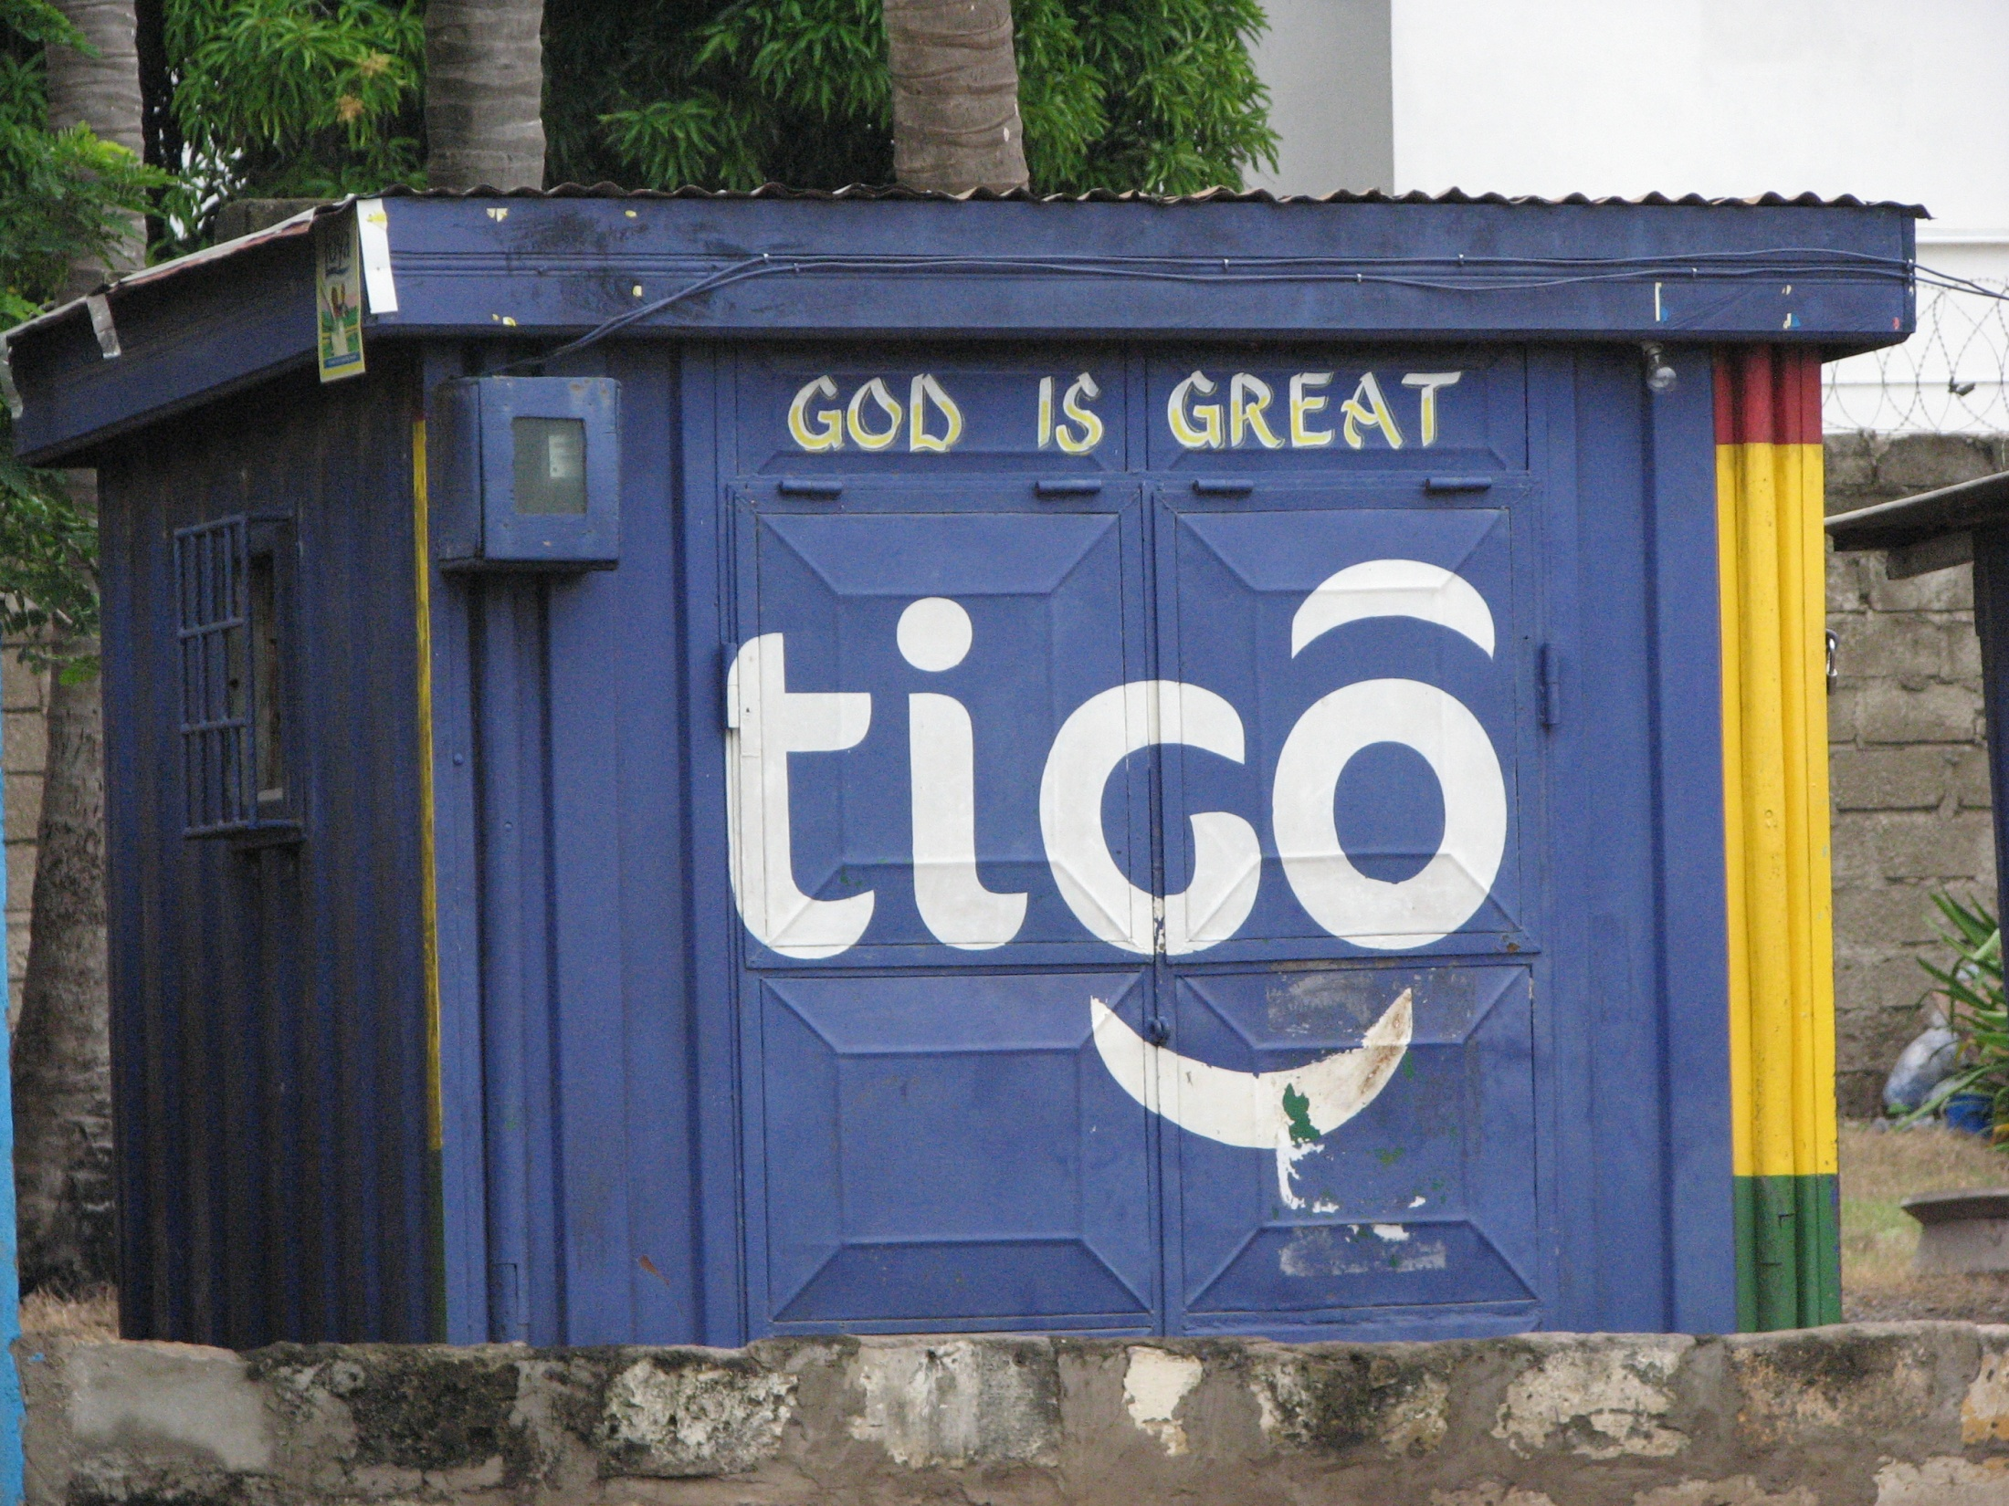
Agents
Initial MM settlement period was 7 days, preference for cash
Agent profit margin too low: “more profitable to sell bagged water”
Agents not available (e.g. Apam, Northern Ghana)
Agents absent when needed
“Nobody is driving the agent relationship”

Slide 16
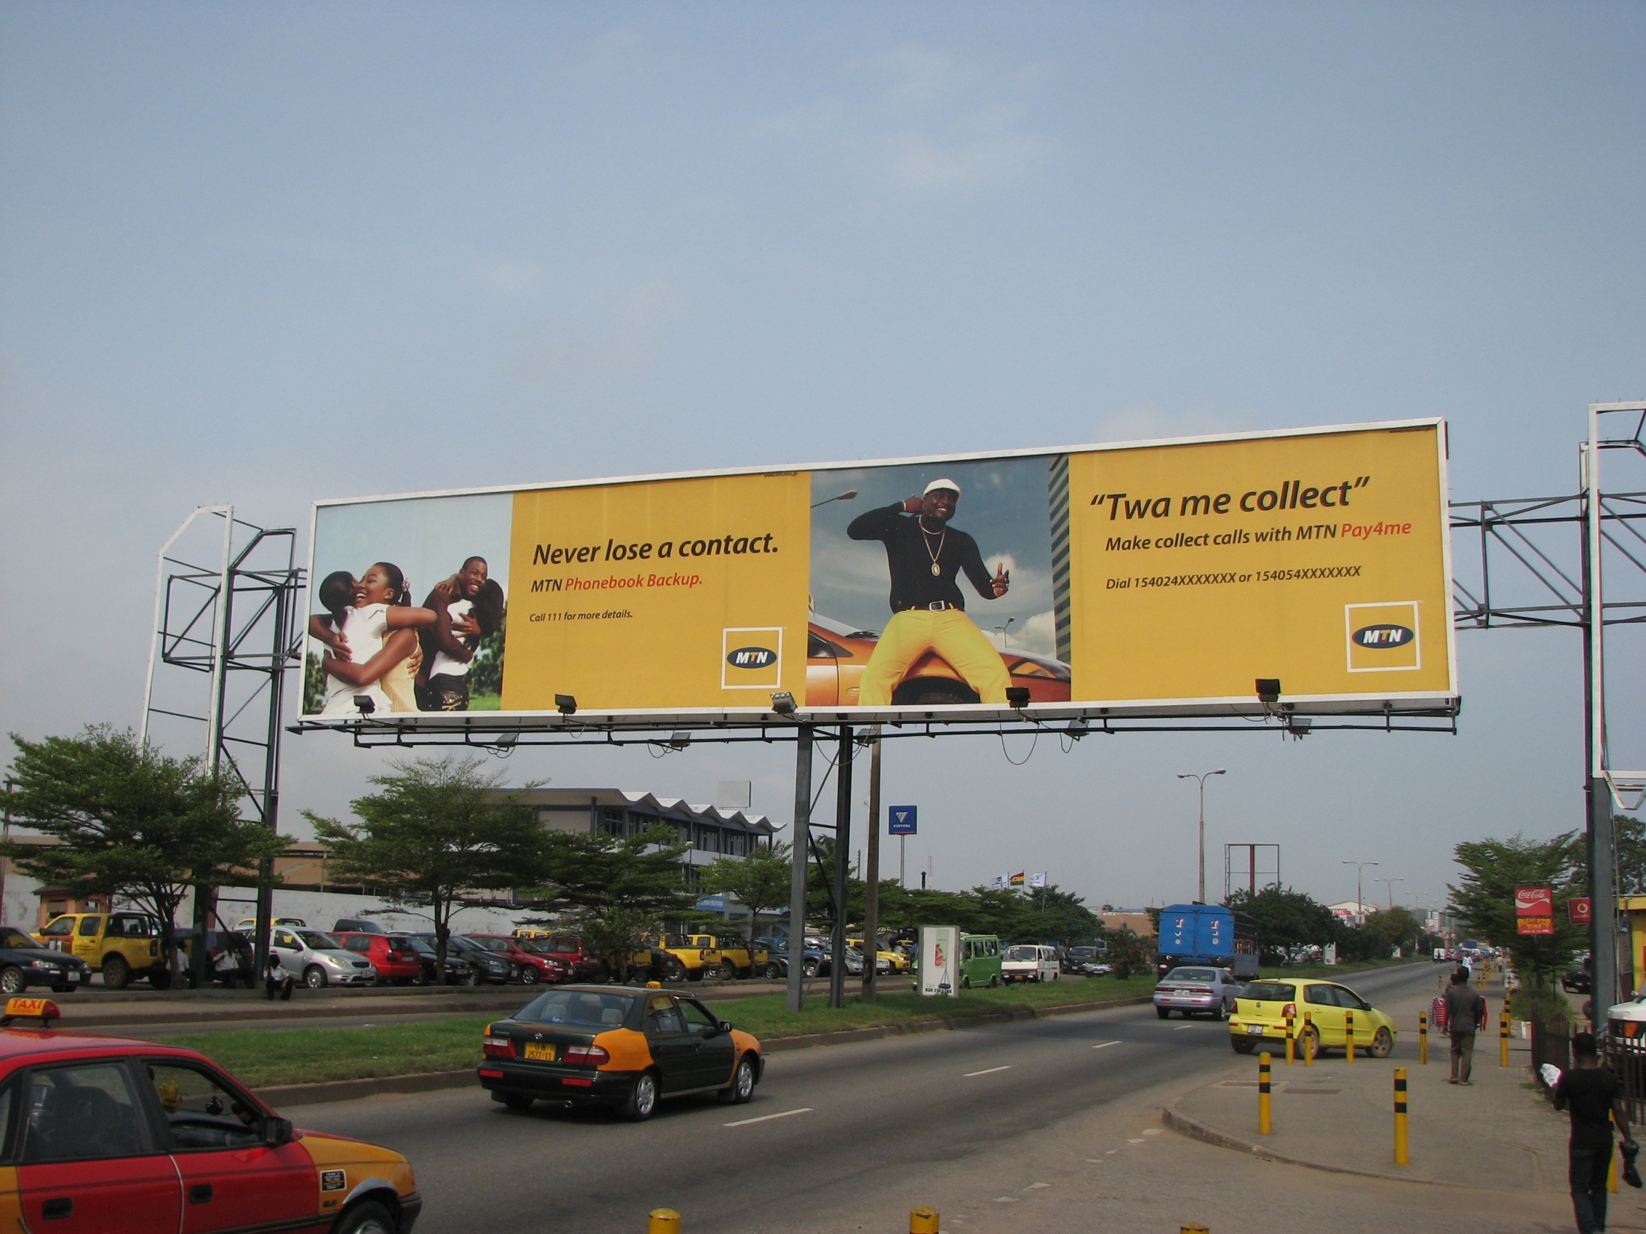
Information Gap
“On 2 separate occasions, a regional director sent the BNI to go and arrest (people from) a company that allowed people to pay their electricity bills with MM”
Low public awareness despite advertisement overload
“people just think of it (slogan from MM ad) as a new term”
More strategic marketing/selective segmentation needed
Illiteracy is a barrier

Slide 17
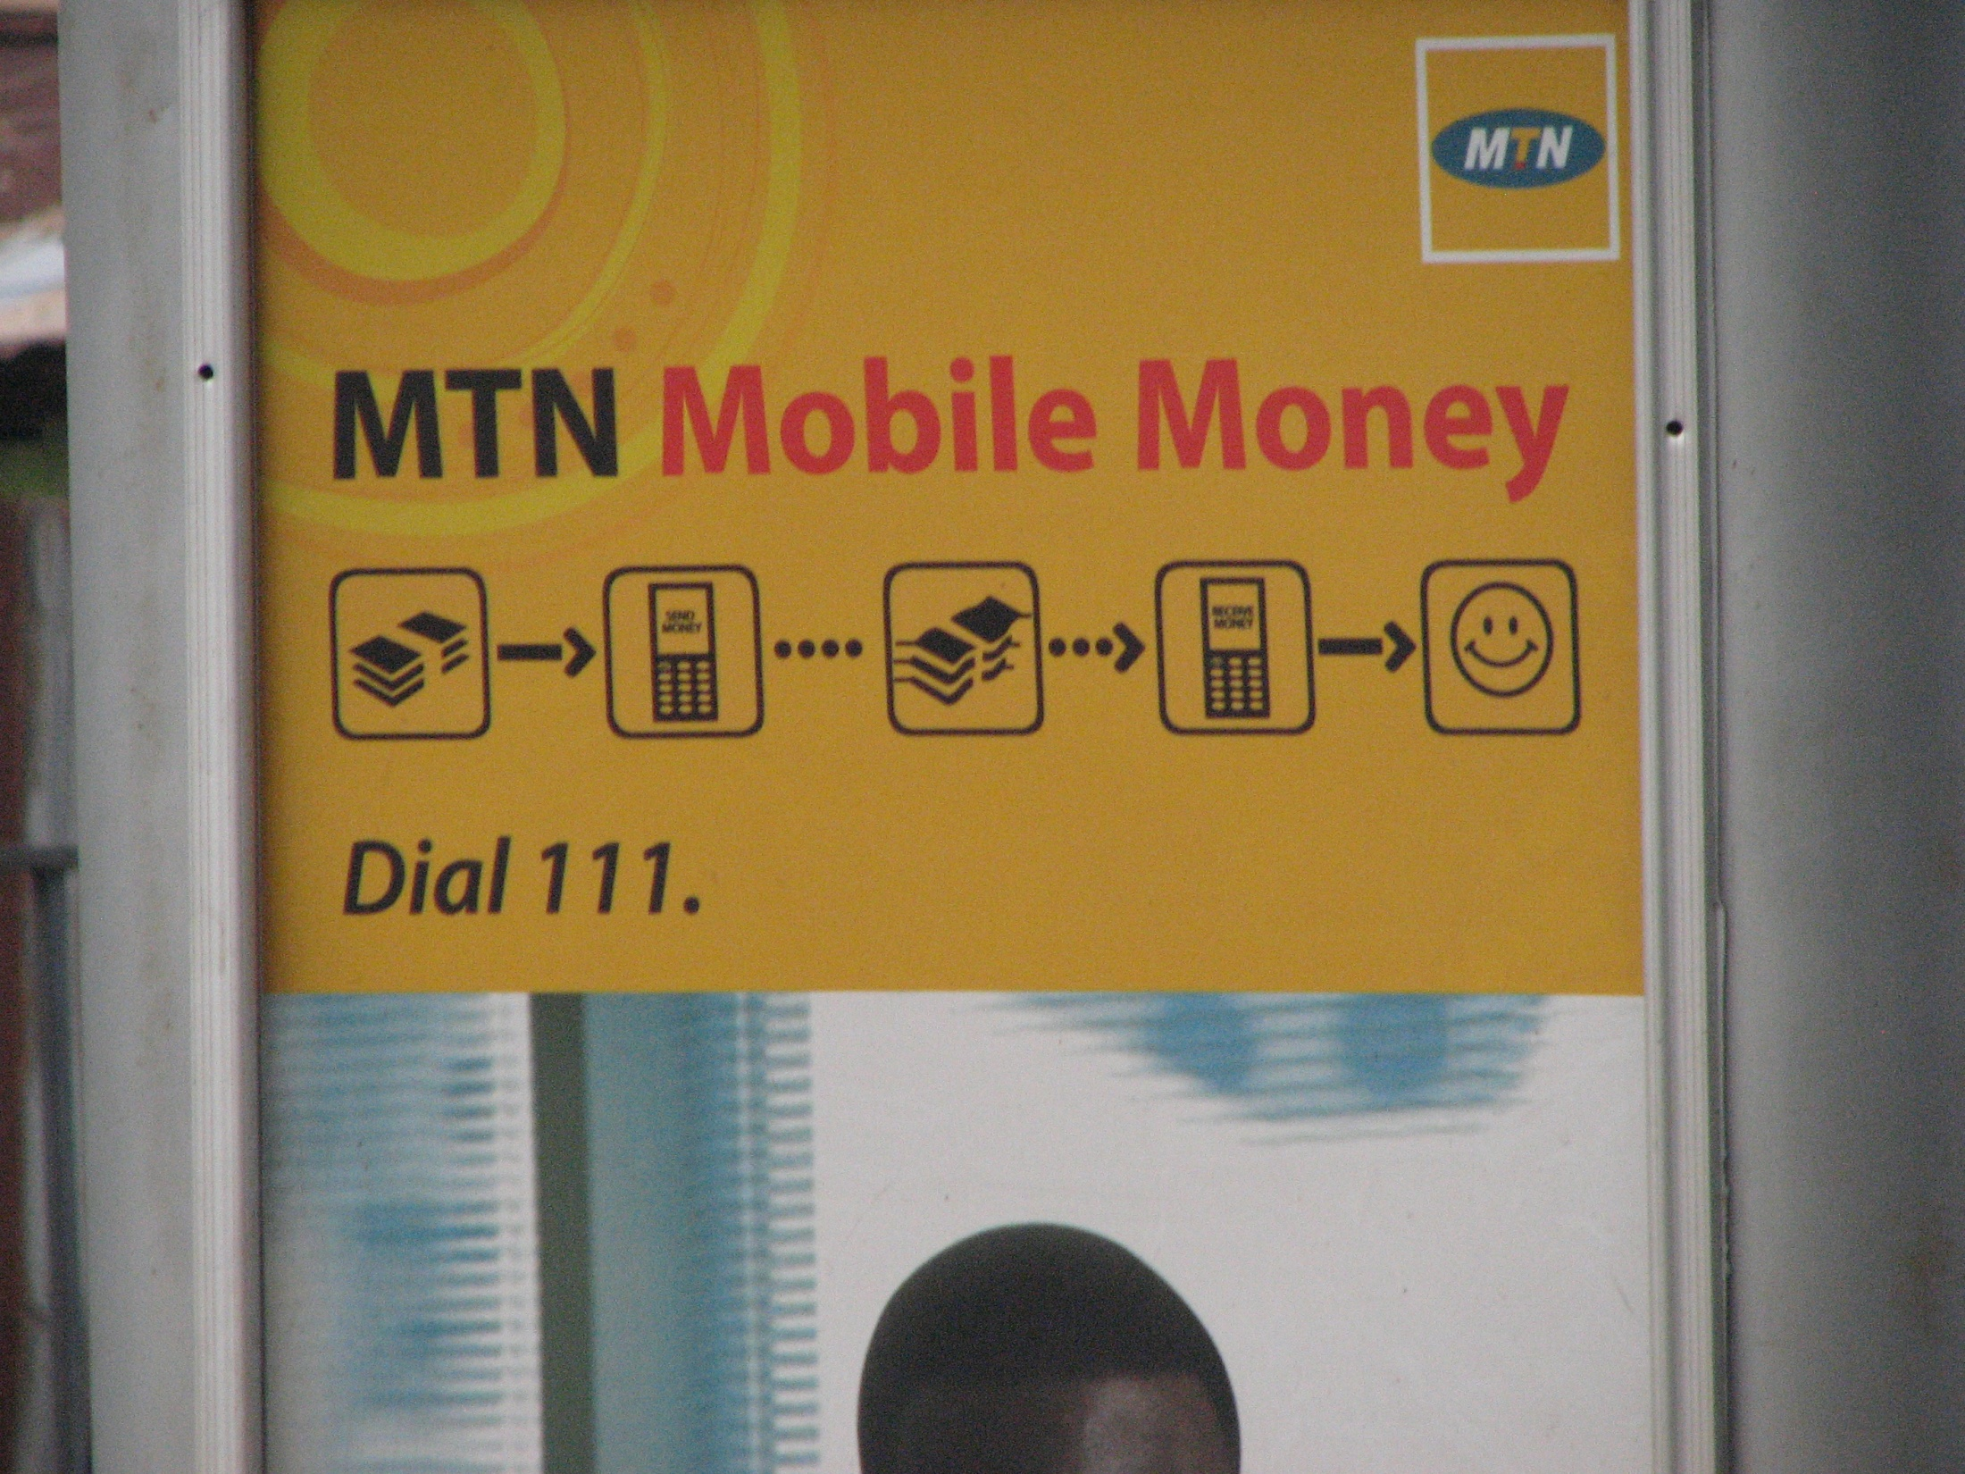
Bank Partnerships & MM Regulation
Regulatory body “not on our side”
Regulatory body “10 years behind the curve”
Varied level of investment from bank partners (from holding float to active marketing and product creation)
Mandated bank partnerships slowing progress
“Level of partnership needs to be redefined”
“They (banks) think we telcos are not giving them recognition”

Slide 18
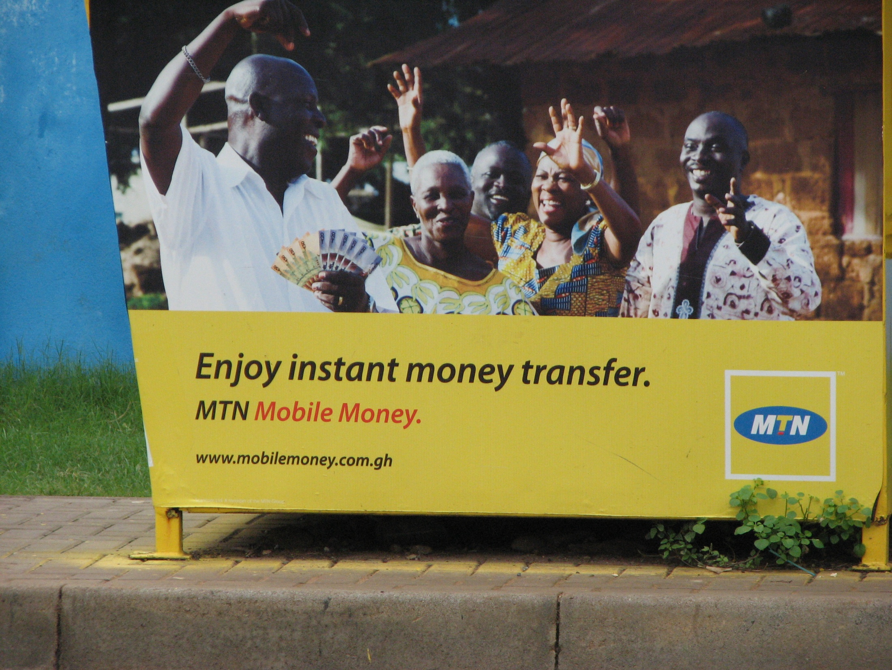
Financial Inclusion?
“MM is providing more channels for the banked (multi-banked), the unbanked are not using it”
“MM would provide a great platform for online shopping”
Great potential in Northern Ghana which has fewer banks

Slide 19
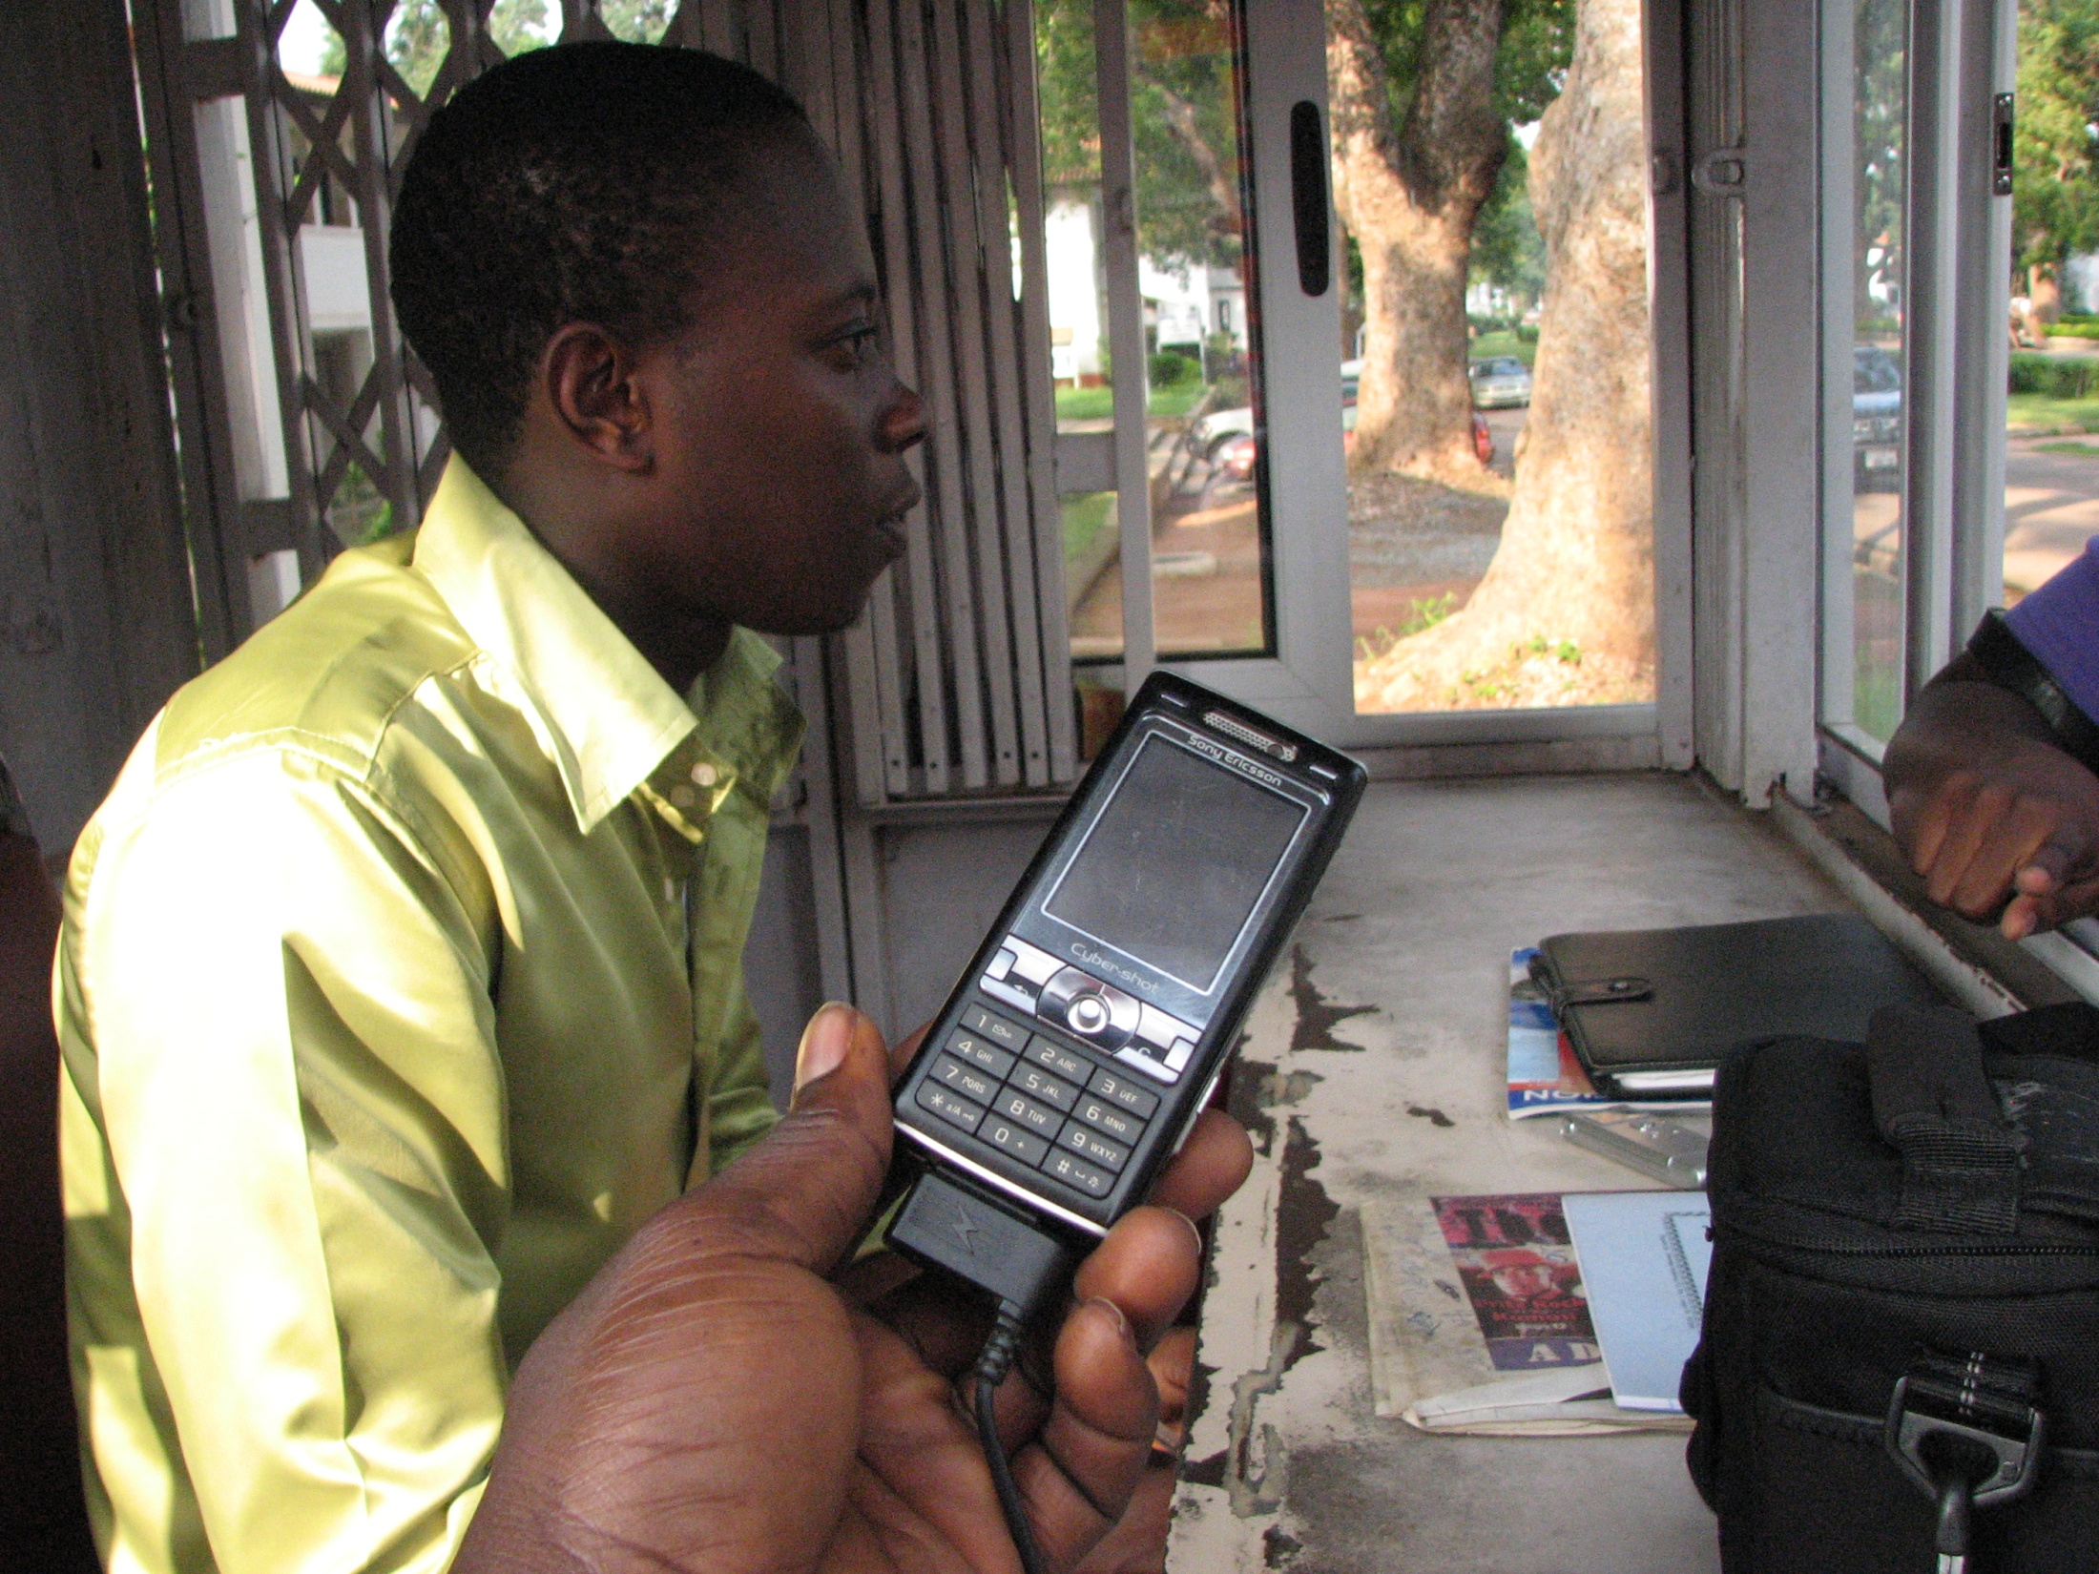
Competition Between Companies
Employee poaching
Turnover and re-organization of MM departments
Alleged sabotaging
“you have all these things sitting in silos trying to do different things with a common objective because there is no national agenda, so it is all over the place”

Slide 20
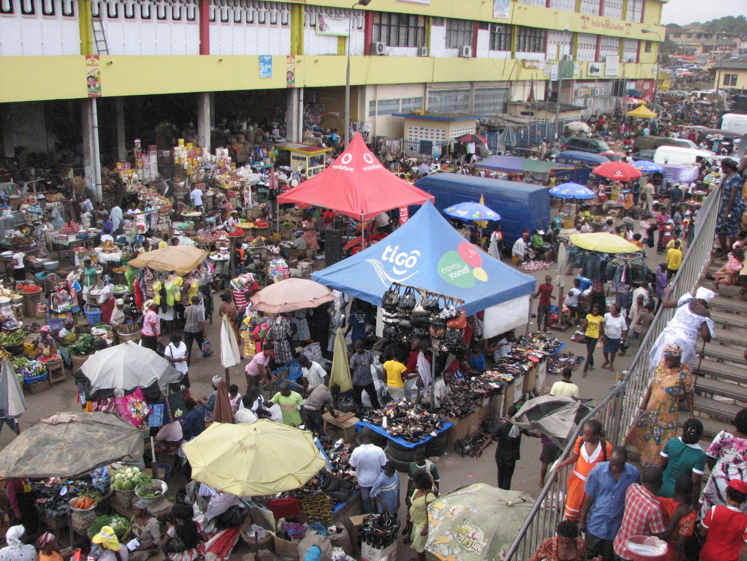
Potential For Growth
“we will get there”
“the building blocks are there”
“It will work. I believe strongly that it will work”
Potential Microfinance focus
Need to build trust
“We have plans in place”

Slide 21

If we build it they will come
vs.
If they need it they will use it
Time Will Tell…..?
1 week,
157 students,
1220 cash-based transactions,
2.86 % non- cash transactions
540,000 Airtel Money
transactions monthly
Tigo Cash float
GHC11million daily
1.5 million MTN transactions monthly, GHC52million
Airtel Money cash float GHC4million daily
156,000 active Tigo Cash subscribers
13% of Tigo subscribers doing 5-6 transactions a month.

