Slide 1

Delivering Cash Grants to Indigenous Peoples Through ATM & GCASH Remit:
The Case of Pantawid Pamilyang Pilipino
Conditional Cash Transfer Program in the Philippines
by Anatoly Gusto & Emily Roque
MICRA Philippines
IMTFI 4th Annual Conference
University of California, Irvine
December 5-7, 2012
Notes:
J

Slide 2
Indigenous people, or IPs
ATM
Financial technology
Money or cash
Notes:
J

Slide 3
Research Questions
In comparing two types of cash grant disbursement,
  how do IPs perceive and respond to using cash? financial technology?
  what are the possible changes in perceptions and behavior towards money and technology?
  how do they spend, save and utilize the cash grants given to them?
Notes:
J

Slide 4
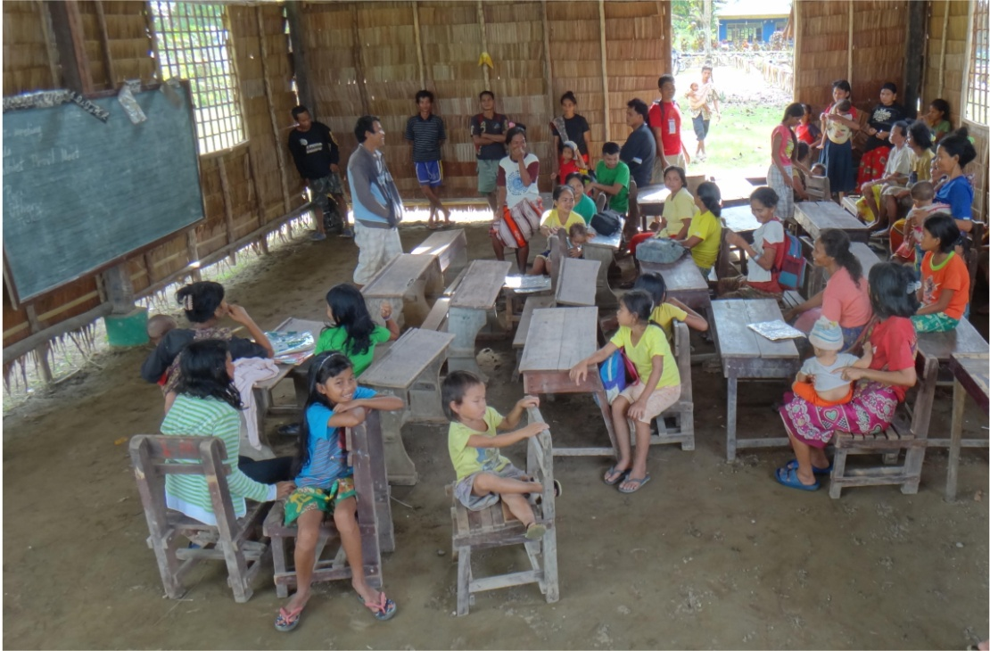
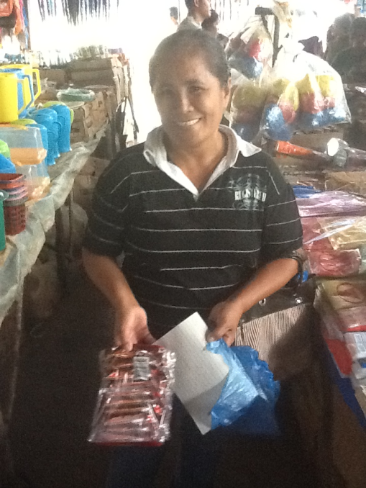
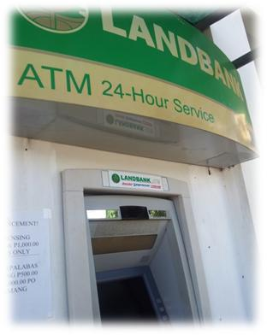

Background
Conditional Cash Transfer (CCT) = social program which provides money (subsidy) to poor families contingent on certain behavior (sending children to school or bringing them to health centers)
Focus is on children as end recipients
4Ps = CCT Program of the Department of Social Welfare & Development (DSWD) in the Philippines
Target segment includes marginalized ethnic groups or indigenous peoples (IPs)
Makes use of various delivery mechanisms/disbursements:
  traditional (over-the-counter)
  technology-driven (ATM; mobile money like GCASH)
Notes:
J
*CCT patterned after programs in Latin America and Africa (Bolsa Familia, Familias in Accion)

Slide 5

Program Conditionalities
EDUCATION
HEALTH
3-5 (Daycare)
6-14 (ES/HS)
Pre/Post Natal
0-2 (Vaccination)
3-5 (BHS Visit)
“ALL
OR
NOTHING”
Php. 300 or US$ 7++ / child (85% Attendance)
Family Dev’t Session (FDS)
Deworming
Php. 500 or US$ 12++ / household
Source: DSWD Region 4B General Orientation of CCT Program
Notes:
E
*Total of Php1,400 for 3 children per month

Slide 6

Actors
Department of Social Welfare & Development or DSWD
Land Bank
Beneficiaries
Notes:
E

Slide 7
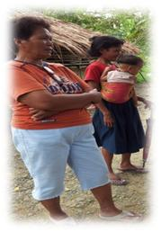
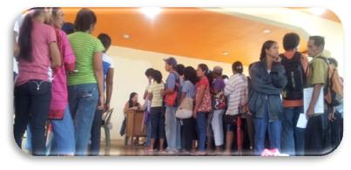
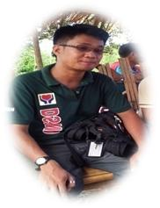
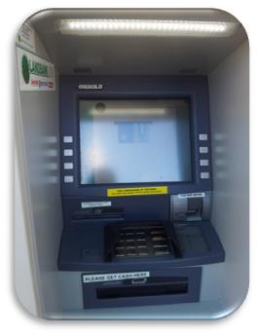

Process of disbursement
Over the counter
DSWD National & Regional office
Municipal Link (ML)
Parent Leader (PL)
Beneficiaries
ATM (with the help of ML or PL)
Notes:
E

Slide 8
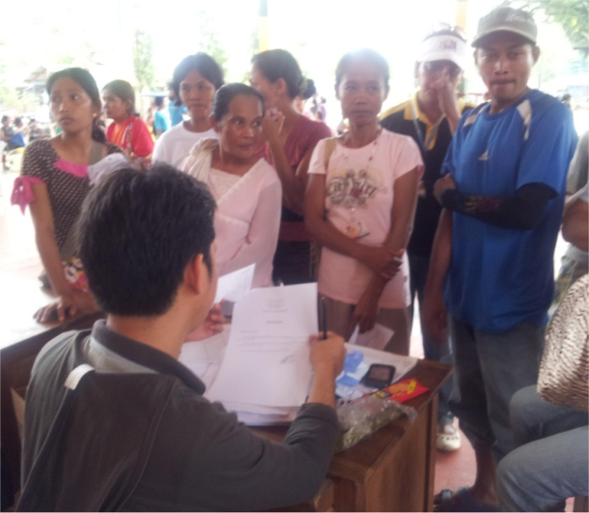
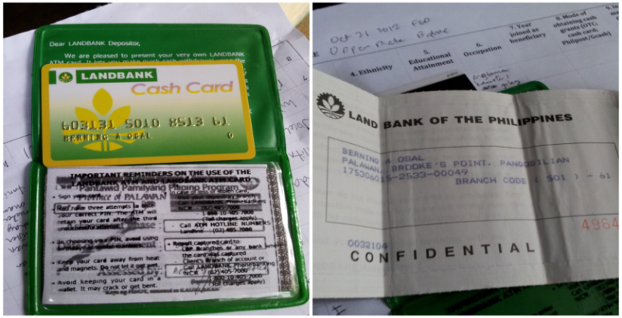
Research Objective: Compare experiences of IP beneficiaries accdg. to type of delivery mechanism/disbursement
Over the counter (OTC)
ATM
Mostly applicable in hard-to-reach areas, especially in municipalities with no banks
Philpost (before, GCASH was used)
Only applicable in the lowlands where banks and ATMs are present
Beneficiaries get an electronic cash card
Only allows for ATM withdrawals
Not connected to a deposit account
Can not be used for payment for goods and services
Land Bank or First Consolidated Bank (FCB)
Notes:
E

Slide 9
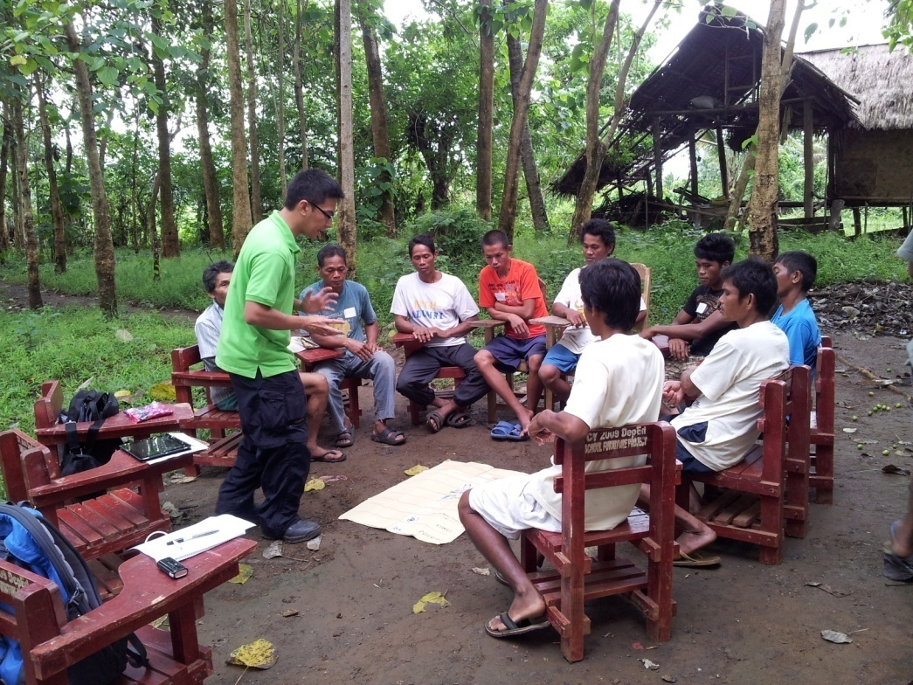
Methodology
survey of 60 CCT respondents (30 per type of disbursement)
Focus group discussions with randomly selected respondents
key informant interviews
Notes:
E

Slide 10
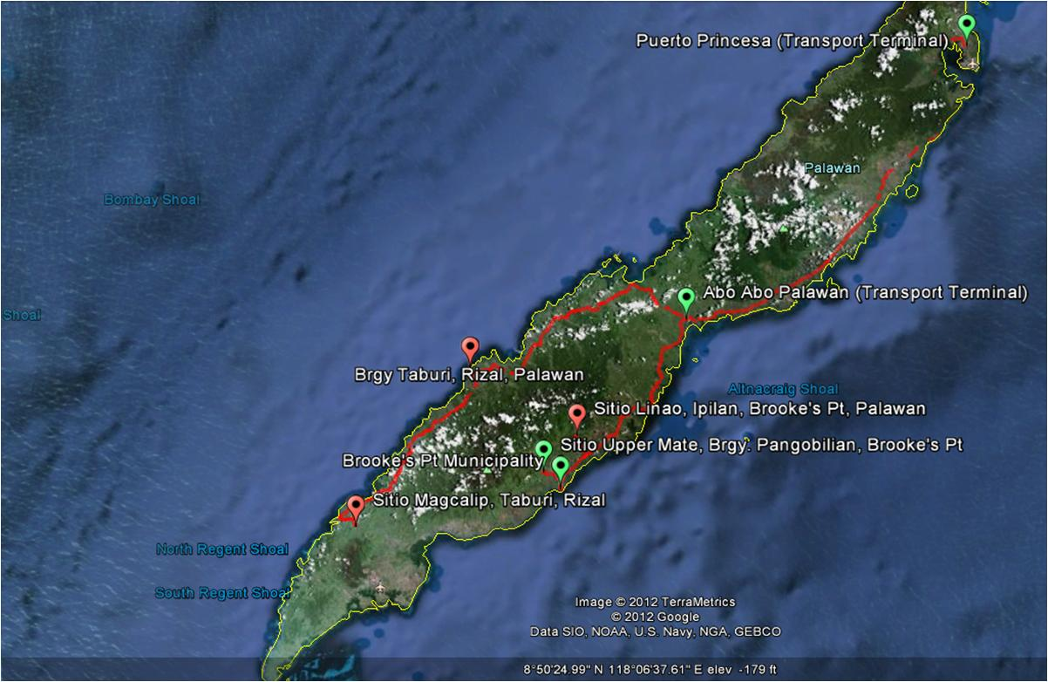
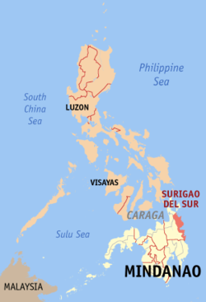
Rizal – over-the-counter
Brooke’s Point – both ATM & over-the-counter
Research Sites in Palawan, Philippines
Notes:
E

Slide 11
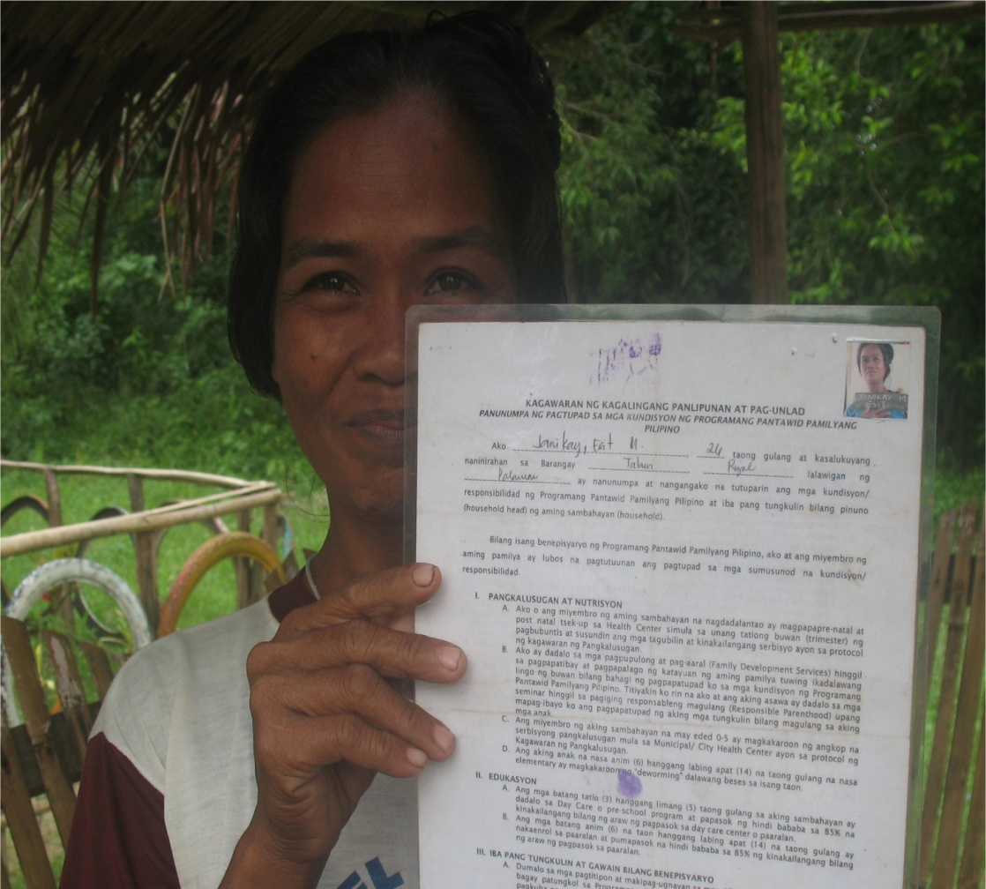
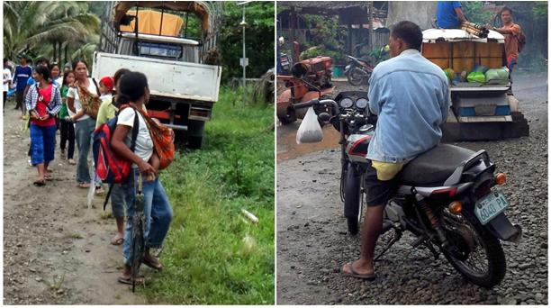
Profile of respondents
mostly female (mothers of children-beneficiaries)
Average age: 36 yrs. Old
Majority had no schooling
Mode of transportation to collect/get CCT money:
  Brooke’s point – tricycle/motorcycle
  Rizal – by foot
Notes:
E

Slide 12
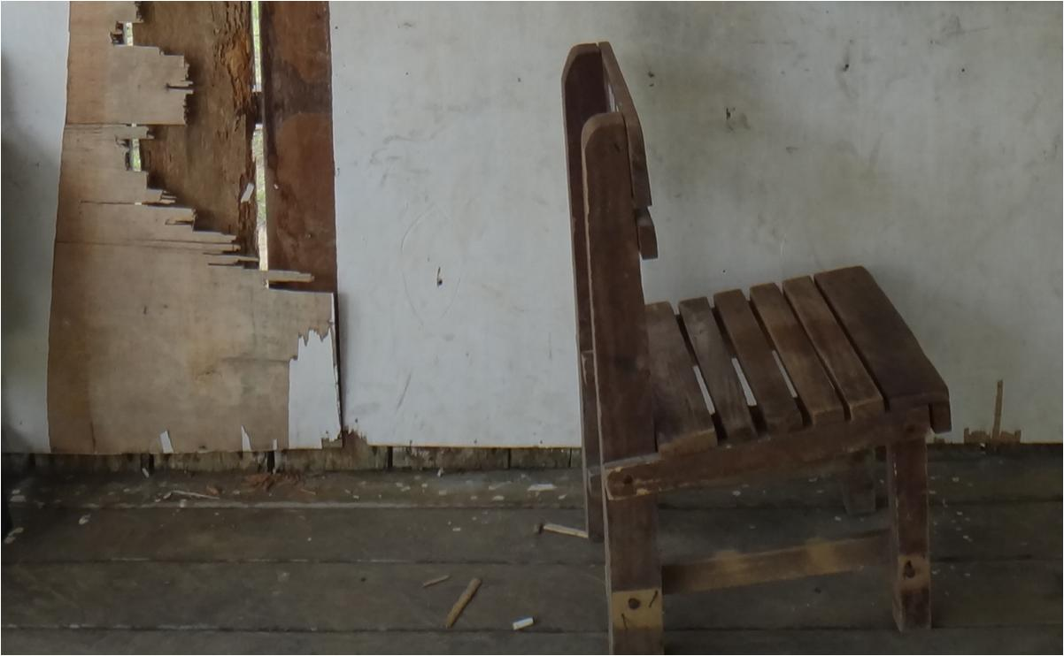
Findings

Slide 13
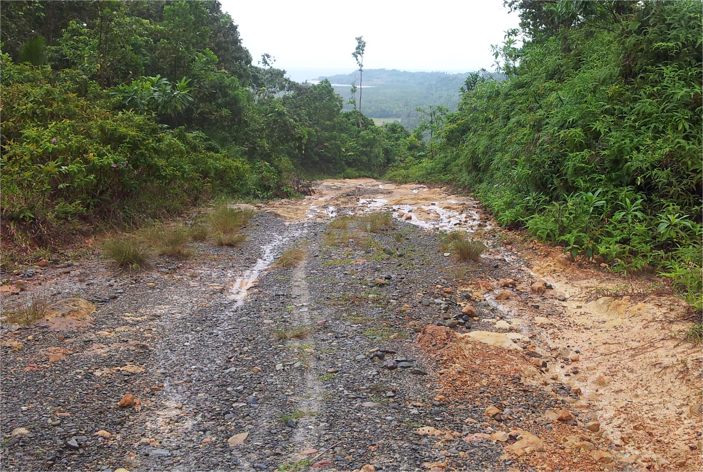

Interesting notes
 | BROOKE’S PT: ATM | BROOKE’S PT: OTC | RIZAL: OTC
Average travel time from respondents’ home to the payment venue | 1 hour | 1 hour | 3 hours
Mode of Transportation | 47% - Tricycle 40% - Motorcycle | 73% - Tricycle 20% - Motorcycle | 93% - by foot 7% - truck/motorcycle
Average Transportation Cost | Php 85/ $2++ | Php 50/ $1++ | Php300*/ $7++
Complaints/Issues | -long line; exposed to heat or rain -takes a whole day (7am to 3 pm; 10 pm if ATM malfunctions) | -faster line due to DSWD staff checking grants manually -venue has shade/roof -takes only 3-5 hours | -far from the community -takes a whole day; delays happen to staff delivering grants due to weather
Notes:
E

Slide 14
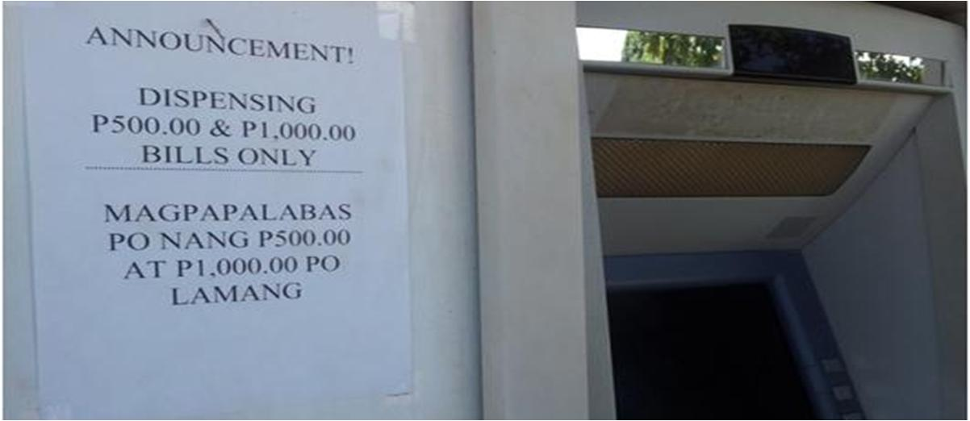
Interesting notes: ATM in Brooke’s Point
Cash grant | ATM will only dispense.. | What’s left | Can only withdraw when next cash grant leaves...
2,800 | 2,500 | 300 | 200 (500)
2,200 | 2,000 | 200 | 300 (500)
1,000 | 1,000 | 0 | 0
800 | 500 | 300 | 200 (500)
beneficiaries can only withdraw “what’s left” when the next cash grant has “leftovers” amounting to 500, 1000, 1500 & so on
in a way, they are “saving” & attest to feeling happy when they get a bigger amount in the next payout
Notes:
E

Slide 15
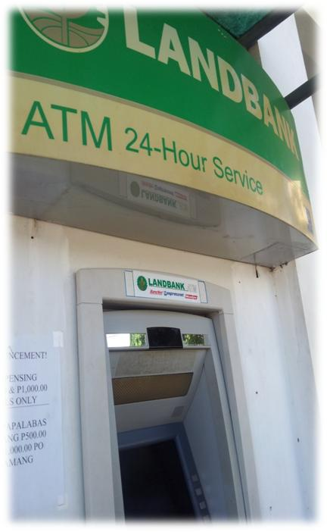
Interesting notes: ATM Challenges
  Beneficiaries don’t know how to perform ATM transactions on their own
  Only Parent Leaders were taught by Municipal Links on how to use the ATM
Beneficiaries’ experience of using the ATM
  afraid to use it because card may be captured by the ATM
“I was afraid that the machine will break/ malfunction and I can no longer get my money and cash card back (if I press the wrong buttons)”
Notes:
E
IP Beneficiaries have yet to understand how ATM and mobile money works and how they can benefit from it.

Slide 16
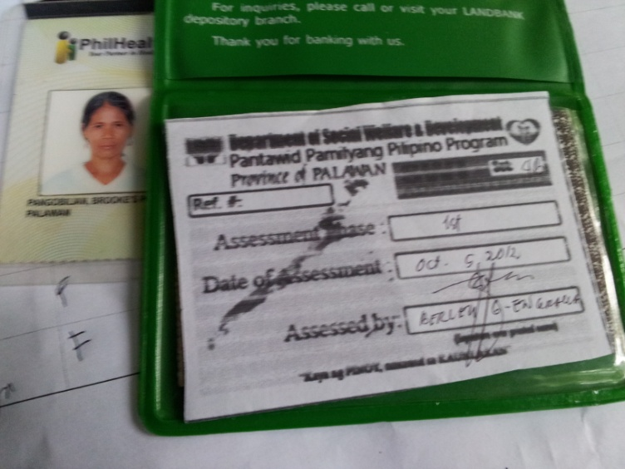
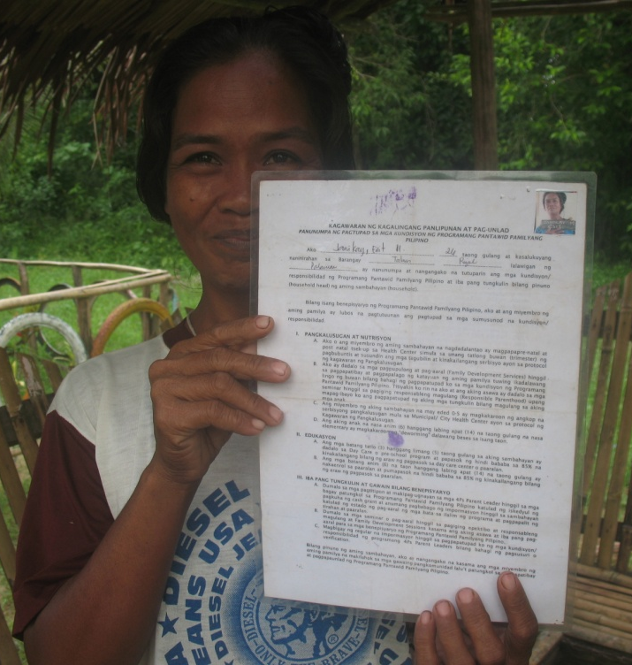
Interesting notes: OTC Challenges
  IPs do not easily trust outsiders and programs
“We are afraid that if DSWD took a picture of us for the ID, we would be brought into the lowlands with a big ‘wanted’ sign, which would ensue to our arrest and imprisonment.” “We are afraid to ride a truck going to the CCT payout. We believe that we would be brought somewhere to be burned alive. “ “The CCT Program is not a real program; others said that if we join, DSWD will put tattoos in our organs.”
Notes:
E
IP Beneficiaries have yet to understand how ATM and mobile money works and how they can benefit from it.

Slide 17
Changes in flow of cash
barter
Cash (CCT)
barter
Rizal
upland
Brooke’s
Point
Cash
credit
Cash (CCT)
lowland
Notes:
E
Rizal: originally, they engaged in barter (though they also earn cash but very little—maximum is Php100); when CCT came, they had cash amounting to less than Php2,000. Beneficiaries spend it mostly on school supplies, then food. When they do not have cash anymore, they go back to bartering goods. The important variable here is their social/geographical location: living in the uplands. Also, no available forms of credit (or at least, credit practices with the IPs)
Brooke’s Point: they were earning cash already from their labor wages, but with CCT, beneficiaries were able to expand their ability to buy goods. However, because costs are high (esp. school materials) and they have access to credit in the lowland, they engage in credit. They pay for this in the next CCT payment (as guarantee)

Slide 18
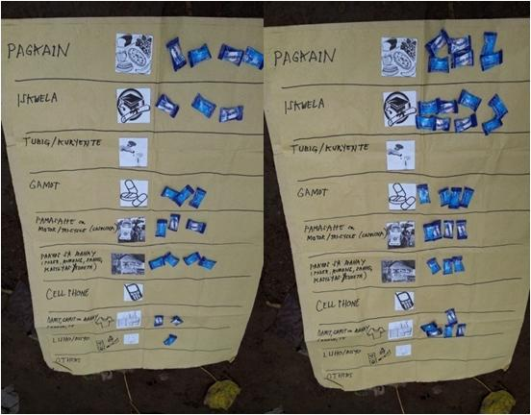
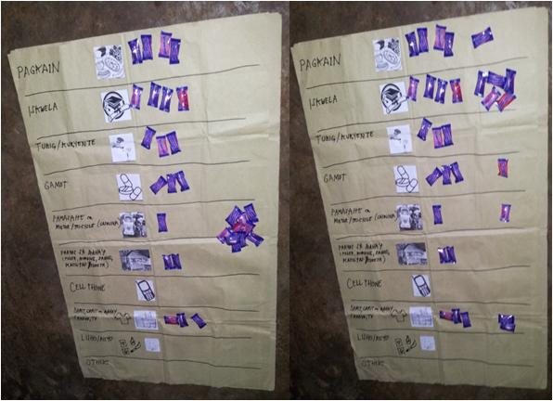
Changing patterns of consumption
IPs were able to raise household consumption: they tend to buy more of the same goods after receiving CCT money.
PAST PRESENT
(w/o CCT) (with CCT)
PAST PRESENT
(w/o CCT) (with CCT)

Slide 19
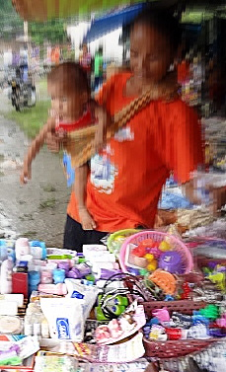
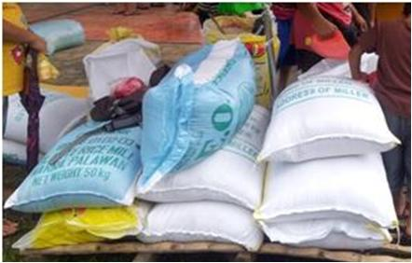
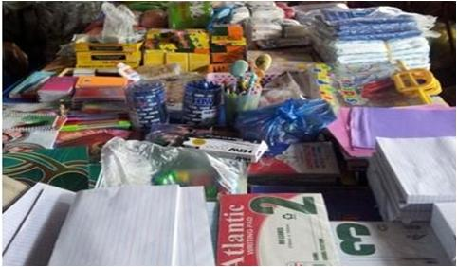
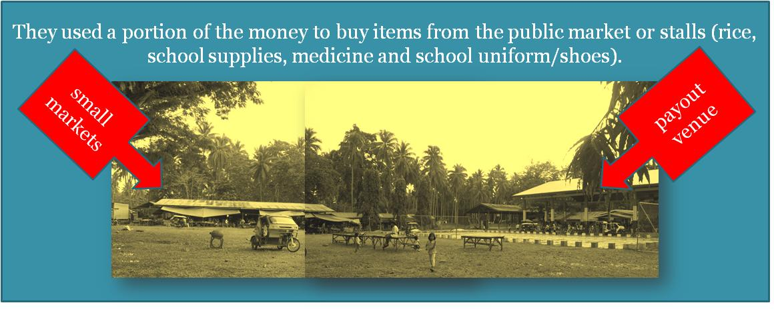
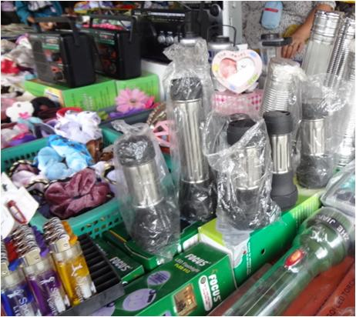
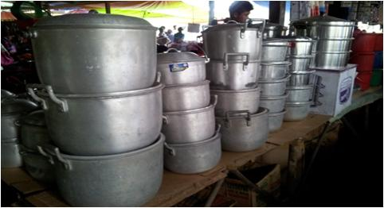
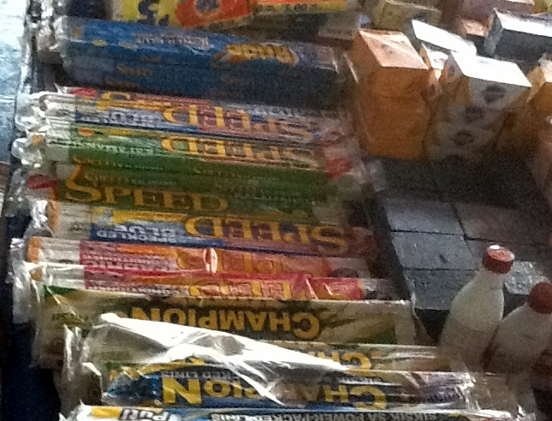
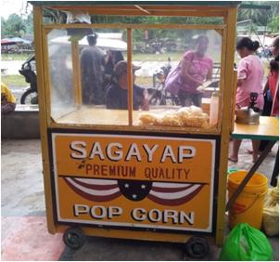
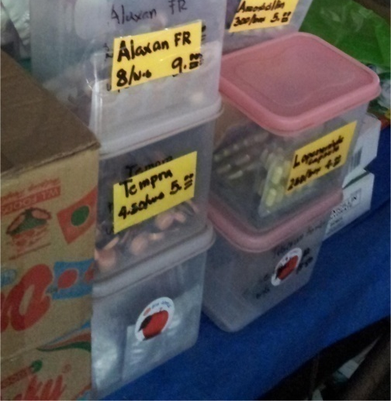
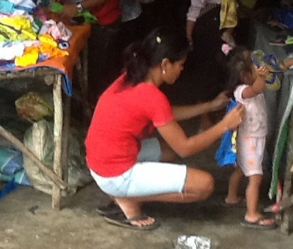

Slide 20
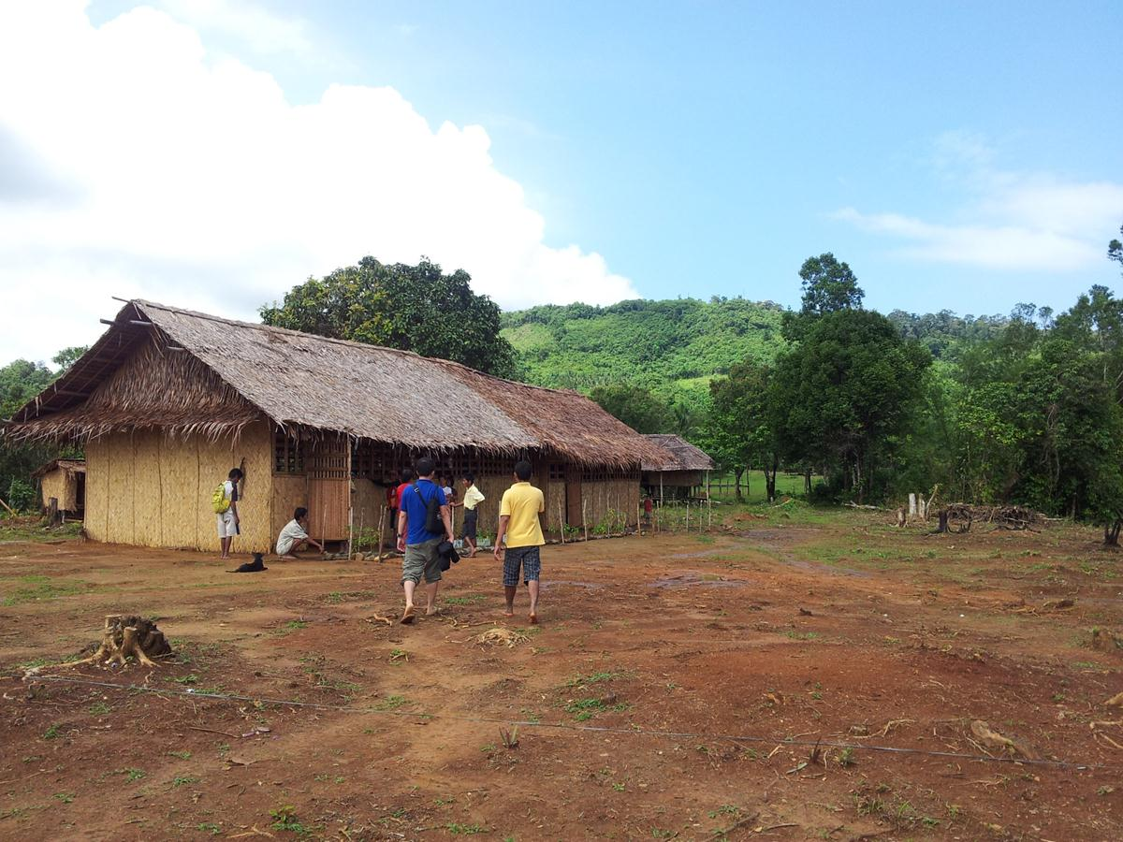
Findings: changing patterns of consumption
Cash is only set aside for the purpose of paying/covering future school related needs of children.
  IPs tend to save a portion of the money to cover other school-related expenses, e.g., school projects, food & transportation allowances of the children
Notes:
INSERT PHOTO OF SCHOOL

Slide 21
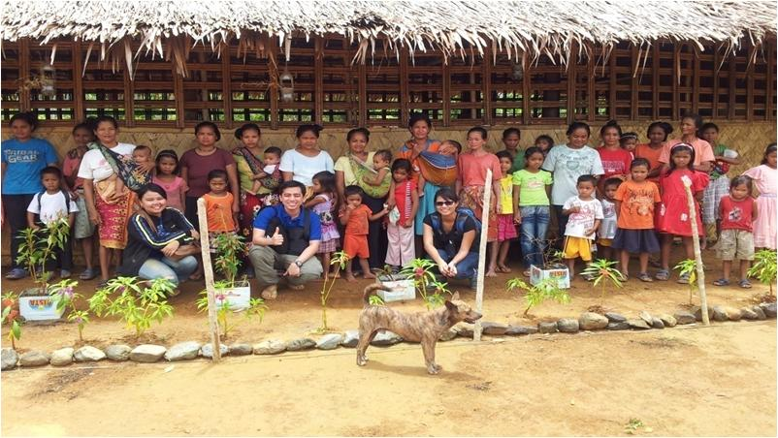
Findings: gender relations
Women take the frontlines because of the CCT program
Men serve as support, even taking on the traditional roles of women (i.e. taking care of children)
Women have also actively participated in the economic life (go to the market place)
Before, men are usually the ones who go down and conduct economic activities

Slide 22
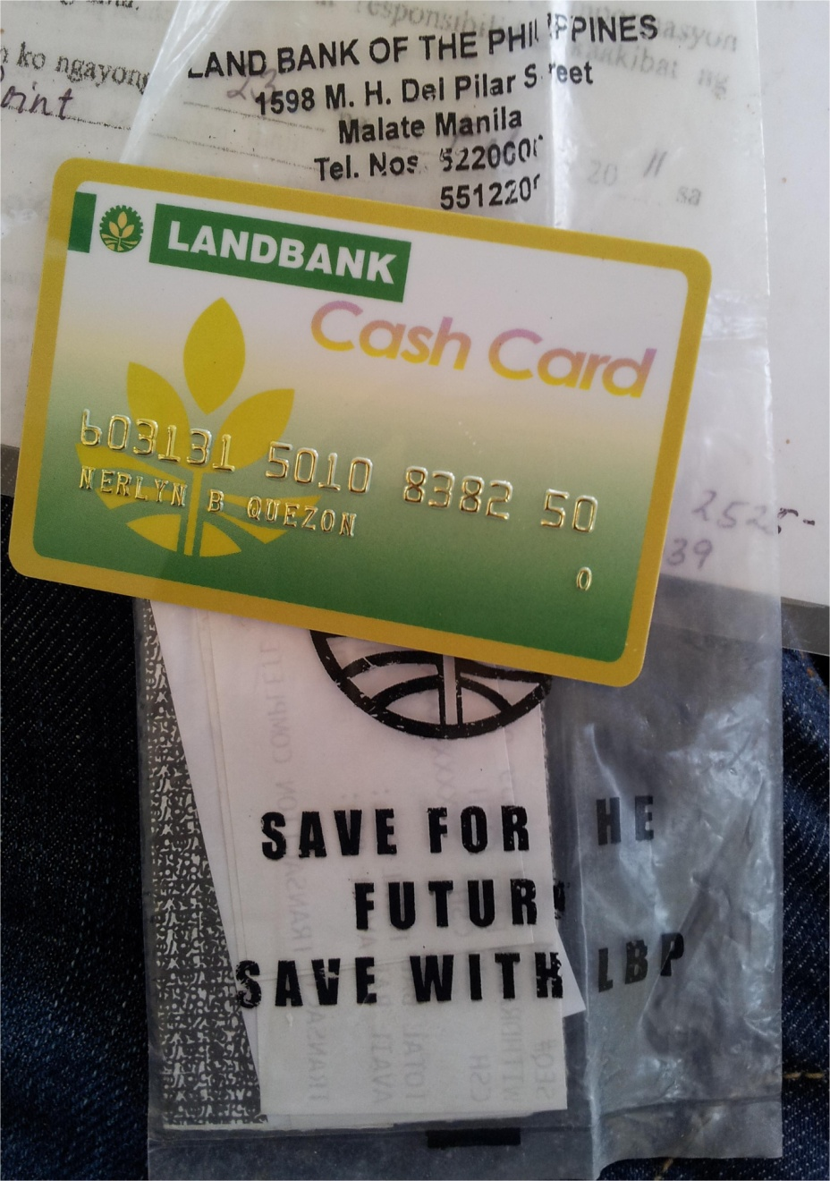
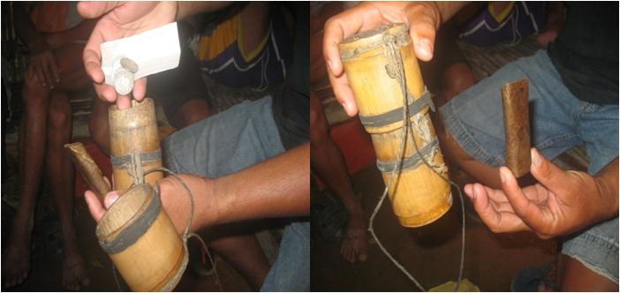
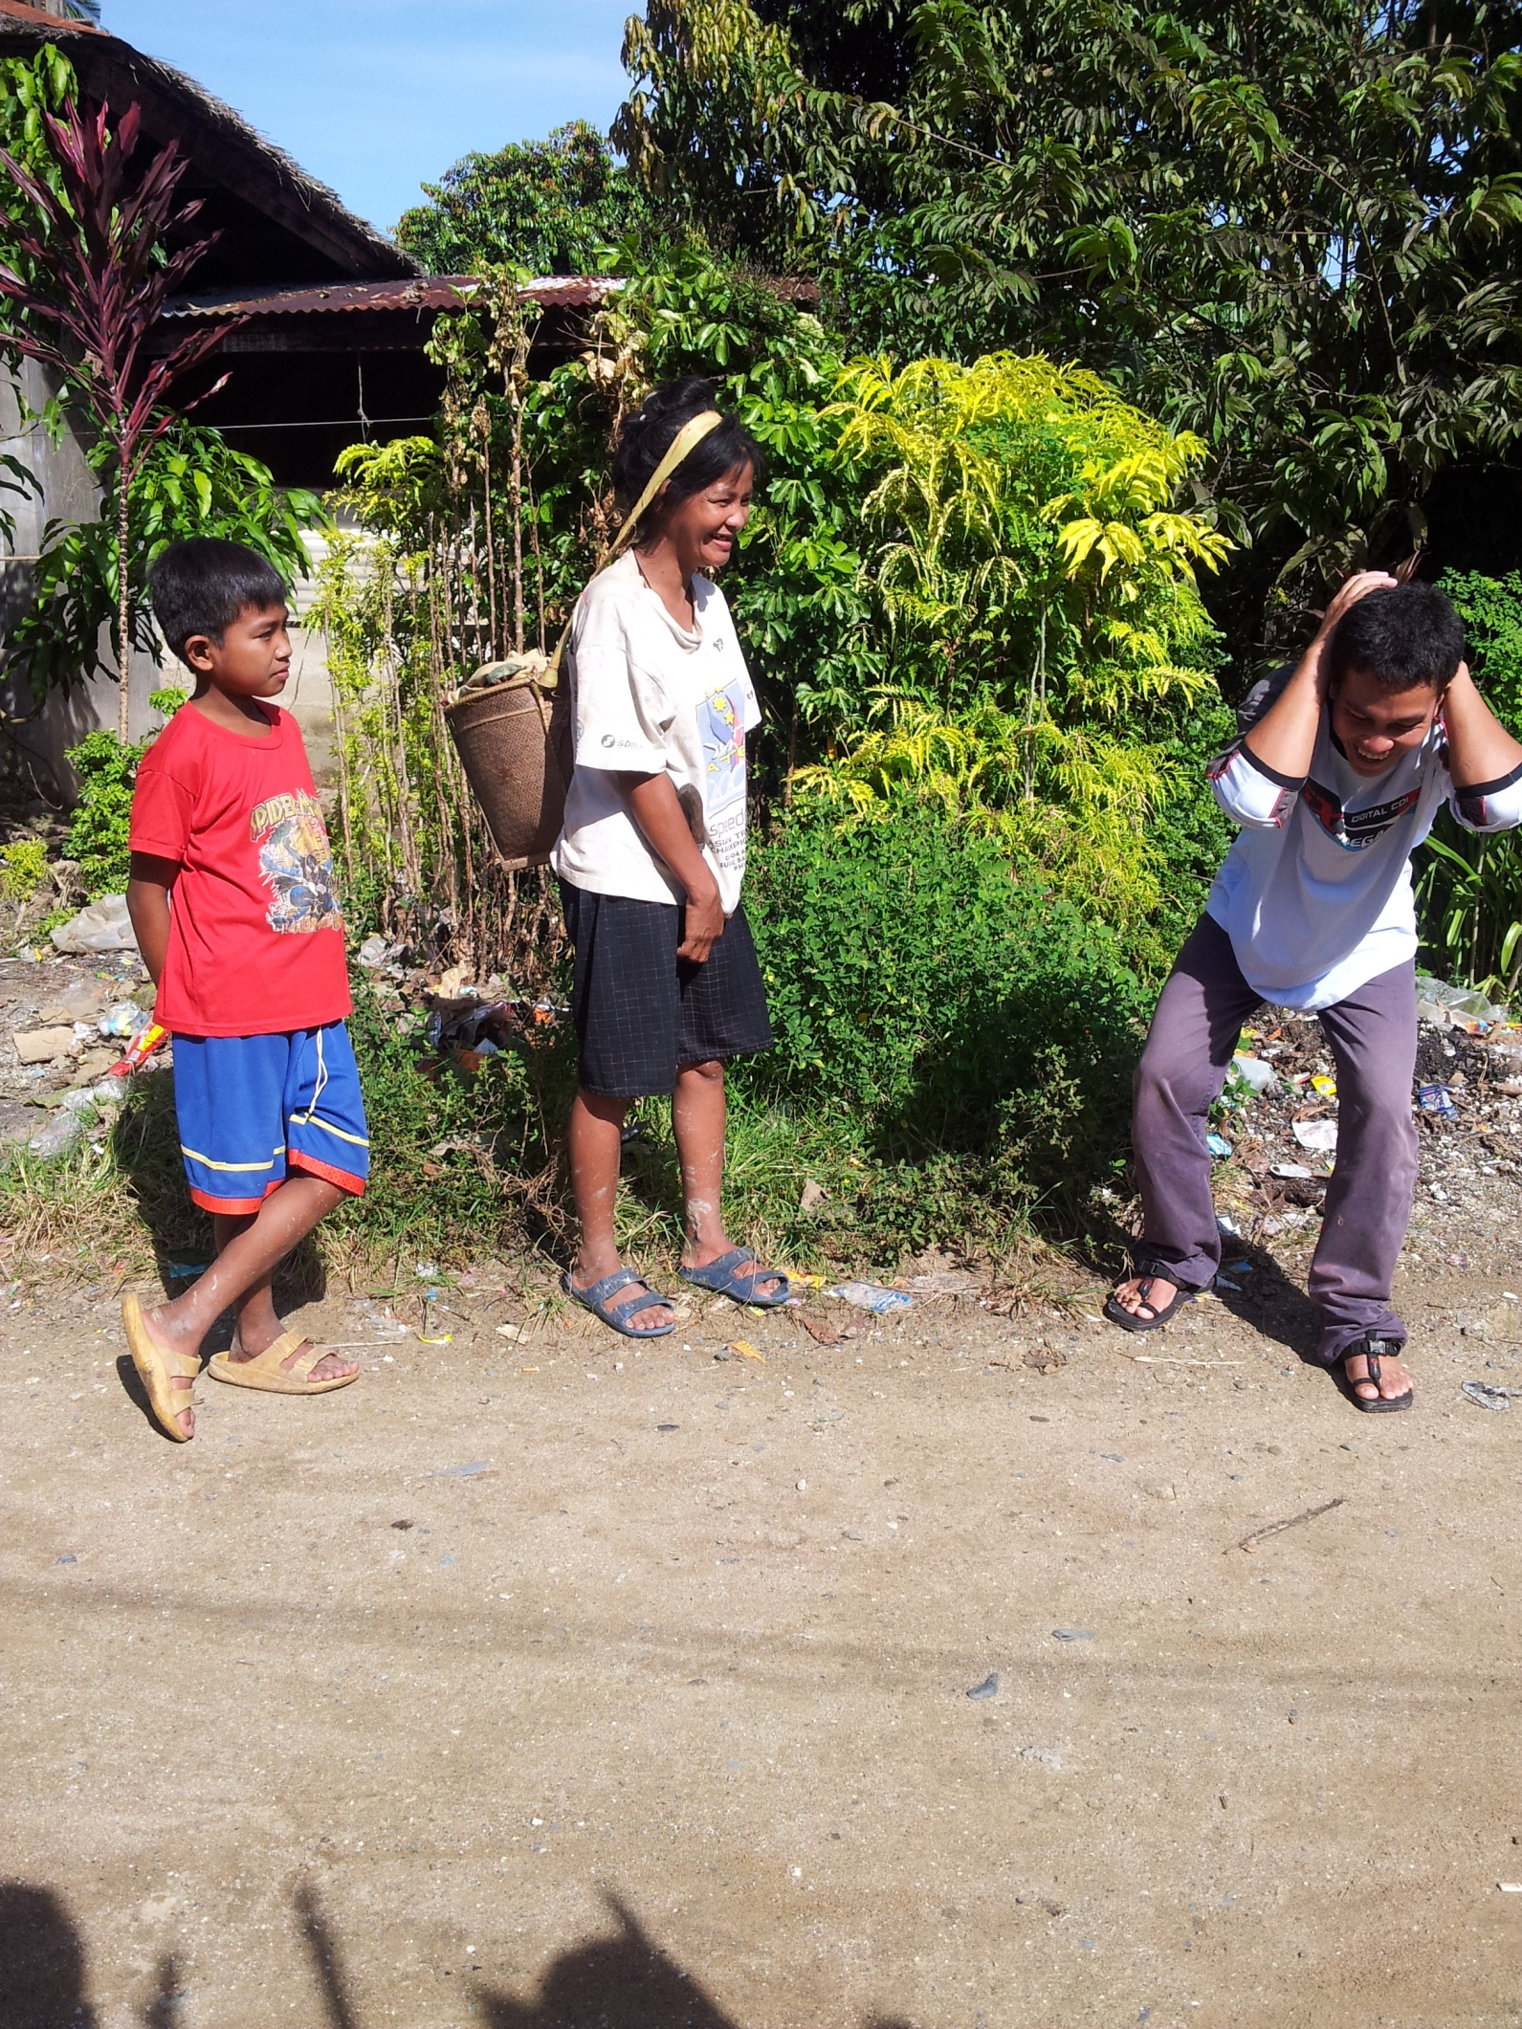
Findings: plastic bags over wallet
Storing of money
  beneficiaries store their CCT money in plastic bags instead of wallets
  only one male respondent had a wooden storage - originally for keeping cigarettes
Notes:
J

Slide 23
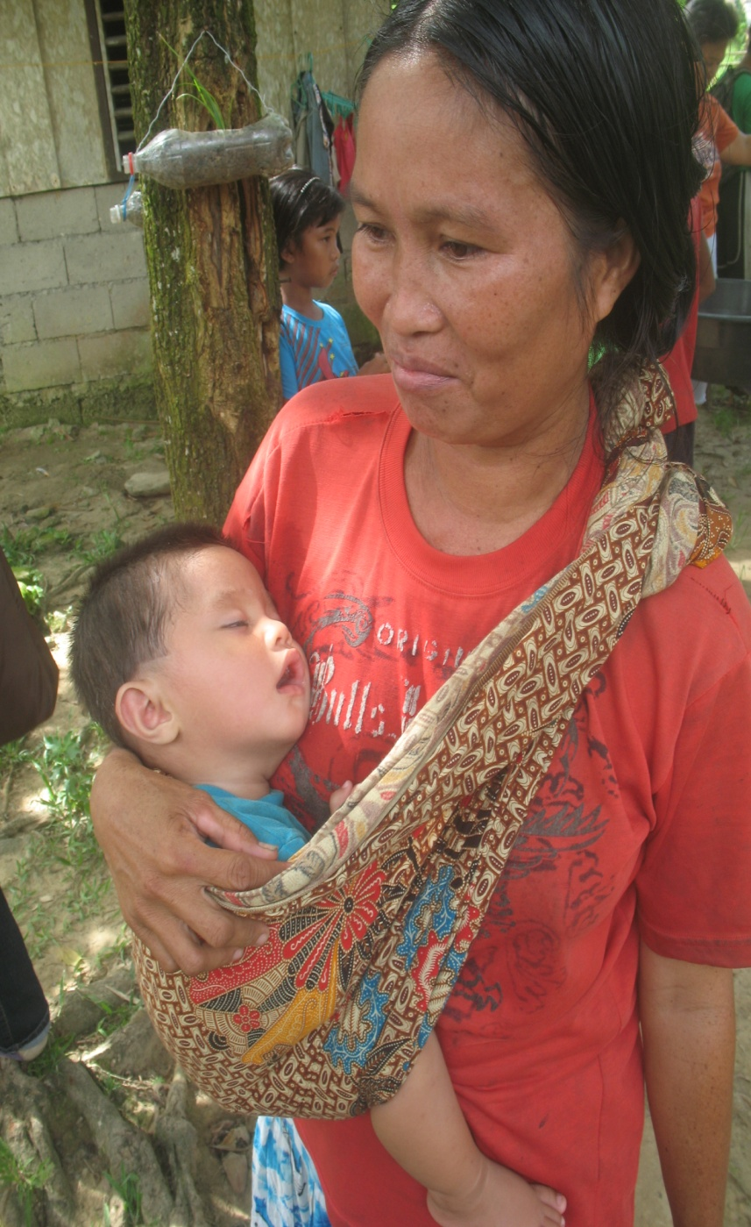
Conclusions/ Recommendations

Slide 24
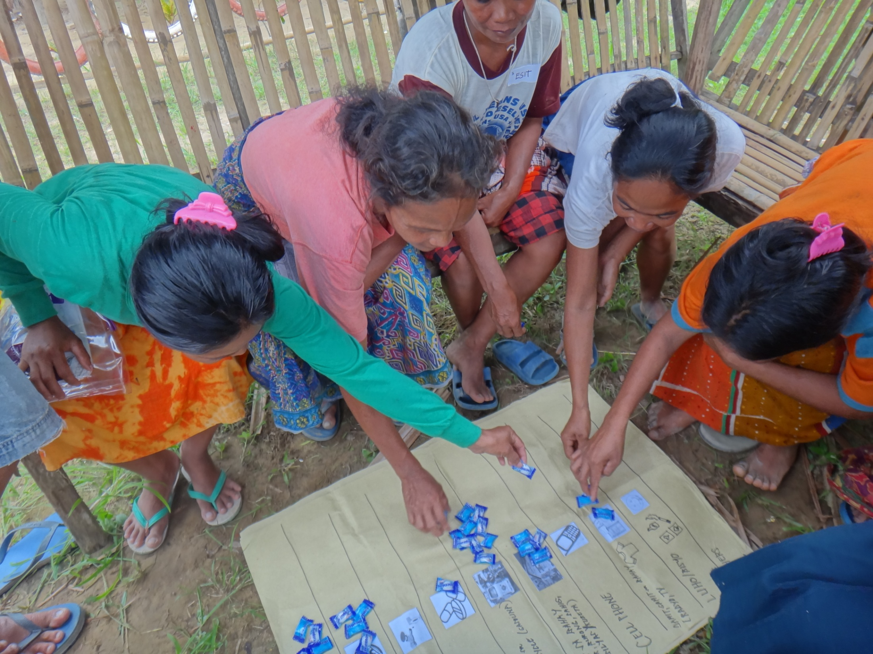
CCT introduced the concept of money to some IP beneficiaries.
There is evidence of change in the way they perform their financial transactions (from barter to cash-based transactions; from cash-based to credit-based transactions).

Slide 25
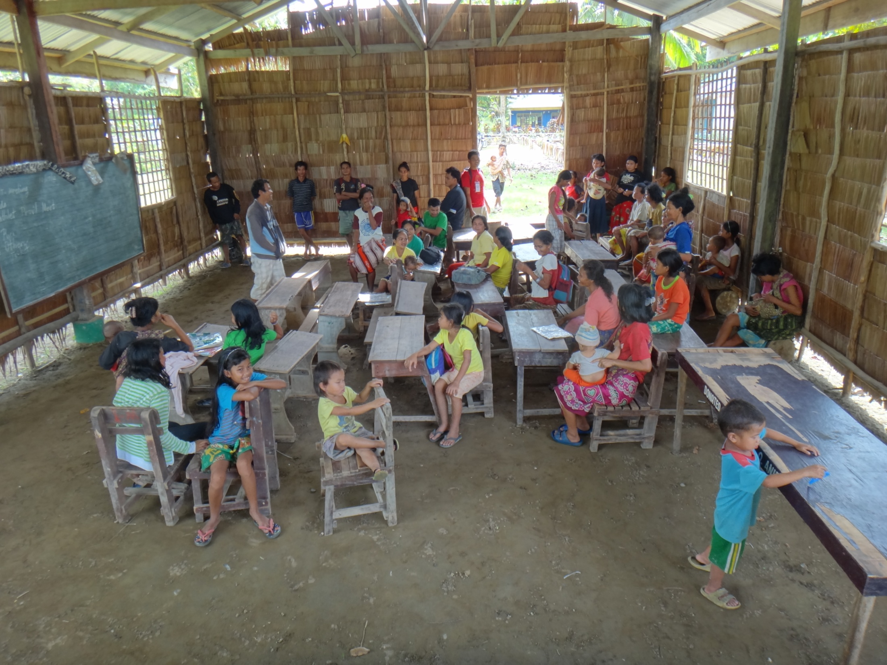
There is evidence of success in raising household consumption that has a positive effect in enrollment rates and attendance of children to school and improved preventive health care.
Leakage: fungibility /liquidity / divisibility (lack of smaller bills/coins for change)

Slide 26
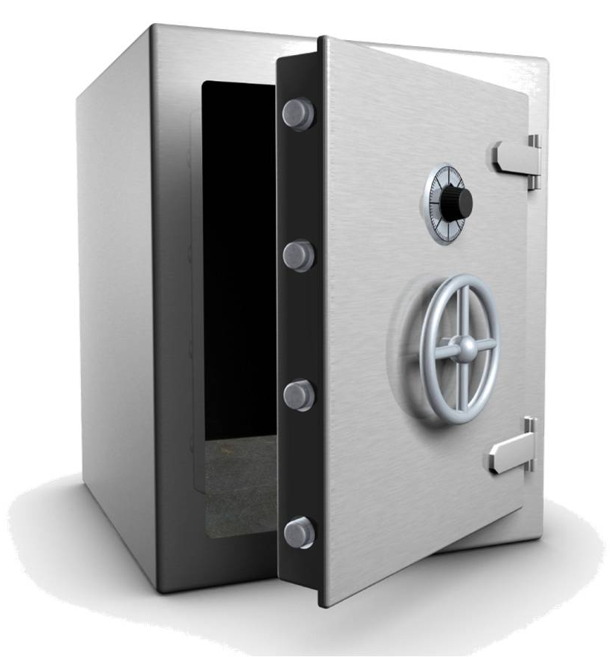
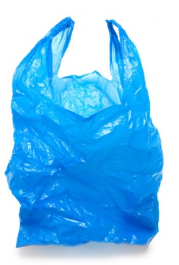
Cash seemed to be perceived more of a means of exchange (“paying/buying” transactions).
Saving cash for other purposes or other needs is still uncommon.

Slide 27
Conclusion/Recommendation
Access to cash cards has not translated to formal savings but….
there are signs that it has provided beneficiaries a glimpse of the importance of saving.
Alternative delivery mechanisms might function better if beneficiaries are taught on how to use them.
CCT Programs (and choice of delivery mechanisms) might be able to bring about transformative change if
  Direction is shifted from being “spending-focused” to “spending and savings-focused” (e.g., why not bundle the cash card with an ATM savings account for interested/qualified beneficiaries?)
  Partners which can provide complimentary financial services (e.g., savings, insurance, remittance) and non-financial services (e.g., post-harvest processing) are chosen.
Notes:
J

Slide 28
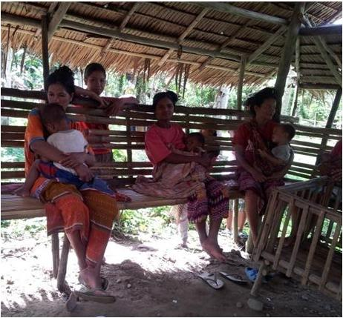
Lessons learned
Understand and respect user context (beneficiary as a “WE” not “I”)
Apply/use delivery mechanisms that are simple , accessible and easy to use.
Notes:
and norms of target segments; use appropriate technology to IP frame.
Especially for ethnic groups which tend to have a strong sense of common ownership, a beneficiary should refer not to an “individual” but to a “group”.

Slide 29
Lessons learned
Identify the “influencer” who can
connect
and
educate.
Those involved in health centers (parent leader in Ipilan)
Those with strong ties with the community i.e., tribal leaders, NGO workers/ volunteers
Those involved in school (parent leader in Rizal)
Notes:
*picture of Letlet?

Slide 30
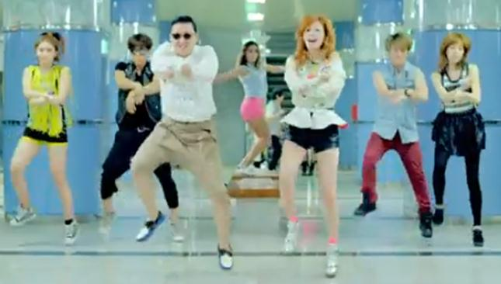
Gangnam Style
CCT Style
inclusive financial services for CCT beneficiaries
“signature dance move”
performed
not by an INDIVIDUAL
but by the GROUP

Slide 31
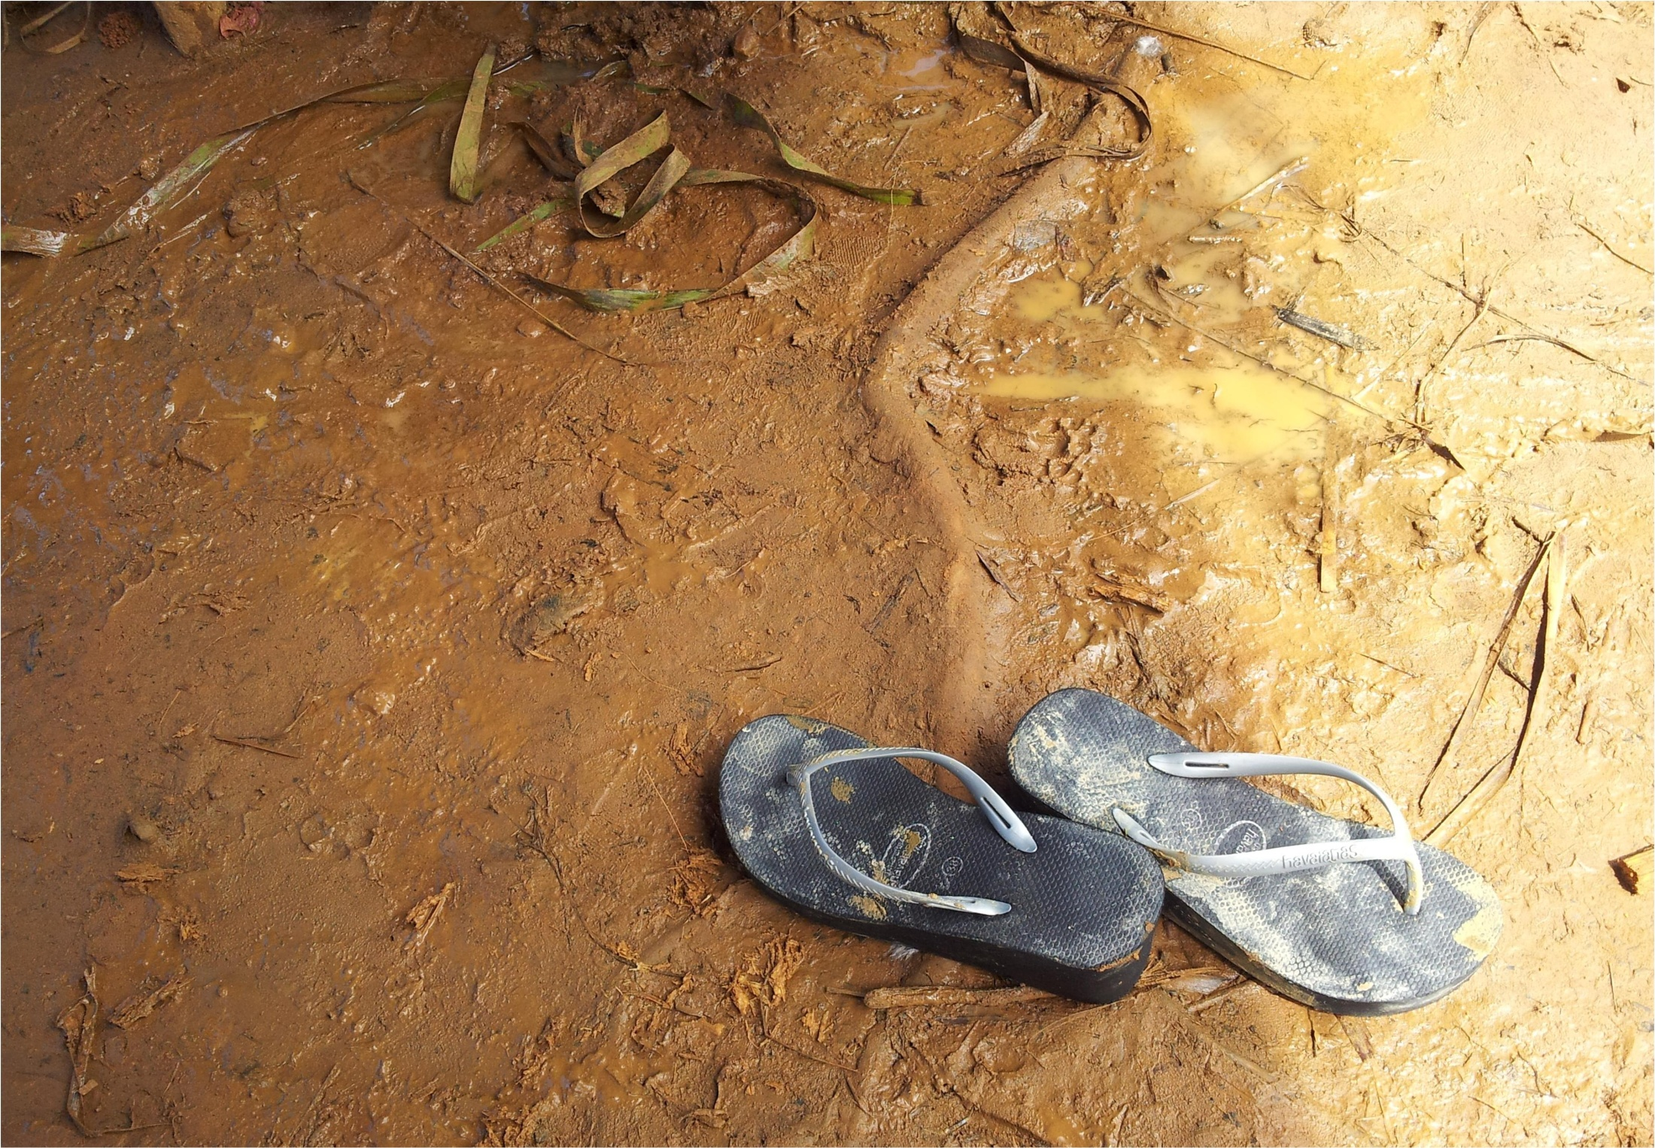
THANKS!

