Slide 1
Composing Development? Quantification & Biometrics in South African Social Protection
Kevin P. Donovan

Slide 2
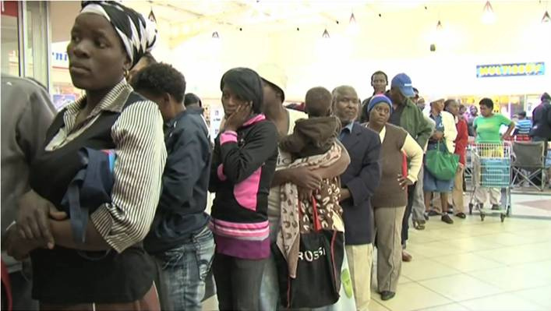
Cash Transfers in RSA
10-15 million recipients
Old Age Pension
Child Support Grant
Disability Grant

Slide 3
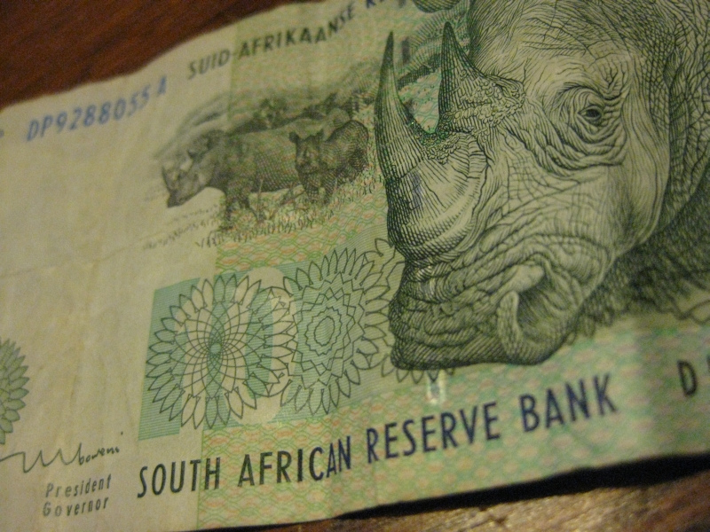
Implementation, or how to connect more than 10 million pockets to the National Treasury

Slide 4
Implementation, or how to connect more than 10 million pockets to the National Treasury
Rationalities
Technologies
Subjects

Slide 5
Quantification in RSA
An historical “mania for measurement”
Today, “awash with statistics”

Slide 6
The Pursuit of Objectivity
Democratic contestation drives quantification
Impact assessments to combat ‘dependency’ discourse
Civil society’s ‘guerilla auditors’

Slide 7
The Risks of Statistics
Centralization
The imperialism of numbers

Slide 8
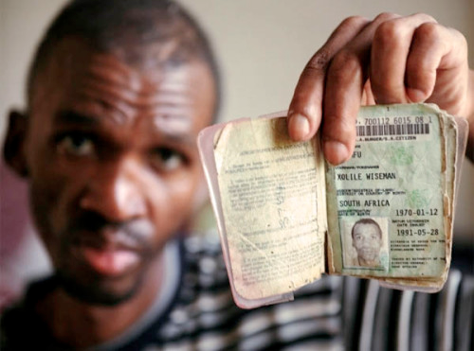
Biometrics in RSA
Why is South Africa enrolling 20 million people in a biometric identification system?
With what consequences?

Slide 9
Biometrics in RSA
It is a “mistake to think that communications will solve the problem of communication, that better wiring will eliminate the ghosts.”
– JD Peters (1999)

Slide 10
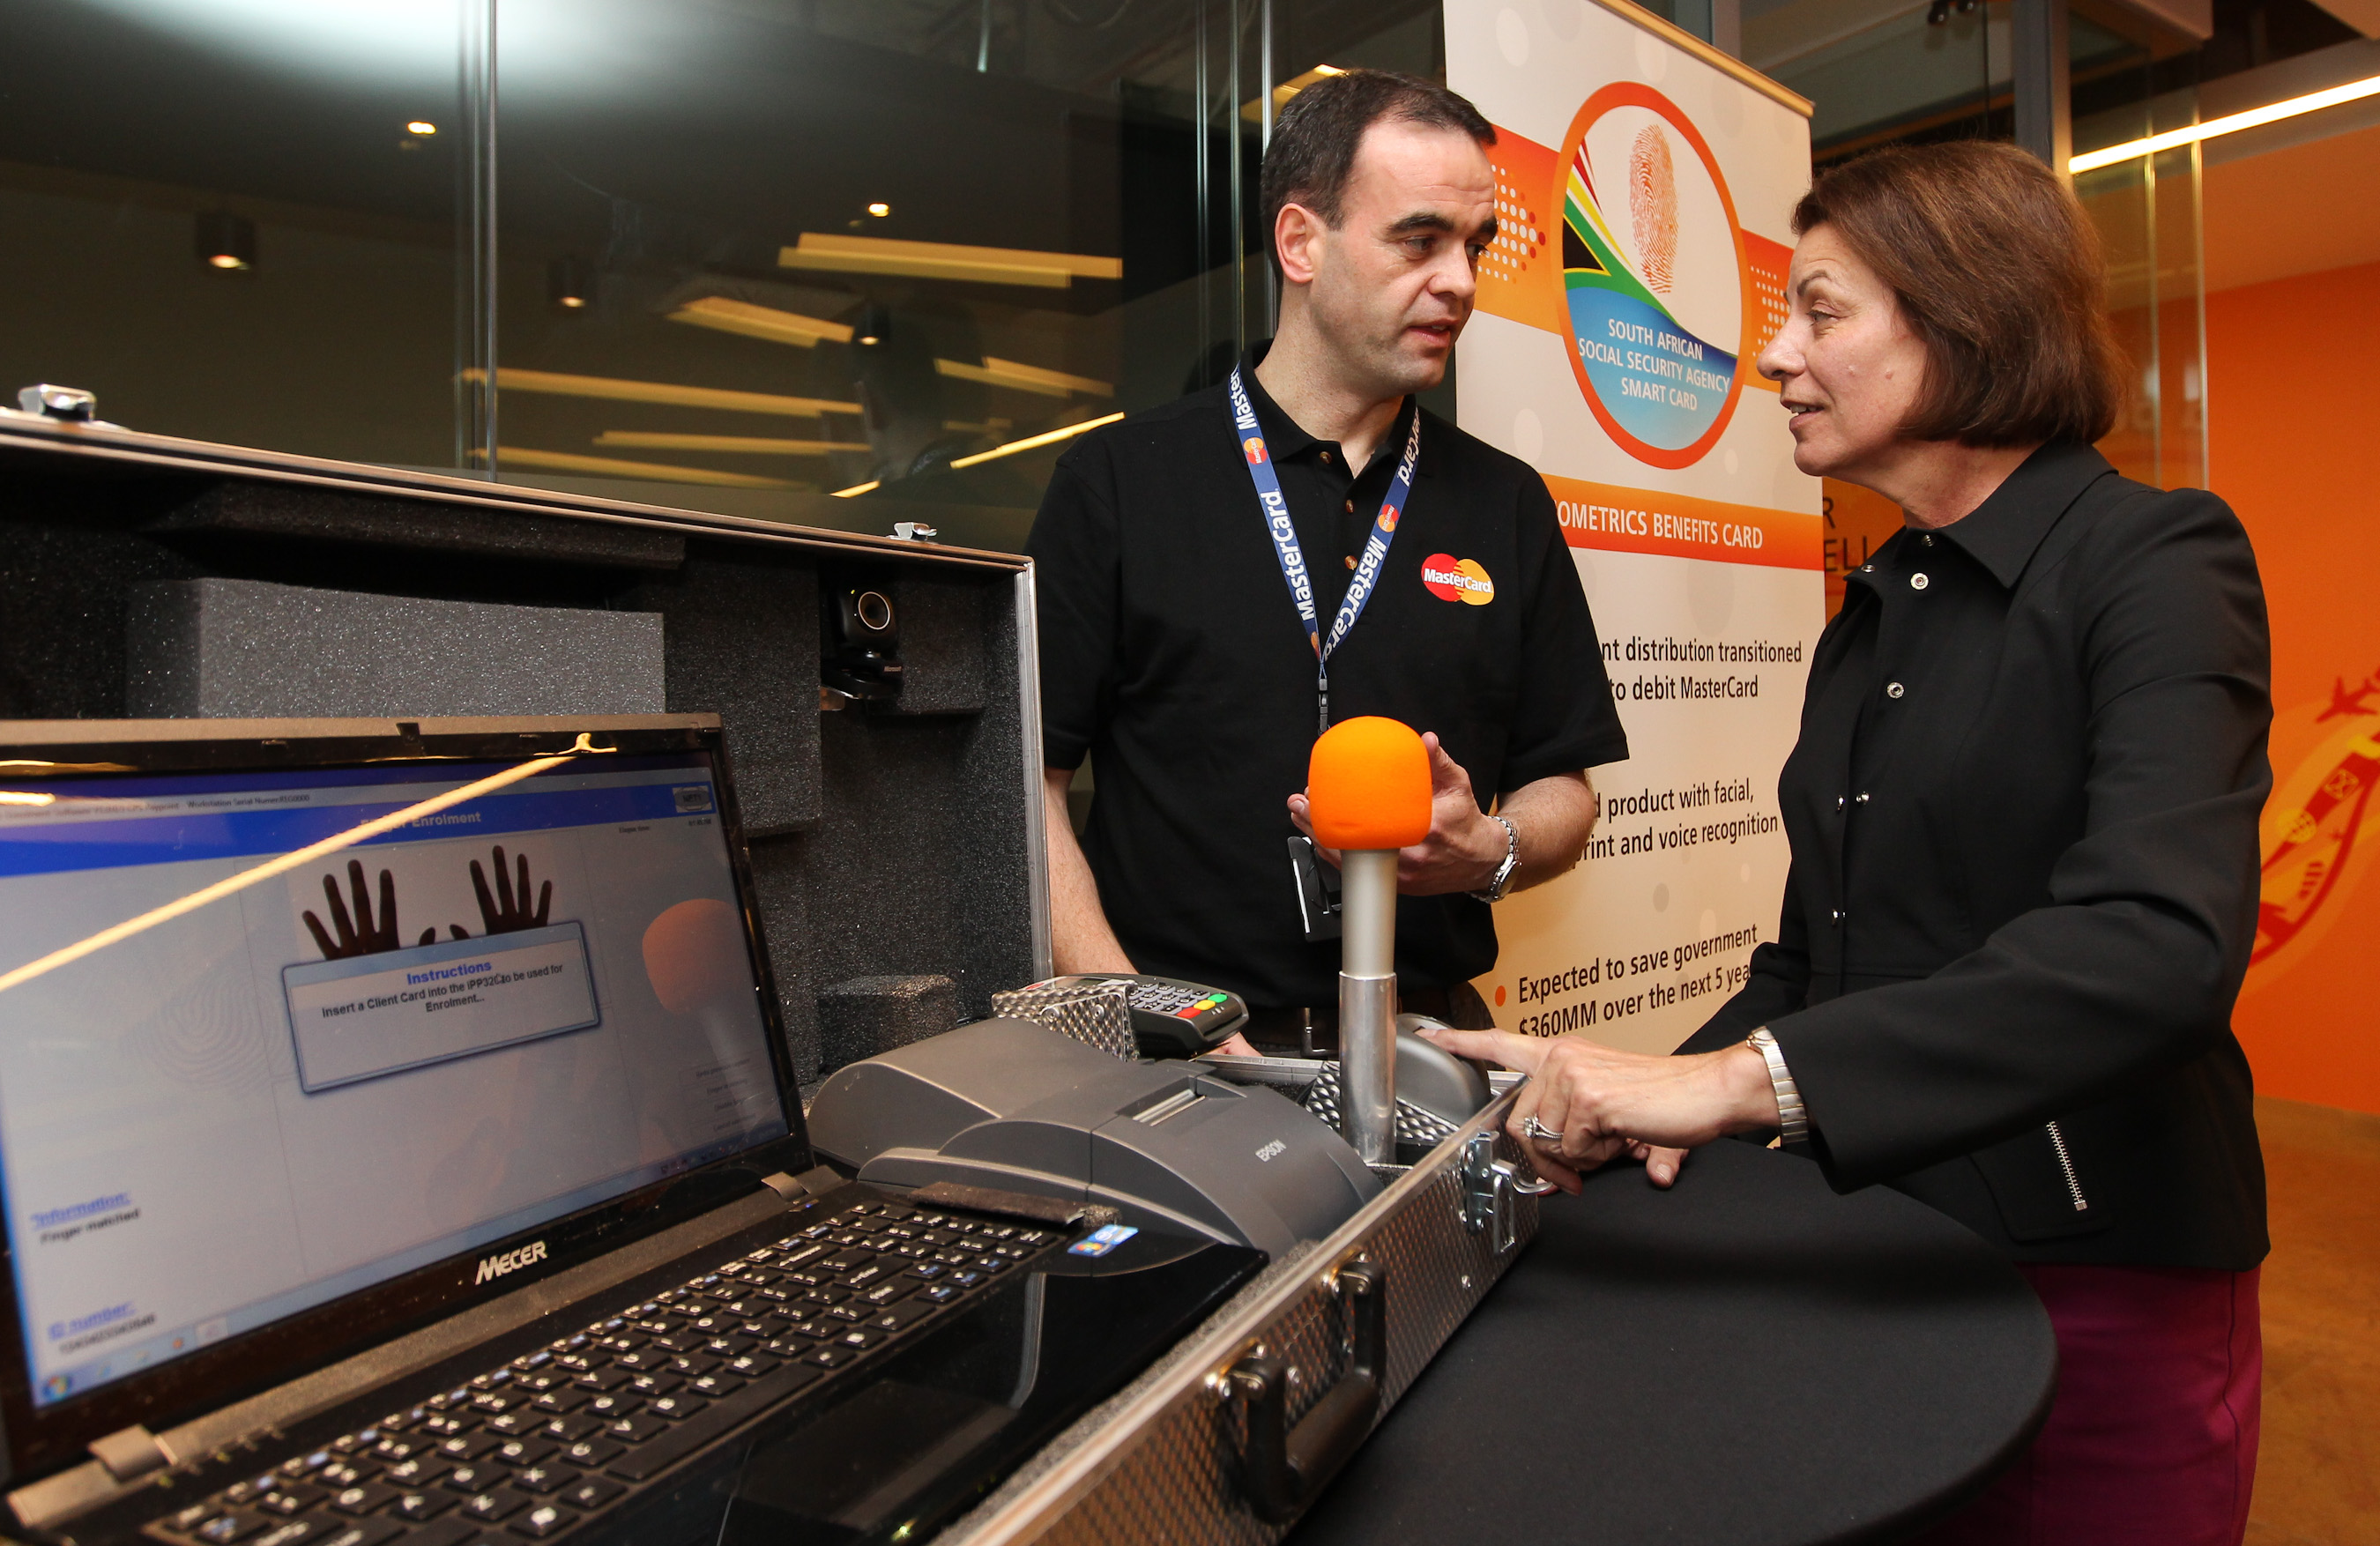
Biometrics in RSA
Opening the Black Silver Box

Slide 11
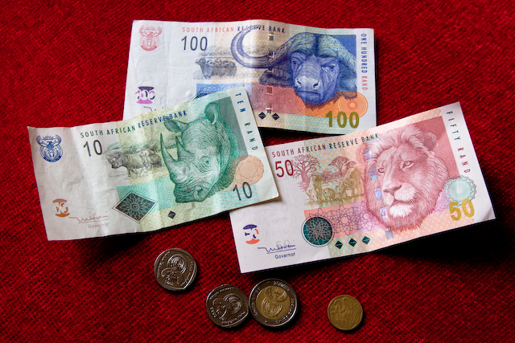
Towards Financial Inclusion?
“Financial inclusion means your money isn’t with you.” – NGO official

Slide 12
Thank You
Kevin P. Donovan
kevin.donovan@uct.ac.za
http://blurringborders.com

