Slide 1
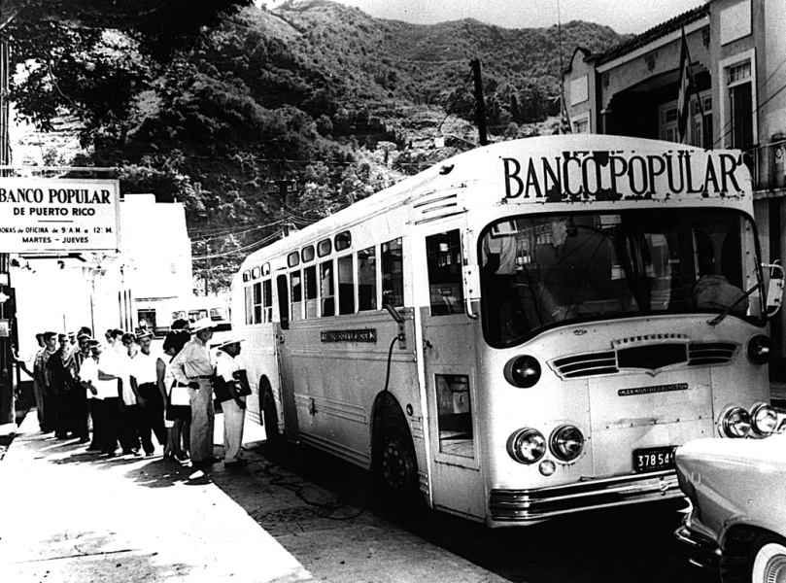


Banking the poor through Mobile Telephony: Understanding the Challenges
Roxana Barrantes
Judith Mariscal

Slide 2
CONTENTS
Research
Telecommunications Sector
Financial Sector
Regulatory environment for financial inclusion on ICT (REFII)
Case study: Oaxaca, Mexico
Conclusions

Slide 3
1
Research

Slide 4
TRE Methodology: MB Ecosystem
El Salvador, Guatemala, Paraguay & Peru (experts perception on environment):
Environment | Dimension
Institutional | Regulation of financial system, promotion of financial inclusion practices, consumer’s protection, telecommunications’ regulation
Market | Competition in financial and telecommunications sectors, innovation in telecommunications’ markets
End user | Branchless banking infrastructure, deployment of agent’s networks

Slide 5
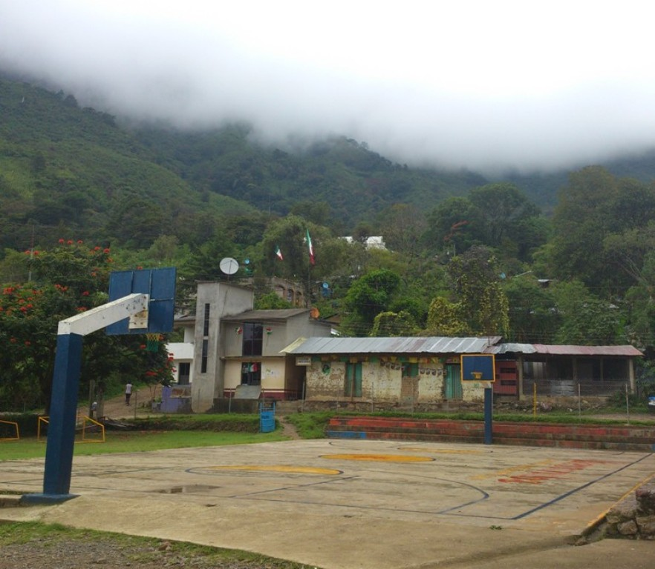
Case study: Santiago Nuyoo, Mexico
A case study was conducted in 2012 to determine:
  1) What conditions enabled the emergence of mobile banking in a marginalized community
  2) How mobile banking is transforming the livelihoods of people (early insights)

Slide 6
2
Telecommunications Sector

Slide 7
Households with Mobile (2010)
Source: National Household Survey from each country (Peru, 2010; Guatemala, 2006; Paraguay, 2011; El Salvador, 2011; Mexico, 2010)

Slide 8
Mobile Affordability
Cost of prepaid service as a percentage of average income (3rd decile )
Note: No data available for El Salvador
Source: Galperin (2009)

Slide 9
3
Financial Sector

Slide 10
Access to financial services
Commercial bank branches
Source: IMF (2012), “Financial Access Survey”.

Slide 11
Access to financial services
ATMs
Note: No data avaiable for Guatemala
Source: IMF (2012), “Financial Access Survey”.

Slide 12
4
Regulatory environment for financial inclusion on ICT (REFII)

Slide 13
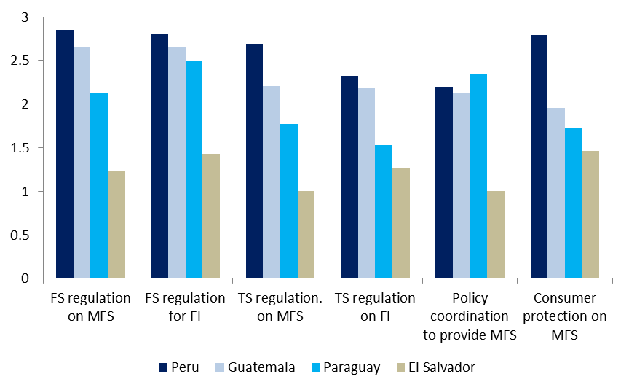
REFII: scores on regulation environment
*Survey asked experts to evaluate efficacy of dimensions to promote MB Ecosystem, where 1 is very ineffective and 5 is very effective

Slide 14
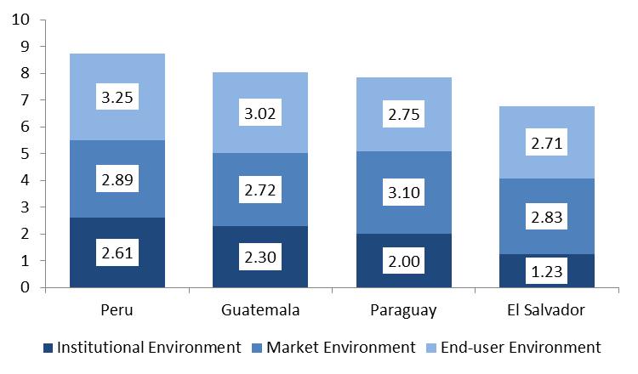
Overall scores
*Survey asks experts to evaluate efficacy of 3 areas that promote MB Ecosystem, where 1 is very ineffective and 5 is very effective
Notes:
These four countries are not ready to launch services that promote financial inclusion over mobile telephony.

Slide 15
5
Case study: Santiago Nuyoó, México

Slide 16
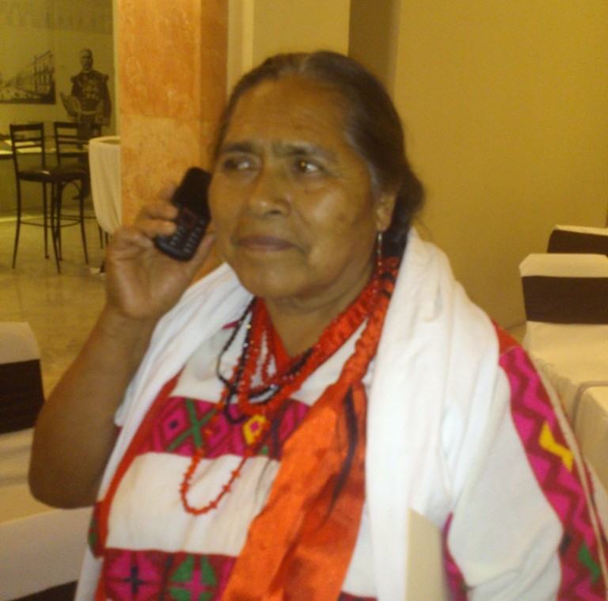
Santiago Nuyoó: a promising example of improving Mobile Financial Services Environment
Rural town with 2,000 inhabitants in Oaxaca’s mountains
83 % share of population are indigenous

Slide 17
Results in Santiago Nuyoó
Mobile usage went from zero (January) to approximately 100 calls and 100 SMS monthly per person (March) and stabilized
Average monthly savings reached raised from USD 11.5 in June
316 Mobile accounts were opened by June
P2P payments monthly average is 1.5 per person

Slide 18
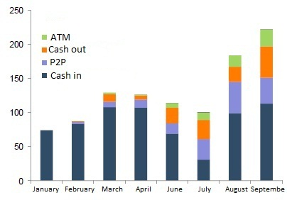
Results in Santiago Nuyoo
Transactions

Slide 19
¿What factors led this program to flourish?
Institutional environment:
  Flexible requirements to open a bank account (2009)
  Existence of Branchless banking figure (2009)
  Interoperability of mobile banking platforms
  Commission to lead coordinated financial inclusion efforts (2011)
  Government as a supplier of connectivity (2011)

Slide 20
¿What factors led this program to flourish?
Market environment:
  Interoperability of platforms
  Non-discriminatory, cheap and fast transactions between banks (SPEI)
  Federal government coordination of public agencies to make direct payments to beneficiaries’ accounts (2011)

Slide 21
¿What factors led this program to flourish?
End user environment:
  Mandatory free-of charge bank account (2007)
  Branchless banking (16,885 points)
  Minimum requirement to open account
  Competition in banking services (3 in 2012 and others in process)

Slide 22
Preliminary Insights
6
TRE methodology correctly necessary conditions
Fundamental conditions in Oaxaca are:
  Supply side: Business interests were aligned with social goals, through governmental coordination
  Demand side: Financial Regulatory Flexibility that eliminates barriers to entry
  Demand side: capacity building through financial and technological education

Slide 23
Preliminary Insights
6
However, several questions remain
Regulation factors appear to be necessary but not sufficient conditions
Regulatory conditions have been in place in Mexico but business models for BoP have yet to flourish
Role of the State as a driver?

