Slide 1

Mobile Payment adoption in Brazil: investigation on a pilot implementation
Adrian Kemmer Cernev
Eduardo Henrique Diniz
Gvcemf – Research Center for Microfinance
at FGV – Getulio Vargas Foundation

Slide 2
Agenda
FGV and GVcemf
Brazilian context
Palmas Mobile case
  Research strategy
  Findings
  Next steps
Mobile Payment environment

Slide 3
GVcemf
FGV – Getulio Vargas Foundation
  Think Tank in Public Policies
  25% of high executives in Brazil
  Economics, Law, Business & Public Administration
  National economic indexes
EAESP - Business Adm. School of Sao Paulo
  12 research centers
  GVcemf – Research Center for Microfinance
    Since 2007, more than 20 research studies in financial inclusion concluded or in progress, covering microfinance impact and technology

Slide 4
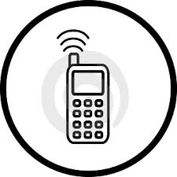
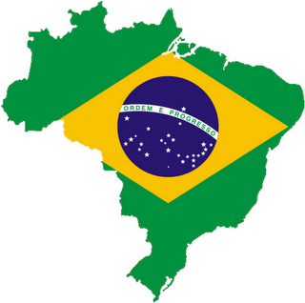



Brazil facts & figures
100%
coverage
260 MM
82% prepaid
195 MM
people
70% of all
transactions
in cash
  45% adults
  no bank accounts
(67% among the poor)
North/South
inequalities

Slide 5
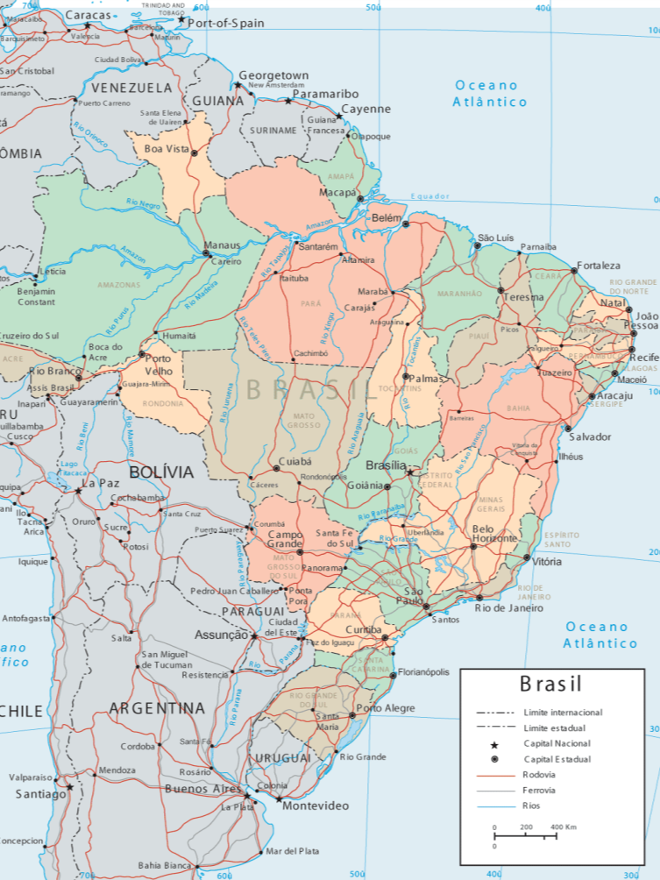
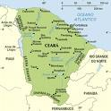
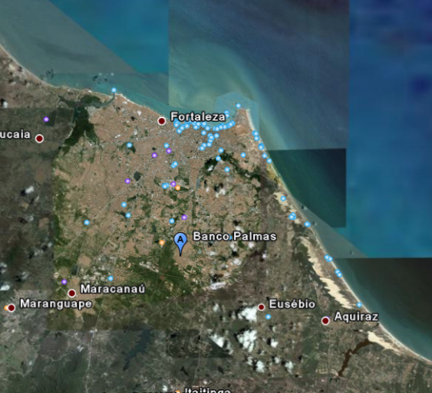
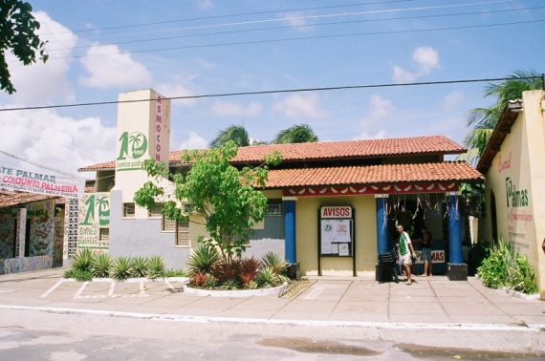

Banco Palmas - Fortaleza

Slide 6
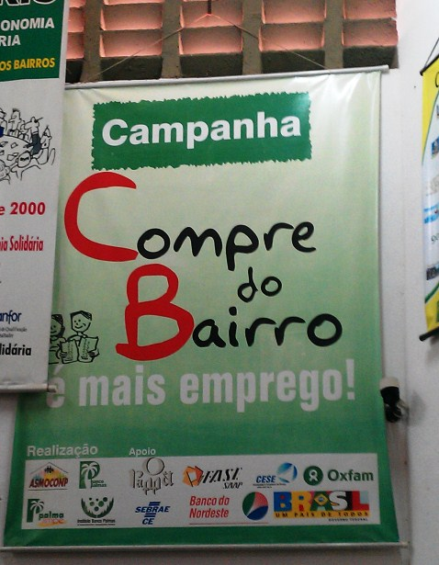
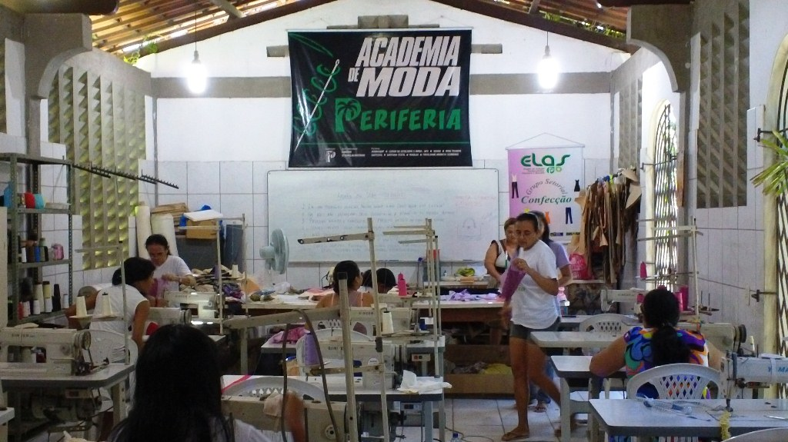
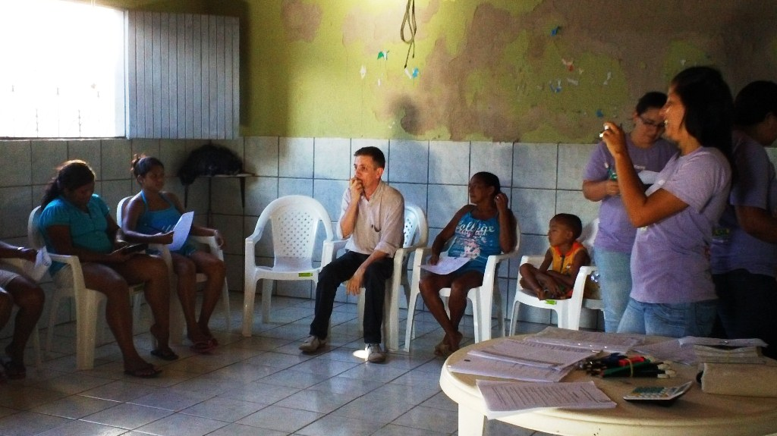
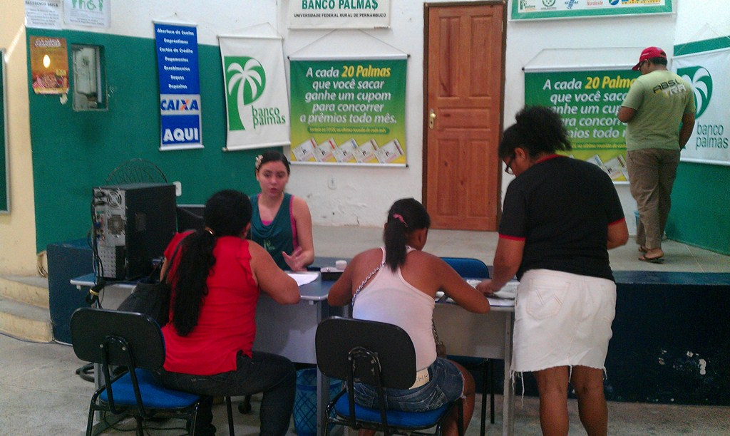

Slide 7
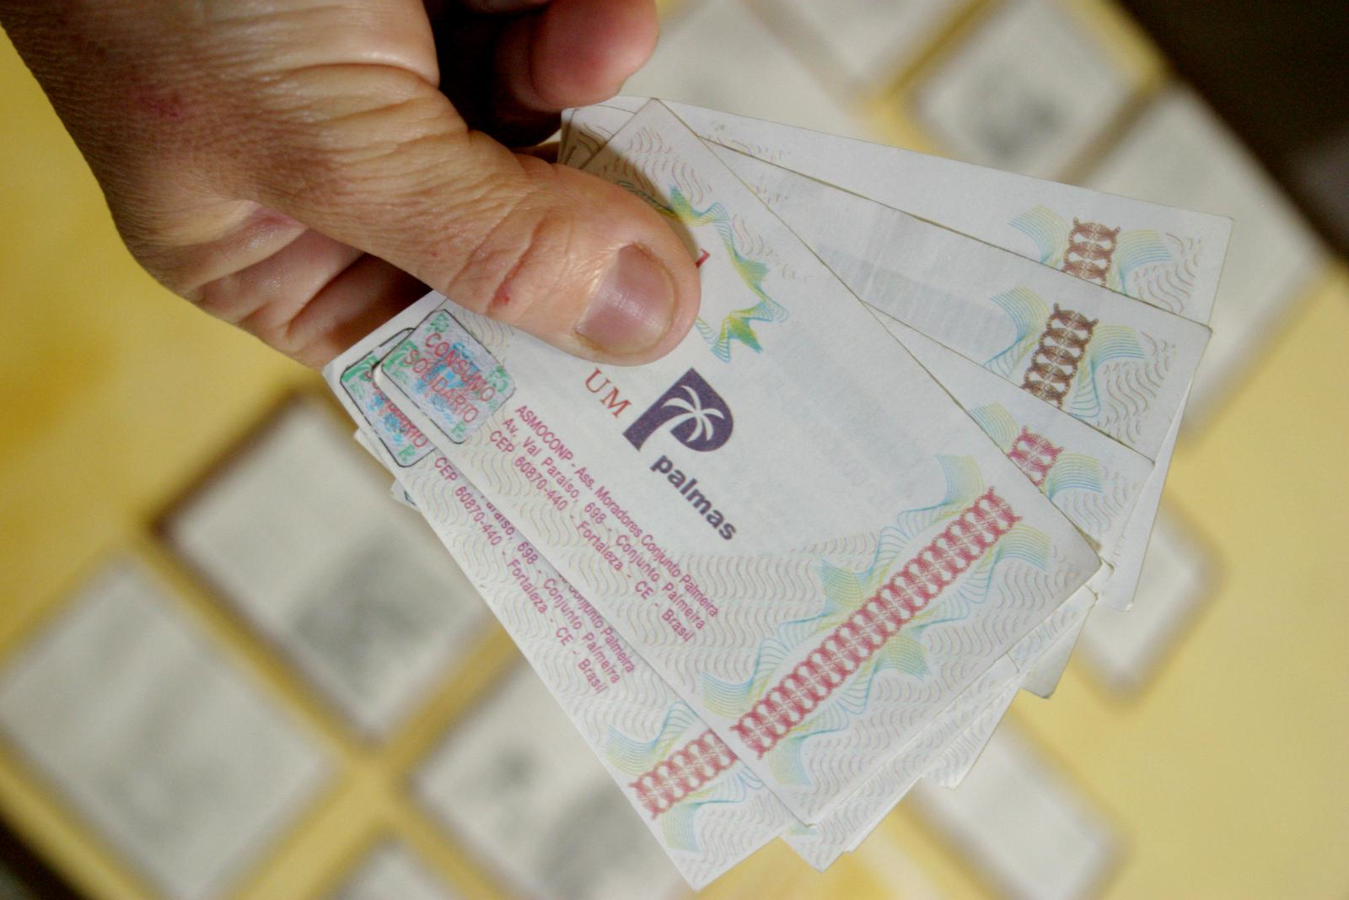
Social Currency

Slide 8
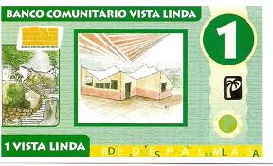




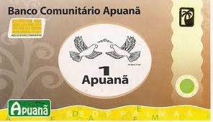
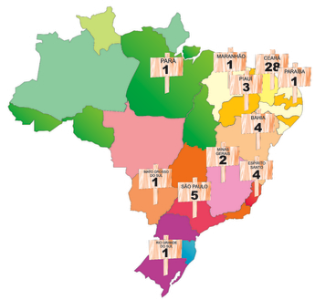


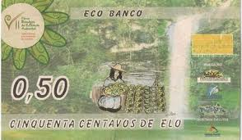



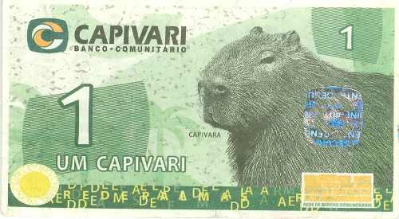

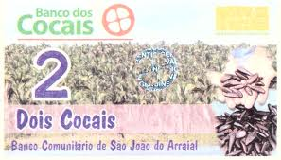




Slide 9
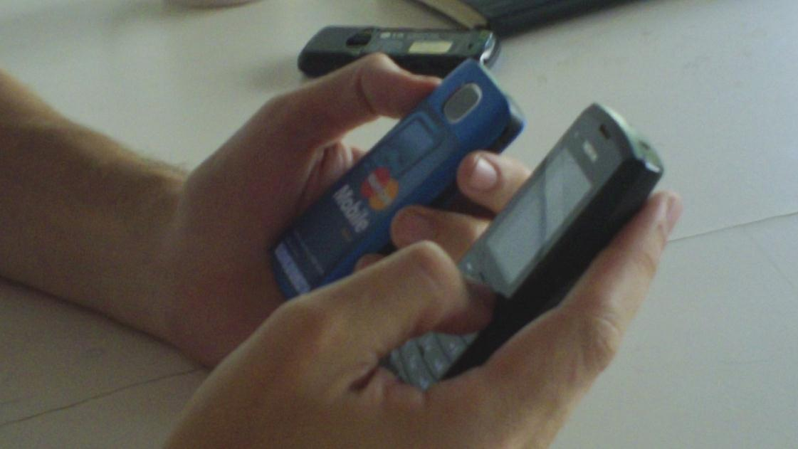
Mobile Payment at
Conjunto Palmeira
Pioneer project oriented to financial inclusion

Slide 10
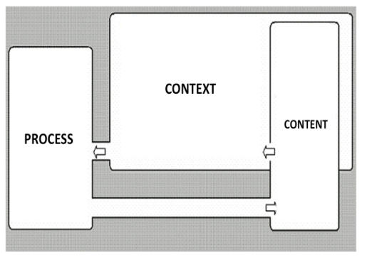
Conceptual Approach*
Theoretical lens
Social Shape of Technology
Structuracionism
Contextualism
*Pozzebon et al. 2009 + Tiwana et al. 2010

Slide 11
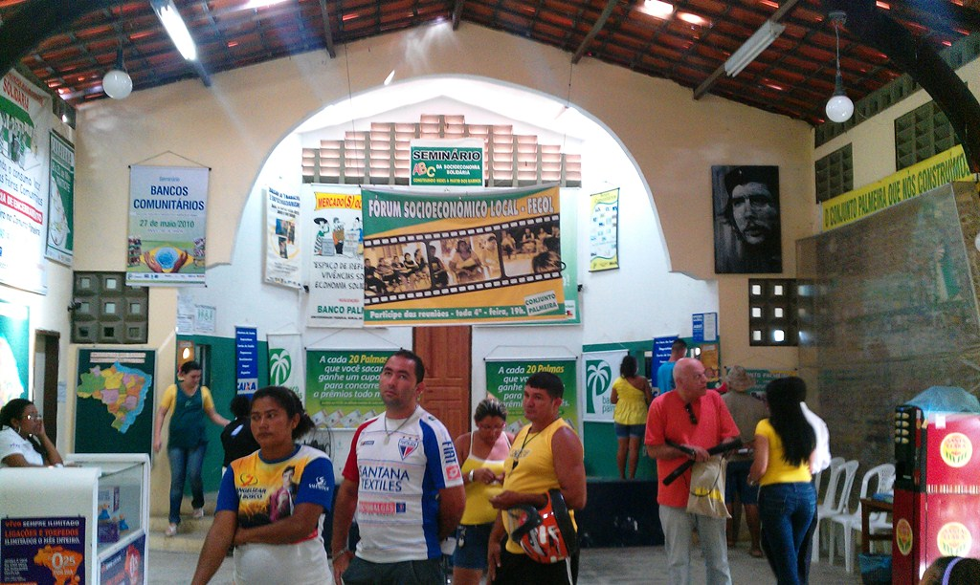
Research Strategy (1st step)
Interviews with actors involved:
Banco Palmas(3), Executives(10), Operational People(3), Clients(14), Merchants(3), Gov officers(5)

Slide 12




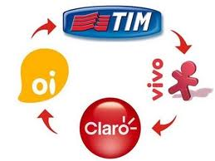



Main actors (2011)
?
Ministry of Social
Development

Slide 13





Main actors (2012)

Slide 14
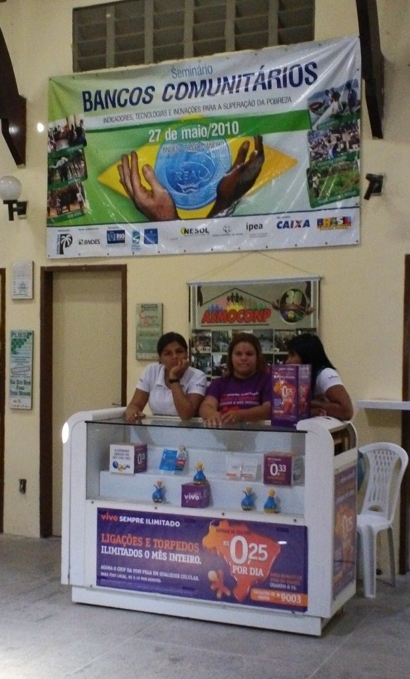
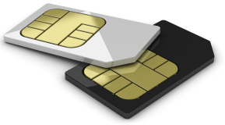
Pilot Project Today
(Users)
1,400 registered
  500 active
No mobile payment
No network externality
Security motivation
Free chip

Slide 15
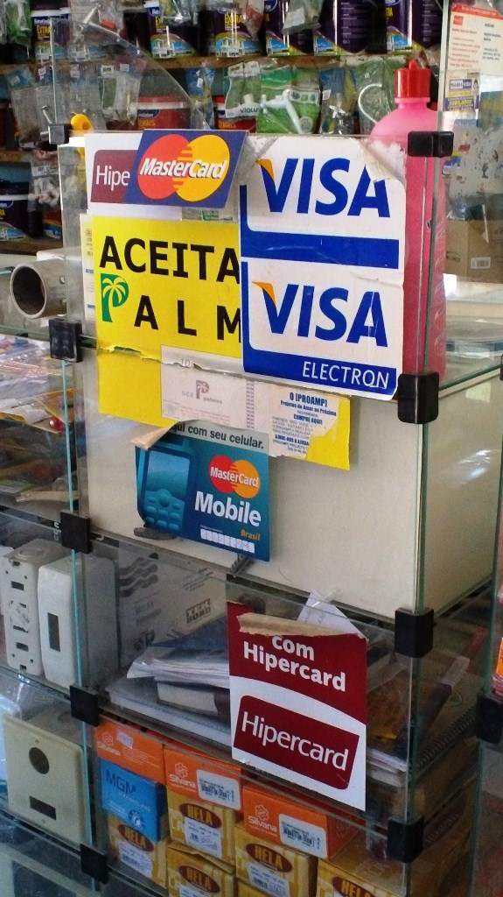
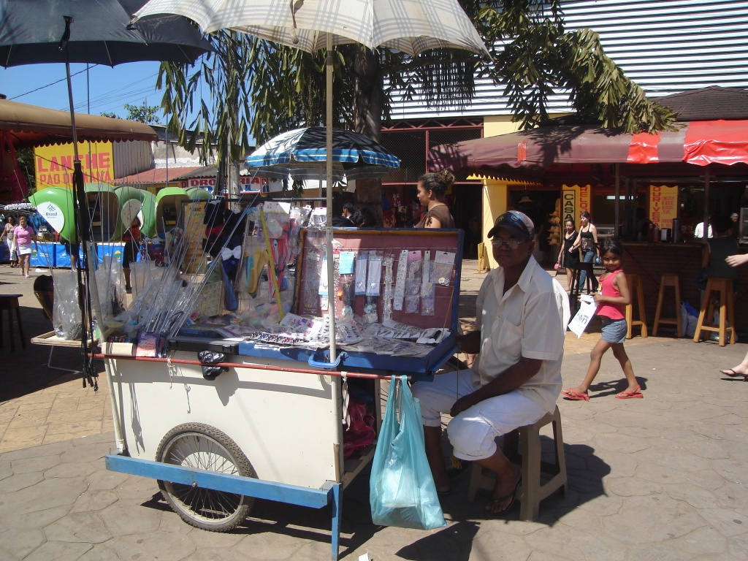
Pilot Project Today
(Merchants)
4 merchants
  no significant use
informal merchants
  B2C or C2C?!

Slide 16
Pilot Project Today (Partners)
Governance
  Expectations on the project
  Time line perspective
  Model conflifts
Social inclusion
To be mature in 15 years
Battle for marketshare
Mobile banking
Channel conflict

Slide 17
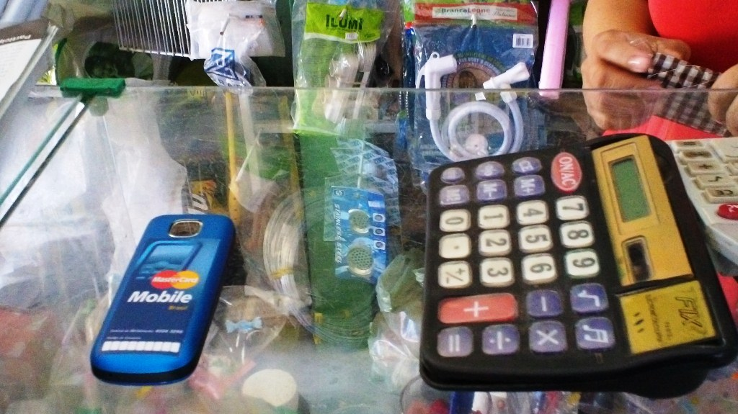
Other issues
Operational failures
Low income market
Banco Palmas role
Cash culture

Slide 18
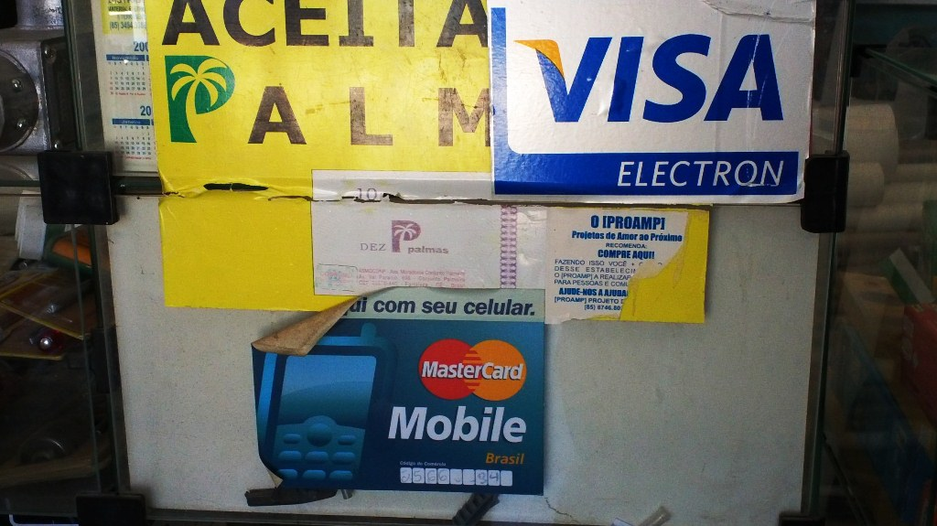
Pilot Project Ecosystem
Interoperability
  Closed networks
Model Replicability
  Acquiring process

Slide 19

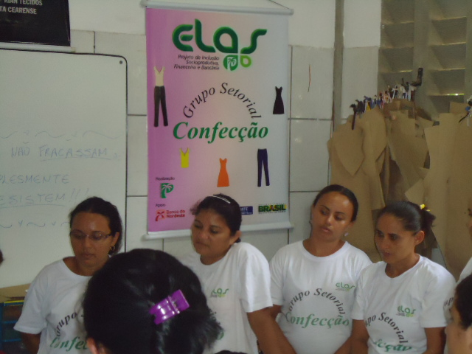
Research Next Steps
Feedback to interviewed actors
  Governance!!!
Data analysis
  Project ELAS data base
  Bolsa Familia Women
  Group comparisons
  Government data bases

Slide 20

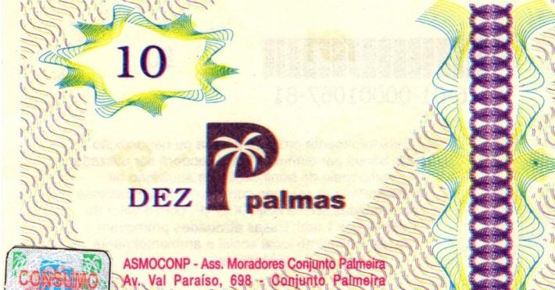
Next Events
Payment Service Providers
  New regulation
  Seminar on MM ecosystems
Ministry of Social Development (MDS)
  Biggest mobile client
Banco Palmas: 15th anniversary

Slide 21
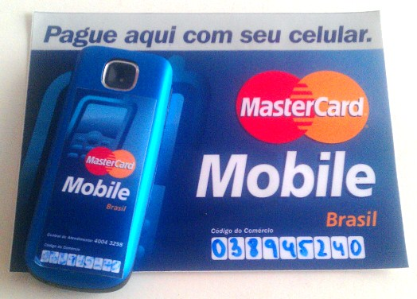

Thank you!
Adrian Kemmer Cernev
adrian.cernev@fgv.br
Eduardo Henrique Diniz
eduardo.diniz@fgv.br

