Slide 1
Branchless Banking
What do we know about low-income customers so far?
November 5, 2009 mpickens@worldbank.org
Notes:
7

Slide 2
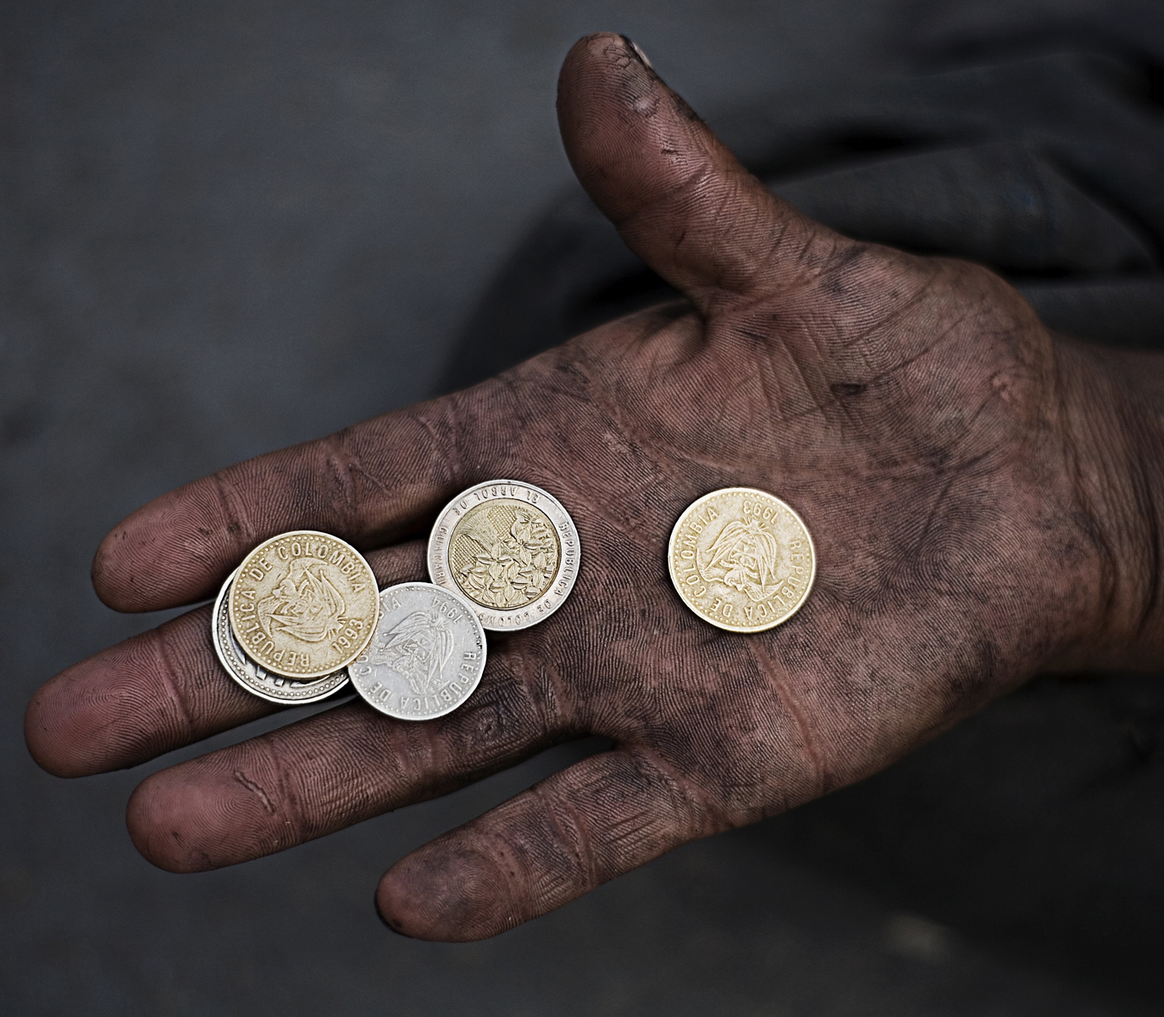
CGAP: Who we are
Independent research and policy center dedicated to advancing financial access for the poor
Founded 1995
Supported by 33 funders
Housed at World Bank
Three major fronts
  Government and policy
  Market intelligence
  Market infrastructure

Slide 3





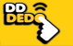

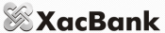
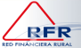



CGAP Technology Program
GXI - Philippines
Eko - India
Orange –W. Africa
NLink - Philippines
Instigate
Equity- Kenya
AVV/DDD-Colombia
WIZZIT – S. Africa
B
New Exp - Kenya
Xac - Mongolia
RFR - Ecuador
TN/Tameer-Pakistan
SERP - India
A
NewBank - Brazil
MMA - Maldives
How will low-income people respond?
Which business models are viable?
What does enabling regulation look like?
Demystify
Clinton Global Initiative, Mobile World Congress
Wired, The Economist, CNN.com, The Banker
Top-rated blog on tech and banking the poor
Focus notes & briefs
Share
2

Slide 4

Branchless Banking: getting big
Source: CGAP analysis based on provider interviews
Notes:
This refers to the number of registered users in implementations which we have reason to believe unbanked people are using in some proportion.
Note, we are not claiming all of these 154.7 mil are unbanked, or poor, or active.
To some extent, it’s better if most of these clients in these implementations are NOT poor. A large chunk of middle income users can be used to initially cross-subsidize outreach to lower-income customers who may be lower-margin, but once reached at volume can be attractive as a segment.

Slide 5
Attractive… but how many success stories?
Throughput: US$ 1000 / year
Item | Value
Fee | 1% (USD 10)
Capture | 25% (USD 2.5)
Active M-PESA | 5.25 million
Revenue (M-PESA) | USD 13.1 mil
Pop. India/Kenya | 34.38 / 1
Revenue (scaled to India) | USD 451.2 mil
Collins, Morduch, Rutherford & Ruthven. Portfolios of the Poor. 2009
CGAP analysis, FSD Kenya, World Development Indicators database

Slide 6


A familiar sight by now…

Slide 7
Growing body of data about poor users
5 surveys, 4 countries, 8 providers, 5657 respondents
Country | Year | CGAP’s Partner | Respondents | Service | Method
South Africa | 2006 | N/a | 515 users and non-users, LSM 5 or less | WIZZIT | Telephonic and in-person 51 minute survey
Brazil | 2006 | N/a | 750 users and non-users with p.c. income <50% of min. wage | Multiple banks | Intercept with 45 minute survey
Kenya | 2007-08 | Univ. of Edinburgh | 350 users in low-income communities | M-PESA | Semi-structured interviews
Kenya | 2008 | FSD Kenya, MIT | 3,000 users and non-users, all income levels | M-PESA | In-person 1.5 hr survey
Philippines | 2009 | GSMA, McKinsey | 1042 unbanked mobile money users in C-D-E consumer segments | GCash Smart Money | In-household, 120 question survey

Slide 8
M-PESA metrics
M-PESA through Oct. 2009
Sending Money Home: then and now
Launched Mar. 2007
7.5 mil registered users
12,000 agents
Handling US$ 600 mil/mo
41% of the population “banked”
Method | 2007 | 2009
Hand | 58 | 32
Bus | 27 | 9
Post | 24 | 3
M-PESA | 0 | 47
Sources: Safaricom, FSD Kenya
Notes:
58% increase in banked status

Slide 9
What do clients say about M-PESA?
Speed
Convenience
Cost
Safety
  Source: FSD Kenya (2009)

Slide 10
Effect of losing M-PESA
  Source: FSD Kenya (2009)

Slide 11
How often money sent but not received?
8x lower incidence of loss
 | Over last five years | Last transaction
M-PESA users | 7.16% | 0.03%
Non-users | 6.99% | 0.24%
  Source: FSD Kenya (2009)

Slide 12
Yet 20% report difficulty withdrawing funds

Slide 13
M-PESA’s success points at what’s next
  Extremely high satisfaction rates
    85% “happy”, “very happy” or “extremely happy”
    Remittance value up 5-30%
  Very focused on the advertised use
    85% use it 1x / month or less
    Mostly on money transfer to family
  Sub-segment of “rebellious” users
      21% use M-PESA to store funds
  Some surprises
      30% of customers are unbanked
      20% report problems with agents
So what…
Clearly possible to gain traction with low-income clients over mobile
Much of the payments space still wide open
Clear demand for more than what M-PESA offers
Is that a bad thing?
Merchants have problems with adequate cash
  Source: FSD Kenya (2009); Morawczysnki & Pickens (2009)

Slide 14
Heat loss on the way to adoption
2/3 of low-income unbanked Filipinos aware of at least one mobile money product
Half understand the utility of mobile money services
75% think mobile money would be easy to use
Yet 1/4 to 2/5 think mobile money is a “product for people like me”
Only 13% of low-income, unbanked Filipinos say they are interested in trying mobile money
  Source: Pickens (2009)

Slide 15
What would make them adopt?
Referral by a trusted source
Family and friends was the most common way users said they learned about mobile money (66%).
Nonusers with friends or family who use mobile money were 63 percent more likely to say mobile money is a product “for people like me”
Tangible goods drive benefit as well as “no-loss” guarantees
  Source: Pickens (2009)

Slide 16
Savings looks like an adoption driver
Savings attractive to some clients
1 in 10 unbanked mobile money users stores an average of USD 31 in their mobile wallet (reported as 1/4 of household savings).
Savings most popular add-on product customers say they may use
  Source: Pickens (2009)

Slide 17
Conclusions
Branchless banking is reaching the poor and unbanked
But also attractive to large numbers of the underbanked
Primarily used in very narrow ways, particularly sending money to friends and family
Some rebellious users point at other use cases (savings, credit, B2B)
Uptake driven by quality of competition

Slide 18
Questions
How do branchless banking products compare against the informal?
Why do clients tolerate problems accessing cash with some branchless banking services?
What do we know about user interfaces that could make BB more accessible?
Are there exploitable links to social networking?
Who’s being left behind?

Slide 20
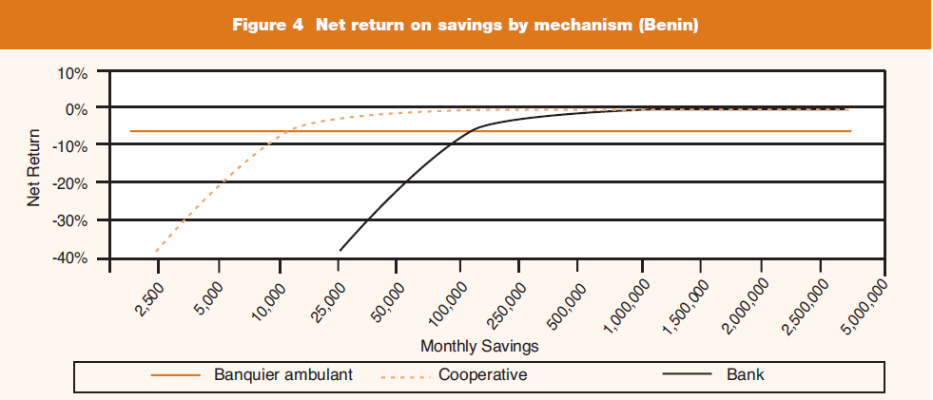
Poor people have poor products

Slide 21
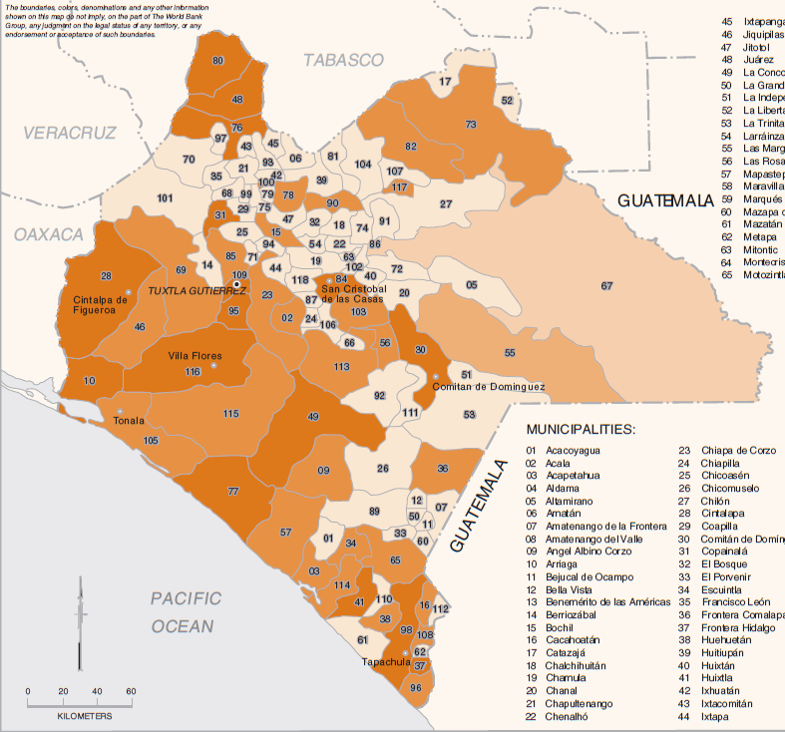
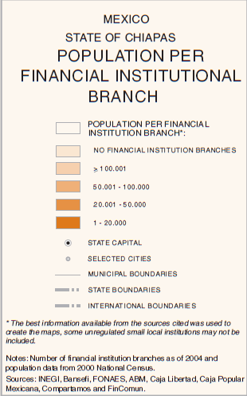
Key values of mobile are “proximity” + “reliability”
Deshpande, R. “Safe and Accessible” CGAP Focus Note 37.

Slide 22
Different customers, different behavior, different profits
Estimated profitability of mobile money accounts
at a major Indian bank
Salaried
Student
 |  | Average Balance
 |  | 500 | 1,000 | 1,500 | 2,000 | 2,500 | 3,000 | 3,500 | 4,000 | 4,500 | 5,000 | 5,500
Average Tx /Mo | 1 | -4 | -2 | 0 | 3 | 5 | 7 | 10 | 12 | 14 | 17 | 19
 | 2 | -9 | -7 | -5 | -2 | 0 | 2 | 5 | 7 | 9 | 12 | 14
 | 3 | -14 | -12 | -10 | -7 | -5 | -3 | 0 | 2 | 4 | 7 | 9
 | 4 | -19 | -17 | -15 | -12 | -10 | -8 | -5 | -3 | -1 | 2 | 4
 | 5 | -24 | -22 | -20 | -17 | -15 | -13 | -10 | -8 | -6 | -3 | -1
 | 6 | -29 | -27 | -25 | -22 | -20 | -18 | -15 | -13 | -11 | -8 | -6
 | 7 | -34 | -32 | -30 | -27 | -25 | -23 | -20 | -18 | -16 | -13 | -11
 | 8 | -39 | -37 | -35 | -32 | -30 | -28 | -25 | -23 | -21 | -18 | -16
 | 9 | -44 | -42 | -40 | -37 | -35 | -33 | -30 | -28 | -26 | -23 | -21
 | 10 | -49 | -47 | -45 | -42 | -40 | -38 | -35 | -33 | -31 | -28 | -26
Self-Employed
Calculated on variable-cost basis)
Rupees/ Month /Account
Source: CGAP analysis
Small Business
Notes:
Rs 7 = USD 0.15

Slide 23
What else do we know about branchless banking clients?
2 studies of M-PESA clients
  85% “happy”, “very happy” or “extremely happy”
  85% use it 1x / month or less
  Remittance value up 5-30%
  30% unbanked
  21% use M-PESA to store funds
  20% report problems with agents
  FSD Kenya (2009); Morawczysnki & Pickens (2009)
So what is M-PESA?
  A money transfer service?
  A transactional account?
  A national payment system?

Slide 24
M-Pesa generates 4.3x gross revenue than airtime
Daily commission
(left axis, in USD)
20
Mean = 86 transactions, $16.1 commission
16
M-PESA commissions
4.3x
Airtime commissions
(at the mean)
-1 stdev =
54 transactions,
$10.7 commission
+1 stdev =
118 transactions,
$21.6 commission
12
8
4
Stdev =
32 transactions
0
Probability distribution of no. of transactions
Number of transactions per day
Assumptions: Agent transaction volumes abased on average transactions observed in selected agents. Commissions are after-tax, and assume: (i) equal number of deposits and withdrawals, and (ii) agent pays 30% of commissions to aggregator. Exchange rate used is 79 KSh/USD.

Slide 25
M-PESA vs. Airtime
M-PESA vs Airtime (USD): 19 agents representing 125 M-PESA shops
 | Airtime | M-PESA
Capital | 129 | 1,605
REVENUE
Gross revenue | 3.77 | 16.11
# trans / day | 163 | 87
Avg ticket size | 0.46 | 16.95
Margin | 5.0% | 1.1%
EXPENSE | 2.22 | 11.10
Liquidity mgmt | - | 3.82
Space (rent + util) | 0.73 | 0.73
Wages | 1.21 | 1.21
Taxes | - | 3.38
Cost of capital | 0.28 | 1.95
PROFIT | 1.55 | 5.01
ROI | 373% | 97%
M-PESA vs Airtime:
Amount of K needed to finance an agent business is 12x greater (equal to Kenya’s GDP per capita of US 1600)
Cost to maintain liquidity is #1 expense (30% of total expenses)
Although margin (1%) is lower than airtime (5%), agents are not fixated on the differential.
Profit from M-PESA (USD 5.01 / day) is 3.2x greater than selling airtime

Slide 26
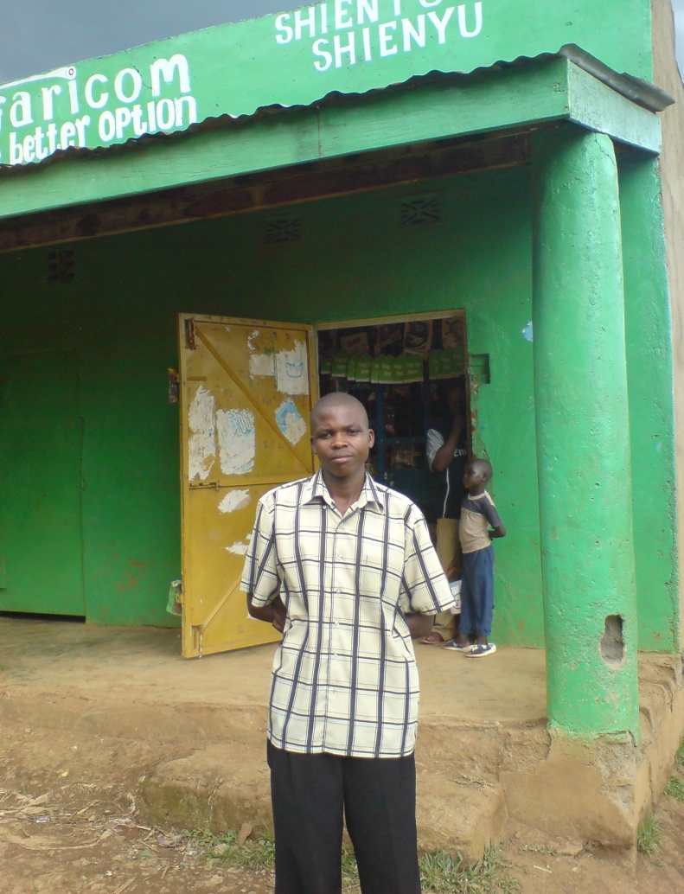
Worst Case: Japhet - Musoli
}
Profit: $2.70
M-PESA unprofitable:
Revenue from M-PESA = $1.80
Cost of M-PESA = $2.20
Liquidity management is 50% of his total expenses due to long distance to exchange cash and e-float
Notes:
26

