Slide 1
Network linkages and money management: an anthropological purview of the Beesi network amongst the urban poor muslims in old city area of Lucknow, India.
IMTFI 1st Inaugural Conference 4^{th-}6th November 09
Dr. Syed AimanRaza
Lecturer, Department of Anthropology
Shia PG College
Lucknow
India

Slide 2
The Problem
The global recession might end soon, but there are no signs of settling down of the woes of the poor in third world countries. The impact of recession is huge- there are definite signs of job losses, loss of income, high expenditures and an unusual increase in food prices.
This dilemma of poverty becomes more pathetic when these earnings are just less than 2$, working for more than eight hours a day. How can one survive in such conditions of haplessness and misery? ???
Do they compromise on the education of their children or do they make compromises on the health front and then what keeps them afloat????

Slide 3
The Answer lies here -
The answer lies somewhere in their social structure, which helps in maintaining strong social networks and ties among the members of the neighbourhood and sometimes even employing financial tools, many linked to informal networks and family ties, which according to Coleman (1990) is social capital of the society - “ a glue that holds societies together” (Serageldin, 1996, p.196).
Social capital consists of norms, networks and horizontal associations (Putnam, 1993; Putnam, Leonardi and→Nanetti, 1993), having important economic consequences on development outcomes including growth, poverty and poverty alleviation (Grootaert, 1996).

Slide 4
Networks
These networks are structures of relationships linking social actors—are ubiquitous in contemporary society, especially among the poor, in third world countries.
They act as instrumental aid for individuals whose social and economic disadvantages place them “beyond the frontier” of formal finance (Von Pischke, 1991), successful financial intermediation is often accompanied by social intermediation.
Social intermediation prepares marginalised groups or individuals to enter into informal networks often known as Rotating Services and Credit Associations (ROSCA’s)
In West Africa they are tontines, paris, or susus (Krahen and Schmidt, 1994)
Hui in Taipei (Beatriz and Murdoch, 2005)
Beesi in India.

Slide 5
Aim of the Study
The study contributes to the linking of micro levels of analysis of money management through informal financial network (ROSCA), popularly known as Beesi, among the poor skilled Zardozi (embroidery) workers in Lucknow, along with highlighting other different financial tools used for money management.
heds light on various dimensions of social capital, poverty, household economic portfolio and how families live on so little- less than two dollars a day.

Slide 6
Methodology
The data was collected from 60 households belonging to the Asna Ashari Shia sect, who are involved in Zardozi (embroidery) work, from two distinct Shia dominated areas of the old city in Lucknow - Ghazi Mandi in Bajaza and Raees Manzil in Husainabad.
Purposive sampling was done and only those households were covered which were managing their finances through informal Beesi networks.
Criterion Sampling was also done to select the Beesi networks which had a majority Zardozi workers attached to it
Household census, which included all the social indicators – education, migration, health and household assets, consumption of essential commodities was conducted.
Participant observation along with narrative and in-depth interviewing, having open ended and fixed response questions was done.
Focus group interviews provided relevant information about problems and prospects in Zardozi (embroidery) as an occupation, including income and expenditures variations caused due to seasonality.

Slide 7
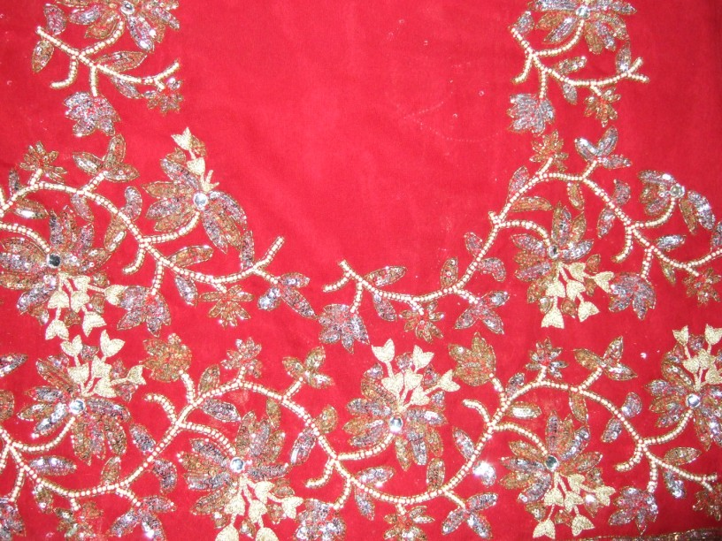
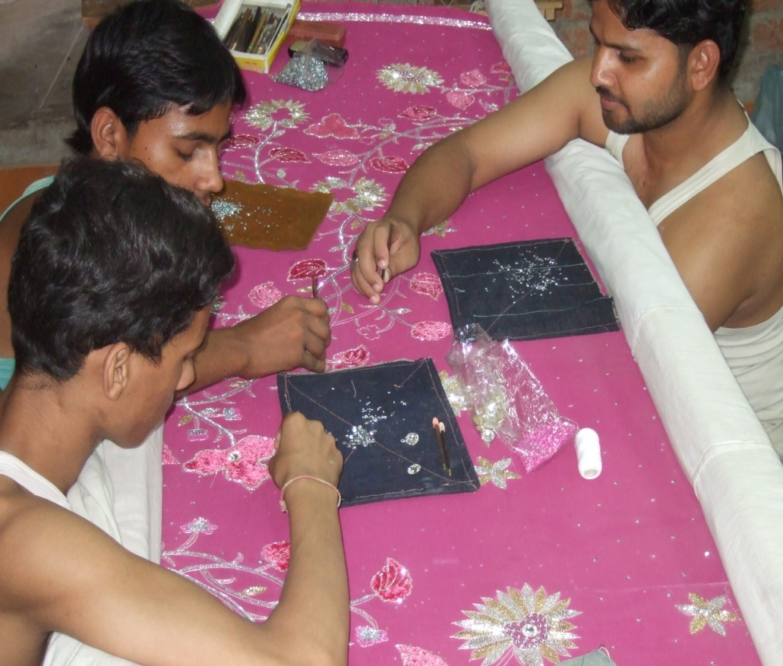
Zardoz At Work

Slide 8
Average Income and Expenditure Raees Manzil

Slide 9
Income and Expenditure Ghazi Mandi

Slide 10
Educational Status

Slide 11
Educational Status

Slide 12


The Beesi Process

Slide 13
THANK YOU

