Slide 1
A Study of Money and Financial Services and the Impact of ICTs Among Poor Communities in Developing Countries: The Case of Botswana
By Alice Shemi & Beatrice Magembe
University of Botswana
Botswana
Paper presented at the IMTFI CONFERENCE for first funded researchers, 3 – 6 Nov, 2009.

Slide 2
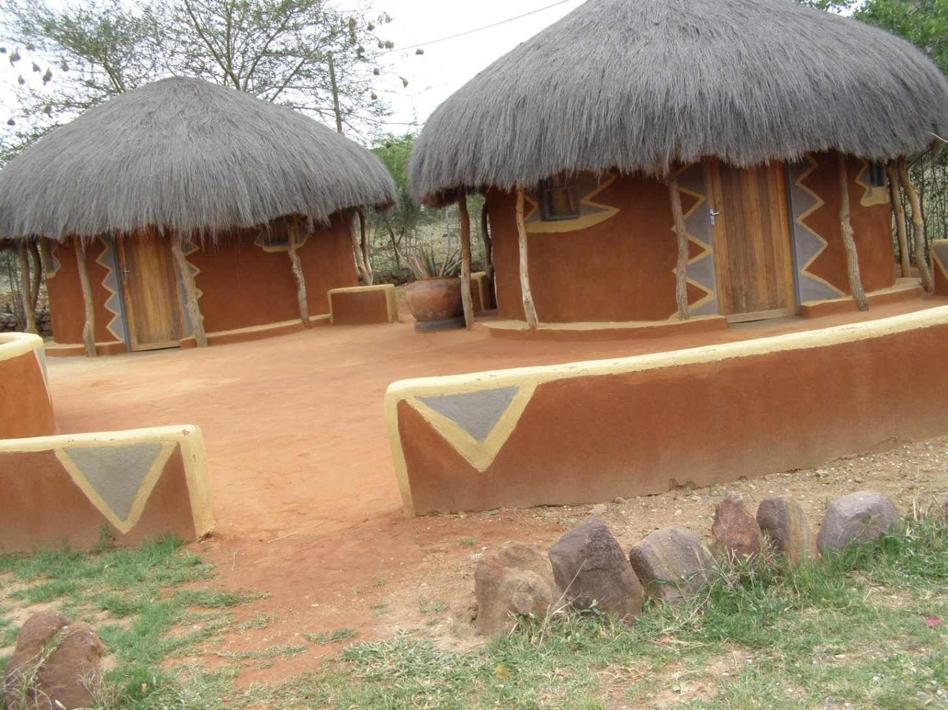
Traditional Huts

Slide 3
Outline
General statistics about Botswana
The Problem Statement and Objectives
The Research Methodology and Design
Perception and use of money
Occupation and income
Financial inclusion or exclusion
Use of ICTs
Conclusions
Part 2 of the Research

Slide 4

BOTSWANA STATISTICS
Area: 581 730 sq km
Population: 1,84 Mi (2008)
  Per capita GDP:
  US$13, 000
Poverty ranking:
81 out of 135 developing countries
49% of total population live on less than US$2 per day (UNDP 2009 Human Development Index).
Human Development Index (HDI) ranking:
125 out of 185 countries studied
18^{O}S
26^{O}S
20^{O}E
28^{O}E

Slide 5
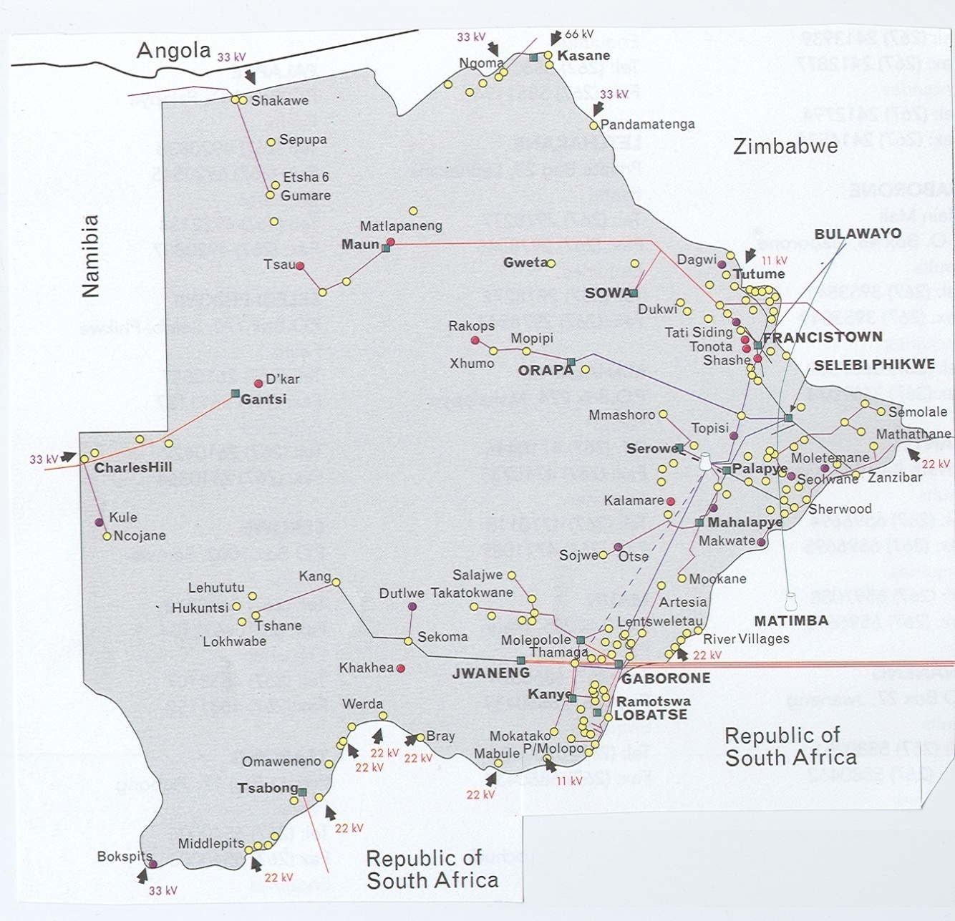
BOTSWANA STATISTICS
  Commercial Banks:
  FNB, Barclays, Standard Chartered, Stanbic, Bank of Baroda, bank Gaborone & Capital Bank.
Mobile phone operators:
  Mascom, Orange, BTC

Slide 7
Problem Statement
Botswana has the highest per capita GDP in Africa, yet 49% of her population live on less than US$2 per day.
Our study focuses on those Batswana who live on less than US$1 per day.
Vision 2016 – poverty eradication
  Calls for promotion of savings through innovative financial instruments
  Free access to information and communication facilities
  Botho principle (respect, sharing)

Slide 8
Problem Statement
Little is known of how the poor, in rural and urban Botswana, who earn less than US $1 a day, are assisted to borrow, accumulate, transfer, secure their money, livestock and other forms of wealth.
There is also a dearth of knowledge, on what financial resources are available to them to preserve their wealth for a ‘rainy’ day in the future.

Slide 9
Major Objective
The major objective of this study is to understand and explain the different media that is used to fulfill the basic functions of money by the poor people in Botswana; that is people living below the poverty line.

Slide 10
Specific Objectives of Study
To find out how money is perceived and used by the rural and urban poor communities in Botswana.
To investigate the attitudes of poor communities towards saving and investment and other financial services.
To investigate from the demand and supply-sides, what financial services are available for the poor and marginalized communities .
To explore the use of ICTs, and other innovative intervention methods that can be used to provide financial services to poor communities .

Slide 11
Methodology
This is a qualitative research. The study has been conducted in two parts.
Part one of the study entailed: face to face interviews; data entry and preliminary analysis of data.
Sampling Technique
    Urban and Rural poor
    Participants were chosen from 3 urban localities (Gaborone, Francistown & Lobatse), and 3 rural localities - (Jwaneng, Kanye, & Molepolole)
    Respondents were categorised into two:
    Less than US$1 ( less than BWP 210 pm)
    Those who earn exactly $1

Slide 12
Methodology
    Data Collection Method-
        Face to face interviews were conducted by visiting participants in their village/home localities- Contrary to earlier plan by researchers to seek contact through ward/village heads at the kgola ( traditional centre)- Ethical issues emerged
        Voice recording of the interviews was done with interested participants where possible – use of equipment posed security threats to researchers/assistants especially in poor urban localities
    Data Analysis
        Qualitative data analysis using Nvivo8 software

Slide 13
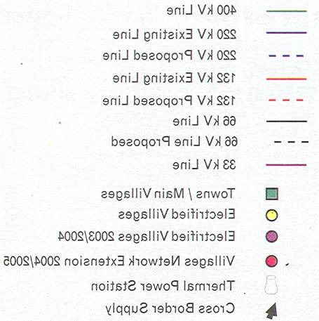
Botswana

Slide 14
Findings
Field work was completed around October 15, 2009.
A total of 333 respondents participated in the study.
  Gaborone - 32
  Francistown - 76
  Lobatse - 47
  Kanye - 64
  Jwaneng - 56
  Molepolole - 58

Slide 15
Findings-Perception and Use of Money
  Over 70% of those who earn less than US $1 use the money for immediate purposes. They do not save nor invest. They narrate that ‘it is not enough’.
  A 30% of the respondents engage in some form of savings: Traditional Motshelo method, Post Office , Hide under mattress or somewhere in the house.
  Hardly any respondents saved with the Financial institutions nor converted their returns into buying livestock (cattle , goats) for future use.
  Money as a status symbol: –”my neighbours think I am a thief because I don’t have money”
  No plan of taking care of emergencies – run around, seek help, borrow – a 30 % seek social worker assistance.

Slide 16
Findings-Occupation and Income
  Most respondents did not have regular jobs.
    Casual labour
    Piece jobs
      Litter picking
      Building
      Bricklaying
      House keeping and laundry/washing jobs
    The over 50 years of age were on pension(earned $1) and are on government food ration
    Income: Over 90% of the respondents (Jwaneng and Francistown) were earning less or up to a US $1 a day.
    Income was erratic
    A third of respondents could receive more than US $1 a day.

Slide 17
Findings-Financial Inclusion or Exclusion
Perception of ‘banks do not care about low income people’; ‘Banks are too greedy’; they are too profit conscious’; banks help people with steady jobs’
Respondents are not aware of any financial products targeted at marginalised people.
They suggest- Post Office can assist them by locating nearer
A sense of helplessness- Have no ideas as to how they can be assisted.

Slide 18
Findings-Use of ICTs
Over 70% of respondents (Jwaneng and Francistown) have mobile phones. All of them have no computers (i.e., PC).
A 50% bought the equipment for themselves, and the rest stated that they were given by friends, relatives, or boyfriend.
Respondents use mobile phone for communication, especially in emergencies
Over 90% have never used a computer.
Some people think they are marginalised due to their lack of knowledge of the computer and its usefulness

Slide 19
Conclusions
Preliminary findings show that money is not used as a means of preserving wealth. A majority do not save nor invest for the future.
Evidence of financial exclusion of the poor
Use of mobile phones for communication is prevalent

Slide 20
Part 2 of Research
Entails:
  Data entry of all responses into the NVIVO software
  Qualitative analysis of all responses to extract:
    Respondents’ perception of money
    Respondents’ attitudes towards savings and investments
    Information on how ICTs can be used to enhance accessibility of the poor to financial services
    Conducting Focus Group interviews to elicit information on how ICTs particularly, the mobile phone can be used to help the people living with less than US$1 a day gain access to financial services.

Slide 21
Part 2 of Research
    Interviews with Financial services providers (commercial banks, microfinance institutions) to find out if they have any products/services targeted for the poor, and how those people living with less than US$1 gain access to financial services.
    Interviews with mobile phone service
    Focus group meetings with all stakeholders
    Collect secondary data from newspapers, and other sources. There was a lot expectations in the run-up to the elections that the government is going to take steps to change the livelihood of the people in Botswana.
    Detailed analysis using NVIVO8

Slide 22
END OF PRESENTATION
Thank You For Listening

