Slide 1
The financial ecologies and circuits of commerce of retail credit cards in Santiago de Chile
José Ossandón; Macarena Barros; Felipe Gonzalez
Tomás Ariztía; Camila Peralta; María Jesús Fernández
Escuela de Sociología Universidad Diego Portales
Santiago de Chile
jose.ossandon@udp.cl
http://estudiosdelaeconomia.wordpress.com/

Slide 2
Research Proposal Abstract
The expansion of consumer credits has been one of the most wide-ranging transformations in the last 20 years in Chile. One can argue that Chile has gone through its own process of ‘financialization’ and that this has had a very specific and domestic character: consumer credits. Of course, this is not the only country where consumer credits, and particularly, credit cards, have seen a significant growth. However, recent trends in the Chilean case show an important particularity: the access to consumer credits has neither been driven by banks nor by other traditional financial institutions but mainly by retailers such as supermarkets and department stores. In today’s Chile retail credit cards are not merely used to purchase goods in the issuers’ stores, but also increasingly as revolving credits cards that are usable in an expanding network of places (including airline tickets, private hospitals, pharmacies, and, certainly, other stores). In a developing country, where a large proportion of the population has not traditionally been considered by banks as potential customers, chain retailers are becoming the main access to finance. The expansion of consumer credits in Chile has recently been the focus of many of the main discussions in social research in Chile. However, little attention has been paid by academic research to credit practices itself. A central issue that has not been studied yet is the consequences of the expansion of retail credit cards to areas of the population and the city previously excluded from formal finance services. This research aims at starting to fill this gap. This work will be elaborated from an “object based” approach and it will focus on two main aims: describing the new “financial ecologies” and the “circuits of commerce” emerging after the expansion of retail consumer credit to poor areas of Santiago, Chile’s capital city.

Slide 3
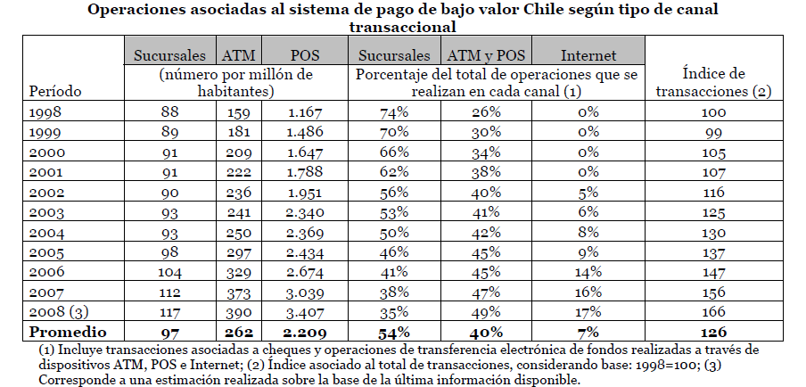
Context: the consumer credit industry in Chile
Increasing relevance of bank credit and debit cards.
The amount of credit cards increased 10 times from 1991, from 890.481 to 5.347.649 (Barros 2009). The amount of debit cards increased from 1.152.000 in 1997 to 7.411.133 in 2007. The amount of bank consumer debtors from 1.5 millions to 2.3 between 1994 to 2005, and 10 times its $. (Morales & Yáñez 2006).
Bank Credit Cards in Chile – 1991 - 2007
Source: Flores et al 2008
Source: Serie Técnica de Estudios N°012. Instrumentos de Pago de Bajo Valor en Chile: Evolución y Tendencias. Noviembre de 2008, SBIF.

Slide 4
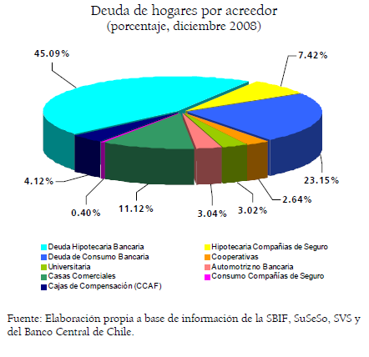
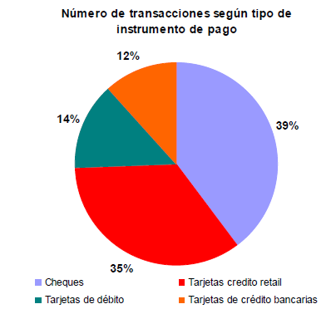
Context: the consumer credit industry in Chile
However, there are other actors in the consumer credit industry: particularly important are DEPARTMENT STORE AND SUPERMARKETS’ credit cards.
While the number of bank credit cards increased from 1.310.325 in 1993 to 4.499.627 in 2007, the amount of retail credit cards increased from 1.350.000 to 19.273.919 (Montero & Tarzijan 2010).
There are more than 4 retail cards per bank card (while USA 0,9; Brazil 1,5; Colombia 0,25; Mexico 0,4).
If we take the same period- in this case April to June 2010- there were performed 21.334.163 bank credit cards transactions, while 48.574.543 retail credit card transactions were done (SBFI 2010).
Not only installment. Store cards are increasingly used in other stores (bus tickets, utilities, etc…); it is possible to withdraw cash; and to take consumer loans.
Source: Matus et al 2010
Source: Serie Técnica de Estudios N°012. Instrumentos de Pago de Bajo Valor en Chile: Evolución y Tendencias. Noviembre de 2008, SBIF.

Slide 5
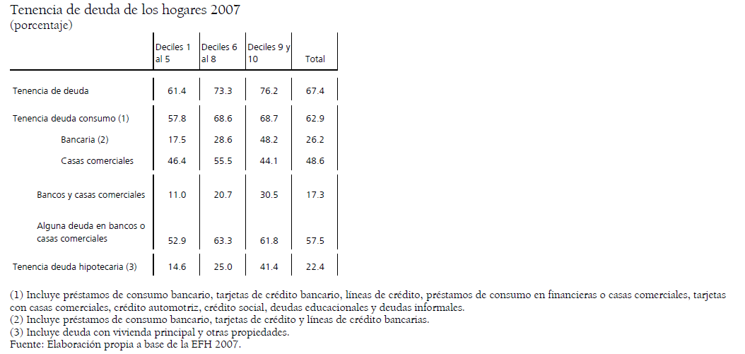
Context: the consumer credit industry in Chile
Retail store credit is important in different home segments, but relatively more relevant in poorer homes where access to bank accounts is restricted.
The 2007 survey shows that 62,9% of Chilean households have a consumer credit debt, 26,2% of them owe just to banks, 48,6% just to retailers, and 17% has a mixed debt (Matus et al 2010). But, 39% of the richest set of households have bank (credit card or overdraft) consumer debt, and 35% of the same group has a retail card debt (Banco Central 2010).
At the same time: different stores target different groups. Increasing part played by those stores that are targeting “riskier” groups. Expansion enabled by IT, risk management and “cards as devices”. However, outside the industry little is known about financial practices in this context….

Slide 6
2. Concepts and Methods
2 main concepts:
Geographer A. Leyshon and colleagues (Leyshon & Thrift 1997, Leyshon et al 2006, Leyshon et al 2004) have pointed out that the expansion and technologization of finance is not even. Even in the same city new and relic financial practices can cohabite, producing particular “financial ecologies”.
Aim 1: To understand better formal financial practices outside banks and their distribution among other financial service in the city.
Economic sociologist Viviana Zelizer’s “circuits of commerce” (2005) are small structures, or relatively stable social relations, that mark symbolic boundaries between different types of transactions or payments.
Aim 2: To Explore the circuits associated with the use of “retail credit”, and the controversies associated with them.
We are studying the “financial ecologies” and “circuits of commerce” associated with retail credit in Santiago. Specifically, for families that live in areas of the city where there is very low access to bank credit.

Slide 7
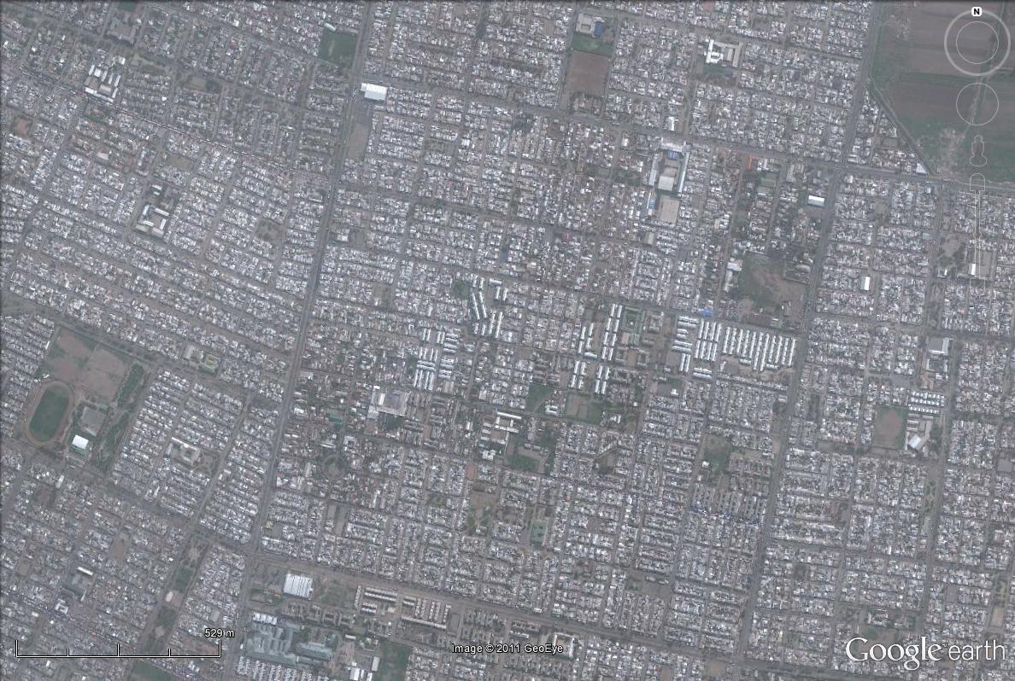
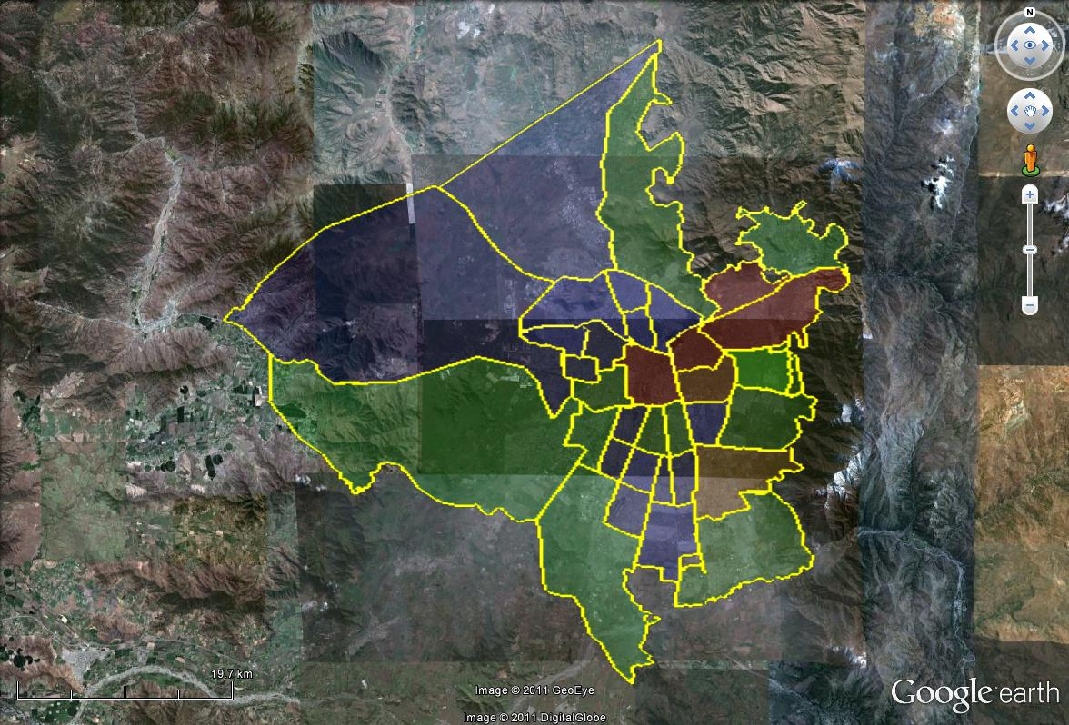
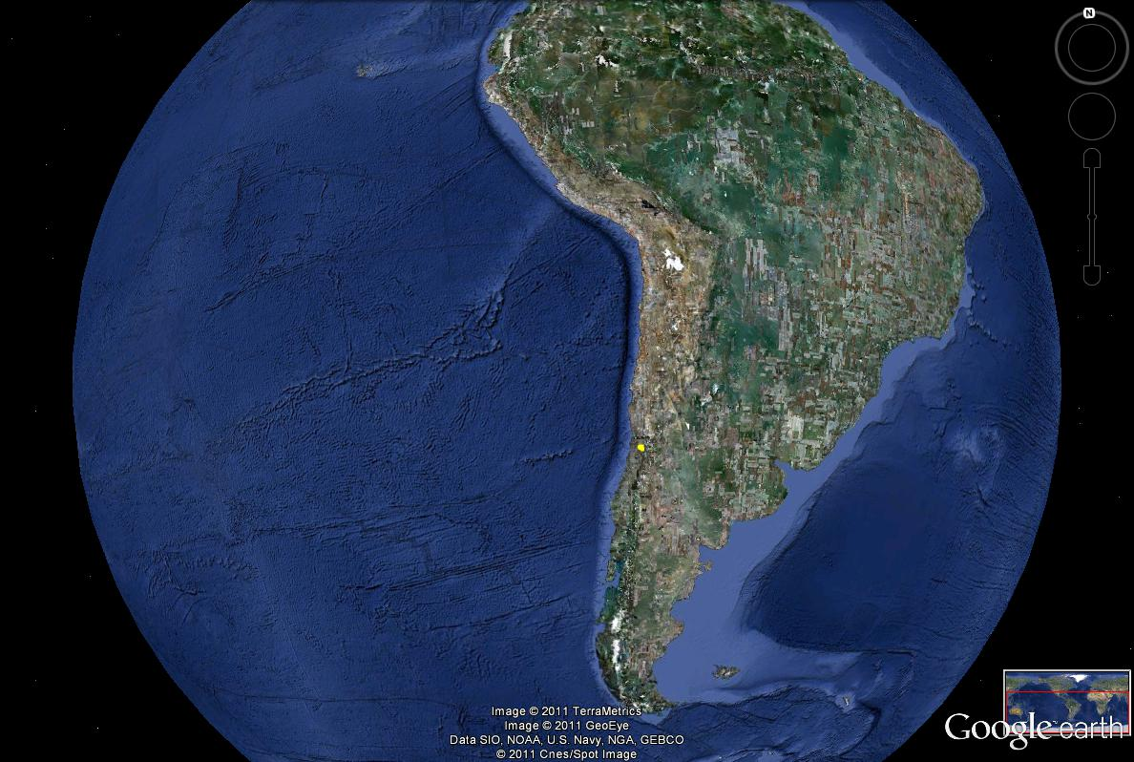
Particularly in this presentation:
Focus on five families from la “Comuna de el Bosque”, one of the poorest areas in Santiago de Chile. Less than 10 bank branches (for more than 175k inhabitants). But still: 30% of the homes have department store debt (while less than 5% bank credit cards).

Slide 8
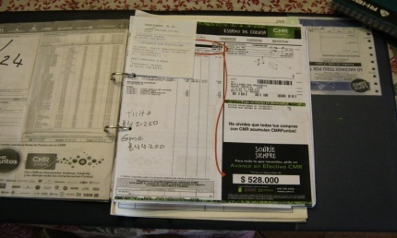
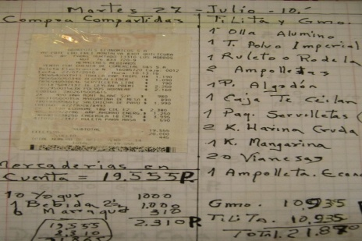
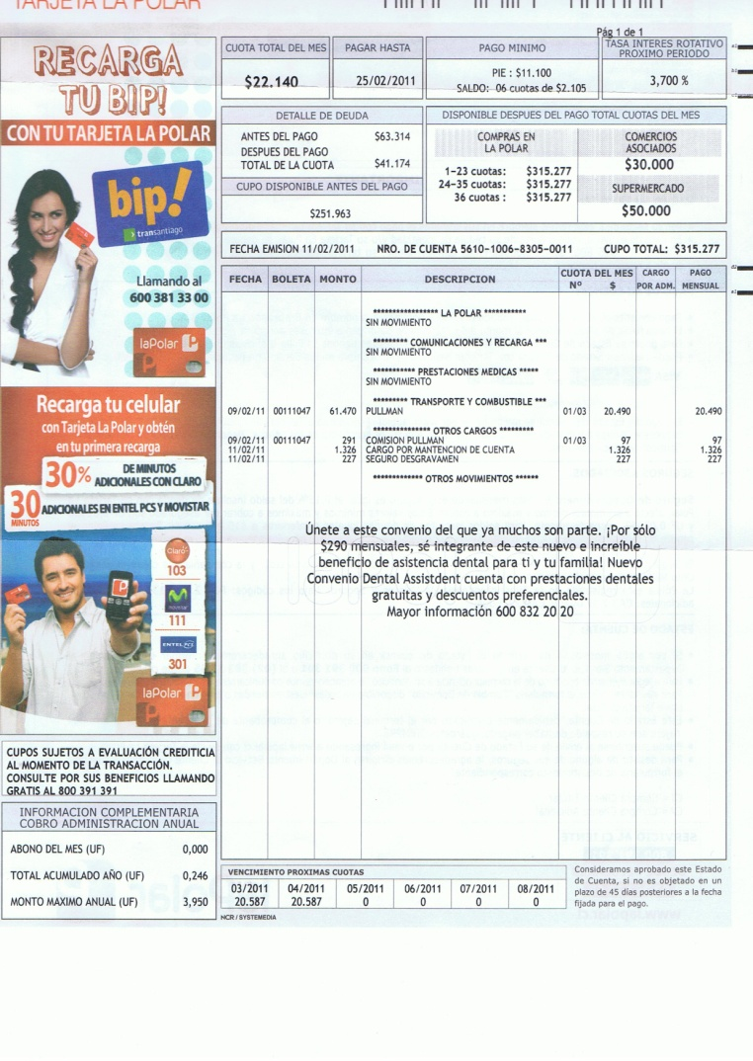
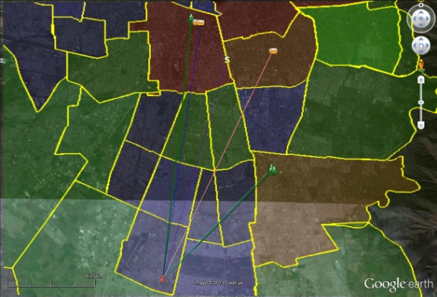
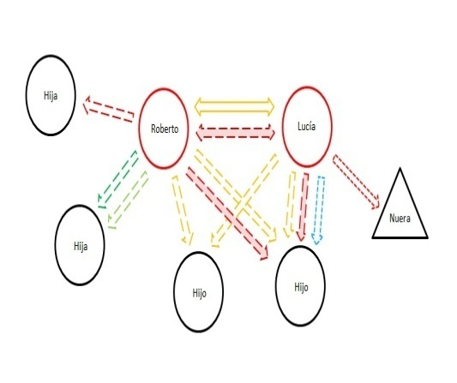
Fieldwork: “Re-constructing” the cards memory.
Interviews -
Files and Notebooks
Bills
Mapping
Circuits

Slide 9
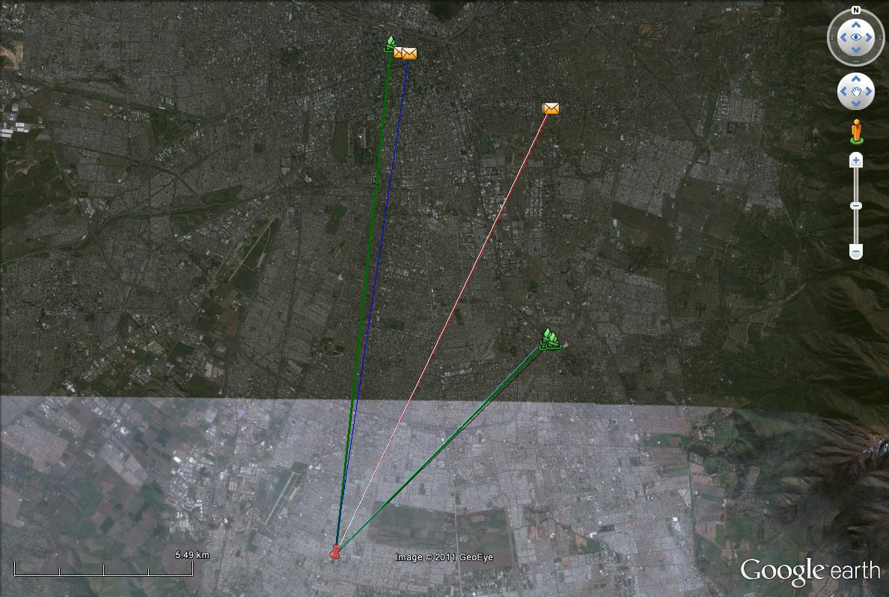
Story 1. Roberto and Lucia have lived in the same flat for the last 22 years. He is retired and 75 years old, his main income is his pension (which is about USS300 per month). Lucia is 57 years old, works as a cleaner in a local primary school and also sells cosmetic products. Her salary is about USS600, but considering debts and other discount she receives only US$250 in cash. They have one son and one granddaughter in common. But Roberto is the father of other nine.
Lucia and Robert are very “organized” with their expenses. He keeps a diary (in fact 2 diaries to have one as a back up) where he registers all their purchases. In fact he has a full register of at least 15 years of their economic activities.
Finance Ecology
Roberto & Lucía normally use “credit” but also savings.
They have access to different sources of credit. For instance: in 2010 Roberto borrowed US$2.000 from his credit union in order to pay their son’s student trip to Japan. They had also borrowed money from their “Caja de Compensación”, and an insurance company. In Lucia’s work, she also participates in a rotating self-organized “Polla”.
Department Stores Credit
Roberto has been a CMR (Falabella’s card) user for 30 years. He uses this card to buy in the store, but also to consume credit widely. For instance: in 2008 he borrowed US1200 (to pay his son’s studies), and in 2010 US$2500 (in 24 montly installments ).Currently they had paid 15/24.
“Falabella toda la vida se ha portado muy bien conmigo, me ha dado sin yo tener mucho, porque yo cumplo bien yo creo. Por eso yo llevo casado con Falabella tantos años. (…) Yo sigo siempre siendo socio de Falabella”.
Lucia’s has her own CMR card, but they use more Roberto’s card that has more “capacity” (cupo) or bigger overdraft. However, she says her card is good in case of emergency (cash withdrawals). Lucia also has Paris and Ripley cards.
Geographically, their card uses are in Falabella in Santiago’s downtown and in Plaza Vespuccio, the main shopping mall in the south of the city.

Slide 10
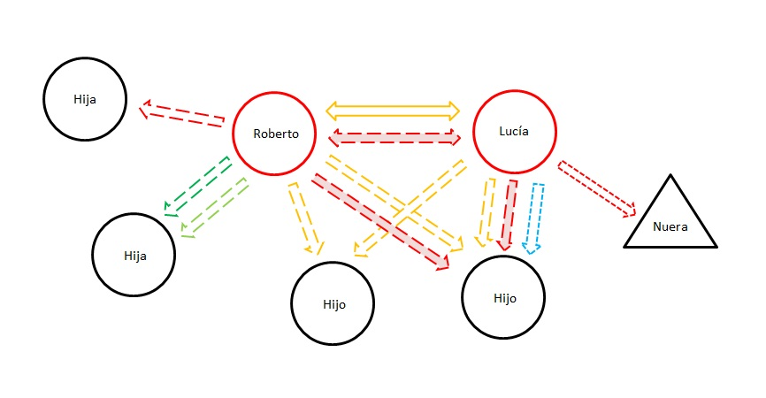
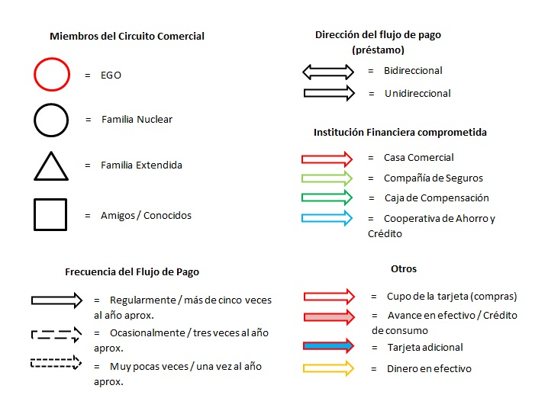
Circuit of Commerce
Roberto and Lucia normally lend their cards. Lucia only lend them to her sons and her sister in law. She determines the “monthly installment amount”, as a form of insuring that she could afford to cover it in case they cannot pay back. This is how they bought their washing machine and bed. Her son also used her Ripley card to buy a laptop. She prefers to have these cards “empty” in order to avoid mixing up the different types of payments.
Roberto used to lend his Hites card, but not anymore, since one of his daughters didn’t pay the debt and at the end he went through a lot of trouble to “clean things up”. However, he currently has credits with an insurance company and a credit union that he took to pay another of his daughters’ delayed mortgage.
They have built a credit circuit where they are at the centre (as they don’t borrow from other members of this network). They do not only lend their “card capacity”, but also consumer loans and cash withdraws for their kids.

Slide 11
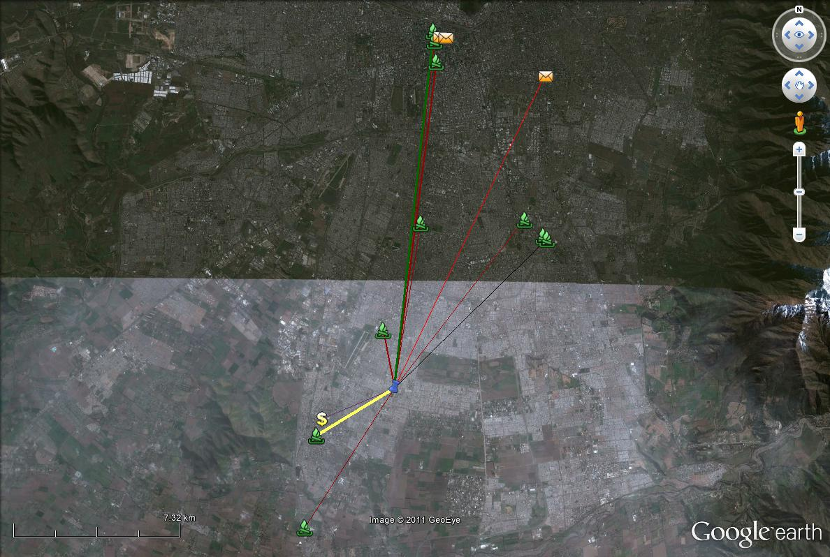
Story 2. Carolina and Esteban have lived for 13 years in the same flat. Carolina is 31 old years, she works in a comunitary “tele-centre”, and her salary is US$300 per month. Esteban is 37 years old, and work independently as a carpenter. He earns between US$600 and 700. They live with their two kids: Diego (9) and Carla (4). They manage their home budget together. They keep a notebook with information about the main expenses, and they try to save US$20 to 30 per month.
Finance Ecology
Carolina and Esteban accessed to credit through department stores. Their first credit was to buy a “good bed” after their marriage, with his Ripley card. After Ripley, Esteban also got CMR and Hites card. With them they bought “big things” (furniture) in long but small installments. They tried to pay one thing at a time per card.
However, Esteban’s cards were blocked in 2007 when he lent one of his cards to a friend who didn’t pay back. After that he does not have access to other cards.
Since then, they only use Carolina’s cards: Hites and La Polar (respectively the yellow and red lines in the map). She got La Polar card in 2004 mostly to “try it”, and to buy presents. She would pay them back saving in their home expenses.
However, later the card has been more busy. It has an average of 17 purchases per year going from 3 to 12 monthly payments. In order to cover Esteban’s income irregularity they have also had to withdraw cash. In 2010 Carolina got a second card, in Hites.
They also participate in the rotating system that Carolina organizes with their neighbors.

Slide 12
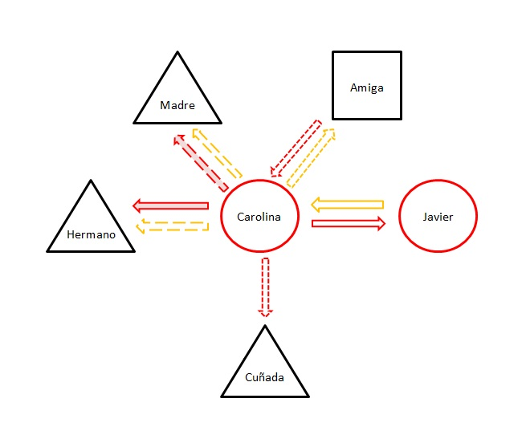
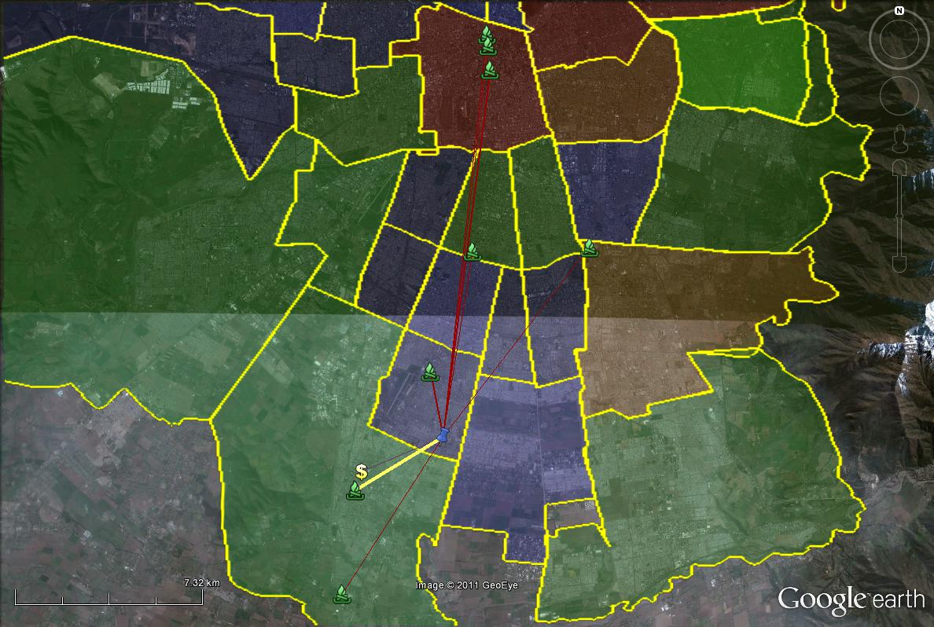
Circuits of Commerce
They prefer not to borrow money or cards from their friends or family. However, Carolina remembers once where she asked for her friend’s card, because her card had bigger “capacity”, enough for a specific item.
Carolina is at the centre of a circuit conformed by her husband, her mother, her brother and her sister in law. Carolina lends her card to Esteban, since his cards were close down, to buy trainers, perfume and electronic equipment.
Carolina’s mother uses Carolina’s La Polar Card one or two times per year. Mostly for “important” purchases, for instance, to buy a US$300 mattress in 12 monthly payments.
Carolina’s brother, Sebastian, uses her cards every 3 to 4 months. Once, she opened a card for him, but he didn’t pay on time. Now she allows him to use her card to buy things like perfumes. Last April, her sister in law also used her card to purchase a suite of dinning room table.
These cards exchanges are complemented with some emergency cash withdraws for her family members.

Slide 13
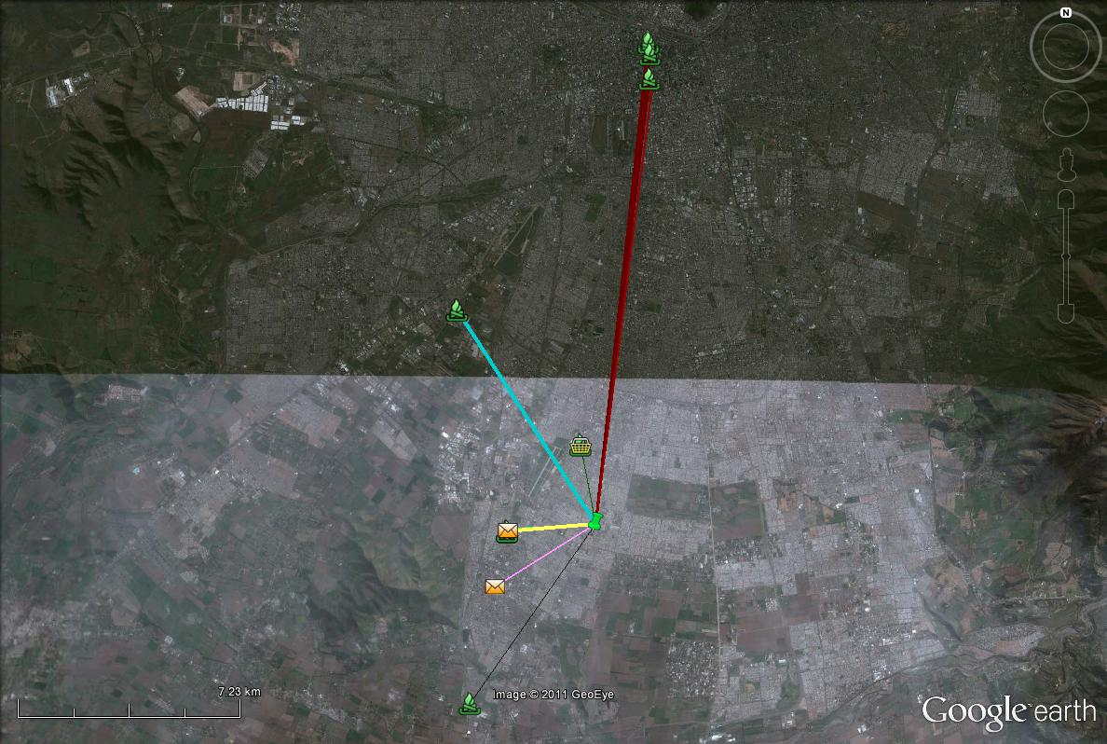
Story 3. Francisca is 31 years old, and she lives with her two kids, Gonzalo (13) and Pia (8). Francisca’s husband is currently in jail. She works as a part time seller in a store in an important shopping center in Santiago’s west. Her salary goes from US$400 to US$600. Francisca is helped by her mother who lives in the same building. In fact, when she is working, Gonzalo and Pia stay at Maria’s house.
Maria is 66 years old and receives a pension of US$200, and she lives with two of her four sons: Juan who works in a fruit market and earns US$600 and Bryan (27) who works in a store in Santiago’s downtown and earns US$300.
Finance Ecology
Maria got her first card 15 years ago (La Polar) and later she took also Hites and Ripley cards. Francisca got her own Ripley card 5 years ago, and later CMR and Almacenes Paris. Francisca buys mainly in two shopping centres, while Maria goes mainly to the city centre.
Maria and Francisca frequently use the “overdraft” option in their cards. For instance, Maria borrowed US$1000 (18 payments) in her Hites card in 2010 – in order to pay her debts with another store, La Polar. Later the same year she used it twice again to buy groceries.
Francisca also normally buy with her cards. For instance, during the last year she bought clothes, toys, perfumes, bed linen…
Maria uses her cards to buy electronic equipments and home stuffs. Concerning other credit sources: Maria once (in 2005) got a bank credit, and she used to participate in the rotating saving system at the school she used to work.

Slide 14
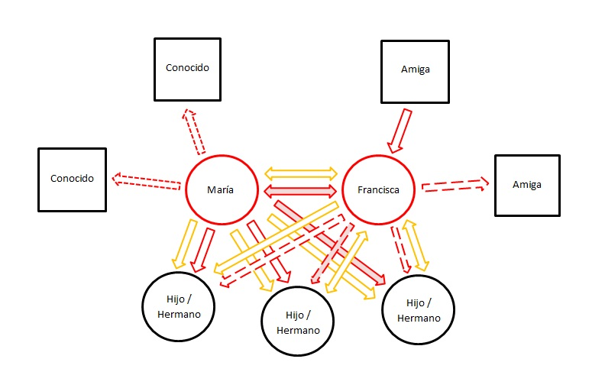
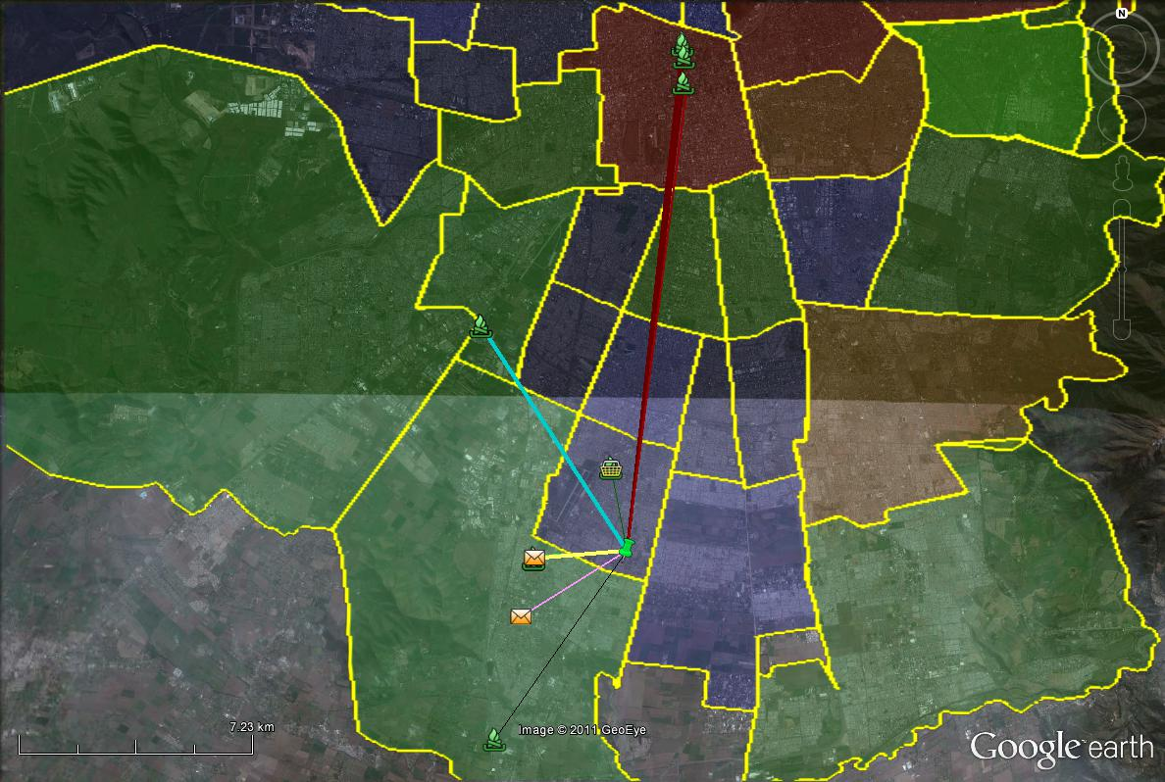
Circuit of commerce
There is a fluid flow. They all lend money to each other when the other need it.
Francisca has her own cards, but not in Hites and La Polar (Maria´s cards). She borrows her mother cards when she needs to buy something in these stores, or her card capacity is not enough.
Marias’s sons do not have their own cards. One of them once had one, but he didn´t pay back on time.
For instance: from Maria’s La Polar card.
March:
Maria took two “cash withdraws” (each of US$120/12 payments) to lend this money to her son Claudio. She also lent her card to Juan to buy trainers (US$100/7).
April
Maria lent her card to Brian who bought a pajama (US$50/4).
June:
Maria withdrew cash (US$150/12 payments) for her and Francisca.
She lent the card to Juan who bought a hoody (US$50/3), to Brian to buy a perfume (US$30/3), and to Francisca to buy trousers and a t-shirt (US$50/6)….
Then… in a single bill Maria has to collect each of the payments. In case some of them cannot pay, she will try to cover them. She also mentions about a couple of ocassions when she lent her card to two of Brian’s friends (who paid on time).
Francisca has also lent her card, but much less frequently than her mother. For instance, when Maria wants to buy in Falabella or A. Paris she uses Francisca’s cards. The same with her brothers. Francisca has also lent her card to a friend, and she has used another friend’s card.

Slide 15
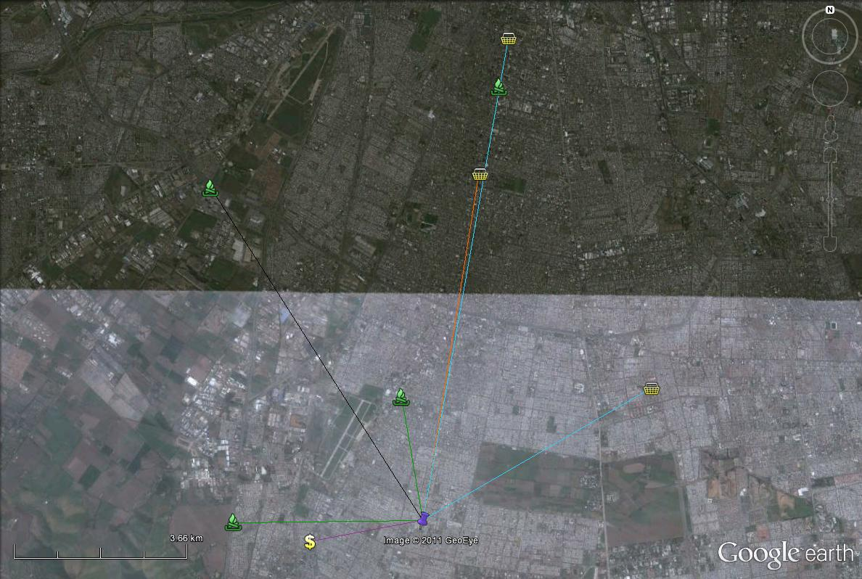
Story 4. Juana and Miguel have two sons, Claudia (34) and Carlos (37), but they don’t live together. Claudia works in a “café con piernas” and Carlos is a security guard. In the last months Juana has been taking care of Claudia’s daugthers. Juan is also in charge of the budget of the neighbors association. Juana is not working anymore, but she used to work as a cleaning maid and also used to have a small shop in her house. Miguel has worked for the last 20 years in the Municipality where he assists in different things, mainly electric installations.
Juana doesn’t not know how much is his salary, but she thinks he earns around US$800. He gives her US$400 a month to pay the bills and daily purchases. But Miguel is in charge of paying their mortgage with Banco Estado. When Miguel receives an extra income he gives this money to Juana, because she is very well organized and good at saving. In fact, they try save every month. With their savings they have been able to pay three properties (social housing), theirs, and where their daughter and son live.
Juana has a suitcase where she saves all the receipts from their credit cards bills, and also utilities payments. She has information of more than 15 years.
Finance Ecology
Juana and Miguel have had department store cards for at least 10 years. However, they use them much less than the previous families. Once or twice per year, mainly to buy electric equipment, like a TV. Maria makes their own clothes, and they try to buy in cash. And when they use credit they prefer “tres cuotas precio contado”, to avoid debts.
Juana has CMR and Wallmart’s Presto. She has used the first only twice in 2010 and the second once to buy a PC screen. Miguel has Ripley, CMR and MAS. In 2008, he made his last purchase with Ripley (when he bought a TV in US950 / 24). In 2010 he used CMR to buy his car batery (US$120/3) and in Christmas 2010 he exceptionally used MAS to buy food.
They have had access to the State bank credit (Banco Estado), where Miguel took a loan to run Maria’s small shop and also to buy their kids’ flats.

Slide 16
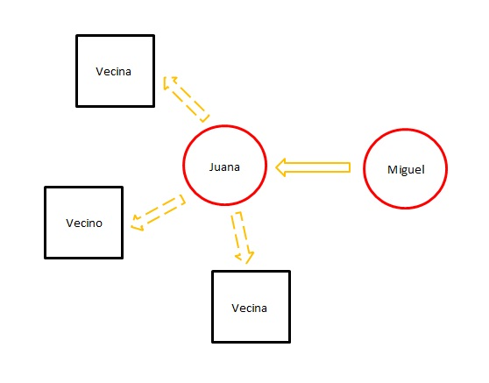
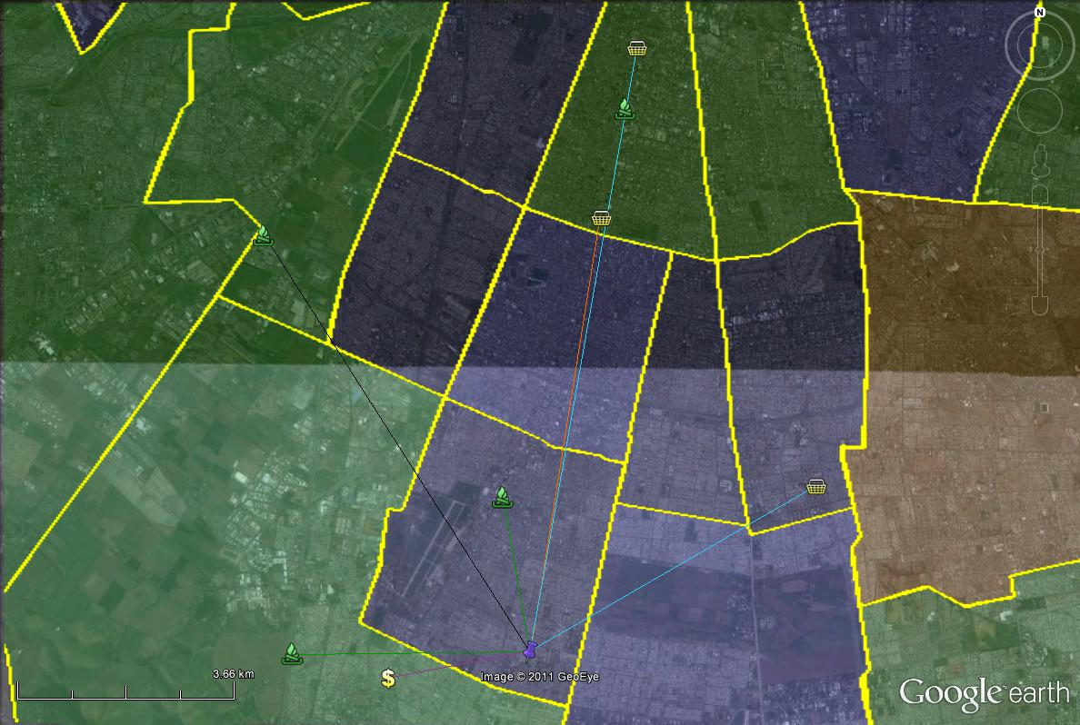
Circuit of commerce
Juana and Miguel prefers not to lend their cards. Juana had bad experiences lending cash to her neighbors and prefer not to risk friendships ties.
“No las presto yo a nadie, es porque creo que esas cosas son personales, y no es de ser egoísta, sólo que he tenido la experiencia de ver en otros casos que piden la tarjeta y después no la pagan y te dejan con las deudas. Entonces yo no me voy a prestar para eso, para perder una amiga más que nada y después tener que pagar una deuda que no corresponde. Entonces prefiero no hacerlo. Mi marido tampoco ha prestado la tarjeta por lo mismo.” (Juana)

Slide 17
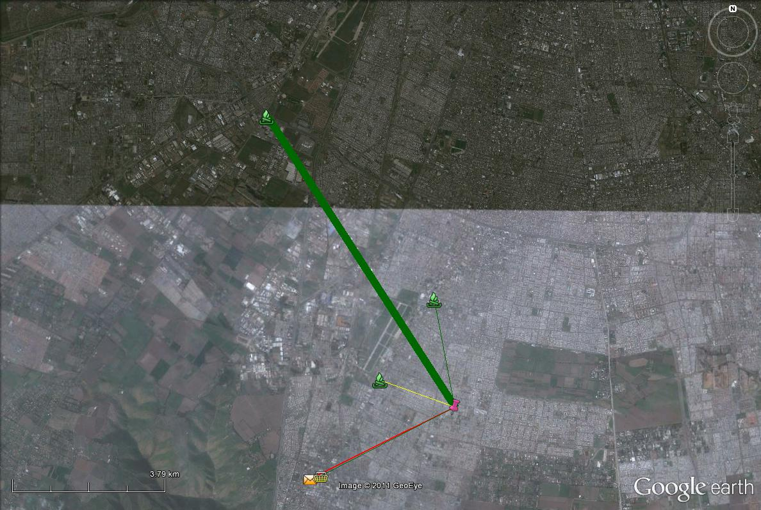
Story 5. Paula is 32 years old. She lives with her daughter, Jessica (14), her mother, her sister, Nadia (22), and her brother, Juan Carlos (19). Paula has worked for the last 2 years as a sales person in a big department store. Her salary goes from US$350 to US$550.
Her mother is 51 years old and works cleaning at a laboratory (her salary is US$150). Nadia works in a nursery school and earns US$400. And Juan Carlos is unemployed. The other sisters, Margarita (23) and Carla (29), frequently visit their sister and mother. Carla, says Paula, is the most successful of the family, because she works as an accountant in a car dealer firm. Jessica’s father, Cristián, works in the storage room of the same department store where Paula works. He does not live with them, but she meets him almost every day.
Here each of the members of the home give US100 per month to the common expenses.
Finance Ecology
Paula used to have many department stores cards (La Polar, Hites, CMR, Ripley, Tricot, Mas…). However, when she started in her new job she decided to closed them down to stop paying so much in interests.
The only one she didn’t close was the CMR the card of the store where she works. Here she has better conditions because of her contract. She uses her card to buy clothes and presents for her daughter and partner.
Also, she has used it to withdraw cash.
Paula has also had access to Cajas de Compensacion credit (two times a couple of years ago, for holidays), and her partner borrowed money from Banco Estado to buy a car, that they are paying together.

Slide 18
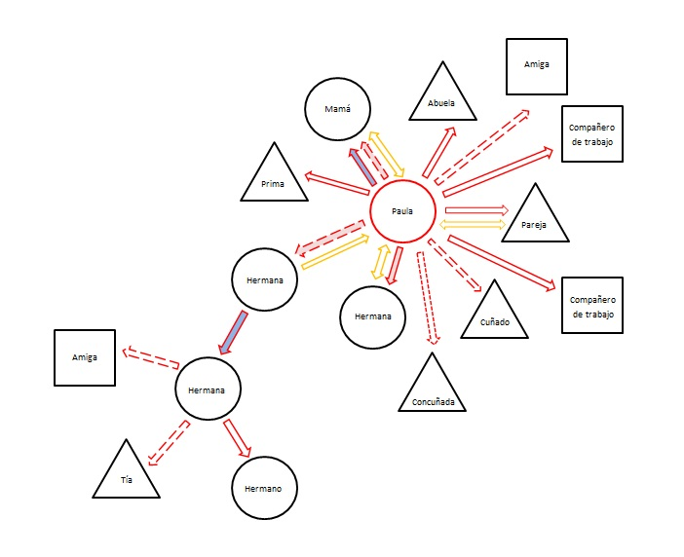
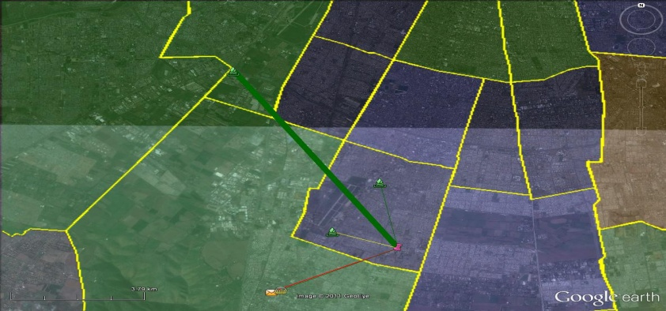
Circuit of Commerce
Paula and her family (grand mother, mother, brother in law, cousin, and sister).
For instance: September bill detail
Paula lent her card to her g. mother to buy a gas heater
“A mi abueli yo le saco cosas de repente, pero cosas grandes y mi Ita siempre paga un tercio y dos cuotas. Siempre paga puntual, mi Ita es igual que yo, yo heredé eso de mi abuela, mi papá igual, es igual que yo, no somos derrochadores.” (Paula)
In august, she lent her card to her brother in law who bought a duvet (US$10), in September to her friend Francisca to buy a rain coat to her son (US12), and also to her cousin Jannette, who bought a microwave and trainers for her son. In October her card was used by two of her colleagues, because as she has a contract, she has better conditions, and more “capacity” in her card.
“Yo se la presto a mis compañeros, pero si ellos me lo pagan altiro, y además no a cualquiera tampoco, tiene que trabajar conmigo o si está necesitao de plata, pa ayudarlo.” (Paula)
Paula says that she only lends to her family, friends and colleagues, because she had some bad experiences with her neighbors, because they were paying late, without paying the interest.

Slide 19
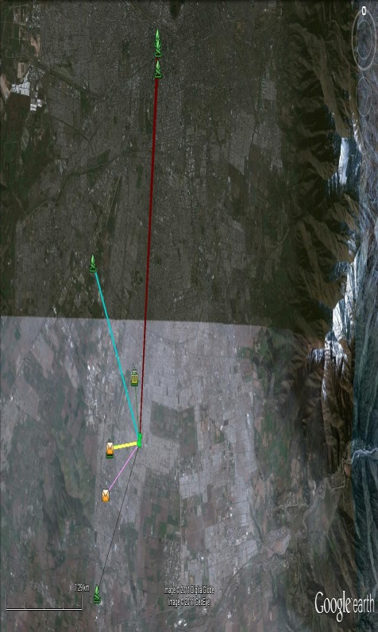
Preliminary findings…
Rationality: A complex use of multiple alternatives… Dealing with multiple cards: multiple payments, types of credits, and cards. “Domestic Traders”
Ecologies…excluded from banks (mainly), but not stores. From El Bosque to downtown or shopping centres.
However, excluded, but not the poorest. This is also a window to those that are excluded of store credit, but connected to circuits.
Circuits….. Credit is mixed with families and care. Only one sees “cards” as only “private”. However, there are rules and conflicts after some don´t pay.
Socio-technical networks in a strong sense. These are not only social, but networks that are hold by a specific market devices: “cards” (“capacity” “risk evaluations” / but at the same time: producing “circuits”), where, however, borders are also marked by kinship and affective ties.

Slide 20
The financial ecologies and circuits of commerce of retail credit cards in Santiago de Chile
José Ossandón; Macarena Barros; Felipe Gonzalez
Tomás Ariztía; Camila Peralta; María Jesús Fernández
Escuela de Sociología Universidad Diego Portales
Santiago de Chile
jose.ossandon@udp.cl
http://estudiosdelaeconomia.wordpress.com/

Slide 21
2006 | Chile | Singapore | US | UK
Branches | 104/mill | 108 | 370 | 460
ATM | 329/mill | 400 | 1318 | 998
POS | 2674/mill | 15422 | 17288 | 17380
B. C. Cards | 0,25/hab | 1,13 | 4,39 | 1,15
Debit Cards | 0,38/hab | 1,71 | 0,90 | 1,12
Source: Flores et al 2008

