Slide 1
Money Management and Mechanisms In THE Palestinian financial sector based on multi currencies Context
Nidal Rashid Sabri
Professor and Dean; College of Commerce and Economics, Birzeit University Palestine
Diama K. Abulaban
Lecturer of Finance; College of Commerce and Economics, Birzeit University Palestine
Dima W. Hanyia
Lecturer of Management; College of Commerce and Economics, Birzeit University Palestine
A study Financed by A grant from the
Institute for Money, Technology, & Financial Inclusion
University of California, Irvine
September, 6, 2011

Slide 2
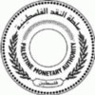
The Palestinian Financial Sector
The Palestinian financial sector includes various groups such as:
First: the official banking system: It includes about eighteen banks, some are local banks, while the majority are foreign commercial banks, they include commercial and Islamic banks with 209 branches located in both West Bank and Gaza Strip major cities.
Second: The moneychangers: The money changers perform different tasks such as buying and selling of currencies, money transfers, cashing checks, and granting small loans.
However, the Palestinian related laws prevent the moneychangers from accepting deposits or granting loans, and dealing with options and derivatives

Slide 3
Third: Microfinance organizations: there are about nine microfinance organizations besides the UNRWA, who offer short term loans to small business firms, without complicated procedures.
All microfinance firms in Palestine are working as Non- for profit organizations (NGOs) and receiving their sources of funds from international aids.
Fourth: The FOREX trading firms; there were about forty FOREX trading firms trading in currency markets working in Palestine. (is closed now)

Slide 4
Fifth: the insurance sector, which includes 10 insurance corporations and 255 insurance agents.
Sixth: The financial market: There is one stock exchange, dealing with the trading of common shares of 40 national Palestinian corporations, with market capitalizations of 2.44 billion dollars at the end of 2010, while there is no trading related to bonds, options or derivatives.

Slide 5
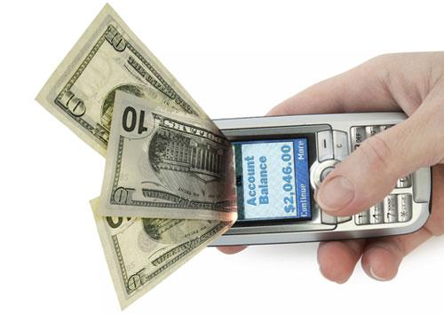
Significance of the Study
The significance of this study comes from the unique merits of the Palestinian economy in general and the Palestinian financial sector in particular which may be summarized as follows:
First: Due to the political situation, the Palestinian territories are not connected to each other, as well as within each other ,
Plus there are some poor areas such as the Refugee camps, where official banking system does not exist.
(The new innovative electronic money may be considered as one of the solution)

Slide 6
Second: : the Palestinian economy has no national currency; this situation has led to have three currencies in use for different purposes,
The ATMs of the Banks working in Palestine deal with three currencies at the same time
This situation is also applied to the payments system for daily transactions, which are based on the types of goods and assets
For example
When dealing with lands, the JD is the only accepted currency,
For buying an apartment the US$ is the used currency,
For daily transactions and consumables goods occurs in NIS
JD
Table No. 1
Currencies’ market shares in the Palestinian Economy in 2009
 | Value by $ billion | US $ | JD | NIS | Euro & others
Current and Deposits accounts | 6.2 | 43% | 28% | 23% | 6%
Granted Credits | 2.2 | 64% | 10% | 25% | 1%
Checks presented for Clearing | 8.1 | 24% | 7% | 68% | 1%

Slide 8
Third: Limited availability and awareness of using innovative financial instruments:
As for infrastructure, the using of internet, electronic money and even ATMs, are still limited in the Arab environment, including the Palestinian economy.
Fourth: The high incoming remittances of the Palestinian economy compared to the developing economies. The incoming remittances of the Palestinian economy were so significant and reached 6.5 billion US$ compared to 4.6 billion US dollars as out coming remittances (PMA, 2010b).
The incoming remittances come from two sources:
The international aids which are offered to the Palestinian National Authority budget, to the UNRWA and to the NGOs budgets.
The remittances comes from workers working abroad who transfer monthly payments to their families at home.

Slide 9
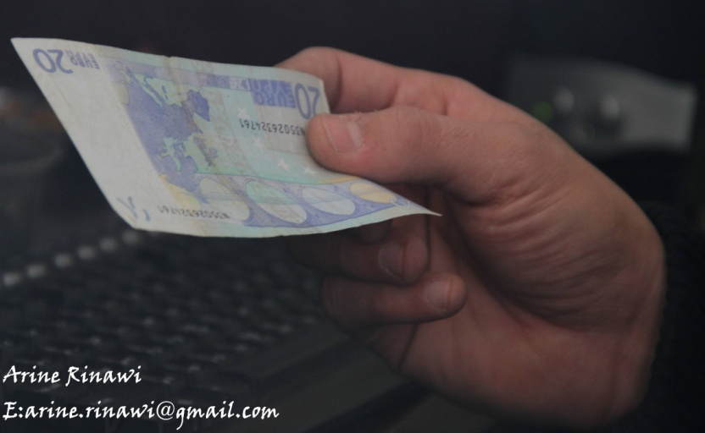
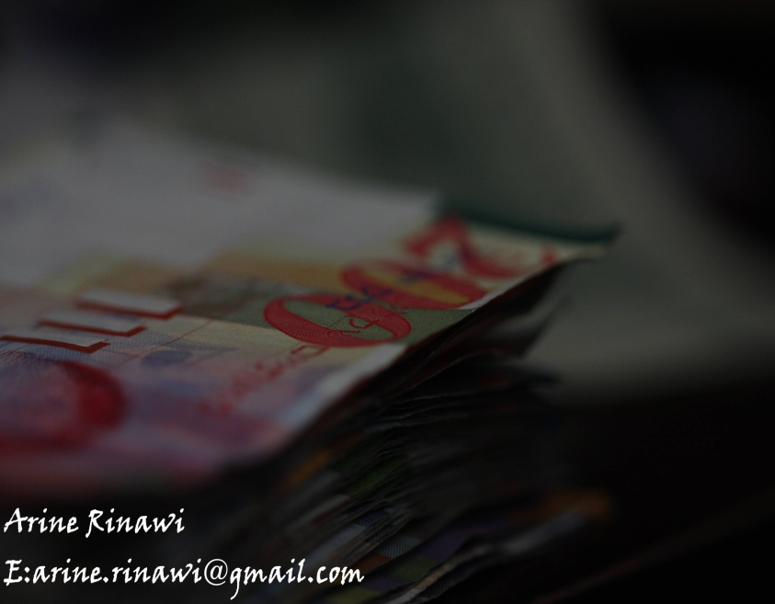
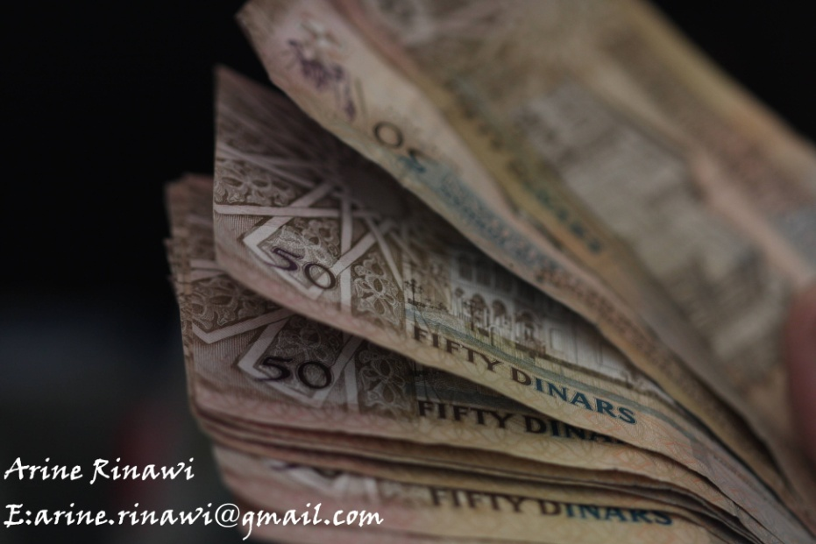

Slide 10
Purposes of the study
This research aims to study the Money Management features including systemic and technological infrastructures in the Palestinian Economy .
In more details it aims to accomplish the following purposes:
To explore Palestinian clients behavior in case of savings, getting loans and conducting business transactions in the context of using three currencies simultaneously
To determine to what extent internet-banking, ATMs and other electronic money instruments are used, and what are the major social, cultural and technical problems that are facing such instruments.
To point out the factors of selecting a currency as saving basis by the Palestinian clients, including the interest rate factor.
To point out the needed revisions on the present laws, in order to accept new innovative financial instruments including Mobile money and various forms of electronic money.
To state the practices followed in managing treasury activities, including closing the cash surplus position of the three or more currencies in addition to the ways and conditions of implementing such practices.

Slide 11
Methodology
Various research instruments were used which may be summarized as follows:
Examining the related laws, rules and regulations regarding the issues that are to be discussed in this proposed research. This includes laws, rules and regulations published by the Palestine Monetary Authority, and the Palestine Capital Market Authority.
Analyzing the related data to examine the relationship between changes in values of banking deposits of each of the used currencies, and their respected interest rates, by using quarterly data for the last ten years.
Interviews with banks treasurers, about the three currencies positions, and currency trading management issues were conducted.

Slide 12
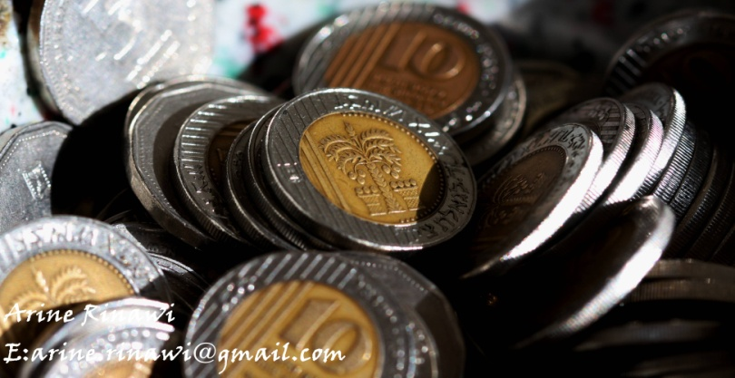
Questionnaires articulated in five answers of Likert scale (Five states for strongly agree while 1 states for strongly disagree), and directed to a selected sample of bankers, and banks’ clients.
In order, to collect the perceptions of all concerned parties regarding the following issues.
Problems of using internet banking, and ATMs applications in the Palestinian financial sector in the context of using multi currencies.
The conditions of managing treasury departments.
The possibility of using innovative financial instruments such as Mobile money and other electronic payments methods.
Factors of selecting a currency as saving basis by the Palestinian clients.

Slide 13
The Selected Sample
The selected sample covered a group of bank mangers, treasurers, and clients who use traditional and internet - electronic banking instruments.
The selected sample included 12 out of 18 Banks working in the Palestinian economy including local and foreign banks operating in Palestine.

Slide 14
Findings of the research
Savings practices in a multi currency economy
Motivation for selecting a currency for savings and deposits accounts as reported by the clients
Table No. 2
The Motivation for selection a currency for deposits
as perceived by clients of Banking System in the Palestinian Economy
Rank of motivations | Ratio | Motivations
2 | 27% | Trust the currency not to decline in value on short or long-term
1 | 44% | The currency that I receive my income
3 | 17% | The currency with the highest interest rate
4 | 12% | It’s the currency I conduct my business transactions

Slide 15
Motivation for selecting a currency for savings as perceived by banking officials
Table No. 3
Perceptions of Banking Directors and staff towards saving practices by the
Palestinian clients
 | Means*
The customer selects the currency with the higher interest rate for savings and deposits | 3.2
The client frequently changes his deposit from one currency to another according to the changes in the interest rates | 2.7
The client hesitates to transfer his deposit into another currency even when the interest rate of his current deposit currency is low or declining. | 4.7
*1 point strongly disagree to 5 points strongly agree

Slide 16
Motivation for selecting a currency according
to the financial analysis
The study conducted a correlation test between the average interest rates of the three currencies and their respected total deposits values from 2001 to first quarter of 2011, using the quarterly data, to indicate whether there is a significant relationship between interest rate and the selection of a specific currency
Table No. 4
The minimum and maximum of Average of Interest Rates offered for deposits and value of Deposits Between 2001 and first quarter, 2011
Source: Collected data from the Palestinian Monetary Authority, 2011
Currencies | Average of Interest Rates offered for deposits
 | Minimum |  | Maximum
 | Ratio | Dates | Ratio | Dates
JD | 1.05 | January, 2011 | 3.62 | December, 2001
US $ | 0.27 | December, 2010 | 3.38 | February, 2007
NIS | 0.25 | January, 2010 | 5.55 | February, 2002
 | Value of Deposits
 | Minimum |  | Maximum
 | Value | Dates | Value | Dates
JD | 252.20 | September, 2005 | 688.63 | December, 2009
US $ | 896.75 | June, 2005 | 1190.55 | November, 2007
NIS | 89.76 | September, 2006 | 228.30 | March, 2009

Slide 17
In addition, the correlation test between the changes of the interest rates of each currency and the changes in values of deposits for the related currencies during the period from 2001 to first quarter of 2011 was conducted as shown in Table No. 5.
Table No. 5
Correlation test between Interest rate changes and values of Deposit changes in Palestinian banking system between 2001 and 2011
Currencies | Pearson Correlation | Sig. (2-tailed) | N
JD | -0.093 | .573 | 39
US$ | 0.308 | .057 | 39
NIS | -0.062 | .709 | 39
Accordingly, we can say that interest rate is not a critical factor in selecting currency for savings and deposits for the majority of the Palestinian banking clients.

Slide 18
Managing of Treasury transactions in multi currency economy
many aspects were examined in this study regarding managing currency by Palestinian banking treasuries, as presented in the following section
Closing currency positions (surplus) as existed in the Palestinian banking system: there is a need to match between the available cash of each currency and its actual clients accounts held by banks’ books, and thus, the surplus of any currency should be within the limits stated by PMA and the top management of the bank.
this study examines the practices of treasury departments that deal with this issue as reported in Table No. 6 using structured interviews with directors of the treasury departments and a special questionnaire directed to treasury directors and staff.

Slide 19
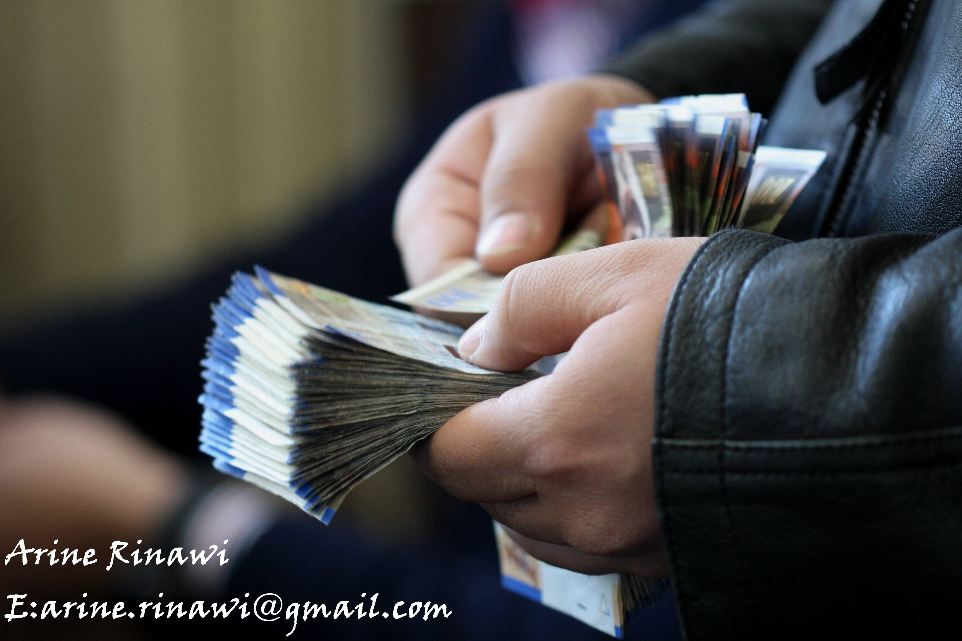

Slide 20
Table No. 6
Managing of the Treasury in multi currency economy
Management Practices | local | Ratio to the total sample
Maximum of permitted currency surplus | 5% of owners equity for each currency and/ or 20% of owners equity for all currencies together | 16%
 | 1-3% of owners equity or less | 42%
 | Maximum amount 200,000- 500,000 $ | 42%
Time of closing currency’ surplus | Immediately special (large amounts) | 20%
 | End of the day (normal transactions) | 80%
Closing of currency’ surplus | Other banks and branches working in Palestine, and moneychangers. | 15%
 | Headquarters of Arab banks (Jordan) | 40%
 | Corresponding foreign banks | 45%
Working days of treasury | Sunday to Friday | 50%
 | Sunday to Thursday | 50%

Slide 21
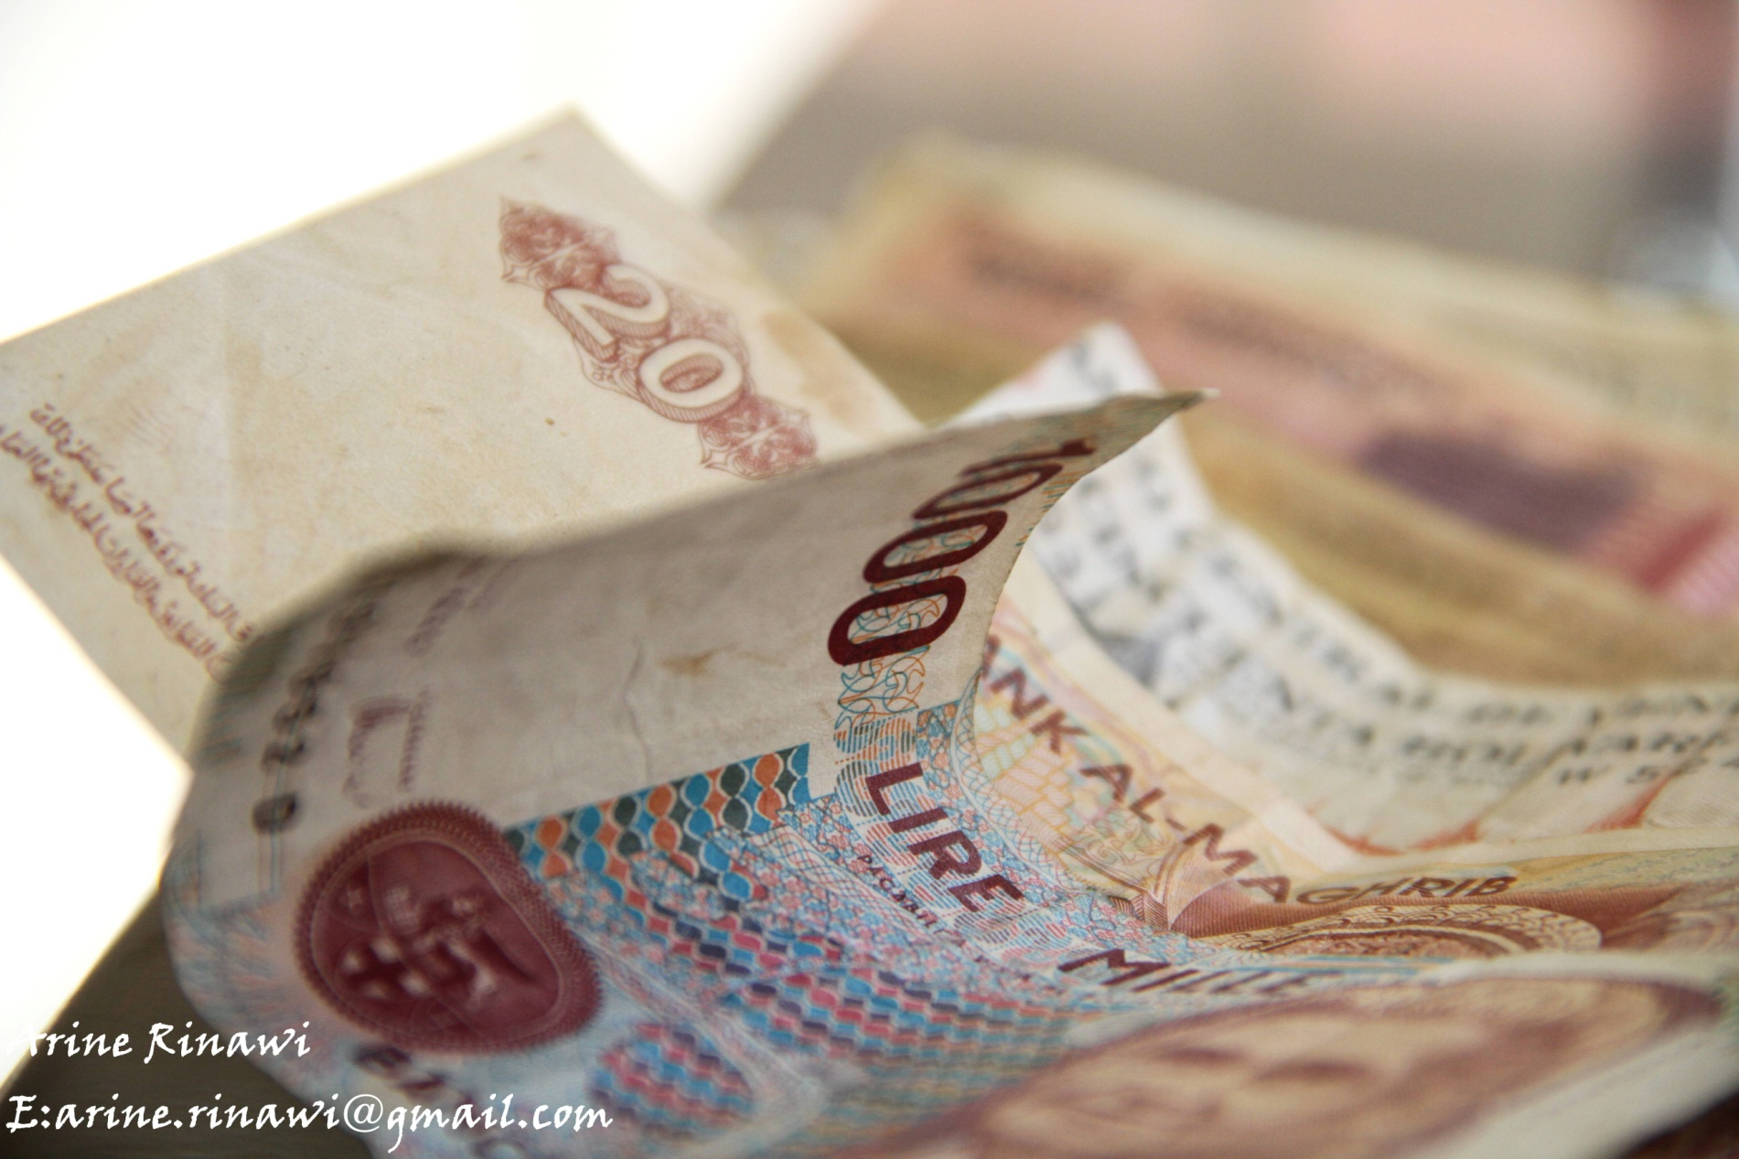

Slide 22
In the same area the majority of directors answered that it is a first priority to have additional instructions that cover some of the activities of treasury management as ranked number one of the most needed reforms as presented in Table No. 7.
Table No. 7.
Ranking of the most needed reforms to increase the efficiency of Treasury management
Rank | The most needed reforms to be
5 | To cancel the 5% limit imposed on the balance of currency positions by the PMA in order to match customer transactions and assets
3 | To Cancel restrictions imposed on some speculative trading instruments such as options trading in currencies
2 | To allow the treasury staff to work fully on Fridays in order to track the ongoing changes in currency rates in permanent situations
1 | There is a need for additional instructions that cover some specific activities of the treasury
4 | to increase the percentage of the total balance for all major currencies while conducting speculative operations for the bank

Slide 23
The last part of this regard was to get the perceptions of treasury mangers and staff, regarding reducing risk and improving efficiency of the treasury activities. As indicated in Table No. 8,
Table No. 8
Perceptions of Treasury staff regarding risk and performance of
Treasury activities
 | Mean
The Implementation of an electronic payment system facilitated the process of treasury management | 4.3
Increasing of bank clients who trade in currencies through internet transactions led to an increase of treasury risk | 4.0
The use of three major currencies in the Palestinian economy is a negative phenomenon and increases the risks in treasury management | 3.1
The fluctuations in exchange rates increase the risk of treasury management | 4.4
The Increased of electronic transfers by customers increases the risk of treasury management | 3.3
I prefer to separate the Treasury Department into tow departments, one for the speculative transactions and the other for clients transactions | 3.2
The use of mobile banking will increase the risk of treasury activities | 3.1
There is a need for addition legislation to cover all related transactions to facilitate the work of the Treasury | 4.5
*1 point strongly disagree to 5 points strongly agree

Slide 24
Recommendations of Treasury managers
and staff:
The maximum ratio of 5% to be hold should be varied based on the currency and keep 20% for the total.
To extend the time of work including Fridays in order to keep up with the time differences in other countries
To reduce the restrictions imposed by the Palestinian Monetary Authority on trading and investments by Palestinian banks outside Palestine.
To permit trading in options and future transactions including duke deposits
To permit trading using margins in transactions settlements
To adopt advanced MIS programs to connect treasury transactions with outside banks
To use awards system to encourage employees and staff of the treasury in Palestinian banks.
To offer special trainings to employees and staff of the treasury in the Palestinian banks.
To issue exchange rates (prices) currency bulletins every two hours, instead of one time every day by PMA and each banks.

Slide 25
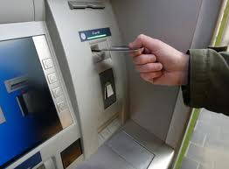
E-banking activities in the Palestinian banking
system
Existing E- banking (internet banking, other electronic channels and instruments) in the Palestinian banking system:
Table No. 9 summarized the E- banking situation
in the Palestinian economy as existed in June, 2011.
Table No. 9
 | Ratio to Sample
ATM machines | 100% | From 1 to 150 ATM (Average 20)
Internet inquires | 58%
Internet transactions | 25%
Credit Cards (Visa and Master) | 50%
Visa Electron | 31%
Voice (Phone) transactions and SMS | 17%
Banks owned machines of point of sales | 17% | Bank of Palestine & Ahli- Jordan
Banks connected to machines of point of sales | 38%
Email enquires | 17%
Email transactions | 0%

Slide 26
To What extent E- banking channels are used by clients (electronic channels and instruments): in order to indicates to what extent Palestinian clients using E-banking transactions Table No. 10 presents summary of the clients, answers
Table No. 10
To what extent Palestinian clients using E-banking Transactions
Never | Sometimes | Always
18% | 12% | 70% | ATM transactions
64% | 16% | 20% | Credit cards in payments
57% | 25% | 18% | Enquiries through the Internet
78% | 8% | 14% | Conducting transfers through the Internet
82% | 6% | 12% | Buy locally using the Visa Electron and point of sales
88% | 8% | 4% | Voice transactions (Phone)

Slide 27
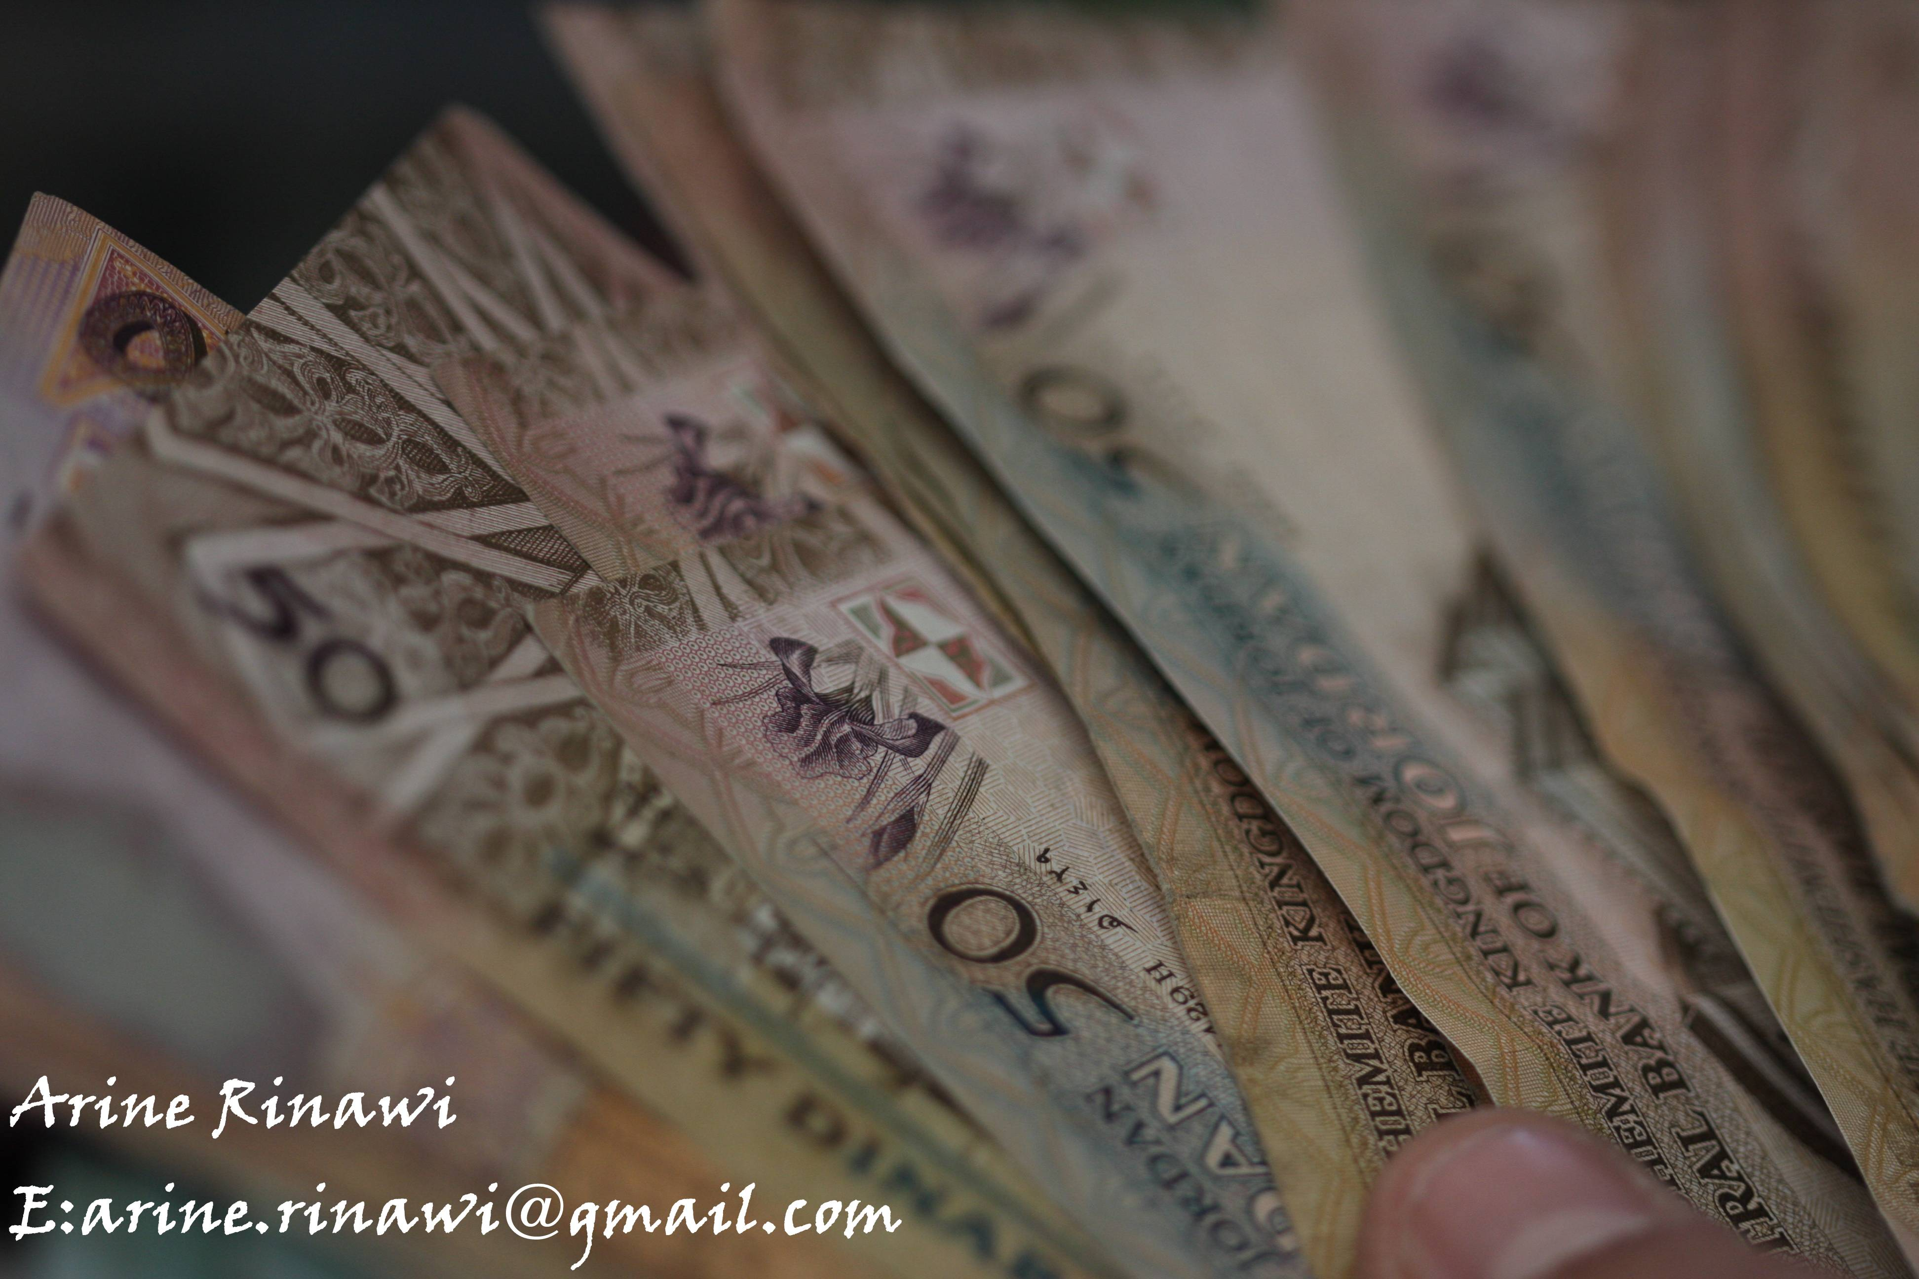

Slide 28
Reasons of not using E- banking transactions as reported by clients:
Table No. 11
Ranking of reasons for not using E- banking transactions
as stated by the Clients
Rank * | Possible Reasons
2 | The clients don’t know about the existing possibilities
1 | Customers do not know how to use it
7 | Requires the knowledge of English language
3 | Customers prefer personal Interaction
4 | Customers are afraid of security and hacking
6 | The lack of a permanent support center to answer enquires
5 | Exchange rates of currencies through the Internet transactions are not competitive
*Rank 1 is the most important reason for not using e banking transactions

Slide 29
Reasons of not using E- banking transactions as reported by Banking directors and Staff
Table No. 12
Ranking of reasons for not using E- banking transactions as Perceived by Banking directors and Staff
Rank | Average | Possible Reasons of not using E- banking transactions
3 | 3.6 | The clients don’t know about the existing possibilities
1 | 2.5 | Customers do not know how to use it
7 | 6.5 | Requires the knowledge of English language
4 | 4.2 | Customers prefer personal Interaction
2 | 3.2 | Customers are afraid of security and Hacking
6 | 4.8 | The lack of a permanent support center to answer enquires
5 | 4.7 | Exchange rates of currencies through the Internet transactions are not competitive
*Rank 1 is the most important reason for not using e banking transactions

Slide 30
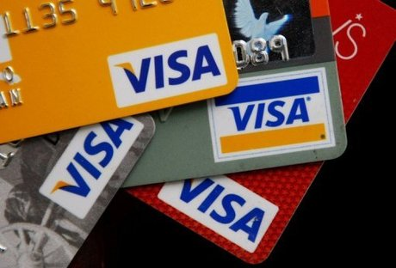
Other issues of E- banking: one of the purposes of this study is to explore the perceptions of banking directors and staff related to some issues in E- banking in the Palestinian economy.
Beside other things, the following table shows that the banking staff do not see much problem in dealing with ATM with multi currencies.
However, some of the participants express the technical difficulty with having three currencies in one ATM, and when they tried to use ATM for single currency, the clients were not satisfied.
Table No. 13
Perceptions of Banking Directors and staff towards using E-banking issues
Statements | Means*
There is an increase in the use of electronic transactions by customers | 3.1
The Use of three major currencies is considered a problem in managing ATM | 3.5
There is a need for a legislation to use mobile banking in the Palestinian banking system | 4.2
There is a need for complementary legislations to cover other electronic transactions | 4.7
*1 point strongly disagree to 5 points strongly agree

Slide 31
Examining the related laws and regulations:
There are no stated regulations to regulate or monitor e-banking transactions issued by PMA or other legislations’ bodies.
However, we find specific regulations for each bank which mainly organize the limits imposed in E- banking and they differ from one bank to another, specially those related to the maximum values of e-banking operations.
There is a need for new regulations and/or modifying the existing regulations as shown by the responds of the treasury directors.

Slide 32
Conclusion
The majority of Palestinian banking clients select the currency of savings and deposits either because it is the currency that they receive their monthly income with or because they trust the currency not to be devaluated in the long run, while only 17% of them consider the interest rate when they select the currency of savings and deposits.
The banking officials reported that the clients hesitate to transfer their savings and deposits accounts into another currency even when the interest rate of their current deposits are low or declining.
The financial analysis also pointed out the weak relationship between interest rates and the values of savings and deposits for each currency.
The treasury departments of the Palestinian banks apply a conservative policy and holding currencies’ positions lower than permitted by related laws.
Due to the fact that director of treasury departments believe that the high fluctuations of exchange rates among currencies increase the risk of treasury operations.

Slide 33
Conclusion
All banks having ATM machines, dealing with three currencies including JD, NIS, and USD with various transactions , while only half of the banks issue credit cards to their clients, with limited use during travels outside Palestine compared to ATM and Visa Electron cards.
58% of the banks offer internet inquires service, while only 38% of banks offer internet transactions and transfer of funds, 38% of banks connecting to point of sales machines, and 31% of banks issue visa electronic cards.
Of the total sample of the clients, 70% of the clients use ATM transactions all the times, 20% use credit cards, 18% do inquires through internet banking system, while 14% of the clients are conducting transactions through internet banking and 12% use point of sales' cards.
With the exception of dealing with ATM, the majority of the banking clients don’t know about the existing possibilities of E- banking channels available in their banks, or they know about it but they don’t know how to use it or never tried it. Their hesitation is because of security and possible hacking, thus preferring to have a direct contact with bank employees.
The banking directors and staff do not see much increase in using E- banking transactions by their clients, in spite of the new adoption of electronic instruments by the majority of banks working in the Palestinian economy in the last three years.

Slide 34
Recommendations
There is a need to have awareness campaign to indicate to clients the major differences between interest rates based on type of currency for their savings and deposits.
In order to facilitate the E- banking transactions as well as treasury transactions there is a need to adopt new related regulations and to be issued by PMA.
To adopt advanced MIS programs to connect treasury transactions with outside banks as well as to permit trading in options and using margins in transactions’ settlements.
The banks should present awareness campaigns to their clients about the existing possibilities of using electronic channels and how much safe, and to offer call centers to support clients and explain how to use such activities and transactions.

Slide 35
Thank you

