Slide 1
AN ASSESSMENT OF ADOPTION AND USE OF MOBILE MONEY SERVICES IN EAST AFRICA:
Case Studies from Uganda and Tanzania
IMTFI Annual Conference Schedule 2011
Batilda E. Moshy - Sokoine University of Agriculture, Morogoro Tanzania
Paul I. Mukwaya - Makerere University, Kampala Uganda

Slide 2
Presentation outline
Introduction
Objectives
Data and methods
Preliminary results
Conclusions???

Slide 3
INTRODUCTION
Financial Inclusion (FI) has become a key pillar of development policy in a number of countries
Policy reforms to create liberal market-oriented economies and competitive financial systems have been introduced
Proliferation of mobile phones in developing countries has changed the money landscape with an increased use of mobile money services [MMS].

Slide 4
Research on the adoption and use of mobile money services in the developing world is scanty.
Although MMS are now reaching millions of customers in Uganda and Tanzania …
The MMS landscape in the two countries is quite different.
  Is this a question of institutional, social and cultural contexts surrounding use and adoption of MMS?
  Is it levels of TRUST that people have developed with MMS?

Slide 5
 | Uganda | Tanzania
Population | 32 million | 42 million
Main mobile players [mobile money service – launch date | MTN [Mobile money] – Mar 2009 Airtel - Airtel Money – June 2009 UTL [M-sente] – Mar 2010 Safaricom - Mpesa | Vodacom – [Mpesa] – April 2008 Airtel – [Airtel Money] Feb 2009 TIGO – [Tigo Pesa] Aug 2010 ZANTEL- [Z-Pesa ] April 2008
Share of 16+ with a bank account | 18.8% | 6.8%
Share of 16+ with mobile phone or active SIM | 20.7% | 21.5%
Banked population | 21% | 1.95 million (9%)
Never banked |  | 18.3 million (92%)
Mobile phones | 14,000,000 (June 2011) | 22,251,964 (June 2011)
Table 1: Mobile phone and bank account penetration
Source: Comninos, A., S. Esselaar, A. Ndiwalana & C. Stork (2008) with additions

Slide 6
 | Kenya | Rwanda | Tanzania | Uganda | Africa
Mobile cellular penetration 2003 | 5% | 2% | 2% | 3% | 5%
Mobile cellular penetration 2008 | 42% | 13% | 31% | 27% | 33%
Compound annual growth rate, 2003-2008 | 54% | 55% | 68% | 56% | 44%
Table 2: Mobile penetration and growth rate
Source: ITU, 2009. Mobile penetration is defined as the number
of active SIM cards/population so can exceed 100%

Slide 7
Figure 4: Annual telephone subscriptions growth and penetration, 2009/10
Source: Uganda Communications Commission (2010)

Slide 8
Figure 4: Mobile subscriber trend 2000 – 2009 by company in Tanzania
Source: Data from www.tcra.go.tz

Slide 9
PROJECT OBJECTIVES
Phenomenon and pace of adoption and use of MMS in Uganda and Tanzania
  Variability in pace of adoption in the two countries
  Social - cultural, institutional, regulatory, policy and geographical factors
  -Presentation is largely focused on this objective-

Slide 10
Customer's mobile experience and how this builds trust and loyalty/support for mobile money services.
  Variance in trust in the use of MMS be explained by trust in technologies, trust in vendors etc.
  Forms of trust support, service quality trust, and customer loyalty and satisfaction
  -Further data analysis is being done here-

Slide 11
DATA and METHODS
Study setting
Two urban centres in each country were chosen for the study - Tanzania and Uganda (Figure 2)
  Dar es salaam (TZ) and Kampala (UG) – The commercial capitals for both countries/ areas where MMS were started
  Morogoro (TZ) and Lira (UG) - represent medium size towns where latest reports indicate that MMS are being used by a substantially bigger population.

Slide 12
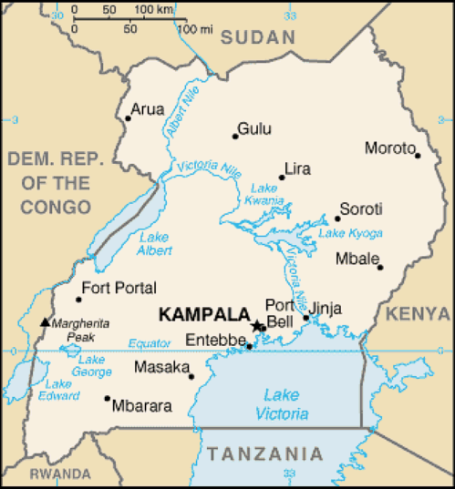
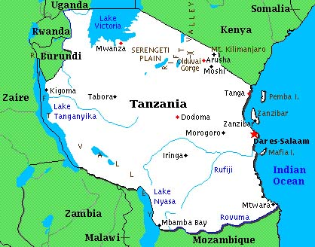
Study sites in Uganda and Tanzania

Slide 13
Data collection
Pilot survey
  Consultations with Telecom companies, MM agents and ICT professionals
  Modification and adjustments made to the original questions.
  Translation of the questionnaire into Kiswahili for the TZ audience.
  The questionnaire was adapted from several readings and changes were made to situate them in the TZ and UG context.

Slide 14
Final questionnaire designed consisted of two sections.
Two subsections
  MM and technology adoption related questions derived from the TAM model
  5-point Likert scale that included: strongly disagree, disagree, neutral, agree and strongly agree [Choice of one of the options].
Questions including demographic/cultural questions such as gender, age, occupation, education, income and marital status
  The questions were designed in multiple choices and respondents could choose the option which was more applicable to them.

Slide 15
Use of key informants and consultations with persons responsible for MMS in
  Individual telecom companies – agencies responsible for the MM market
  Banks
  MMS Agents
Review of documents
  Reviews of country specific MMS data
  Collation and analysis of country specific official policy documents, manuals, blog posts.
  Critical scrutiny of media reports/newspaper articles and press statements

Slide 16
Data Analysis
Institutional analysis – to assess regulatory and other factors that affect use and adoption of MMS in the two countries
Factor Analysis and Cronbach’s Alpha applied in order to identify the appropriate items for regression analysis.

Slide 17
PRELIMINARY RESULTS
MMS have become very popular in the two countries within a period of 4 years
Because of their simplicity in execution
Not only are they sought by businesses and services providers, but they have spread to areas/communities/individuals which/who were not served by conventional banks before.

Slide 18
Mobile subscribers as a percentage of the population
Source: Data from the International Telecommunications Union,
2009

Slide 19
64,740 persons adopting MTN service per month
6,245 persons adopting Airtel Money service per month
4,077 persons adopting M-sente service per month
Number of MMS registered customers in Uganda March 2009 to February 2011
Source: Bank of Uganda data. In: Ssonko, 2010

Slide 20
Number of MMS transactions in Uganda
Source: Bank of Uganda data. In: Ssonko, 2011

Slide 21
Value of MMS transactions (UGX) in Uganda
Source: Bank of Uganda data. In: Ssonko, 2011

Slide 22
I use MMS because of… | Responses
 | N | Percent
Ease of accessibility | 161 | 23.6%
Security and trustworthy | 97 | 14.2%
Convenience and instant | 85 | 12.5%
Less travel time to service point | 75 | 11.0%
Cheaper/low cost | 32 | 4.7%
Good service | 128 | 18.8%
Less time spent queuing | 103 | 15.1%
 | 681 | 100.0%
MMS instabilities??? Network failures MTN??? Agents/service points almost everywhere/within reach More services can be performed at an instant Good recommendations from other users Non formal systems riskier …..pots, mattresses, beds etc Costs lower – Opening up accounts and transacting business compared to traditional banks
Notes:
Money is safe since every transaction uses encryption and password that adheres to highest banking security standards. In addition , airtime and money account are kept separate

Slide 23
Table 4: What is the ease/difficulty with which one can open up an MMS account?
Difficult
Easy
 | Easy |  | Difficult
 | F | % | F | %
Account opening and registration | 168 | 86.2 | 27 | 13.8
Conducting transaction at agent stations | 155 | 85.6 | 26 | 14.4
Time taken for account to be active | 139 | 77.7 | 40 | 22.3
Information checks and disclosures | 112 | 63.6 | 64 | 36.4

Slide 24
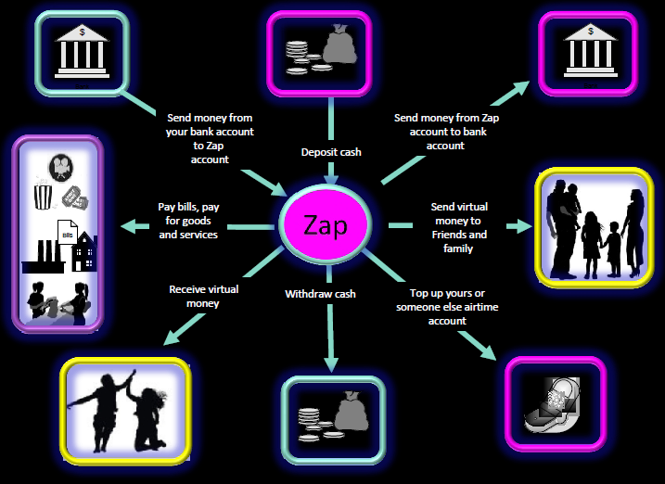

Slide 25
Table 5: Uses to which mobile money is put | N | Percent
Sending Money | 191 | 24.7%
Receive money / withdraw money | 150 | 19.4%
Buy airtime | 122 | 15.8%
Store/deposit money | 85 | 11%
Receive salary | 31 | 4.0%
Receive payment for services / job done | 22 | 2.8%
Paying school fees [350 schools registered with Airtel!!!] | 42 | 5.4%
Pay bills: water , electricity, TV | 83 | 10.8%
Buy goods | 27 | 3.5%
Pay post paid bills | 19 | 2.5%
Total | 772 | 100.0%
Loan payments/disbursements?? Church contributions, making donations, Air ticket payments etc??
PAYMENT AND REMITTANCE SERVICES’ categories

Slide 26
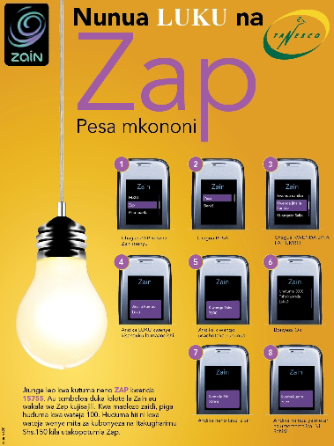
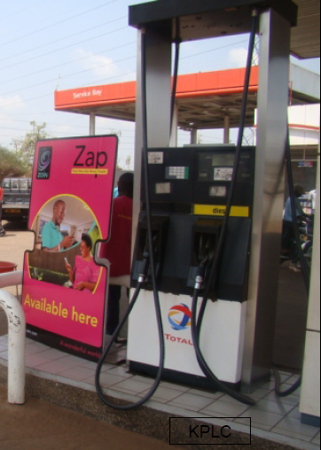

Slide 27
Reasons for the growth of MMS
Institutional and regulatory factors
Regulation of MMS
  Financial transactions regulated by both BoT and BoU
  Mobile phone operations monitored by TCRA in Tanzania and UCC in Uganda.
A system to regulate MMS and ensure that customers’ money remains safe in the event of collapse of the phone companies is non-existent.
Several sector laws that govern the various areas that straddle MMS….
Challenge…..is MMS a banking service, payment system???

Slide 28
SIM Card Registration in Tanzania
The Electronic and Postal Communications Act (EPOCA) of 2010
SIM-card registration mandatory for every person owning or desiring to own and use a SIM-card.
TCRA published an order requiring all SIM-cards to be registered by 30th June 2010.
  Protecting consumers from misuse
  Enabling consumers to be identified as they use value-added services such as mobile banking, mobile money transfer, electronic payments for services such as water, electricity, pay-TV etc
  Enhancing national security
  Enabling network operators to “know their customers”
SIM card registration not a requirement in Uganda
Once registered extra confidence given to customers

Slide 29
Efforts by mobile operators through their MMS agents to ensure that the KNOW YOUR CUSTOMER (KYC) GUIDELINES are adhered to avoid exposure to risk due to information asymmetry.
As a result of the KYC guidelines, agents may require all or any of the following information and documentation prior to opening up an account:-
Full name; physical address; date of birth; gender; mobile number (which serves as the account number as well); identity card (voter‟s card, military ID, and passport etc); and source of income amongst others.

Slide 30
“Natamani ningeweka pesa zangu kwenye MPESA account jana. Wangechukua simu peke yake……….ningeenda Vodacom leo ku-swap line yangu na ningepata pesa zangu salama salimini”
“I wish I had deposited my money into my MPESA account yesterday. They would have taken the phone only…….today I would have gone to Vodacom offices, swap my SIM card and find my money safe and sound”

Slide 31
Telecom companies responsible for branding and marketing MMS.
Set up and manage network of cash-in/cash-out agents.
Provide customer care sections and 24/7 phone lines
Select and manage the technology vendors who supply the transactional platforms which underpin the service.
Have made significant investments to scale up MMS so as to reap the benefits if mobile money is a commercial success.

Slide 32
Ground promotions and education
Full commitment by tel. companies to improve MMS
Aggressive advertising and complimentary benefits for using MMS.
Marketing of the service is intense – Use of several media outlets, road shows, etc. to promote their services
The “walled garden” commercial approach to pricing where a service such as sending money to a non-registered user is more expensive than to a registered user.
  The latest slogan/rebranding of Vodacom - 'Kazi ni kwako' - 'Superman', which are fast, safe, certain, and its readiness to assist community any time and any place.
  Several other examples by company

Slide 33
Partnerships
  With financial institutions
  Banks-maintain CASH FLOAT for agents, transfer of money between bank account and MM account
The Central Banks in both UG and TZ do not issue payment or e-money licenses to non-banks.
Telecom companies do not hold licenses to offer MMS from financial regulators.
Banks hold such licenses and telecom companies utilize the banks to act as super agents to support agent liquidity and acts as fraud risk buffers to customers’ money

Slide 34
 | Name of MMS | Mobile operator | Commercial Bank
Uganda | MTN | MTN Uganda | Stanbic Bank UBA Bank
 | ZAP | Airtel | Standard Chartered Bank
 | M-Sente | Uganda Telecom | DFCU Bank Post Bank
 | M-PESA | Safaricom
Tanzania | M-PESA | Vodacom | NBC
 | TIGO-Pesa | TIGO
 | Airtel – Money | Airtel | Posta & CITIbank
 | Z-Pesa | ZANTEL | FBME & E-Fulusi

Slide 35
Partnerships with consumer service providers
 | Mobile operator | Name of MMS | Service providers
Uganda | MTN Uganda | MTN | NWSC,
 | Airtel | ZAP | Schools
 | Uganda Telecom | M-Sente | NWSC, DSTV, Star Times
 | Safaricom | M-PESA
Tanzania | Vodacom | M-PESA | DSTV, TANESCO, TCU, AURIC Air
 |  | MI-Pay
 | TIGO | TIGO-Pesa | DSTV, TANESCO
 | Airtel | Airtel – Money | DSTV, US Embassy, TANESCO, DAWASCO, TCU, OilCOM
 | ZANTEL | Z-Pesa
Eliminated the burden of long queues at service points and other points of sale and can customers make payments using their mobile phones at their convenience from anywhere and anytime.

Slide 36
Agent Network
Distributed, visible and well supported agent network
On the ground representatives for tel. companies
Include - banks, micro credit institutions, telecom service centers, specialized agents, individuals, etc.
Agents are trained on all aspects of the operation of the MMS system including anti-money laundering (AML) policies.

Slide 37
Roles of agents include:- (i) registration of mobile money clients; (ii) depositing cash into registered customers‟ accounts; and (iii) processing of cash withdrawals for both registered and non-registered clients.
Requirements for registration as an agent vary – to operate an outlet - (a) certificate of registration / incorporation; (b) copies of memorandum and articles of association; (c) completed agent agreement; (d) list of outlets; (e) deposit of at least Shs. 1,000,000 (est. US$ 400) per outlet in a specified partner commercial bank; and (f) maintenance of a cash float of Shs. 1,000,000 (est. US$ 400) per outlet.
Other basic office requirements such as personnel for handling day-to-day operations, photocopying machines for duplicating the identity cards of customers, furniture, telephone, and e-mail contacts.

Slide 38

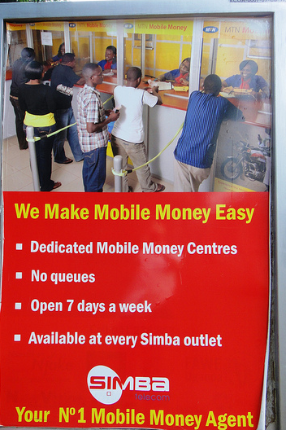
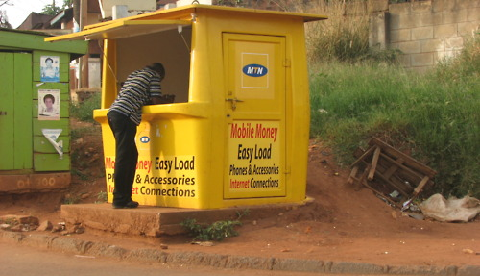
Over 5,000 MPESA agents in Tanzania – no authoritative number for other networks is available in TZ
400-3,000 agents per company in Uganda

Slide 39
LET US LEAVE IT AT THIS
BUT???

Slide 40
Remaining tasks | 2011 | 2012
 | Dec | Jan | Feb | Mar | Apr
Further review(s) of regulations and institutional framework - documents
Focus Group Discussions (2 in Morogoro TZ and 1 in Lira UG
Data analysis – Factor analysis and Regression Analysis
Team Progress meeting
Final report writing and submission

Slide 41
Geographical factors and culture?????
Migrant communities use more MMS in Tanzania than any other community
As a cultural disposition the Chagga and Haya send money back home [Biggest migrant groups in TZ]
The Ngoni culturally detached from their rural areas – rarely send money home.
We need to confirm this in our discussions with key informants and in other fora

Slide 42
The sectoral laws that govern the various areas of MMS in UG include:-
The Bank of Uganda Act 2000 Cap 51 of the Laws of Uganda 2000 that mandates the central bank to supervise, regulate, control and discipline all entities that receive money from the public;
The Financial Institutions Act 2004 that provides for the regulation, control, and discipline of financial institutions by the Central Bank;
The Micro-Finance Deposit-taking Institutions Act 2003 that provides for the licensing, regulation and supervision of microfinance business;
The Uganda Communications Act 1997 Cap 106 of the Laws of Uganda 2000 that created Uganda Communication Commission (UCC) and liberalized the telecommunications sector;
The Bills of Exchange Act Cap 68 of the Laws of Uganda 2000 which deals with the bill of exchange transactions;
The Electronic Transactions Act of 2004 that provides for the use, security, facilitation and regulation of electronic communications and transactions and the encouragement of the use of e-government services; and
The Electronic Signatures Act of 2004 that provides for and regulates the use of electronic signatures.

